Slide 1


EV3 Classroom: Menu System
By Sanjay and Arvind Seshan

Slide 2
Lesson Objectives
Learn to use variables
Learn to create a menu system that is not limited to a particular number of choices
Learn to create a menu system that updates the menu view
Prerequisites: Variables, Math Blocks, Brick Buttons

Slide 3
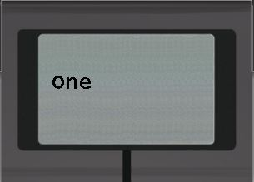
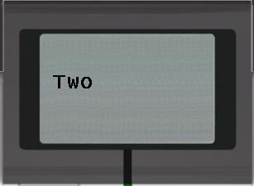
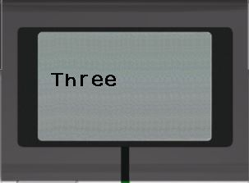
A Fancier Menu System
In the “Using Brick Buttons as Sensors” Lesson in Intermediate, one of the challenges asked you to create a menu with 4 choices and a single screen display for the entire menu
In this version, we build a menu system that updates the menu view each time you change your selection and lets you have a larger number of menu choices
To make this menu, you will need to learn how to use variables

Slide 4
Menu Challenge
Challenge: Make a menu system that lets you perform 3 actions (display and say the numbers 1, 2, and 3) based on the button pressed
Step 1: Use a variable to store the current menu choice
Step 2: Display the menu description for the current menu choice
Step 3: Wait for the user to press a button (top, middle, down buttons)
Step 4: Based on the button press: run the code for the menu choice (for middle button), or increase/decrease the menu choice variable (for up/down buttons)
Step 5: Go back to 2…
What you will see on the EV3 Brick

Slide 5
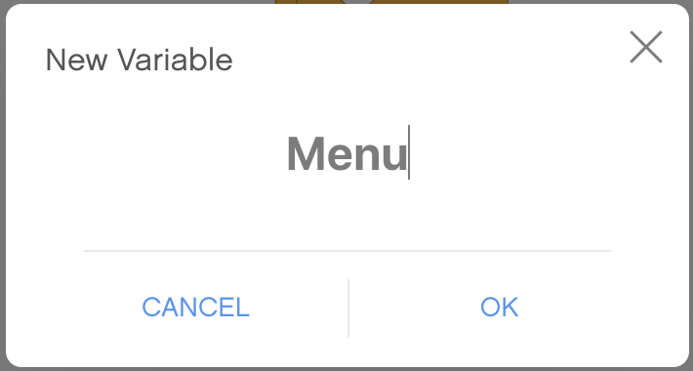
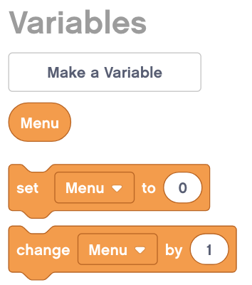
Main Component
Variables can store values for later use. Make a variable and give it a name “Menu” before using it.
Once created, the variable shows up in the Block Palette under Variables. A Set “Menu” and Change “Menu” Block are also automatically created.

Slide 6
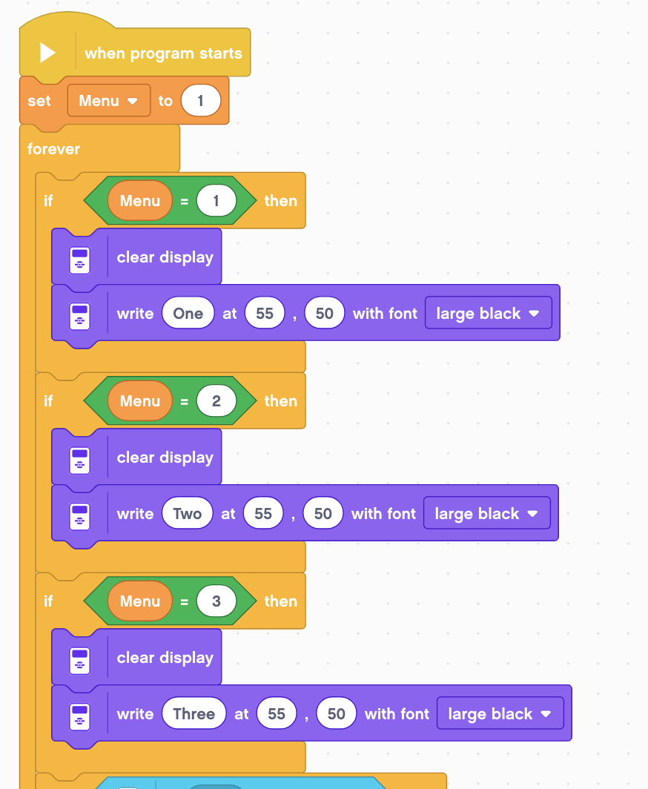
Solution Part 1
Set Variable Menu to start at 1
Display the word ONE, TWO or THREE at the center of the screen using Display Blocks
Clear the screen before each word is displayed

Slide 7
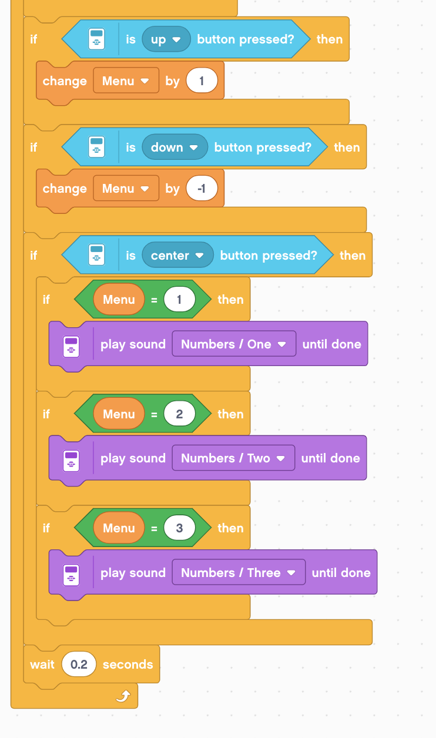
Solution Part 2
When the Up or Down brick buttons are pressed, change the value of the variable Menu by 1
Depending upon which value is picked, play a different sounds (“one”, “two”, or “three”)
In this example, sounds are played based on the menu item picked. You can replace this with any code you you wish.

Slide 8
CHALLENGE SOLUTION

Slide 9
Next Steps
The ideas in this lesson can be adapted to help you build a mission sequencer for FIRST LEGO League. Sequencers are useful because they:
Allow you to skip missions if you are short of time
Allow you to repeat failed missions
Allow you access missions quickly (find them easily)
If your Menu Action code is long (not just a display and sound), consider creating My Blocks out of your code

Slide 10
Credits
This tutorial was created by Sanjay Seshan and Arvind Seshan
More lessons at www.ev3lessons.com
This work is licensed under a Creative Commons Attribution-NonCommercial-ShareAlike 4.0 International License.

