Slide 1

Line Follower with Two Color Sensors and Proportional Control
By Sanjay and Arvind Seshan

Slide 2
Objectives
Learn how to write a line follower that uses two color sensors
Learn how to write a two color line follower that uses proportional control
Pre-requisites: Basic Line Following, Switches, Loops, Proportional Control

Slide 3
A Basic One Sensor Line Follower
Robot sees white, turn left
Robot sees black, turn right

Slide 4
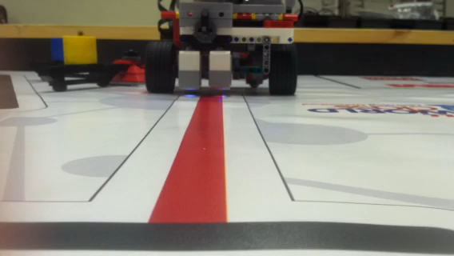
What is a Two Color Line Follower?
The goal is to use two light sensors next to each other to follow a line
The light sensors need to be placed approximately the line’s width apart
When following the line they should both sensors should be reading the edge of the line
Watch video from FLL 1920 to see line straddling in action

Slide 5
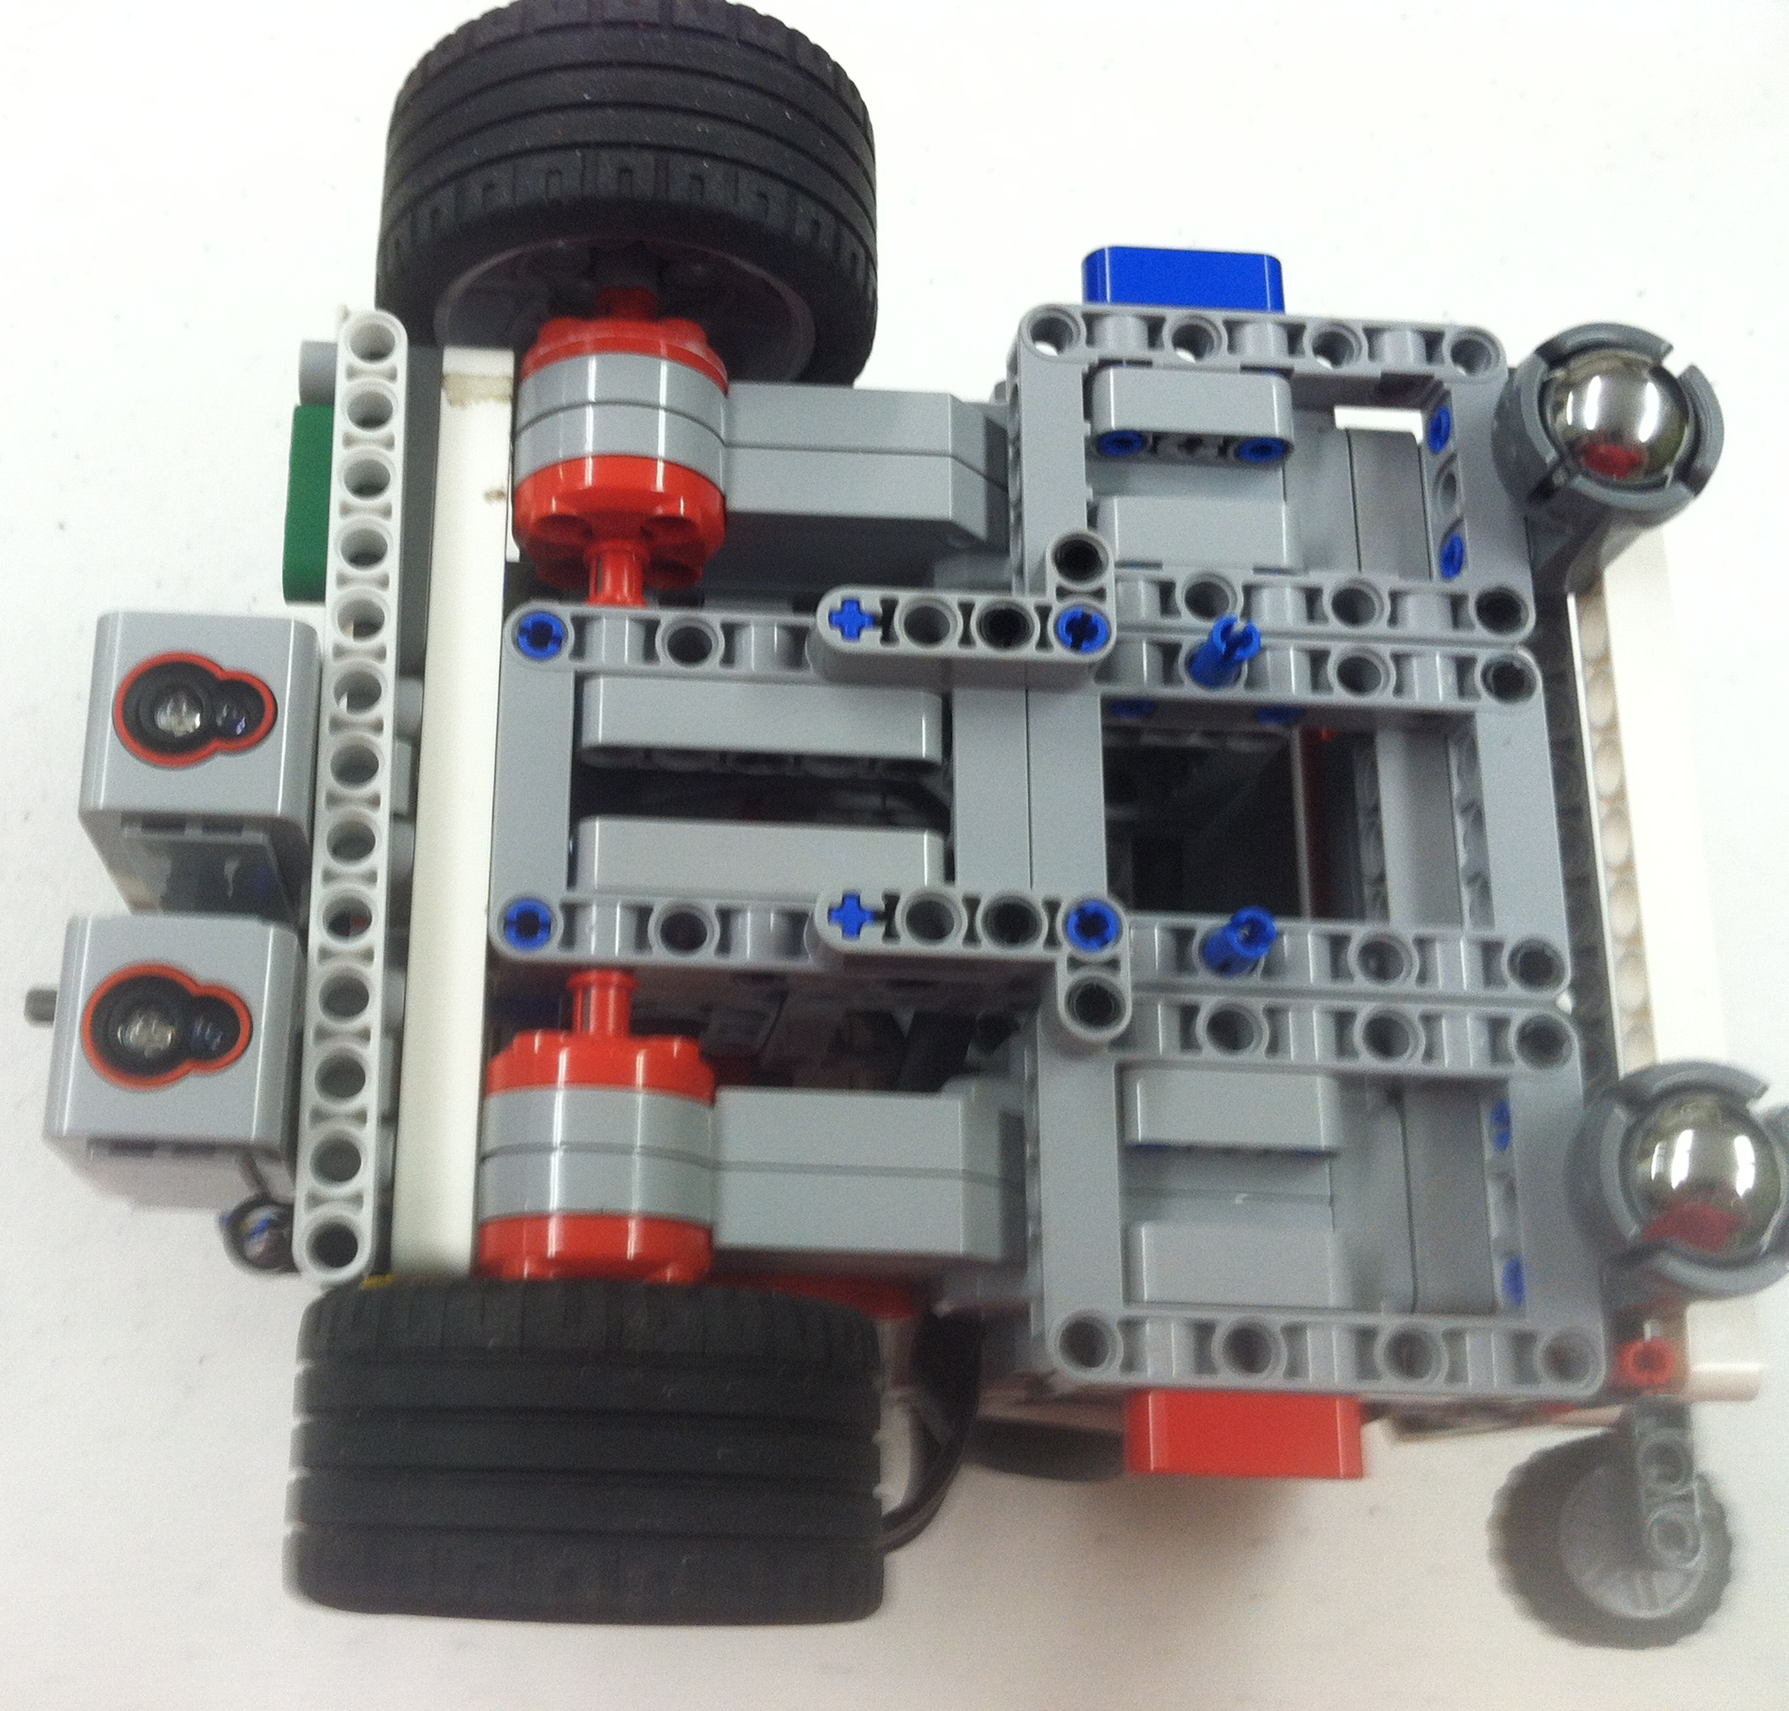
Tips for success
Placement of the two color sensors are very important
In the picture on the right, we have a beam placed so you can see how far apart to place your sensors.

Slide 6
Two Color Sensor Line Follower
1
1
1
2
2
2
Sensor 1 on White
Sensor 2 on White
Go forward
Sensor 1 on Black
Sensor 2 on White Turn left
Sensor 1 on White
Sensor 2 on Black Turn right

Slide 7
Challenge 1
Use the ideas from Slide 4 and write a line follower that straddles a red line – uses 2 color sensors to line follow a red line?
Sensor 1 on White
Sensor 2 on Red Turn right
1
1
1
2
2
2
Sensor 1 on White
Sensor 2 on White
Go forward
Sensor 1 on Red
Sensor 2 on White Turn left

Slide 8
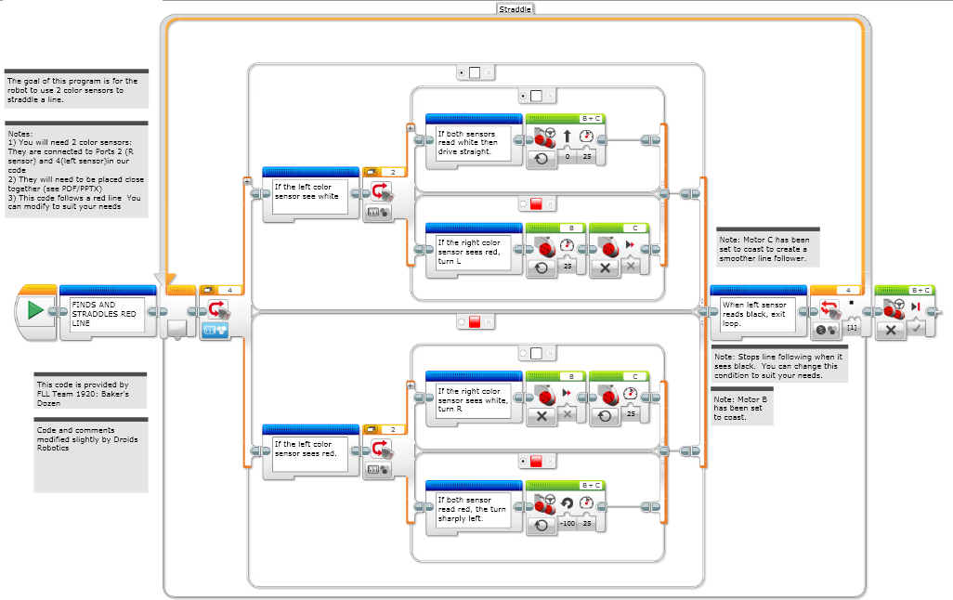
Challenge 1 Solution

Slide 9
How do you add proportional control?
What is the target → both sensors should read the same value
What is the error → the difference between the sensors
What is the correction → turn more sharply if the difference is large
1
1
2
1
2
2
Sensor 1 reading 50
Sensor 2 reading 50
Go forward
Sensor 1 reading 10
Sensor 2 reading 100 Turn Left sharply
Sensor 1 reading 60
Sensor 2 reading 40 Turn right slightly

Slide 10
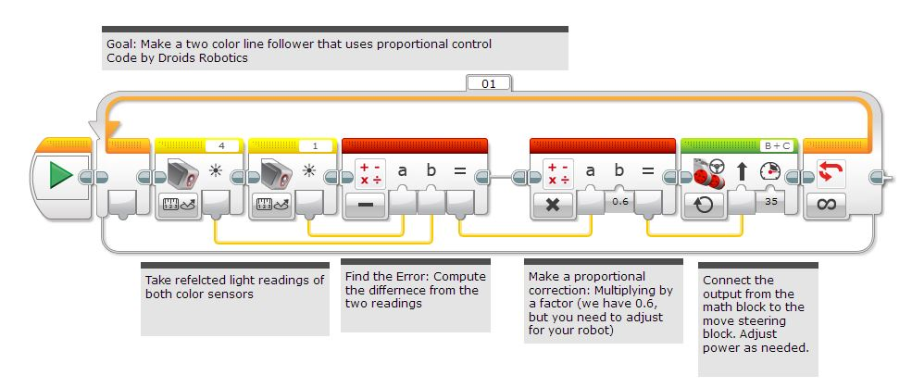
Challenge 2 Solution

Slide 11
Watch this code in action on YouTube
EV3Lessons.com YouTube Channel
https://youtu.be/qHwho1k1GZ4

Slide 12
Credits
This lesson was written by Sanjay and Arvind Seshan
More lessons are available at www.ev3lessons.com
This work is licensed under a Creative Commons Attribution-NonCommercial-ShareAlike 4.0 International License.

