Slide 1

Gyro Move Straight
By Sanjay and Arvind Seshan

Slide 2
Lesson Objectives
Learn what proportional control means and why to use it
Learn to apply proportional control to get your robot to move straight
Learn to apply proportional control to the Gyro sensor move at a particular angle
Prerequisites: Math Blocks, Data Wires, Proportional Control, Gyro Sensor lessons

Slide 3
Tips For Success
You must go through the Proportional Control Lesson and the Proportional Line Follower Lesson before you complete this lesson
You must also complete the three Gyro Lessons (Introduction to Gyro Sensor, Gyro Turns and Gyro Revisited)

Slide 4
What is Gyro Move Straight?
Imagine that you want to drive for 200 cm straight
As you travel, your robot gets bumped by something
A gyro move straight program helps the robot correct itself back to straight, but offset by how much it was bumped

Slide 5
How it Works
A proportional line follower and a gyro move straight code share similar properties
To write a gyro move straight program, you must first think about what the error is and what the correction needs to be
Application | Objective | Error | Correction
Gyro Straight | Make the robot at a constant heading/angle | How far you are from that heading/angle | Turn sharper based on how far you are from that angle
Line Follower | Stay on the edge of the line | How far are our light readings from those at line edge (current_light – target_light) | Turn sharper based on distance from line

Slide 6
Pseudocode
Recalibrate your gyro sensor (if you have not done so already elsewhere in your code) or reset your gyro (yellow gyro block set to reset mode) so that the value starts at “0” and there is no drift
In a loop, compute the error and apply the correction
Part 1: Compute Error (How far from target angle)
To move straight → Target gyro angle=0
Distance from target angle is just current gyro reading
Part 2: Compute a Correction that is proportional to the error
Multiply the Error from Part 1 by a constant (that you must experiment and discover for your robot)
Plug the value from Part 2 into a Move Steering Block
Exit loop as required

Slide 7
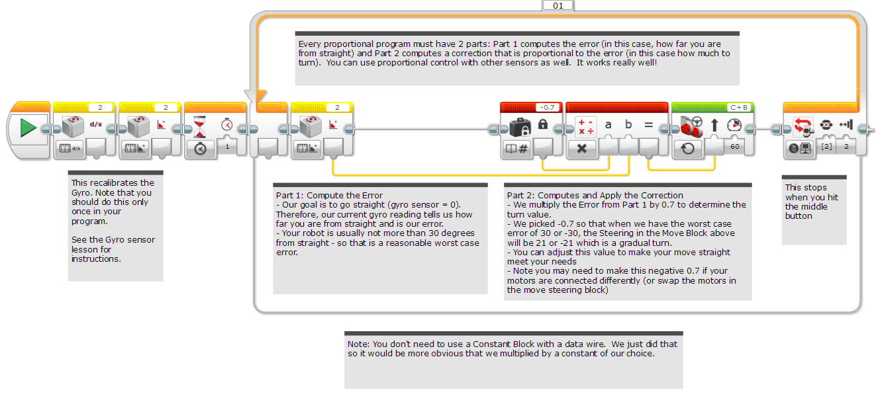
Solution: Gyro Move Straight

Slide 8
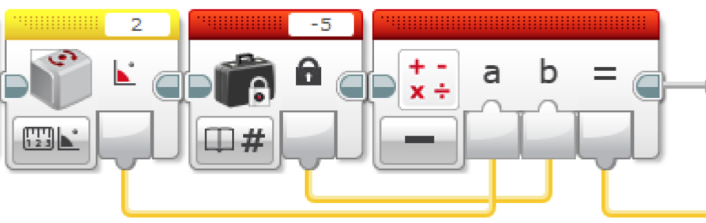
Discussion Guide
Compare the proportional line follower code with the proportional move straight code. What similarities and differences do you see? Ans. The code is almost the same. The one difference is how the error is calculated. The error is calculated using the gyro sensor. The correction is identical.
What if you wanted to travel at a particular angle (not just straight)? How would the code look different?
Ans. In Part 1 of the solution code, there is no subtraction block because we were just subtracting “0” since our target heading is moving straight. You would have to subtract your current angle from the target angle if you wanted to move at some other angle.
Target angle= -5 degrees

Slide 9
Credits
This tutorial was created by Sanjay Seshan and Arvind Seshan
More lessons at www.ev3lessons.com
This work is licensed under a Creative Commons Attribution-NonCommercial-ShareAlike 4.0 International License.

