Slide 1
BACKING UP FILES (iPAD, MAC LAPTOP & CHROMEBOOK)
BY MANJIRI MCCOY and BRUCE SCHAFER
EDITED by ARVIND SESHAN

Slide 2
Lesson Objectives
Learn how to backup SPIKE Prime files on an iPad
Learn how to backup SPIKE Prime files on a Mac Laptop
Learn how to backup SPIKE Prime files on a Chromebook

Slide 3
WHY SHOULD YOU BACKUP YOUR FILES?
It is a good idea to back up files somewhere other than your iPad/laptop in case something happens to your device and you lose your files. This happens to teams every single year and they lose months of work and it is very sad.
SPIKE 2 program files have an extension “.llsp”. SPIKE 3 program files have an extension “.llsp3”
NOTE: You cannot copy files from your Hub to your iPad/laptop. The hub contains compiled code (machine language) and is not a human-readable program.

Slide 4
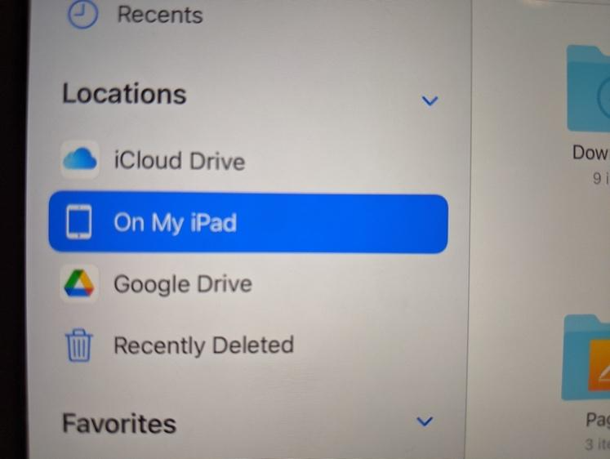
INITIAL SETUP on AN IPAD
You need the Google Drive app and the Files app to back up your programs to Google Drive.
Google Drive setup:
From the Appstore, download and install the Google Drive App. It is published by Google and is safe.
Log into the app. Create a new folder called “Spike Prime” by clicking the “+” icon in the bottom right.
Files setup:
From the App Store, download and install the Files app. It is published by Apple and is safe.
Launch the app. On the right, in the side bar under “Locations”, you’ll see a notification to allow Google Drive as a recognized Location for files. Turn it on. Now Google Drive should be a recognized location.

Slide 5
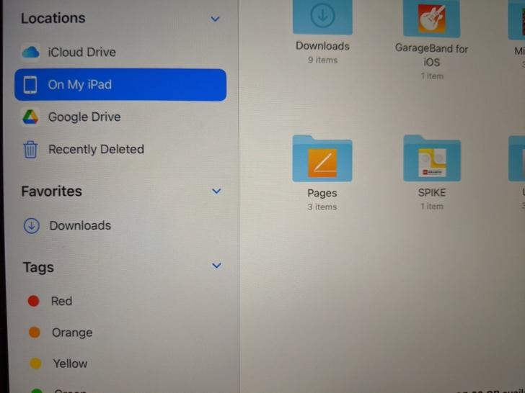
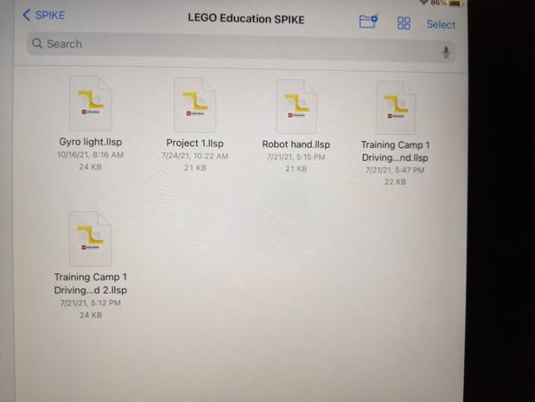
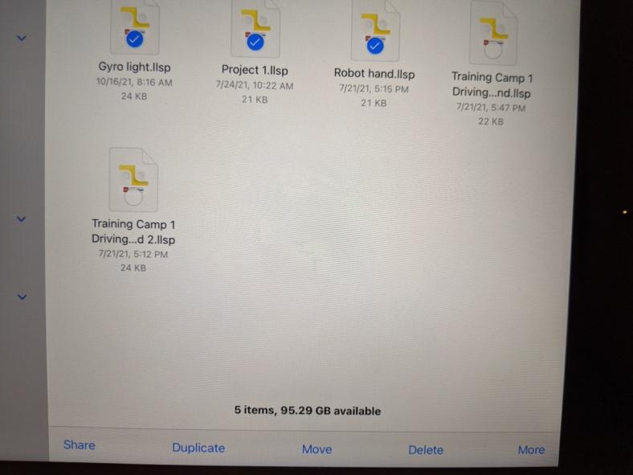
BACKING UP ON AN IPAD
Select “On My iPad” from the Locations sidebar. You will see folders in the main panel, one of which is Spike
Click on Spike, and then on Lego Education Spike. You will see a list of .llsp files. These are your programs.
Click the “Select” link at the top right. Select the programs you want to back up
Click the “share” link in the bottom bar.
Scroll the available programs until you find Google Drive. Click it.
On the window that appears, click “My Drive” near the bottom, Then pick the “Spike Prime” folder.
When you’re in the folder, click the “Create Folder” icon at the top right. Make a new folder with today’s date starting with year YYYY/MM/DD. E.g. 2021/10/25. ALWAYS make a new folder when you have made changes to a program and are saving it for a second or more time. This way you can go back to an earlier version of your program if needed.
Once the folder is created, click the “Save here” link at the bottom right. You will be taken back to the main window.
Upload the selected files by clicking the “Upload” link at the top right.
Your programs are now saved to Google Drive.

Slide 6
ReSTORING FILES ON AN IPAD
In the Files app, go to Google Drive and navigate to the filter that contains your file.
Press the file and drag it over “On My iPad” on the Locations bar. Keep the file pressed.
The folder will open. With the file still pressed, move over the Spike Folder. It will open.
Move over the Lego Education Spike Folder. It will open.
Now drop the file in here. You can replace an existing file or save as a new copy. They will now be available in your projects when you open your App.

Slide 7
INITIAL SET UP ON A MAC
On a Mac laptop, the .llsp program files are stored in one of two locations:
~/Library/Containers/Spike/Data/Documents/LEGO Education SPIKE/
~/Documents
Google Drive setup:
Go to Google Drive.
Create a new folder called “Spike Prime”

Slide 8
BACKING UP FILES on A MAC
Open Finder app
From the toolbar, click Go-> Go to folder and the copy-paste the first location listed above in the text box
You should see your .llsp files. If what you’re looking for is not there, try the second location.
Open a browser window and go to Google Drive, to the Spike Prime folder
Make a new folder with today’s date starting with year YYYY/MM/DD. E.g. 2021/10/25. ALWAYS make a new folder when you have made changes to a program and are saving it for a second or more time. This way you can go back to an earlier version of your program if needed.
Drag and drop files from your Finder Window to the Drive folder

Slide 9
RESTORING FILES on A MAC
Open Google Drive in a browser and go to the folder that has your backed up file
Open Finder and navigate to the first location under the Library folder.
Drag and drop files from Drive to the folder. They will now be available in your projects when you open your App.

Slide 10
EXPORTING PROJECTS ON CHROMEBOOK PART 1
The Chromebook version of the SPIKE Prime application does not store your Word Block projects in a standard place on the Chromebook.
Instead it provides a way to “share” your projects which is really a way of saving a copy of a project as a file on your computer.
To access this feature go to your My Projects screen to get a list of all your projects displayed as icons or in a list.
To save a copy of one of your projects click on a small circle next to one project at a time. The word ”Share” will show up.
Clicking on the “Share” menu item to bring up a file manager window. If you do not have a File Manager set up, you will need to do so (instructions on next page)

Slide 11
EXPORTING PROJECTS ON CHROMEBOOK PART 2
Installing a File Manager
Minimize your SPIKE Prime application.
Start the Play Store application.
Search for Total Commander. (There are probably other file managers that will work but this is the one we’ll use in these instructions.)
Click on Install and wait until the installation has completed.
Return to the your SPIKE Prime application’s My Projects screen
Reselect a project (see previous page)
Click on Share.

Slide 12
BACKING UP SPIKE FILES ON CHROMBOOK
The Total Commander window should show “Save File As” at the top followed by the name of the project you chose followed by “.llsp” or “.llps3”
The first time you do this you probably won’t have a folder set up on your Chromebook for you project files. To create a folder for your backup copies of your projects, use the following steps:
Click on the line that includes “My files”.
Click on the icon that looks like a folder with a “+” sign. You should see a box that says “Create new folder:” followed by a line to fill in with the name of a new folder. Try typing “My Projects” or something similar.
If it doesn’t let you type anything on the line, click on the white box below which will copy the words in the box onto the line. Replace the words with something like. “My Projects”.
Click OK. This will return you to the “Save File As” screen.
Click OK to save the project you selected earlier. This will return you to the My Projects screen in your SPIKE Prime application where you can select and Share a different project.
You will not need to create new folders from subsequent saves. Instead you should see the folder you created earlier shown on a line under the name of your project file. If it isn’t, you can click on the three dots to the right of the blue arrow under that line to navigate to your folder.

Slide 13
BACKING UP SPIKE FILES OUTSIDE CHROMEBOOK
The process above will give you backup copies of your files on your Chromebook but will not assure you have a backup if your Chromebook should fail.
To backup your project files to the “cloud” use the Chrome browser to navigate to “drive.google.com” and use the “+ New” button to upload your files. Instead of using Google Drive via your browser, you could use Play Store to install Google Drive on your Chromebook and use it to upload your project files.
You can also backup your files to an external device. For instance, you can copy the files to a USB drive.

Slide 14
RESTORING FILES on CHROMEBOOK
If you need to restore one of the projects from a backup copy, use Total Commander or another Chromebook file manager to navigate to your My Projects folder and double click on the backup file.
Doing so will load it into the SPIKE Prime application and display it.

Slide 15
TRANSFERING A PROJECT TO ANOTHER COMPUTER
If you want to move the files to a Windows or Mac computer, you should copy or download them and move them to the LEGO Education SPIKE folder in the Documents folder.
Once you have placed project files from your Chromebook in one of these folders, you’ll need to import them into SPIKE Prime by displaying one of the projects already on that computer and then using the File Open feature to load the project.
After you have loaded it this way once, it will appear with the rest of the projects on the My Projects screen.
If you want to move the files to a different Chromebook, copy or download them to the Chromebook and then use the steps under “Restoring a Project”.

Slide 16
CREDITS
This lesson was created for PrimeLessons
More lessons are available at www.primelessons.org
This work is licensed under a Creative Commons Attribution-NonCommercial-ShareAlike 4.0 International License.

