Slide 1
Introduction to Color sensor
BY SANJAY AND ARVIND SESHAN
This lesson uses SPIKE 3 software

Slide 2
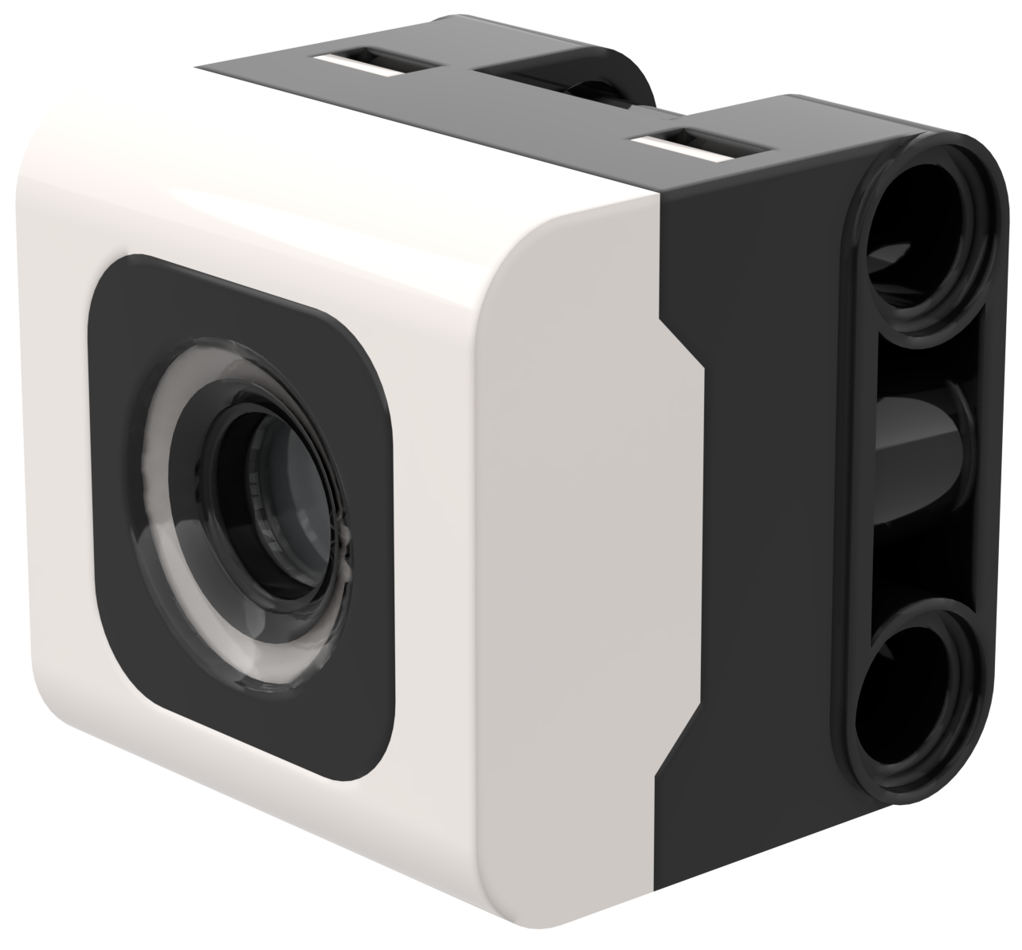
Lesson Objectives
Learn how to use the Color Sensor
Learn how to use the Wait Until Block
Note: Although images in this lessons may show a SPIKE Prime, the code blocks are the same for Robot Inventor

Slide 3
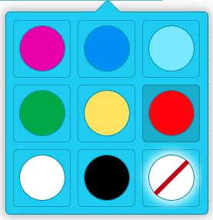
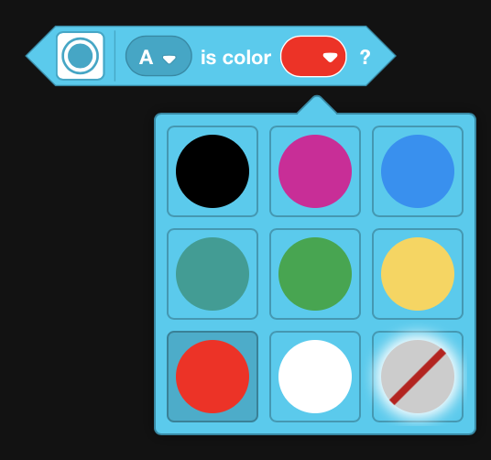
What is a Color sensor?
In the software, the sensor can detect color or reflectivity
Unlike the EV3, reflectivity is with white light, not a red light.
The sensor can detect 8 colors and no color (what those colors are vary between SPIKE Prime and Robot Inventor)
Optimal reading distance according to the specs: 16 mm (depending on object size, color, and surface)
Note: In Robot Inventor, the light blue color is replaced with teal
Detectable Colors
Black (0)
Violet (1)
Blue (3)
Light Blue (4)
Green (5)
Yellow (7)
Red (9)
White (10)
No Color (-1)
Detectable Colors
Black (0)
Violet (1)
Blue (3)
Teal (4)
Green (5)
Yellow (7)
Red (9)
White (10)
No Color (-1)

Slide 4
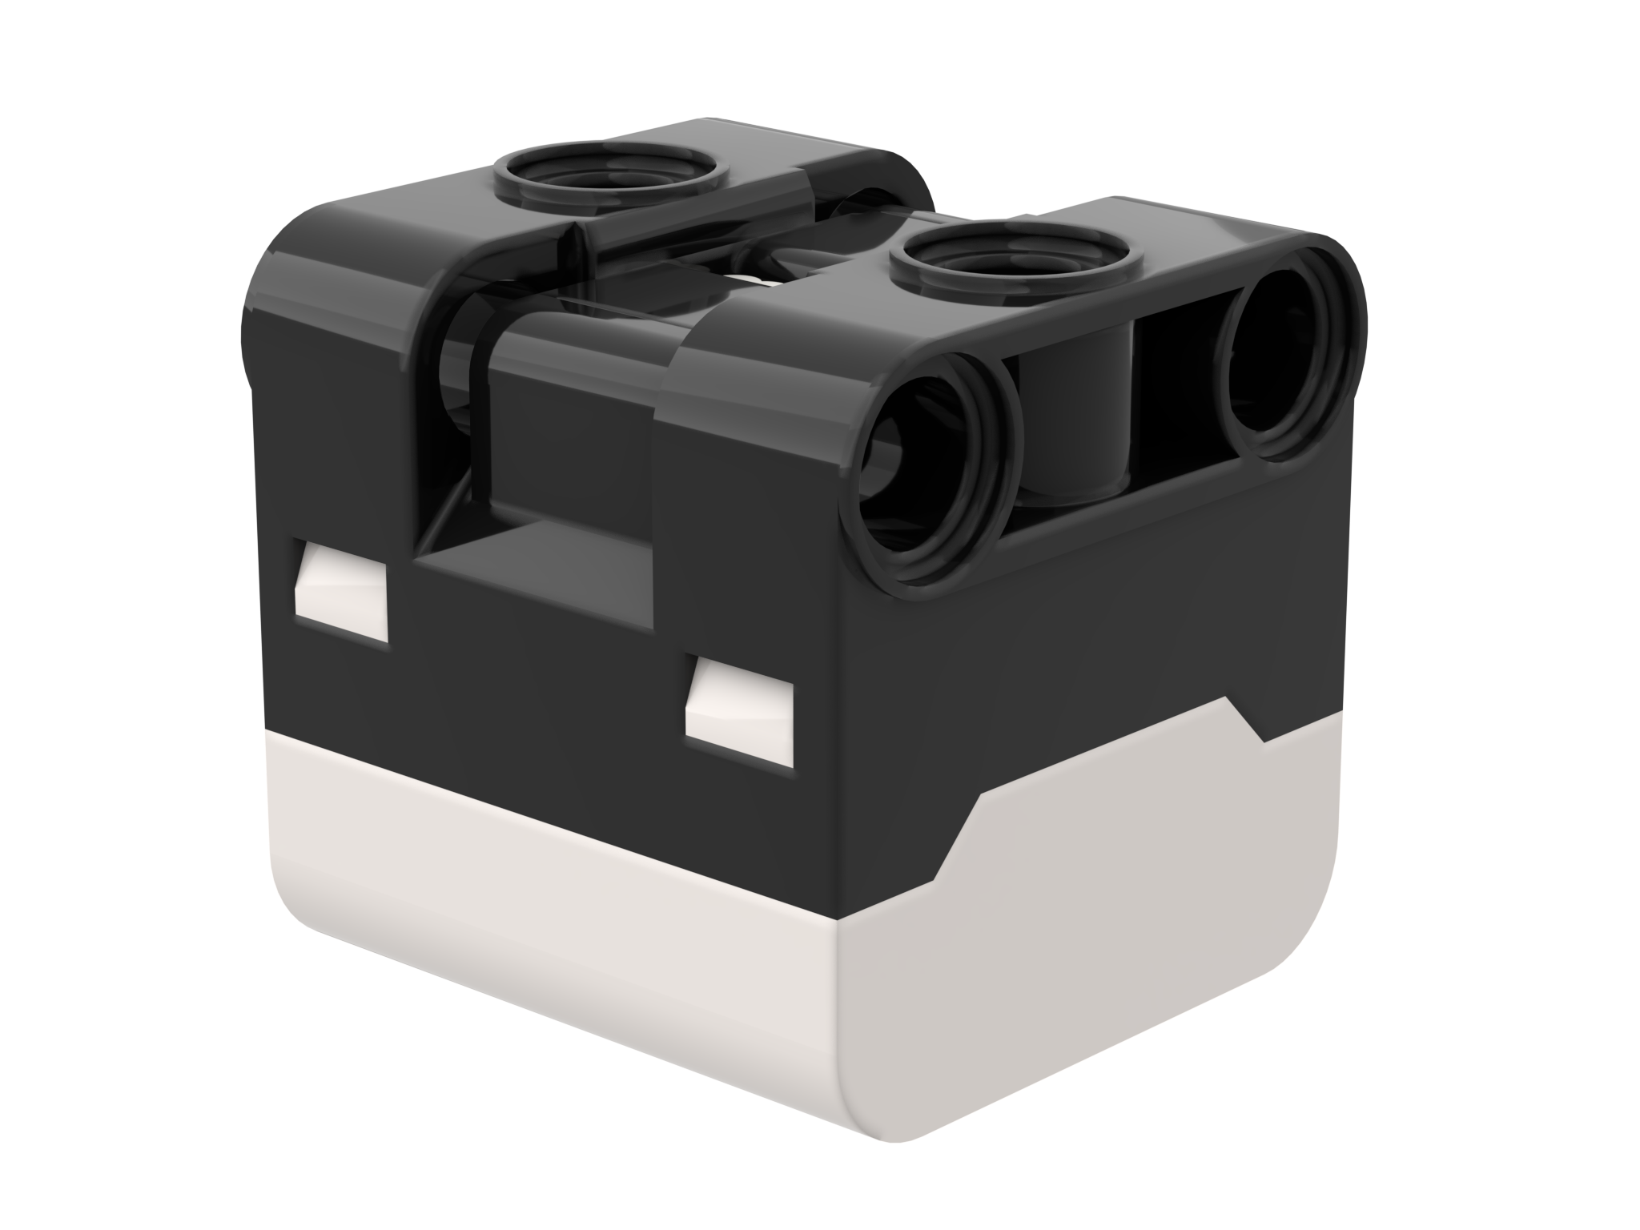
NOTE: ADB and sensing color
The color sensor on ADB (Advanced Driving Base in SPIKE Prime) is mounted at about 8mm off the ground, but the optimal distance for mounting the sensor according to the specs is 16mm.
When using this robot design, Black does not read correctly in Color Mode using electrical tape lines or a FIRST LEGO League challenge mat.
See the next slide for modifications. The build instructions are also provided as a separate file on our site.
16mm
2M (2 LEGO Modules)

Slide 5
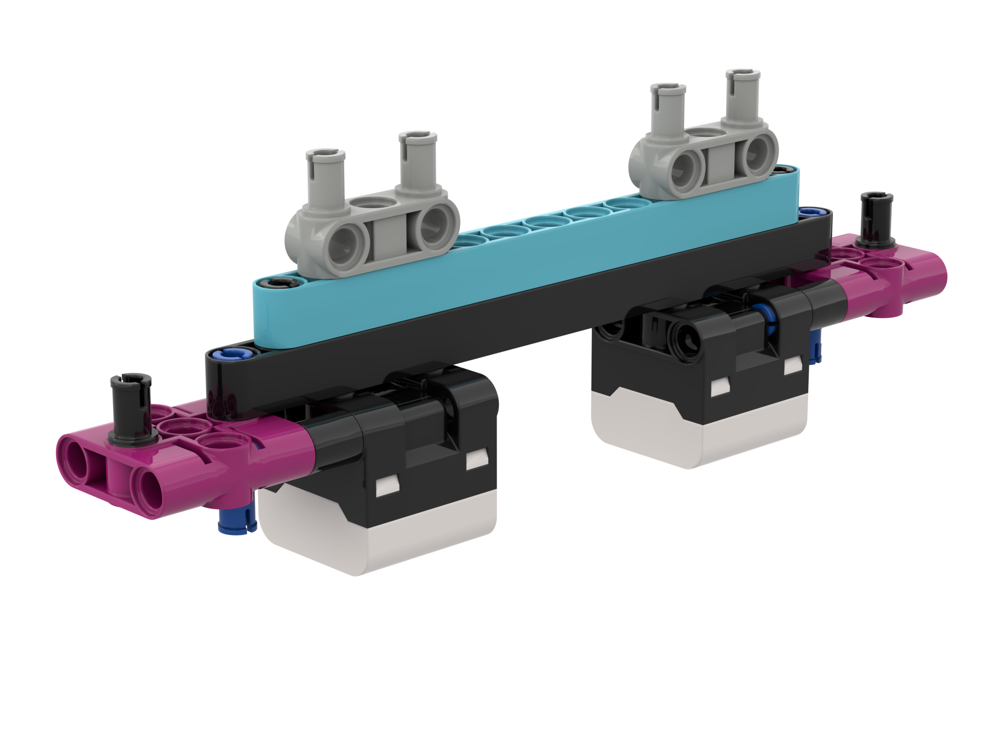
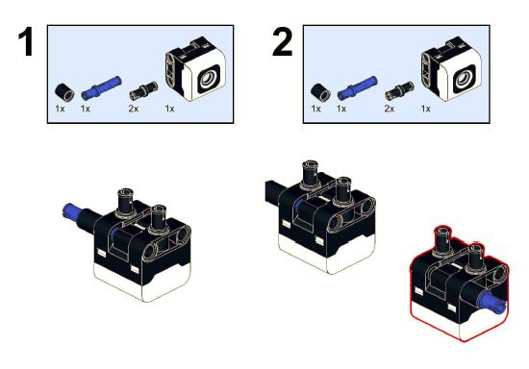
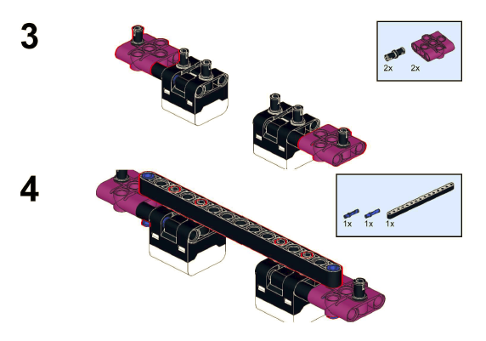
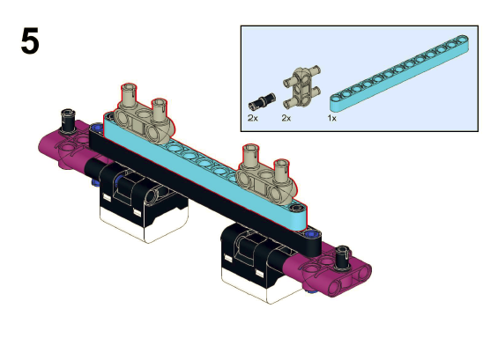
Modifications to ADB
Build instructions for modifying the front bumper of ADB so that the color sensors are raised one LEGO module up are included on this website

Slide 6
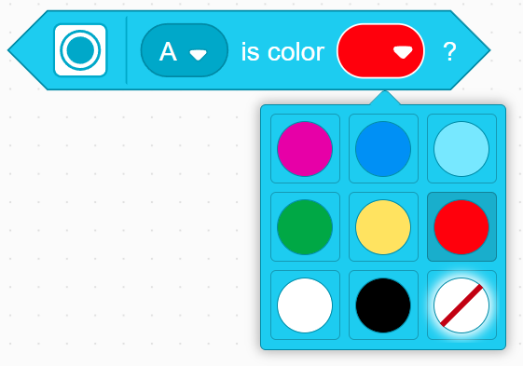
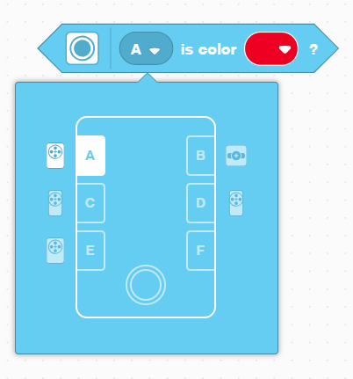
How do you program with a color Sensor?
The two modes you can program the color sensor in: Color Mode and Reflected light mode
We will use color mode in this lesson

Slide 7
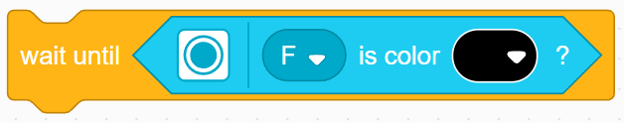
Challenge 1
Program your robot to move forward until the color sensor sees black
You will need to use the Wait For block and the Boolean block of the color sensor
Basic steps:
Set the movement motors for your robot (A and E for Droid Bot IV and ADB robot)
Set the movement speed for your robot
Start moving forward
Use the wait until block to detect when the color sensor sees black
Stop moving

Slide 8
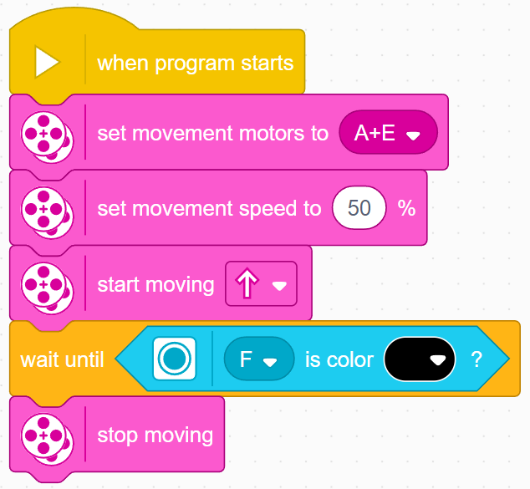
Challenge 1: Solution
In previous lessons, you learnt how to configure your robot. The first set of blocks sets the movement motors and speed. (See Configuring Your Robot Lesson)
Note: 50% is the default speed so the set movement speed block can be omitted in this case. It is provided so you can adjust the speed as needed.
Configure robot
Start moving
Wait until the color sensor sees black
Stop moving

Slide 9
CREDITS
This lesson was created by Sanjay Seshan and Arvind Seshan for Prime Lessons
More lessons are available at www.primelessons.org
This work is licensed under a Creative Commons Attribution-NonCommercial-ShareAlike 4.0 International License.

