Slide 1
Introduction to distance sensor
BY SANJAY AND ARVIND SESHAN
This lesson uses SPIKE 3 software

Slide 2
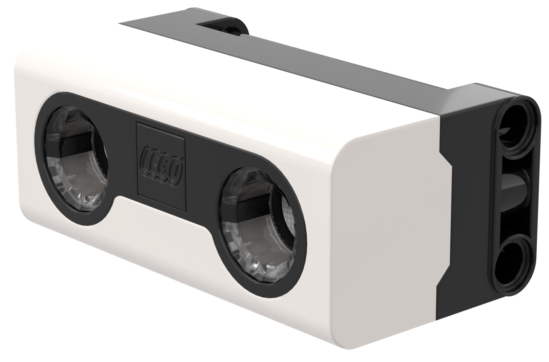
Lesson Objectives
Learn how to use the Distance Sensor
Learn how to use the Wait Until Block
Note: Although images in this lessons may show a SPIKE Prime, the code blocks are the same for Robot Inventor

Slide 3
What is a distance sensor?
Measures the distance to an object or surface using ultrasonic technology
There are also lights around the ultrasonic sensor (4 segments) that can be programmed individually (see Lights Lesson)
The sensor can sense distances from 50-2000mm
There is a fast sensing capability from 50-300mm

Slide 4
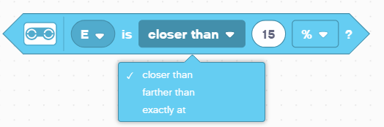
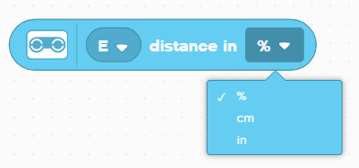
How do you program with a distance Sensor
The Distance Sensor can measure the distance to an object or surface using ultrasonic
You can also program the lights around the sensor. This is covered in a different lesson.
Units can be measured in Percent, Centimeters, or Inches

Slide 5
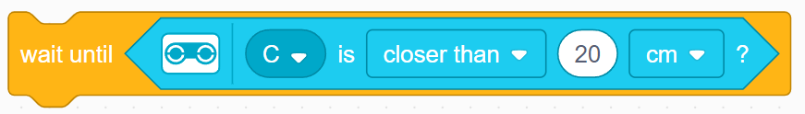
Challenge: Away from the Wall
You want to find the opening. Use your Distance Sensor (mounted on the side of the robot like Droid Bot IV) to locate the gap
Program your robot to move forward until it is less than 20cm from the wall
You will need to use the Wait For block and the Boolean block of the Distance Center
Pseudocode:
Set the movement motors for your robot (A and E for ADB robot)
Set the movement speed for your robot
Start moving forward
Use the wait for block to detect that it is less than 20cm from the wall
Stop moving
20cm

Slide 6
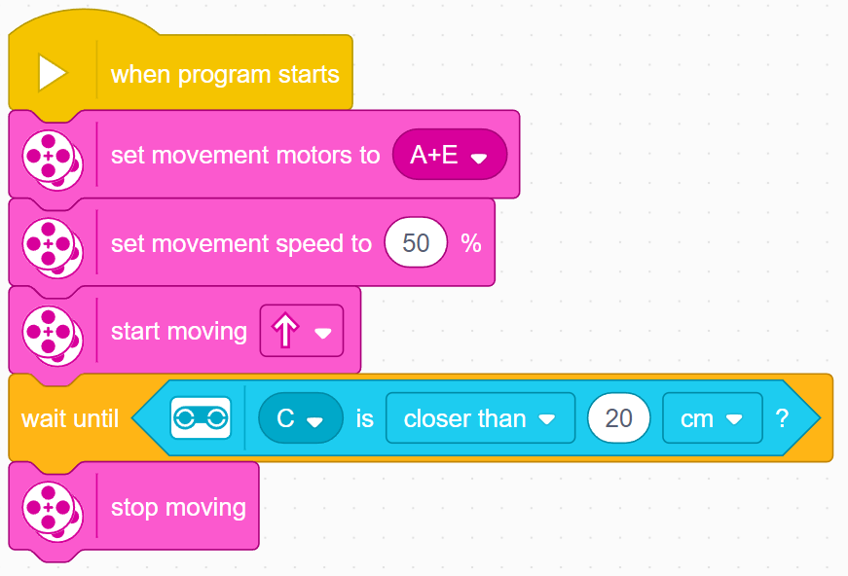
Challenge 1: Solution
In previous lessons, you learnt how to configure your robot. The first set of blocks sets the movement motors and speed. (See Configuring Your Robot Lesson)
Note: 50% is the default speed so the set movement speed block can be omitted in this case. It is provided so you can adjust the speed as needed.
Configure robot
Start moving
Wait until the distance sensor reads less than 20cm
Stop moving

Slide 7
extension
Once you find the wall, move the robot backwards and go through the opening

Slide 8
CREDITS
This lesson was created by Sanjay Seshan and Arvind Seshan for Prime Lessons
More lessons are available at www.primelessons.org
This work is licensed under a Creative Commons Attribution-NonCommercial-ShareAlike 4.0 International License.

