Slide 1
Squaring on Lines
BY SANJAY AND ARVIND SESHAN
This lesson uses SPIKE 3 software

Slide 2
Lesson Objectives
Learn how to get your robot to square up (straighten out) when it comes to a line
Learn how squaring (also known as aligning on a line) can help the robot navigate
Learn how to improve initial code for aligning by repeating a technique
Practice creating a useful My Block

Slide 3
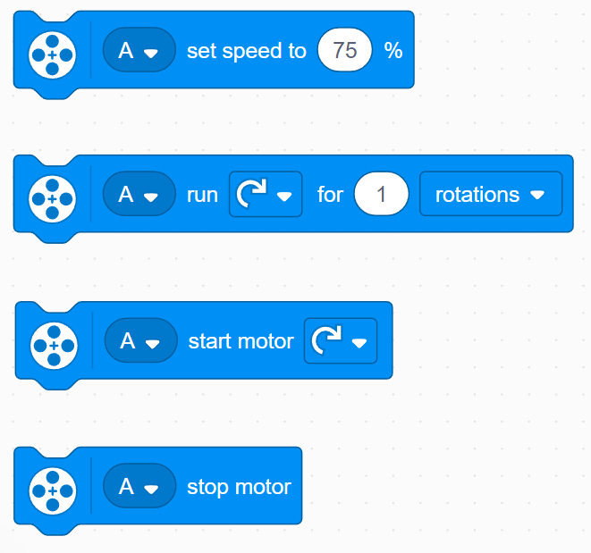
Review
Move Steering lets you control both motors at the same time
What if you want to move or stop one motor at a time?
Use the Motor Blocks
Set Motor Speed
Run Motor For Duration
Start Motor
Stop Motor

Slide 4
WHY Align/Square on a line?
Aligning on a line helps the robot navigate
Robots get angled as they travel farther or turn (the error accumulates)
Aligning on a line can straighten out a robot.
Aligning can tell a robot where it is when it has to travel far
Example Goal: Your robot must deliver an object only inside a small END area. The distance between start and end is 8 feet
Do you think your robot can travel 8 feet and continue to be straight?
End
8ft
Start

Slide 5
Three Easy Steps to Align
Challenge: Make the robot straighten out (align/square up)
STEP 1: Start both motors
STEP 2: Stop one motor when the sensor on the corresponding side sees the line
STEP 3: Stop moving the second motor when the sensor on that side sees the line
Hints: Use a Motor Block, Separate Events

Slide 6
NOTES on the solution
Our solution uses 2 Color Sensors (connected in ports E and F).
Our solution assumes that the color sensor on port E is next to the wheel on motor port A and color sensor on port F is next to the wheel on motor port B.
You should adjust the ports as needed
Your color sensors should NOT be placed right next to each other

Slide 7
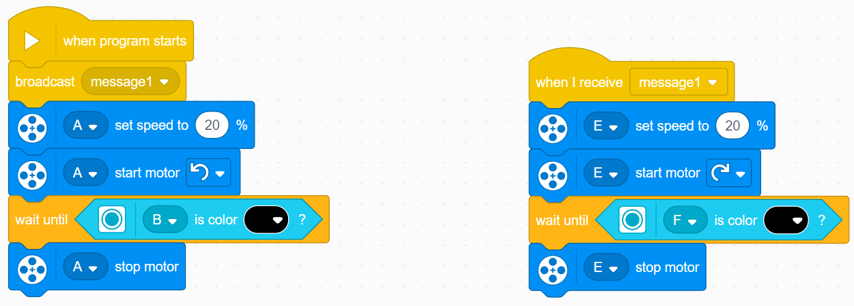
Basic Solution: Move Until Line
Initiates a second event when “message1” is broadcasted
Sets speed
Starts motors
Wait for color sensor to detect black
Stop motor

Slide 8
A NOTE ABOUT EVENTS
When you have two or more events you do not know when each event will finish.
If you wanted to move after the align finishes you might try to add a move block at the end of one of the events.
Note: This will not work because the code will play your move block without waiting for the other event to finish.
Solution: You need to synchronize your events. To learn more about synchronization and solutions go to the primelessons.org lessons called Introduction to Events and Event Synchronization.
The problem of synchronization can be solved by using Wait Until Blocks and Variables. The second event will set a variable to a specific value at its end and the first event will wait for that value to be set.

Slide 9
Improving your code
What do you notice about the solution we just presented?
The robot is not always perfectly straight (aligned) at the end of it.
Both color sensors are on the line, but the robot stops at an angle if you started at a sharp angle
Challenge Continued: Think about how you can improve this code so that the robot ends straighter
Solution: repeat the align except look for white this time

Slide 10
CREDITS
This lesson was created by Sanjay Seshan and Arvind Seshan for Prime Lessons
More lessons are available at www.primelessons.org
This work is licensed under a Creative Commons Attribution-NonCommercial-ShareAlike 4.0 International License.

