Slide 1
Line follower
BY SANJAY AND ARVIND SESHAN
This lesson uses SPIKE 3 software

Slide 2
Lesson Objectives
Learn how to get a robot to follow a line using Color Mode on the Color Sensor
Learn how to follow a line until a sensor is activated
Learn how to follow a line for a particular distance
Learn how to combine sensors, loops and switches

Slide 3
Robots follow the edge of the line
If on black, turn left.
If on white turn right.
If on black, turn right.
If on white turn left.
The robot has to choose which way to turn when the color sensor sees a different color.
The answer depends on what side of the line you are following!

Slide 4
Which side of the line should you start on
If you write a line follower to follow the right side of the line, you have to start the robot on the right of the line
✔
✔
✗

Slide 5
CHALLENGE: Follow a Line
Write a program that follows the right edge of the line
If your sensor sees black, turn right
If your sensor sees white, turn left
Use an If-Else block to make that decision
Repeat the line follower forever
Use Color Mode or Reflected Light Mode
Note: To line follow with the Advanced Driving Base (ADB) in Color Mode you will have to make a modification to the design because the color sensor does not recognize black at the height in the original build instructions. See our Color Sensor lesson.

Slide 6
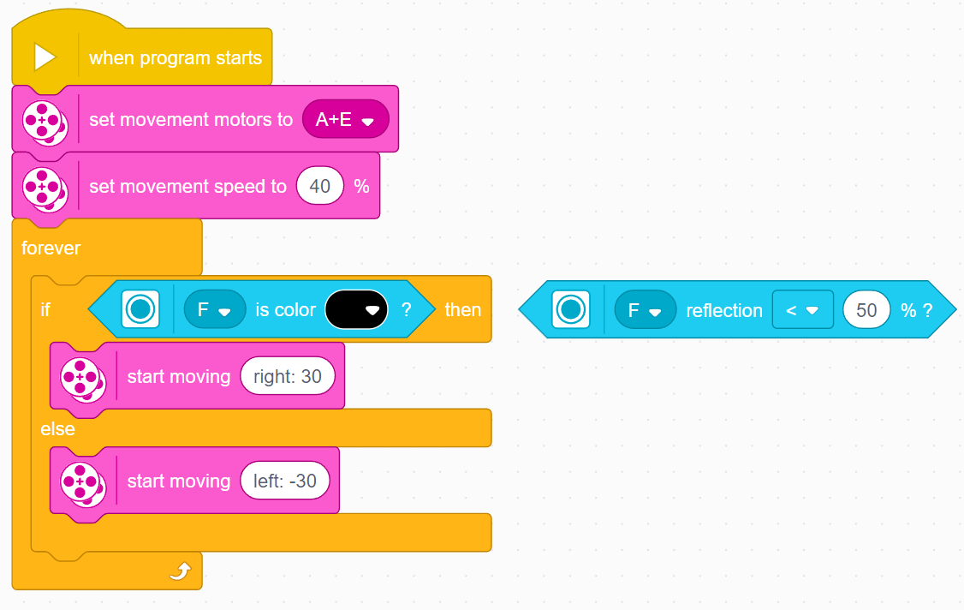
LINE FOLLOWER – color & Reflected mode
This program follows a right side of a black line using the Color Mode
To use reflected light mode substitute the condition
When the sensor sees black, the robot turns right
When the sensor sees white, the robot turns left

Slide 7
Extension
CHANGING EXIT CONDITIONS
What if you did not want to line follow forever? What it would wanted to line follow until a Force sensor was pressed?
Combine this lesson with the Repeat block lesson to solve this problem.

Slide 8
CREDITS
This lesson was created by Sanjay Seshan and Arvind Seshan for Prime Lessons
More lessons are available at www.primelessons.org
This work is licensed under a Creative Commons Attribution-NonCommercial-ShareAlike 4.0 International License.

