Slide 1
Lists and Tuples
By Sanjay and Arvind Seshan
This lesson uses SPIKE 3 software

Slide 2
Lesson Objectives
Learn to create and use 1D lists
Learn to create and use tuples
Learn to create and use 2D lists

Slide 3
Basics
Lists and Tuples store a set of data
Comma separated lists
Lists inside brackets
Tuples inside parentheses
Each entry in a list or tuple is assigned an index, starting at 0
L=[index 0, index 1, index 2…..]
You can read data at an index (for lists, tuples, and strings) by calling
L[index]
# List:
L = [1, 2, 3]
M = ["Hello", "bye"]
N = [1, True, "Hello"]
L[0] == 1 # True
# Tuple:
a = (1, 2, 3)
b = ("Hello", "bye")
c = (1, True, "Hello")
Lists can also be created by using L = [n]*x (creates a list of n x times) → avoid when working with 2d (nested) lists due to some memory referencing nuances

Slide 4
List Methods
All list methods edit the original list and do not return anything (except pop() which returns the removed data)
Method | Description
append(data) | Adds an element at the end of the list
count(data) | Returns the number of elements with the specified value
extend(L) | Add the elements of a list (or any iterable), to the end of the current list
index(data) | Returns the index of the first element with the specified value
insert(i, data) | Adds an element at the specified position
pop(i) | Removes the element at the specified position
remove(data) | Removes the first item with the specified value
reverse() | Reverses the order of the list
sort() | Sorts the list

Slide 5
Mutability
Lists are a mutable data type
Tuples, strings, etc. are not
This means that when you edit a list, it edits that same memory (RAM) object instead of creating a new one
You can edit a List by assigning an index’s data to a new piece of data (see yellow)
This is not true for strings or tuples
>>> s = "abc"
>>> s[0] = "b"
TypeError: 'str' object does not support item assignment
>>> t = (1,2,3)
>>> t[1] = 0
TypeError: 'tuple' object does not support item assignment
>>> L = [1,2,3]
>>> L[0] = 4
>>> L
[4, 2, 3]
>>>

Slide 6
Copying a List
You must use the copy function from the copy module
Unlike strings, tuples, etc., the memory object must be copied; other types will be “copied” simply by “changing” the value
I.e. you cannot do a=b to copy a list, but you can for other types → see this in action in the right (green)
You can copy a list (see yellow)
M = L.copy()
Edits do not affect the original list
>>> L = [1,2,3]
>>> M=L
>>> print(M, L)
[1, 2, 3] [1, 2, 3]
>>> L.append(5)
>>> print(M, L)
[1, 2, 3, 5] [1, 2, 3, 5]
>>> N = L.copy()
>>> N.append(4)
>>> print(M, L, N)
[1, 2, 3, 5] [1, 2, 3, 5] [1, 2, 3, 5, 4]

Slide 7
More About Lists
You can….
Get slices (sections)
Length of list
Sum of list
Append, etc. (see list methods)
Sort a list using .sort() (numerically, alphabetically, etc.) method
Reverse a list using .reverse() method
L = [1, 2, 3, 4, 5]
# Slices
L[1:3] == [2, 3]
L[1:5:2] == [2, 4]
# L[START:END:INTERVAL]
# Length (of list/tuple)
len(L) == 5
# Sum (of all items in the list/tuple)
sum(L) == 15
# Add to list
L.append(6)
print(L) # [1, 2, 3, 4, 5, 6]

Slide 8
For Loops With Lists
You can iterate (i.e. sequentially go through) through a list or tuple using a “for” loop
The loop variable (“item” in the example) is assigned the value of the next item in the list each time through the loop
The loop ends when there are no more items
L = [1, 2, 8, "hello"]
for item in L:
print(item)
Output:
1
2
8
hello

Slide 9
Strings to Lists
You can use the list() function to split each character into an entry
You can also use the split() method to convert the string into a list, splitting at the desired item
You can undo the conversion with "".join(L)
>>> L = list("abcd")
>>> print(L)
['a', 'b', 'c', 'd']
>>> s = "a,b,c,de"
>>> M = s.split(",")
>>> print(M)
['a', 'b', 'c', 'de']

Slide 10
Challenge
Given a list of numbers, sum the squares of the numbers and return the answer. Then print the answer to the light matrix
You will need to use 1D lists, for loops, and optionally functions

Slide 11
Challenge Solution
from hub import light_matrix
import runloop, math, sys
# Function to stop the program using a system exception
def stopAndExitProgram():
sys.exit("Stopping")
def sumSquares(L):
sum = 0
for num in L:
sum += math.pow(num,2)
return sum
async def main():
sum = sumSquares([1,3,9])
# Print the sum after converting it to an int, and then string
await light_matrix.write(str(int(sum)))
# Stop and exit the program. You should see the Program number on your hub.
stopAndExitProgram()
runloop.run(main())

Slide 12
2d lists: Lists within Lists
In Python, a 2D list is just a list of lists (i.e. each element of the list is another list)
You can have 3D, 4D, etc.
2D list sometimes called a matrix
L = [[ 2, 3, 5 ],
[ 1, 4, 7 ]]

Slide 13
Getting an Element
Similar to 1D lists
You get an element of a list within an element of the “parent” list
Address an element by calling
L[row][column]
L = [[ 2, 3, 5 ],
[ 1, 4, 7 ]]
L[0][1] == 3
L[1][2] == 7

Slide 14
Looping on a 2d list
Use nested loops
Iterate on the parent list then the child list
Loop over rows then columns
L = [[ 2, 3, 5 ],
[ 1, 4, 7 ]]
for row in L:
for col in row:
print(col)
Output:
2
3
5
1
4
7

Slide 15
Copying a 2d list
Similar mutability issues to 1D lists but even more
Each “child” list has its own memory reference
We need to do a “deepcopy”
Unfortunately, micropython does not natively implement the copy library so we need to create our own deepcopy
The function below uses recursion (which will be taught in a later lesson) to create a simple copy of list elements without using the original list
Use this function on any list - i.e., M=deepCopy(L)
def deepCopy(L):
if (type(L)==list):
return [deepCopy(e) for e in L]
else: return L

Slide 16
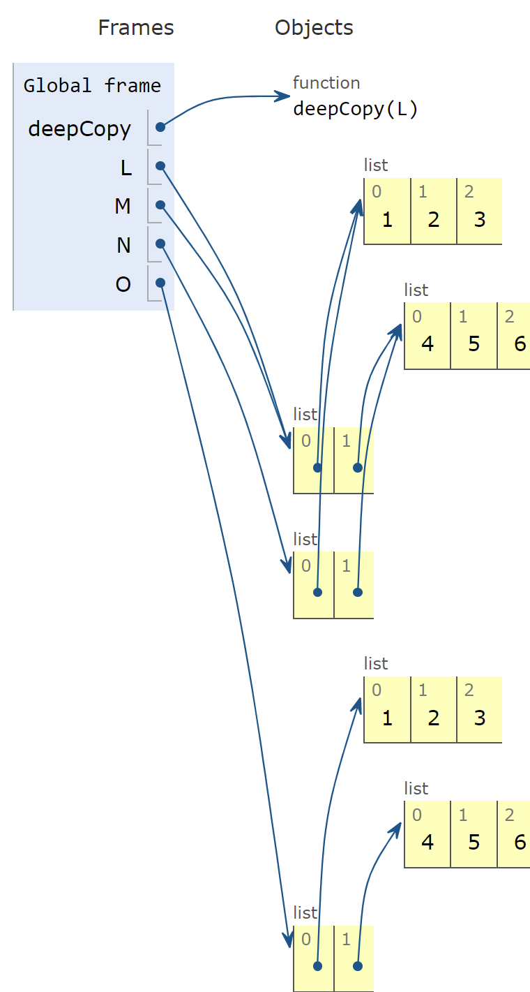
2d List Copying Analysis
Let’s take a look at the memory structure of the following code:
Notice in the object diagram (right), M and L point to the same list, showing that it is really the same object
While N has its own list, its elements point to the same lists as L, showing that they were not copied when using the normal copy method
O, however, has all of its children independent of L, showing that it is copied correctly using deepcopy
Basically, if you are working with 2D lists, use deepcopy.
def deepCopy(L):
if (type(L)==list):
return [deepCopy(e) for e in L]
else: return L
L = [ [ 1, 2, 3 ] , [ 4, 5, 6 ] ]
M = L
N = L.copy()
O = deepCopy(L)

Slide 17
Light matrix pixel Control
Each pixel on the light matrix is represented by a x,y value and a brightness value
The method to control the matrix pixel is set_pixel(x, y, brightness).
The x value is the pixel position counting from the left (range 1-5)
The y value is the pixel position counting from the top (range 1-5)
The brightness value ranges from 0-100
For example:
light_matrix.set_pixel(1, 4, brightness=100)

Slide 18
Challenge
Given a 2D list of coordinates, in a loop, turn on, wait one second, and turn off each pixel sequentially
The list will look like:
L=[[1, 1],
[2, 3],
[3, 4]]
Each child list is an [x, y] coordinate. Note the ranges for the hub light matrix x and y values are 0-4. If you use numbers outside this range, it will be ignored.

Slide 19
Challenge Solution
from hub import light_matrix
import runloop, sys
# Function to stop the program using a system exception
def stopAndExitProgram():
sys.exit("Stopping")
async def main():
L = [[1,1],
[2,3],
[3,4]]
for (x, y) in L:
light_matrix.set_pixel(x, y, 100)
await runloop.sleep_ms(1000)
light_matrix.set_pixel (x, y, 0)
stopAndExitProgram()
runloop.run(main())

Slide 20
CREDITS
This lesson was created by Sanjay and Arvind Seshan for Prime Lessons
Additional contributions by FLL Share & Learn community members.
More lessons are available at www.primelessons.org
This work is licensed under a Creative Commons Attribution-NonCommercial-ShareAlike 4.0 International License.

