Slide 1
Recursion
By Sanjay and Arvind Seshan
This lesson uses SPIKE 3 software

Slide 2
Lesson Objectives
Learn how to create recursive functions

Slide 3
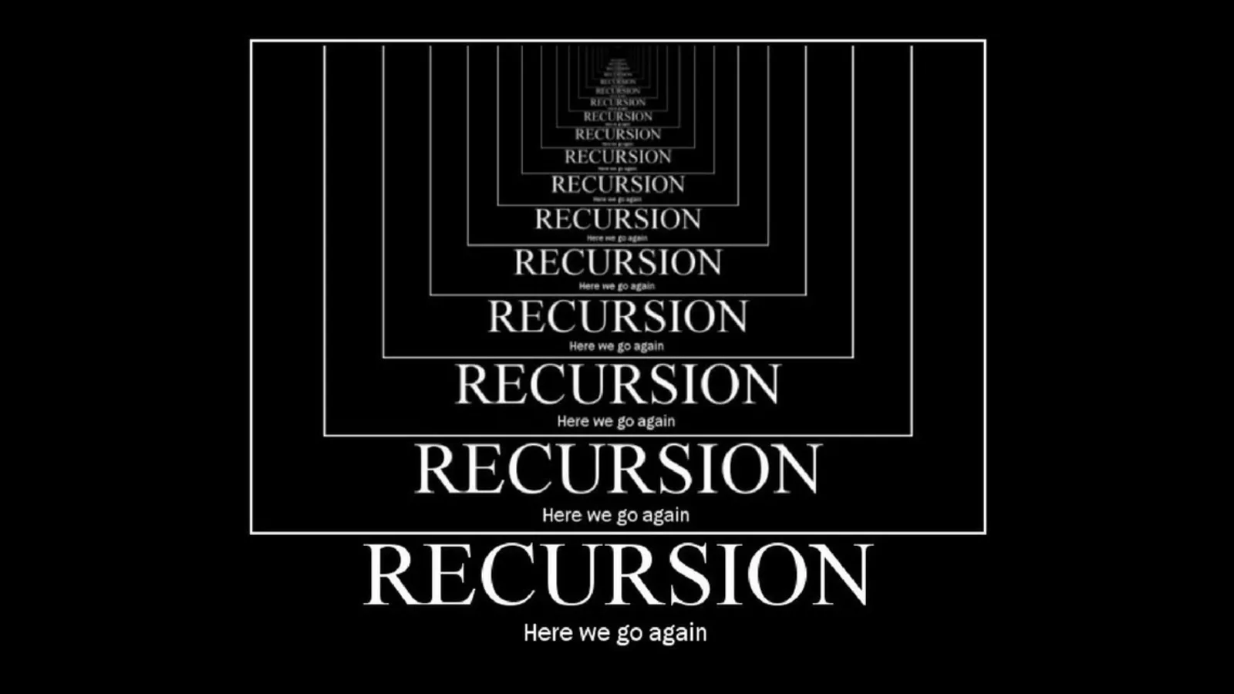


Intro to Recursion
Definition recursion (n):
see recursion
The definition refers to itself (like a loop)
Some famous examples are:
Fibonacci series:
Factorial:
In Python: a function that calls itself
1, 1, 2, 3, 5, 8, 13, …..
5! = 5*(4*(3*(2*(1)))) = 120

Slide 4
Programming a Recursive Function
There are two parts to recursion:
The base case → a known case
Sometimes there are multiple base cases
The recursive case → everything else
def recursiveFunction():
if (this is the base case):
return something non-recursive
else:
return something recursive

Slide 5
Recursion: Factorial
Base Case: factorial(1) = 1 (i.e. 1! = 1)
Recursive case: return n*(factorial(n-1))
def factorial(n):
if (n == 1):
return 1
else:
return n*factorial(n-1)

Slide 6
Recursion: Fibonacci
Base Case 1: fibonacci(1) = 1
Base Case 2: fibonacci(2) = 1
Recursive case: return fibonacci(n-1)+fibonacci(n-2)
def fibonacci(n):
if (n == 1):
return 1
elif (n == 2):
return 1
else:
return fibonacci(n-1) + fibonacci(n-2)

Slide 7
Challenge: Pell sequence
Create a recursive function to get the nth value in the Pell sequence
The Pell sequence is 0, 1, 2, 5, 12, 29, 70, 169, 408, 985, ……
Mathematically, it is defined as
Print the 5th PELL number to the light matrix

Slide 8
Challenge Solution
from hub import light_matrix
import runloop, sys
# Function to stop the program using a system exception
def stopAndExitProgram():
sys.exit("Stopping")
def PELL(n):
if (n < 1):
return "Invalid"
elif (n <= 2):
return n - 1
else:
return 2 * PELL(n-1) + PELL(n-2)
async def main():
await light_matrix.write(str(PELL(5))) # convert number to str before writing
stopAndExitProgram()
runloop.run(main())))

Slide 9
CREDITS
This lesson was created by Sanjay and Arvind Seshan for Prime Lessons
Additional contributions by FLL Share & Learn community members
More lessons are available at www.primelessons.org
This work is licensed under a Creative Commons Attribution-NonCommercial-ShareAlike 4.0 International License.

