Slide 1
INTRODUCTION TO HUB & SOFTWARE (PYTHON)
BY SANJAY AND ARVIND SESHAN
This lesson uses SPIKE 3 software

Slide 2
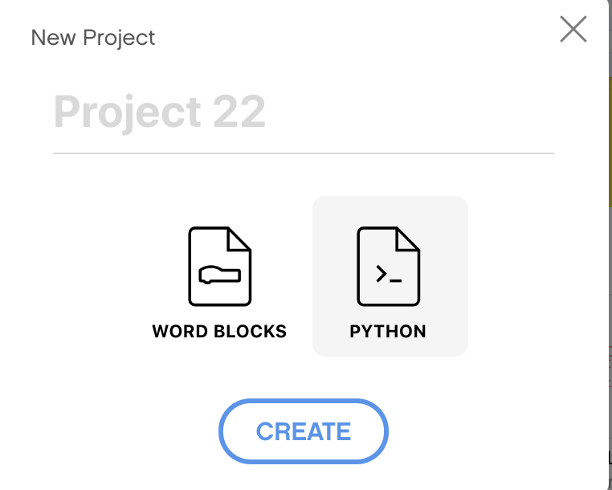
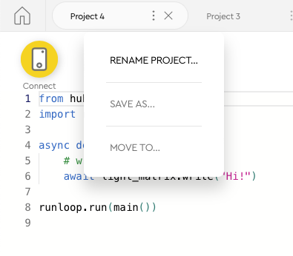
CREATING A PYTHON PROJECT
Select Python from the pop-up
Click on the three dots to change the file name

Slide 3
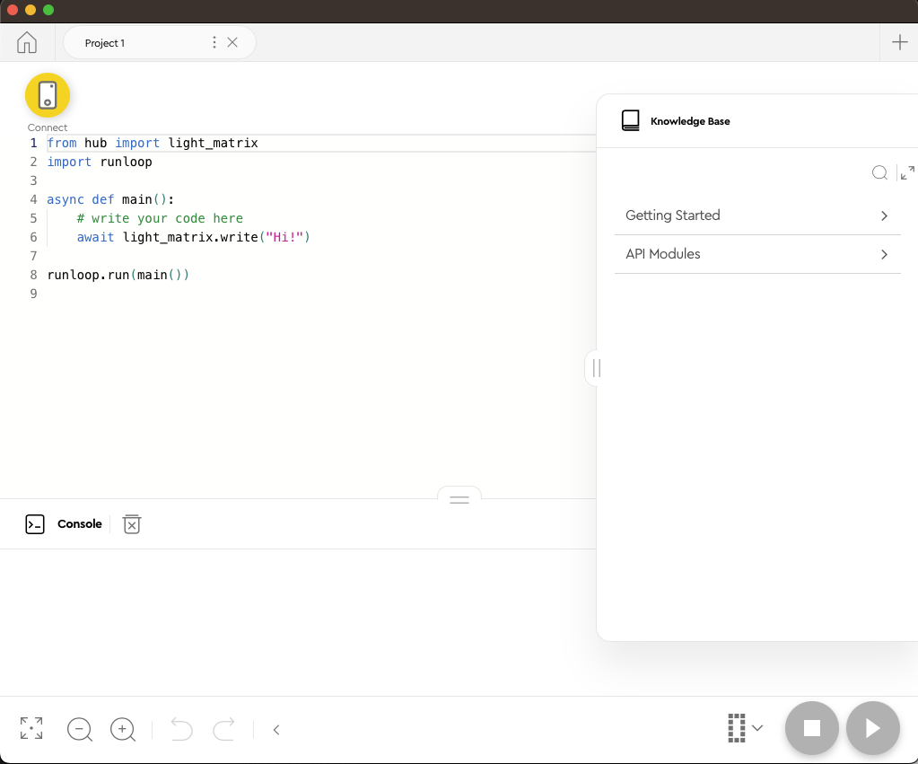
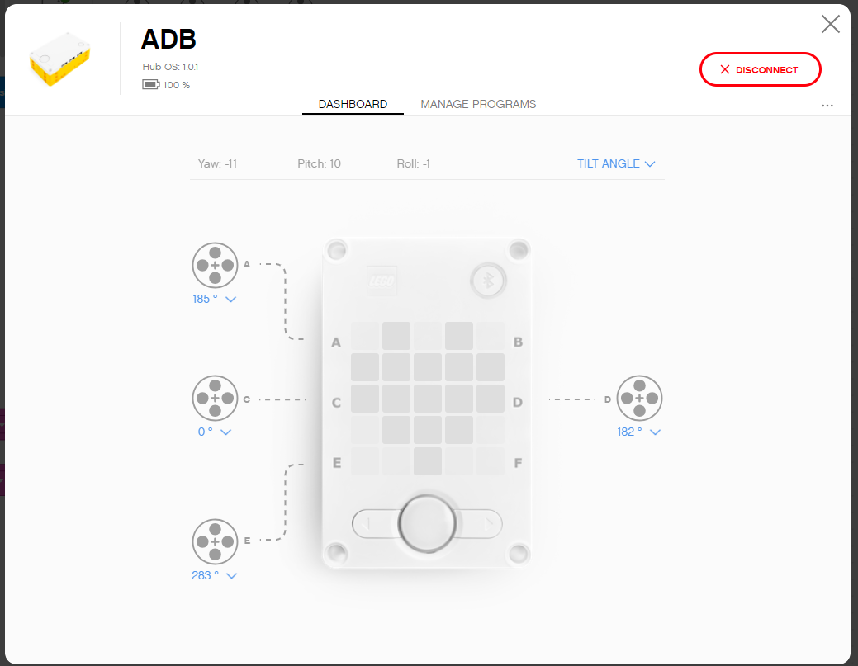
PROGRAMMING CANVAS
Knowledge Base: MicroPython Tips
Programming Canvas: The main programming canvas is where you will create each program (called ‘Project’)
The Connect Icon lets you access the Hub Dashboard
Stop/Play Icon lets you pick which slot to download the code to and run your code
Console: Anything you print as well as errors will show up here
Hub Dashboard
Programming Canvas
Console
Knowledge Base
Stop and Play

Slide 4

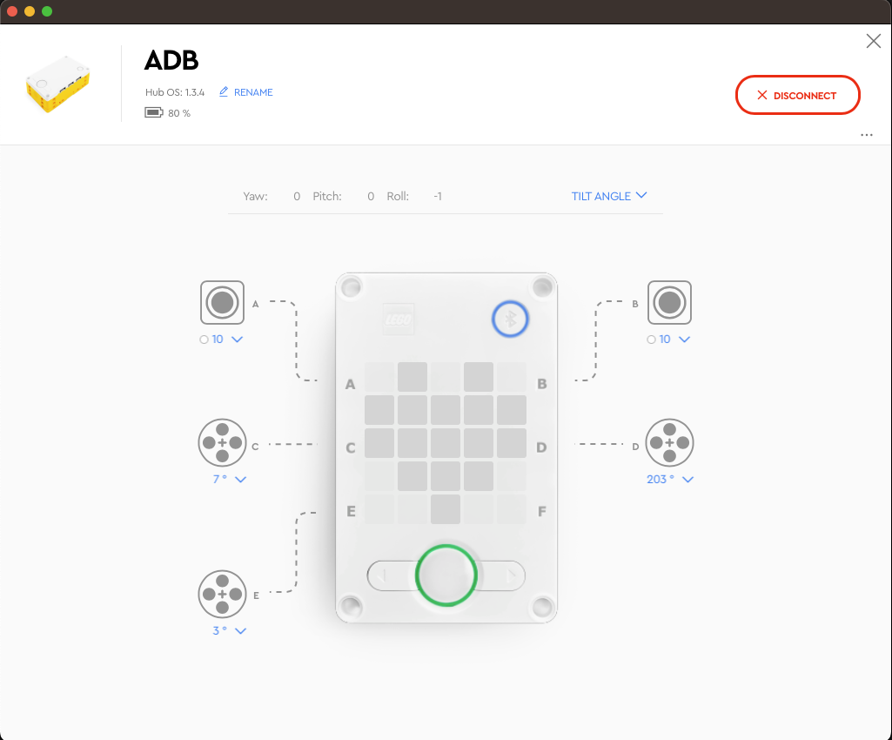
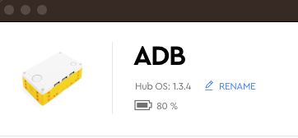
HUB DASHBOARD
You must connect your Hub to access this section
This section is very useful for:
Checking battery level
Hub OS version
Gyro Sensor Values
See which motors and sensors are connected
Get real time values from the motors and sensors
You can also rename your Hub in this panel by clicking on the blue RENAME link next to the Hub OS version number

Slide 5
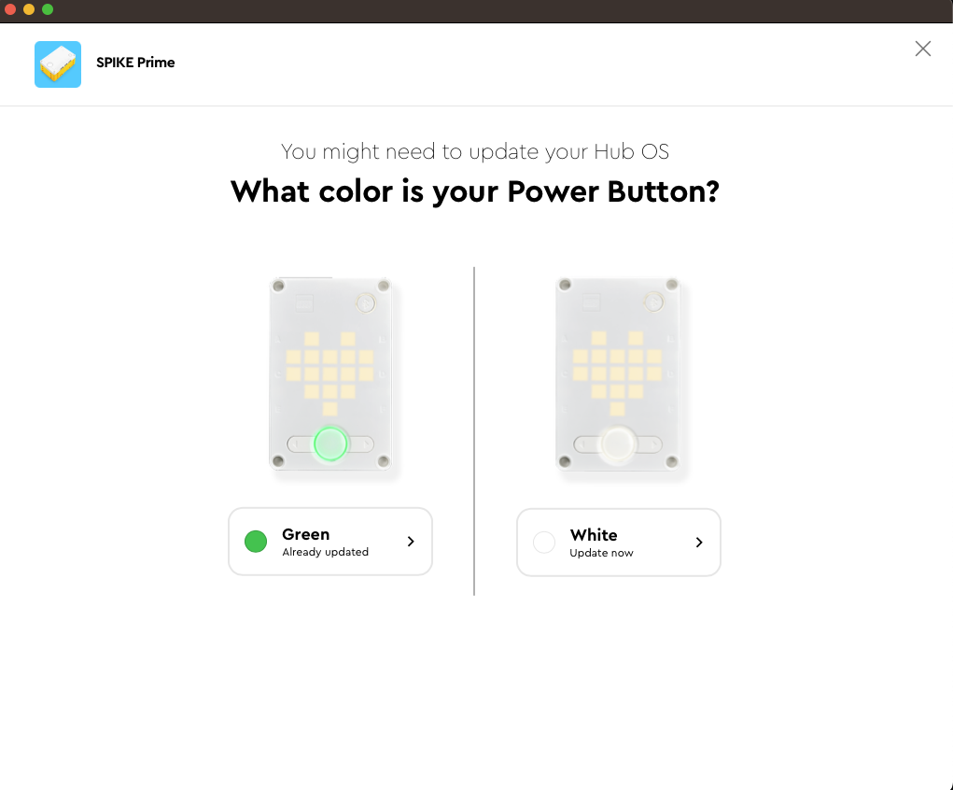
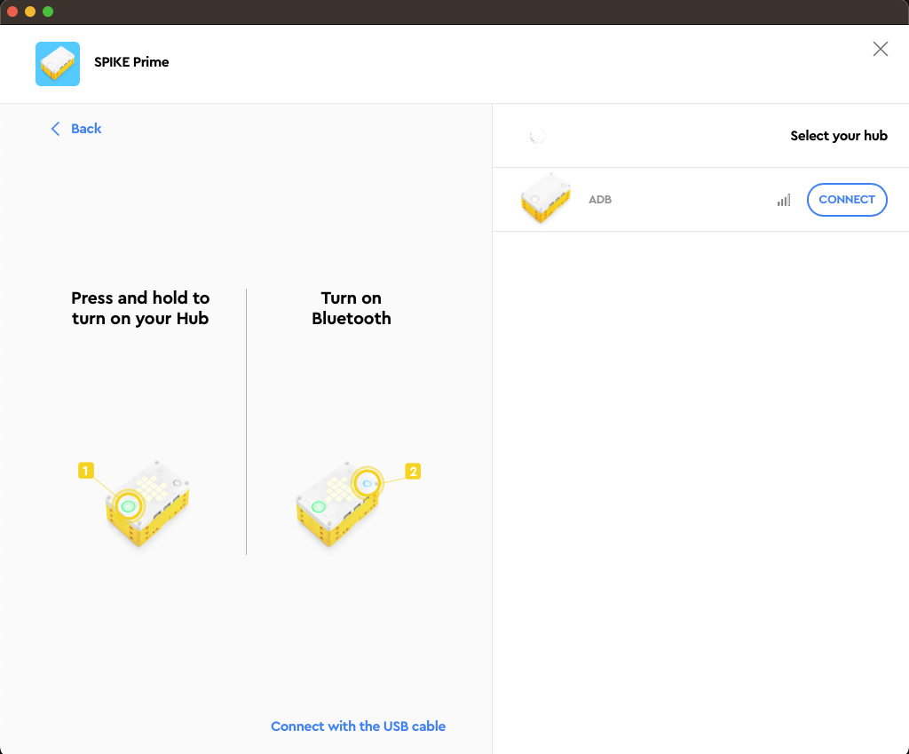
CONNECTING TO BRICK
The software will auto-connect to the brick if you are using USB.
To connect over Bluetooth, click the connect icon in the software.
You’ll get a panel asking what color your power button is. Choose the green power button. If your power button is not green, choose White if you want to update to Spike 3, or exit the app.
Enable Bluetooth by pressing the Bluetooth button on the brick.
Your hub will show on the right side. Click the connect button.

Slide 6
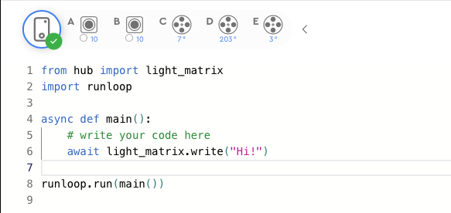
DEFAULT PYTHON CODE
All Python programs will begin with the following code by default
You will typically keep lines 2, 4 and 8: The runloop import, the main function, and the call to main.
You can add more imports to allow you to use the ports/sensors/motors/etc. in your programs

Slide 7
SPIKE 3 - ASYNC AND AWAIT
Spike 3 has introduced functionality to run coroutines using async/await. The Knowledge Base has good information on it.
These are very useful to run multiple functions concurrently without waiting for any to finish, if so desired
To wait for an async function to finish, simply call it with an await:
await myAsyncFunction()
doSomethingAfterWaiting()# will run when above function completes
To run a built-in async function without waiting, simply call it without waiting:
motor.run_for_degrees(port.A, 360, 200)
To run custom async function(s) without waiting, call it using the runloop:
# create two async function calls to send to the runloop
a = myAsyncFunction(<parameters>)
b = mySecondAsyncFunction(<parameters>)
# run both the functions together
runloop.run(*[a,b])
More examples are available in the Functions Lesson

Slide 8
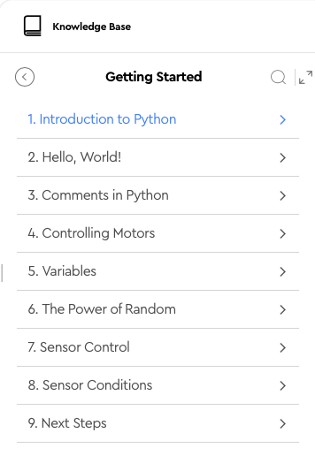
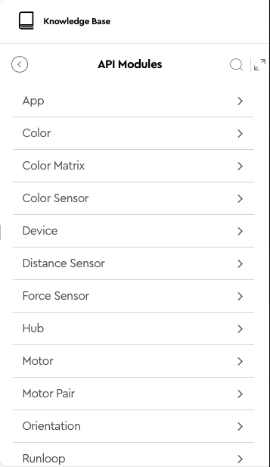
SPIKE 3 PYTHON RESOURCES
The Knowledge base has two sections you should explore:
Getting Started – great if you are new to Python API Modules – details on Spike 3 API

Slide 9
OTHER PYTHON RESOURCES
Note: No endorsement is implied.
W3Schools is a good, free resource for getting started with Python coding online. It has its own Python editor so you do not need to install Python on your machine. Here are some useful sections to get started if you are new to Python:
Python Intro
Python Syntax
Python Comments
Python Variables
Python Numbers
Python Booleans
Python If...Else
Python While Loops
Python For Loops
Python Functions
Python Scope
Python Math

Slide 10
CREDITS
This lesson was created by Sanjay and Arvind Seshan for Prime Lessons
Additional contributions by FLL Share & Learn community members.
More lessons are available at www.primelessons.org
This work is licensed under a Creative Commons Attribution-NonCommercial-ShareAlike 4.0 International License.

