Slide 1
Moving straight
Sanjay and Arvind Seshan
This lesson uses SPIKE 3 software

Slide 2
Lesson Objectives
Learn how to make your robot go forward and backwards
Learn how to use the Move blocks
Note: Although images in this lessons may show a SPIKE Prime, the code blocks are the same for Robot Inventor

Slide 3
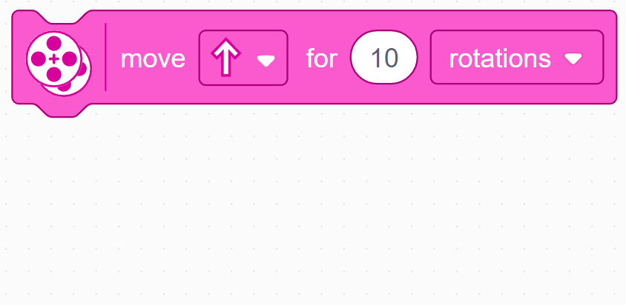

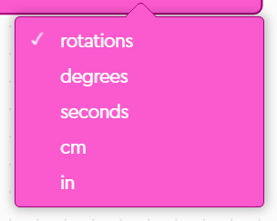
Move for Duration
Duration/Distance
Set in Configuration
To use this block you will set the speed, stop mode, motor ports, wheel size (see Configuring Robot Movement Lesson)
Direction
Mode of operation
Simplest move block – just gives control over direction and distance
Other move blocks give control over speed and steering

Slide 4
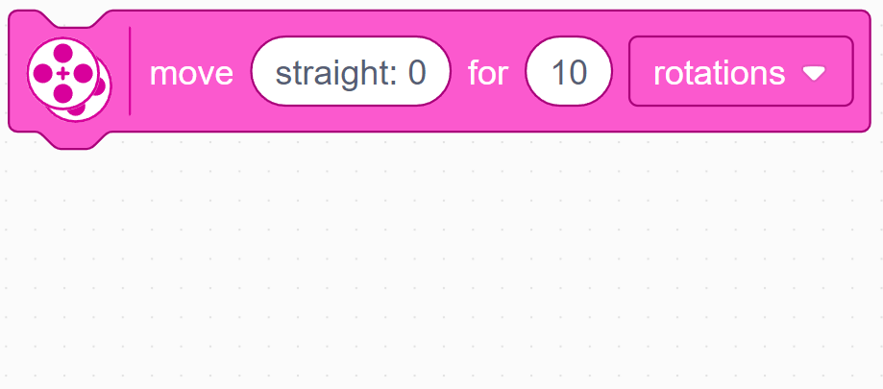
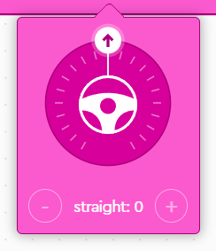
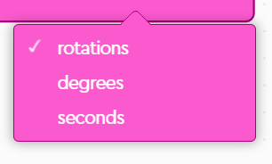
Move with Steering for Duration
Duration/Distance
Set in Configuration
To use this block you will set the speed, stop mode, motor ports, wheel size (see Configuring Robot Movement Lesson)
Mode of operation
Steering
This block allows you to control the move distance and turning of the robot.
This block gives control over steering by giving different amounts of power to the left and right wheels. “straight: 0” steering give equal power to both wheels, which makes the robot move straight. right:100 and left:-100 give full power to both wheels but turn them in opposite directions, which makes the robot spin right or spin left.
Note that the non-linear steering in SPIKE 2 has now been fixed in SPIKE 3. See this video for more details.

Slide 5
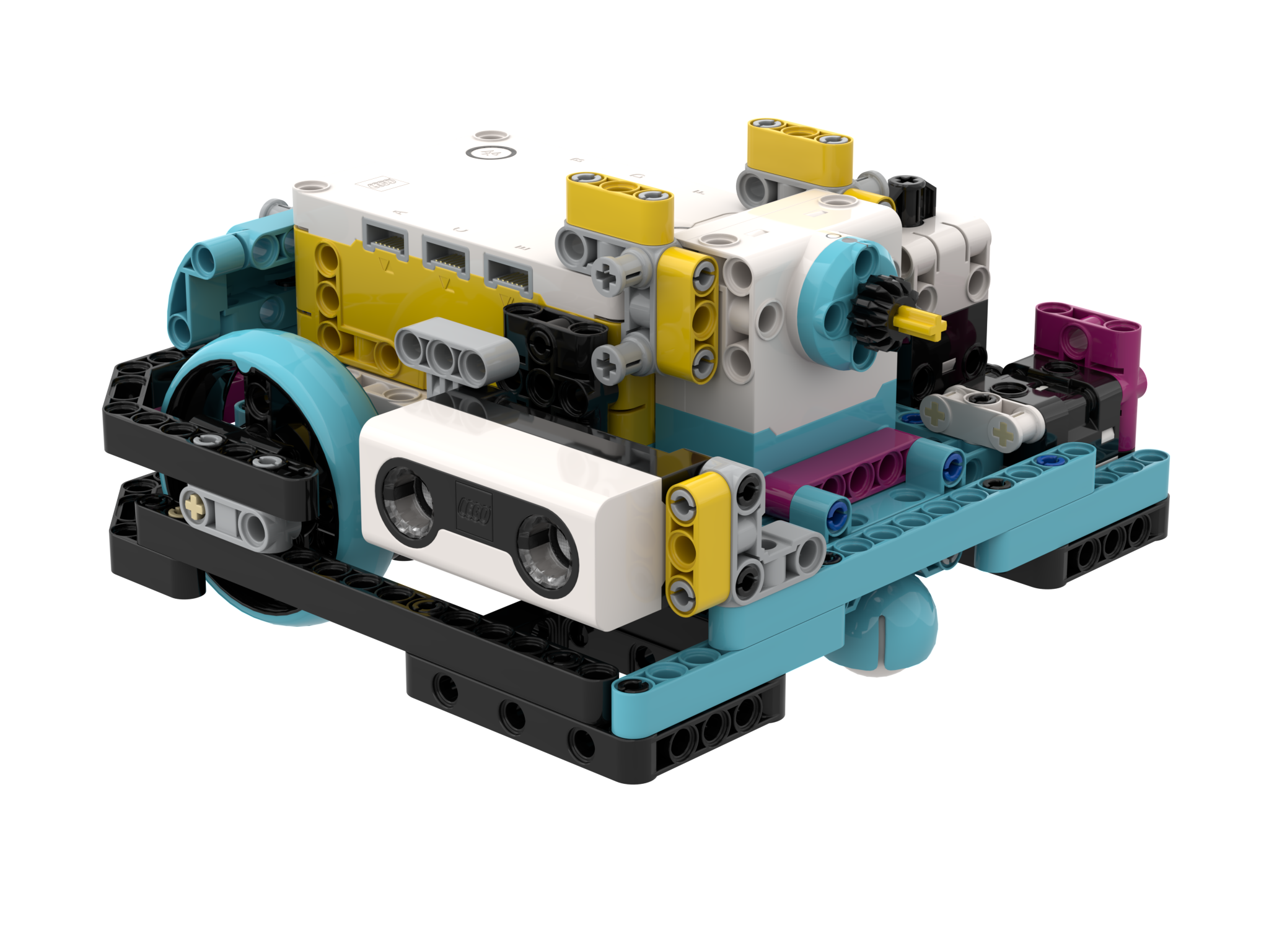
NEGATIVE Values
You can enter negative values for power or distance
This will make the robot move backwards
If you negate two values (e.g. power and distance, or distance and backwards direction), the robot will move forward.
Negative Power = Backwards
Negative Power = Backwards
A
Positive Power = Forward
E
Positive Power = Forward

Slide 6
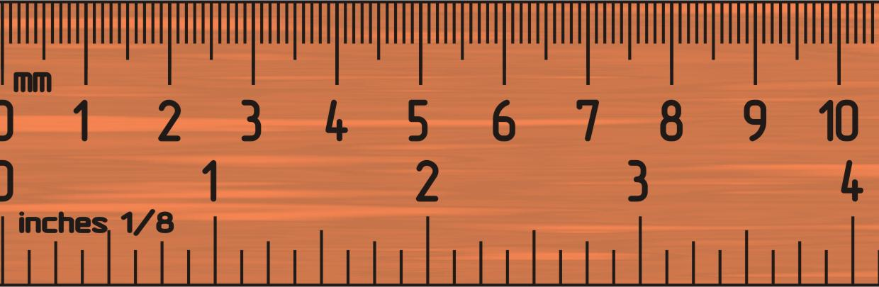
Challenge 1: Move 10 CM
Move the robot 10 centimeters forward
Basic steps:
Configure your robot
Use a Movement Block (Move Tank or Move For Duration block) and move forward for 10cm

Slide 7
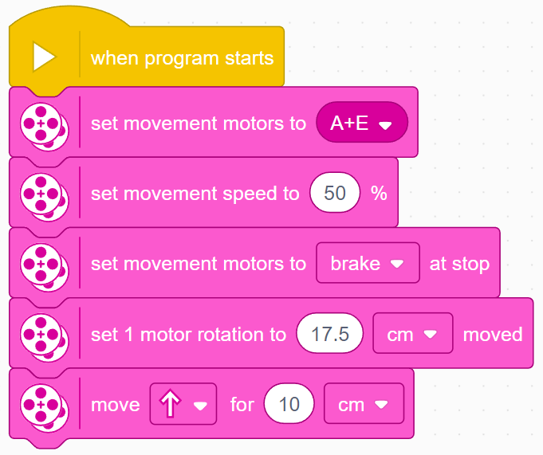
Challenge 1 Solution
Configure your robot
If you are using the smaller SPIKE Prime wheels on Droid Bot IV, set the one rotation to 17.5cm (image on the right)
If you are using the larger SPIKE Prime wheels on ADB, remember to set one rotation to 27.6cm
Move forward for 10 cm. The same cm mode is available in other move blocks.

Slide 8
Challenge II: Move Forward and Back
Move your robot forward from the start line to the finish line (1) and back to the start (2)
Basic steps:
Configure your robot
Use a Movement Block and move forward for the desired amount (40cm)
Use the same Movement Block to move backwards (40cm)
FINISH
1
40CM
2
START

Slide 9
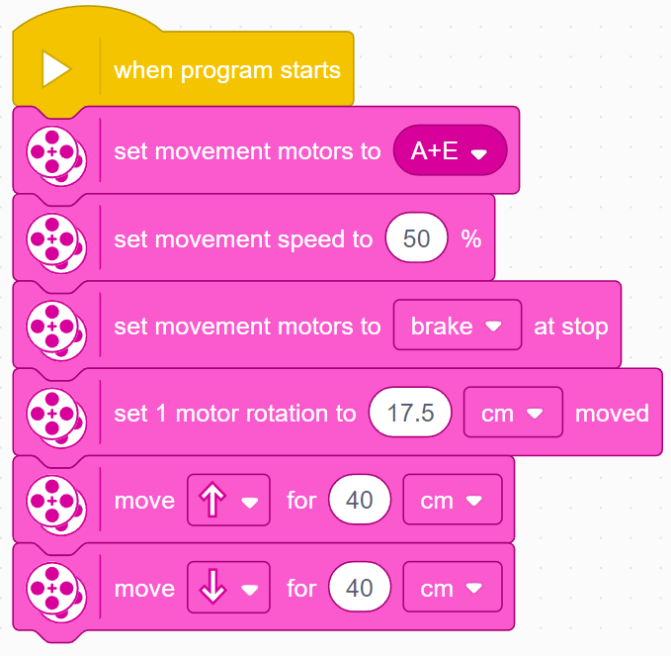
Challenge II solution
Configure your robot
If you are using the smaller SPIKE Prime wheels on Droid Bot IV, set the one rotation to 17.5cm (image on the right)
If you are using the larger SPIKE Prime wheels on ADB, you will set one rotation to 27.6cm
Robot moves forward 40cm and backwards 40cm

Slide 10




Start Moving and Stop Moving Blocks
There are 4 more move blocks in the Movement palette.
The Start moving blocks will turn on your drive motors at the given speed (and steering if given).
These blocks have no duration/distance. After turning the motor on, the program instantly moves to the next block
The motor will continue running until stopped or controlled by another block
Stop moving will halt your drive motors no matter what action they are running.

Slide 11
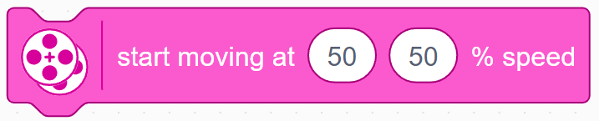
Start Moving at Speed (“Move Tank”)
Set in Configuration
To use this block you will set the motor ports (see Configuring Robot Movement Lesson)
Left and Right
Wheel Speeds
In this block you control the two motor speeds independently. This is often called tank controls.
This Block must be added to your Block Palette using Extensions. It is in the More Movement Palette.
In our lessons, we will use either tank controls (slide 6) or forward/backward (slide 3) since the power given to each wheel is more explicit.

Slide 12

Wait blocks and Challenge iii
Since Start and Stop Moving blocks execute instantly, they need to be used with other blocks to be made useful. One common way they are used is with Wait Blocks. Wait Blocks hold up the program execution until some event occurs. The lessons on sensors cover Wait Blocks in more detail.
For now, we will use the Wait for Seconds block
This block takes the entered number of seconds to run
Challenge III:
Use Start Moving, Stop Moving and Wait blocks to make the robot move forward for 3 seconds

Slide 13
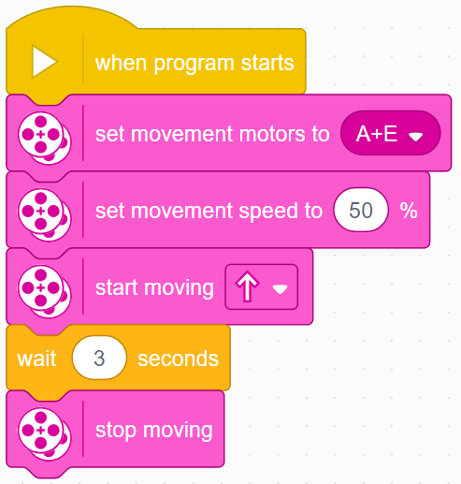
Challenge III: moving For 3 Seconds
Can you Move 3 Seconds using just the Start Moving and Wait blocks?
The Start Moving block starts the robot moving
After turning on the motors, the program begins running the Wait block. This takes 3 seconds to run.
The Stop Moving block makes the robot stop

Slide 14
CREDITS
This lesson was created by Sanjay Seshan and Arvind Seshan for SPIKE Prime Lessons
More lessons are available at www.primelessons.org
This work is licensed under a Creative Commons Attribution-NonCommercial-ShareAlike 4.0 International License.

