Slide 1
Configuring robot Movement
BY SANJAY AND ARVIND SESHAN
This lesson uses SPIKE 3 software

Slide 2
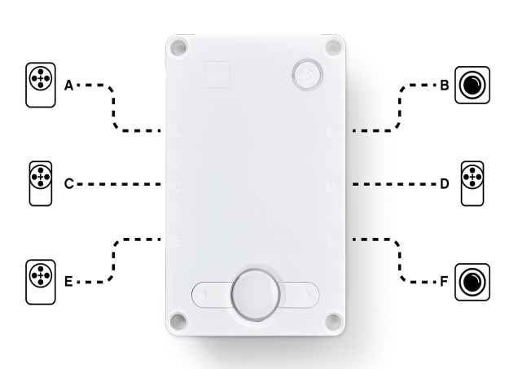
Lesson objectives
Learn to configure robot movement on a SPIKE Prime or Robot Inventor robot
Note: Although images in this lesson show a SPIKE Prime, the code blocks are the same for Robot Inventor
Learn how to add you first programming blocks to the programming canvas

Slide 3
Why configure your code?
Every robot is different
Before you can program to move or turn, you need to first set how you have configured your robot:
What ports are the drive motors connected to?
What type of wheels are you using?
What fast do you want to move?
Do you want to stop immediately at the end of a move?
This information needs to be in every program you write

Slide 4
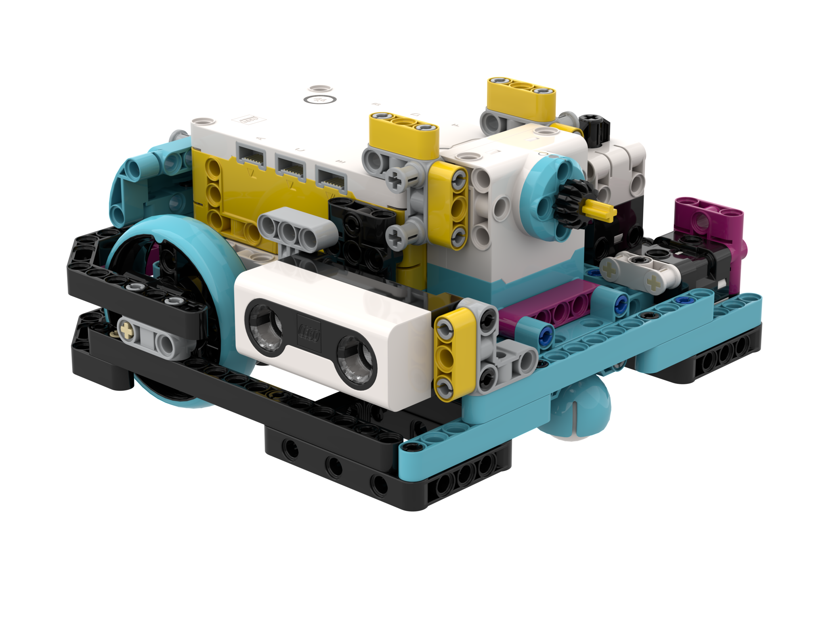
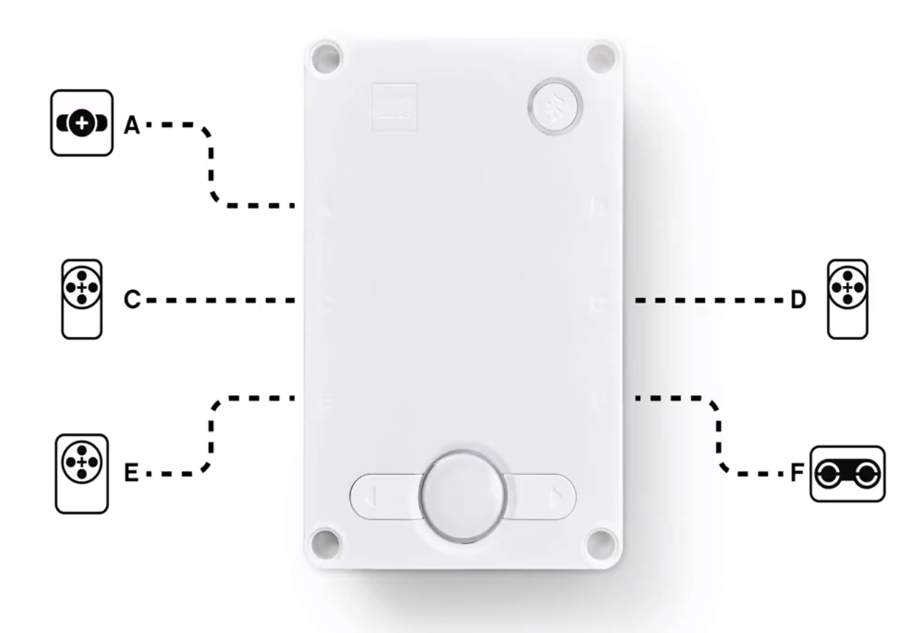
What is connected to each port?
Droid Bot IV
ADB
Droid Bot IV Configuration
ADB Default settings
Drive Motor
Drive Motor
Drive Motor
Drive Motor

Slide 5
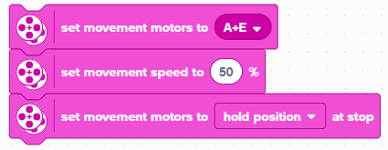
Configuring Movement Blocks
Before using movement blocks, you must configure the robot first.
There are three blocks for this purpose:
Left
A
Right
E
Determines which motors are connected to the left & right wheels (change the settings for your robot). Whenever blocks have 2 inputs for wheels – the first one is for the left wheel and second is for right.
Sets the “default” speed for move blocks you may use later in the program
Determines what the robot does at the end of a move block (brake, hold position, or float). To access this block you will need to add “More Movement Blocks” from block extensions

Slide 6
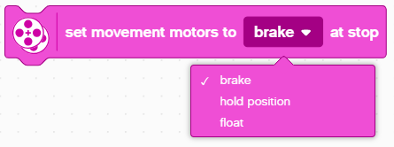
Stop Modes: brake vs. Hold vs. float
Break – after move, bring motors to a hard stop
Hold position – after move, bring motor to a hard stop and use motor power to counter any further movement until the motor is used again. You will not be able to move the motor by hand.
Float – after move, allow motors to move due to momentum
In general, we will use hold or brake in most of our programs.

Slide 7
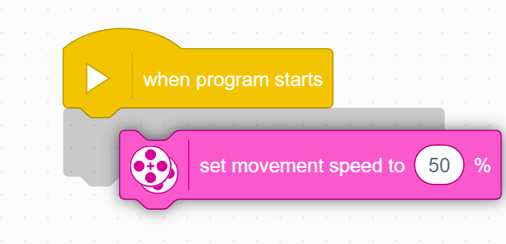
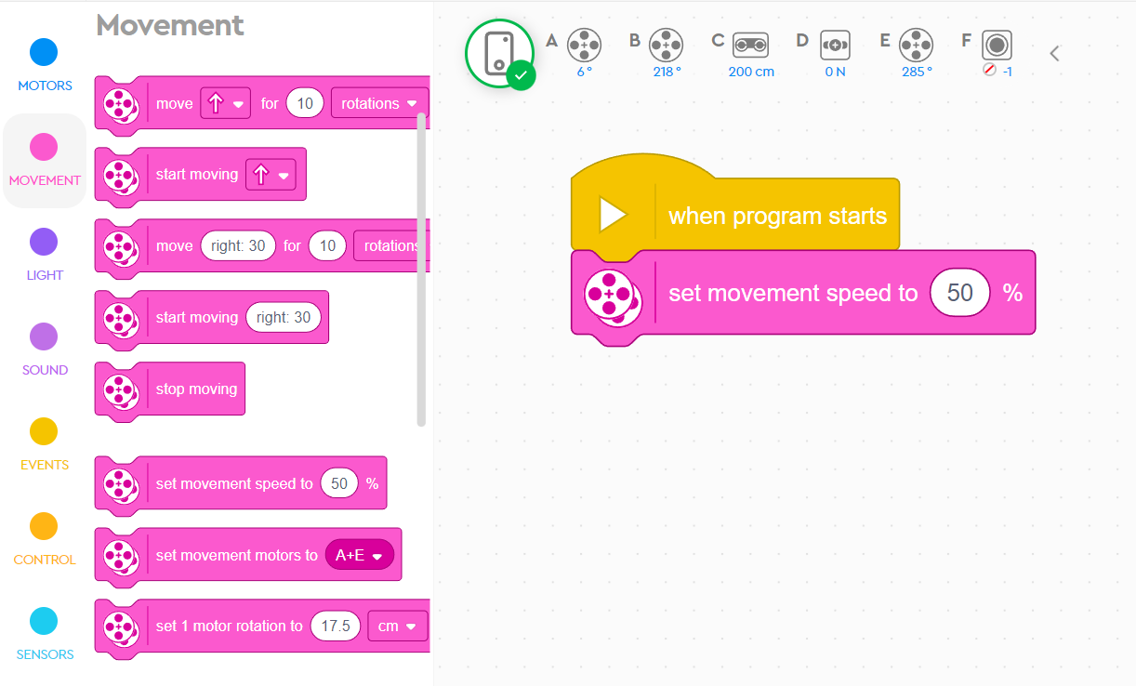
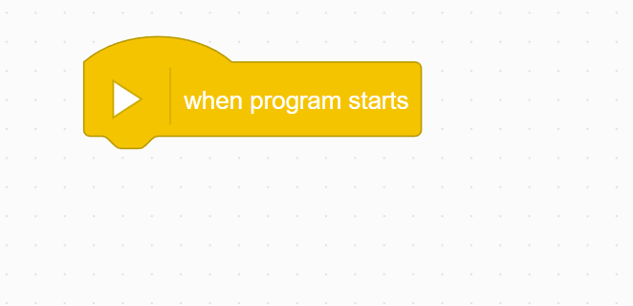
How To Add a programming block
STEP 1: Click and hold Set Speed block and drag to programming area
STEP 2: Drop next to the Start Block (green arrow) (See animation)

Slide 8
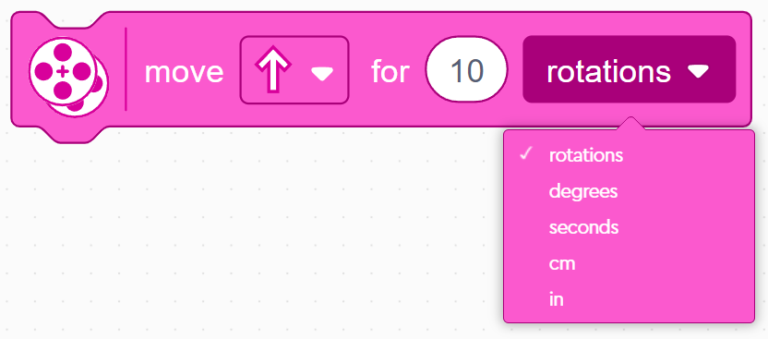
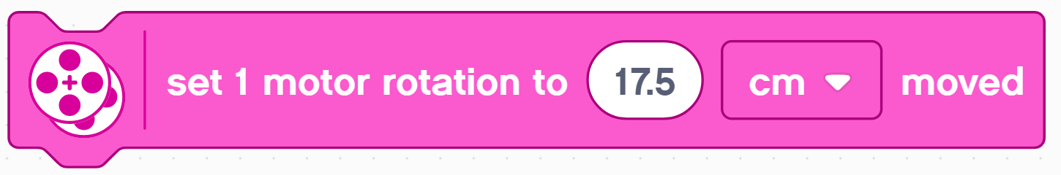

Wheel Size and Movement configuration
The default option for the move block is to move for a specified distance in rotations
We recommend specifying the distance in cm instead
However, prior to using this mode, you have to tell the program the number of cm per rotation moved
You will need to calculate this value as it depends on what wheel you use. The next two slides explain different ways to calculate this value.
Note that you can use inches instead of centimeters if you prefer

Slide 9
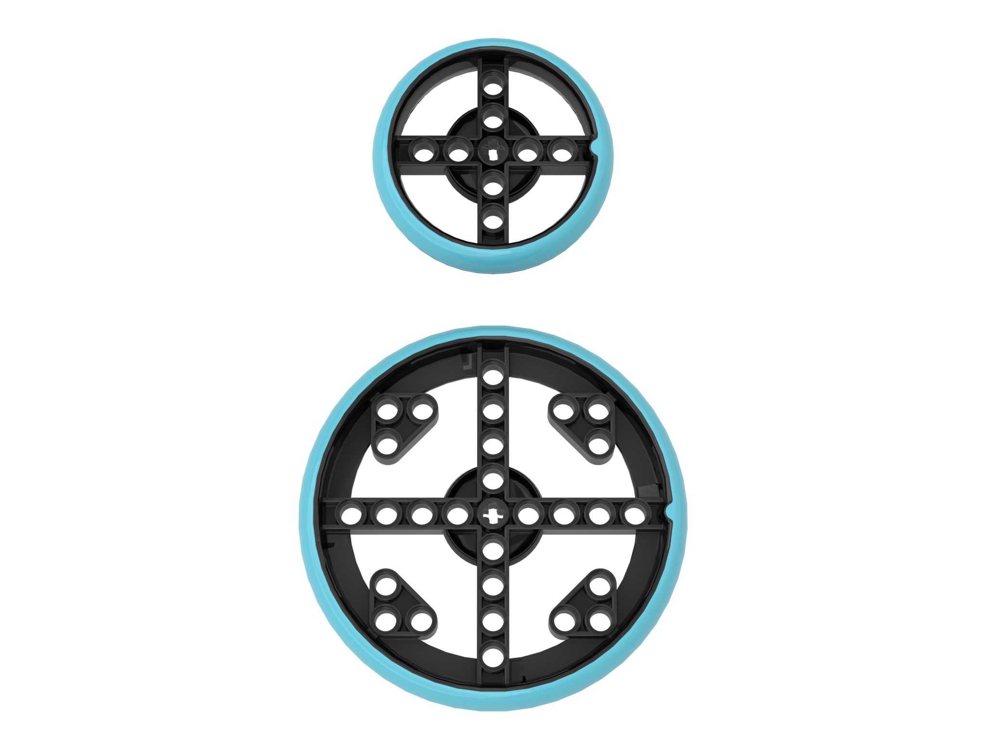
How Many CM Does The Robot Move in 1 Rotation? (Method 1)
Look up the wheel size in mm printed on your tire and divide by 10 to convert to cm (because 1cm=10mm)
Multiply the answer in step 1 by π (3.14) to compute circumference
Use the value to set the motor rotation block
Example calculation using the standard small SPIKE Prime wheels (used in Droid Bot IV):
Small SPIKE Prime Wheels = 5.6cm in diameter
5.6cm × π = 17.5cm per rotation
Example calculation using the standard large SPIKE Prime set wheels (used in ADB):
Large SPIKE Prime Wheels = 8.8 cm in diameter
8.8 cm × π = 27.6 cm per rotation
Helpful chart with common LEGO wheels and their diameters.
http://wheels.sariel.pl/

Slide 10
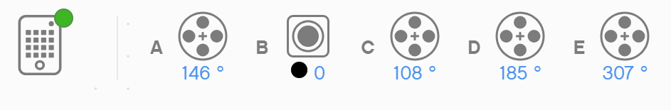
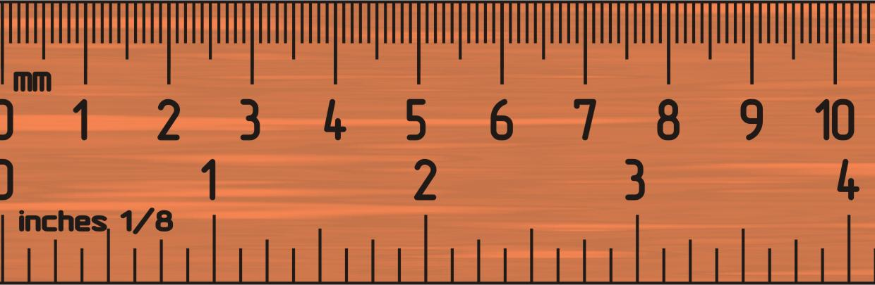
How Many CM Does The Robot Move in 1 Rotation? (Method 2)
Use the Dashboard to view sensor data to find the Motor Degrees value
Put your ruler next to your wheel/robot at 0 centimeters (whatever part of the robot you use to align with 0, you should use to use to measure distance in step 2)
Roll your robot forward until the motor encoder reading (in the SPIKE software) reaches 1 rotation, or 360 degrees. Once you learn to program movement, you can program the robot to move 1 rotation forward.
Read the number of CM the robot moved along the ruler
Use the values to configure your robot’s movement
A
E

Slide 11
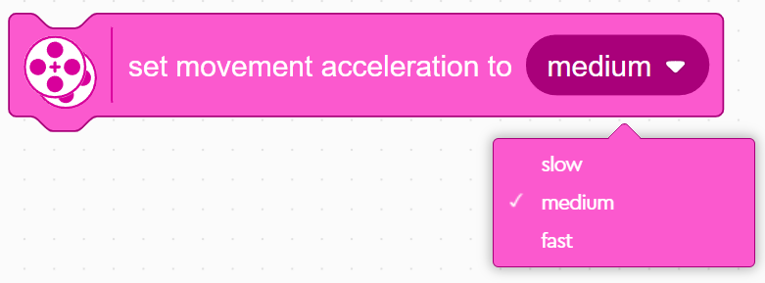
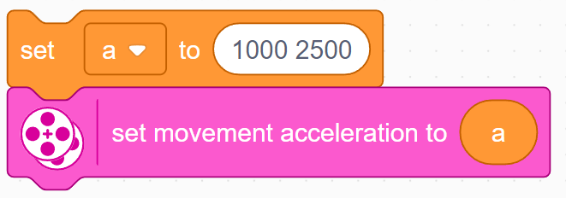
Acceleration
You can also choose to set how fast the motors accelerate and decelerate when starting/stopping
The default is medium, but you can change it to slow or fast
Additionally, variables can be used to fine tune both the acceleration and deceleration of the motor individually with values 1-10000
More on acceleration can be found in the Acceleration Lesson in the Advanced Movement Unit

Slide 12
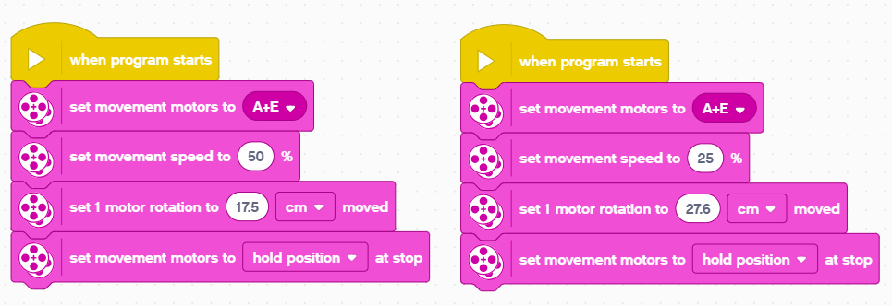
Putting it together
For Droid Bot IV, smaller wheels are used. One rotation only moves 17.5cm. The default movement speed is, therefore, also set higher.
For ADB, the larger wheels are used. One rotation moves 27.6cm. We set the default movement speed lower for additional control.
Droid Bot IV
ADB

Slide 13
CREDITS
This lesson was created by Sanjay Seshan and Arvind Seshan for Prime Lessons
More lessons are available at www.primelessons.org
This work is licensed under a Creative Commons Attribution-NonCommercial-ShareAlike 4.0 International License.

