Slide 1
INTRODUCTION TO FORCE SENSOR
BY SANJAY AND ARVIND SESHAN
This lesson uses SPIKE 3 software

Slide 2
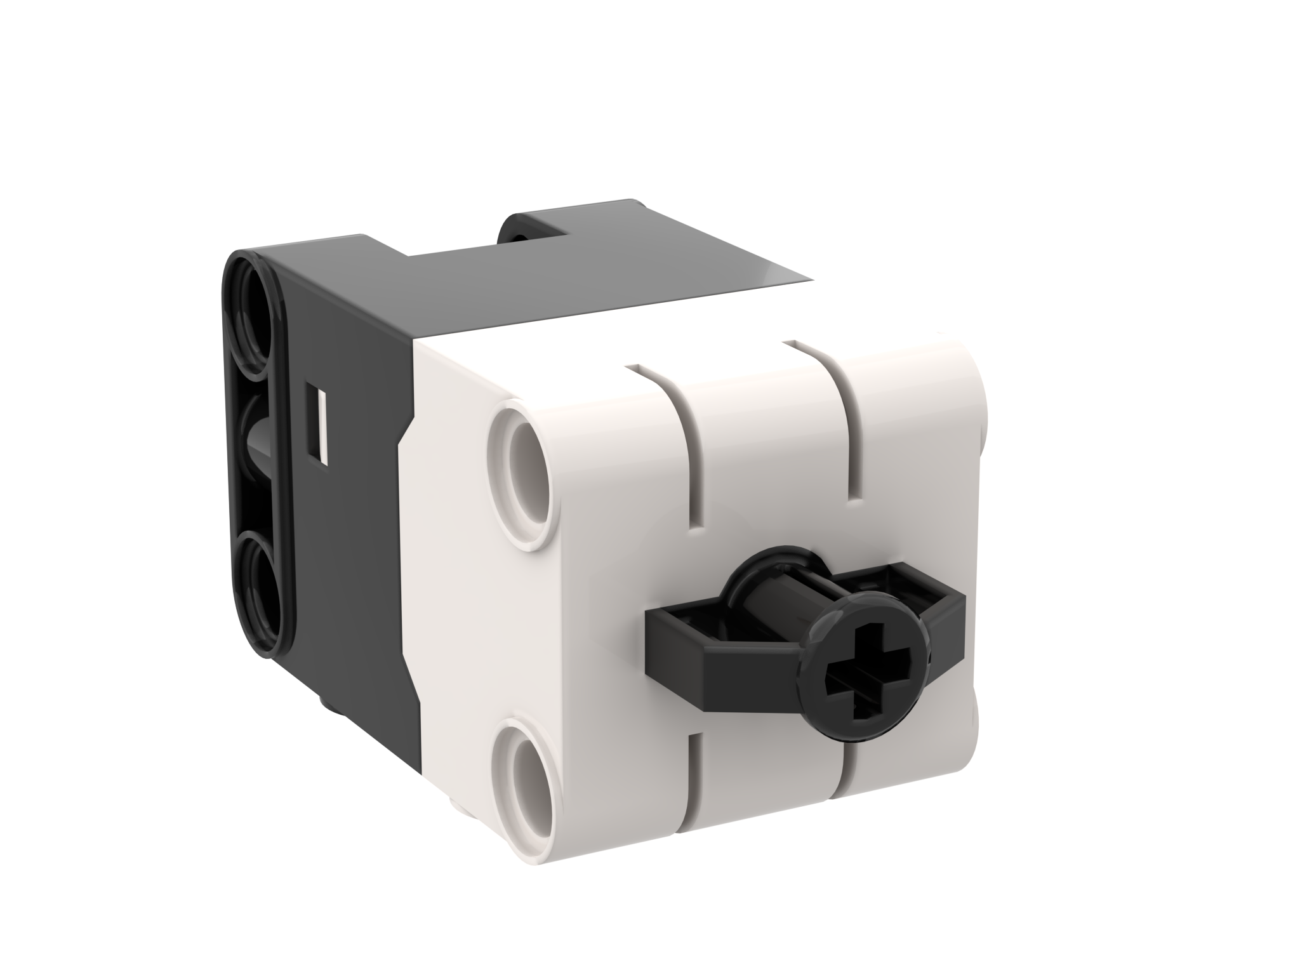
LESSON OBJECTIVES
Learn how to use the Force Sensor
Note: Force Sensor does not come with Robot Inventor. However, the python environment for Robot Inventor does support the sensor.

Slide 3
WHAT IS A FORCE SENSOR?
The Force Sensor does two main types of sensing:
Touch sensing
Force sensing
You can measure the Force in deciNewtons
The following methods are available
.force()
.pressed()
.raw()

Slide 4
HOW DO YOU PROGRAM WITH A FORCE SENSOR
Import the force sensor module
import force_sensor
Query the force
force_sensor.force(port.F)
Query the pressed state (true or false)
force_sensor.pressed(port.F)
Port
Waiting until pressed/released:
await runloop.until(<function that checks pressed/not pressed>)
or using while loops...
while (not force_sensor.pressed()): pass
while (force_sensor.pressed()): pass

Slide 5
CHALLENGE 1: MOVE UNTIL PRESSED
Program your robot to move straight until you press the sensor with your hand
Basic steps:
Write a “force_sensor_pressed” function that returns true if the sensor is pressed
Start moving straight
Await the force_sensor_pressed function
Stop moving

Slide 6
CHALLENGE 1: SOLUTION
from hub import port
import runloop, force_sensor, motor_pair, sys
# Function that returns true if the force sensor is pressed
def force_sensor_pressed():
return force_sensor.pressed(port.F)
async def main():
# Set up the pair and start moving
motor_pair.pair(motor_pair.PAIR_1, port.C, port.D)
motor_pair.move(motor_pair.PAIR_1, 0)
# wait until pressed
await runloop.until(force_sensor_pressed)
# stop and exit
motor_pair.stop(motor_pair.PAIR_1)
sys.exit("Done")
runloop.run(main())

Slide 7
CREDITS
This lesson was created by Sanjay and Arvind Seshan for Prime Lessons
Additional contributions by FLL Share & Learn community members
More lessons are available at www.primelessons.org
This work is licensed under a Creative Commons Attribution-NonCommercial-ShareAlike 4.0 International License.

