Slide 1
INTRODUCTION TO COLOR SENSOR
BY SANJAY AND ARVIND SESHAN
This lesson uses SPIKE 3 software

Slide 2
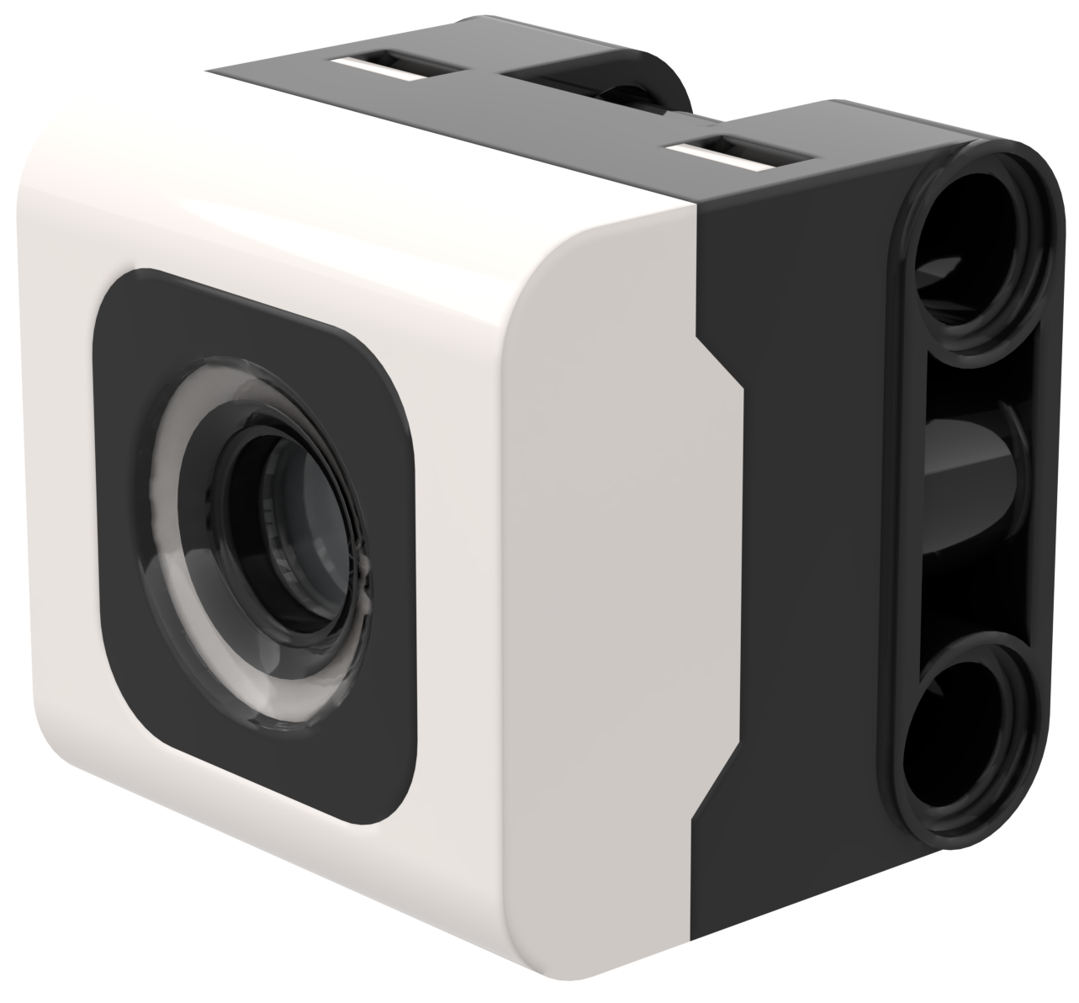
LESSON OBJECTIVES
Learn how to use the Color Sensor

Slide 3
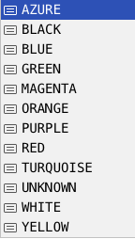
WHAT IS A COLOR SENSOR?
The sensor API can report either the color or reflectivity measured
Unlike the EV3, reflectivity is measured while shining a white light, not a red light.
Optimal reading distance according to the specs: 16 mm (depending on object size, color, and surface)
The sensor can report the colors (shown on right). No color or unrecognized color is the UNKNOWN value.
The sensor can report reflection. It is percentage from 0 (no reflection) to 100% (total reflection)
The sensor can report raw red, green,blue, intensity (rgbi) values as a tuple
Note: In testing v3.4
Orange color could not be recognized.
The r,g,b,i value ranges are unclear and not documented in the Knowledge Base.

Slide 4
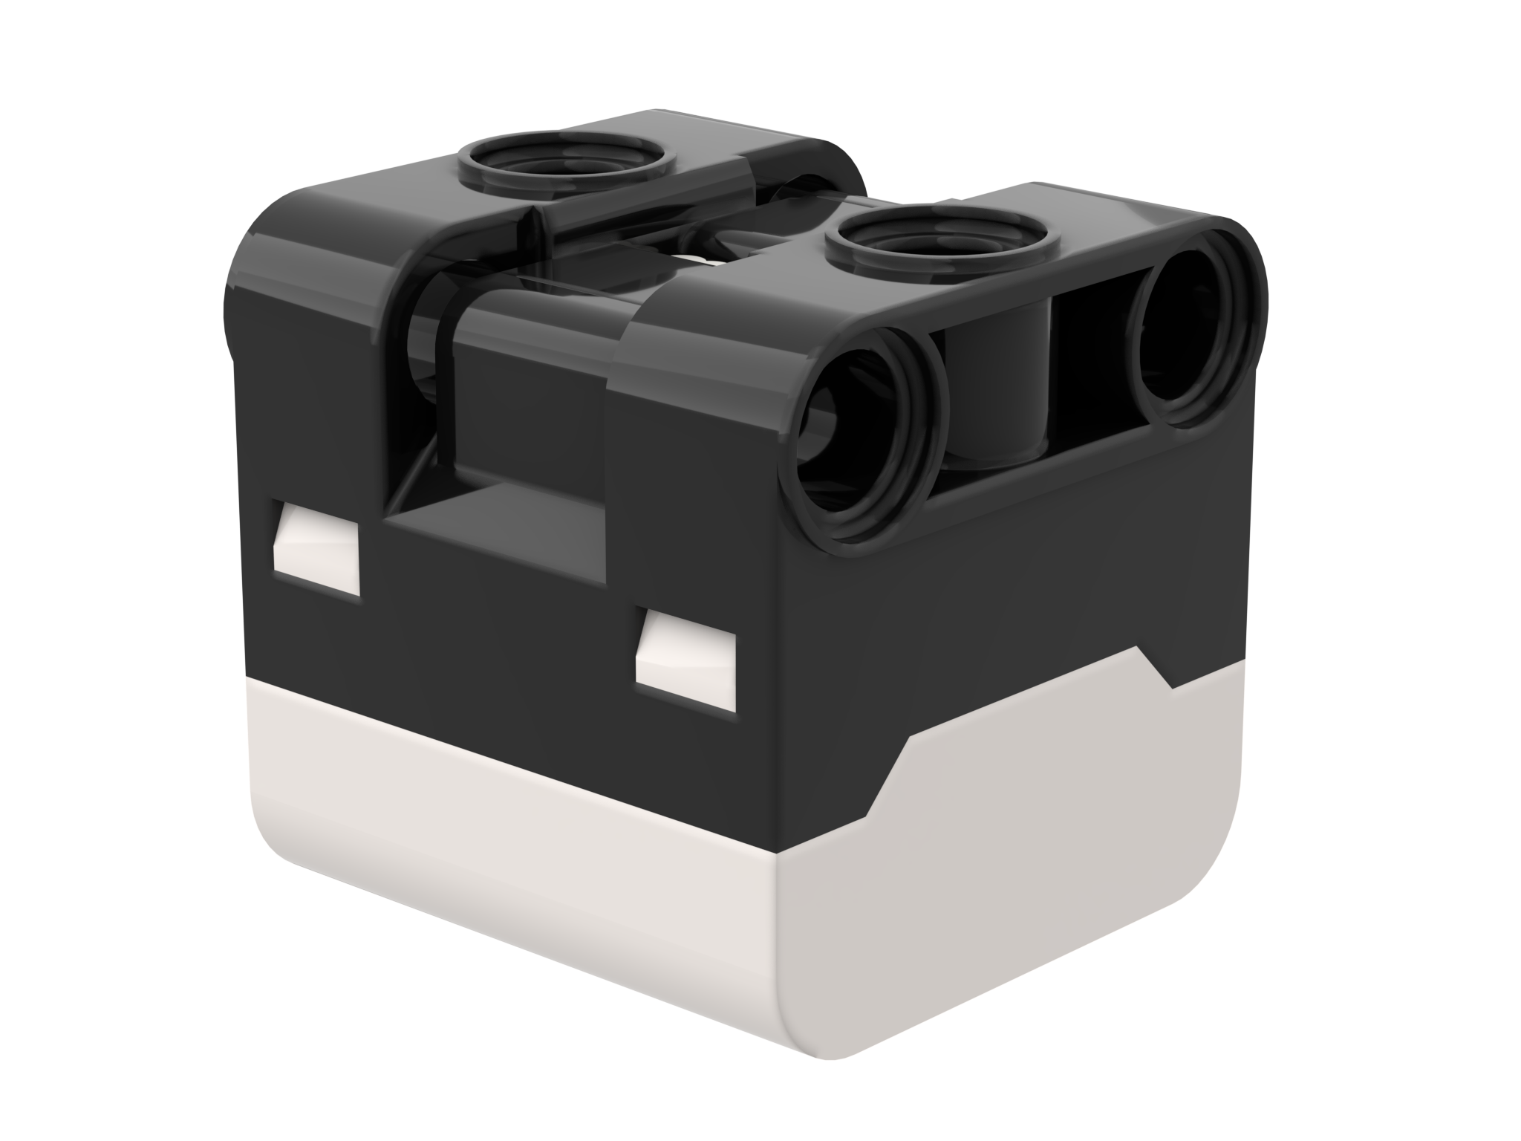
NOTE: ADB AND SENSING COLOR
The color sensor on ADB is mounted at about 8mm off the ground, but the optimal distance for mounting the sensor according to the specs is 16mm.
When using this robot design, Black does not read correctly in Color Mode using electrical tape lines or a FIRST LEGO League challenge mat.
See the next slide for modifications. The build instructions are also provided as a separate file on our site.
16mm
2M (2 LEGO Modules)

Slide 5
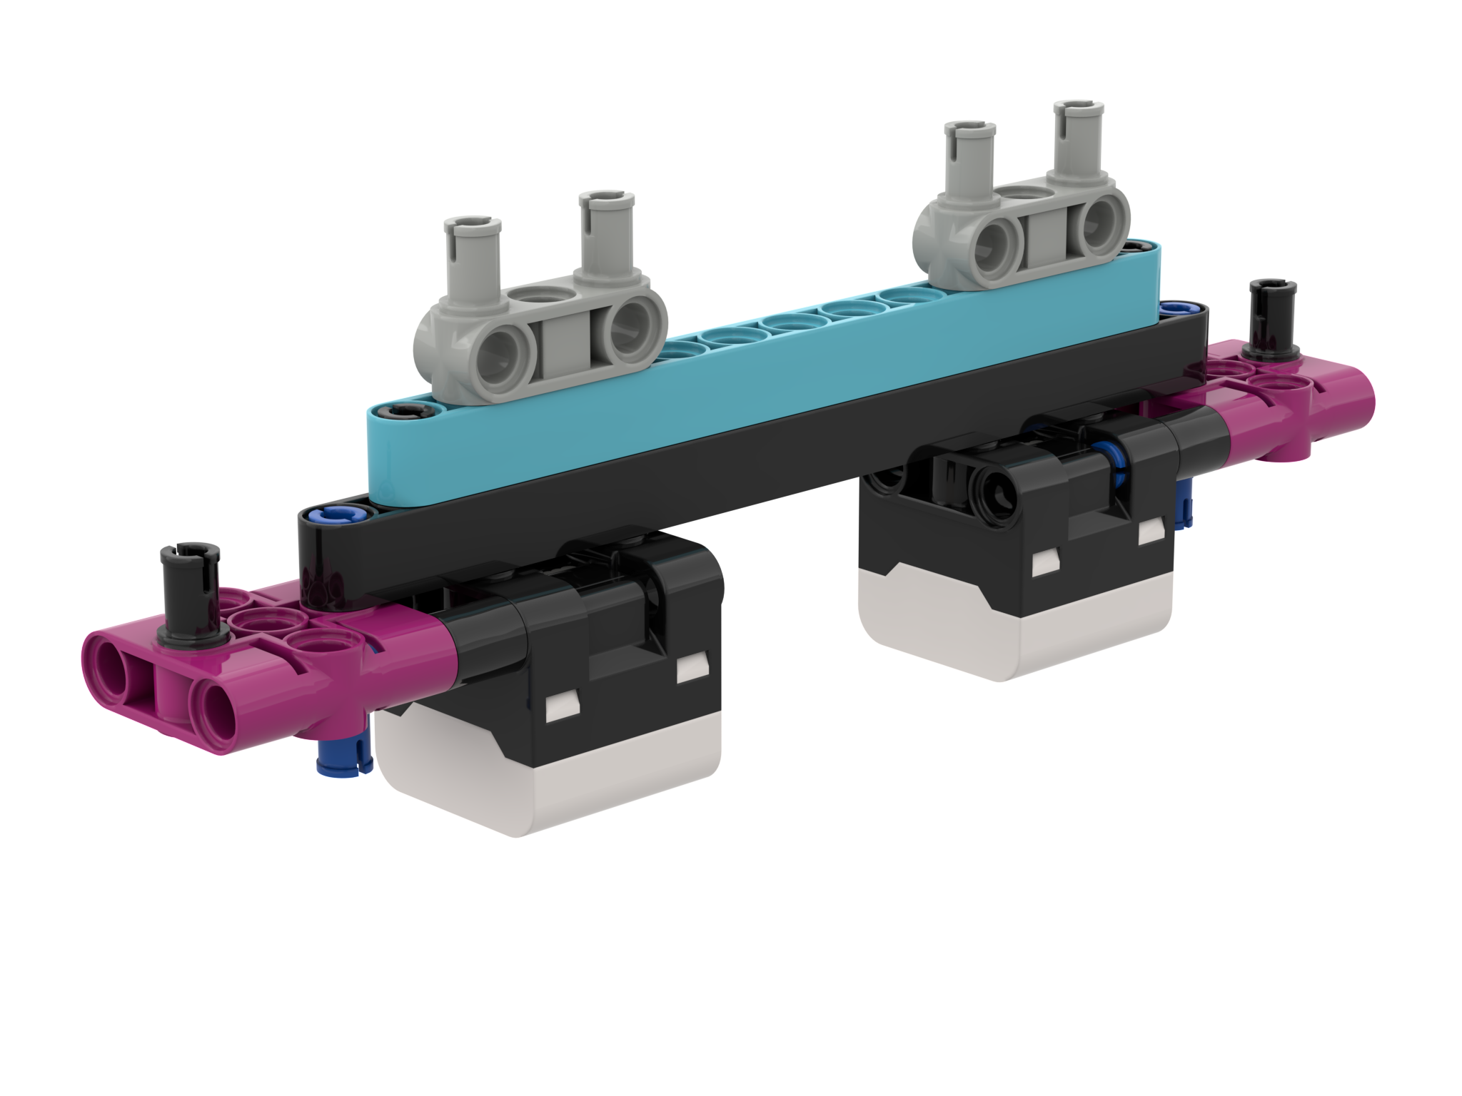
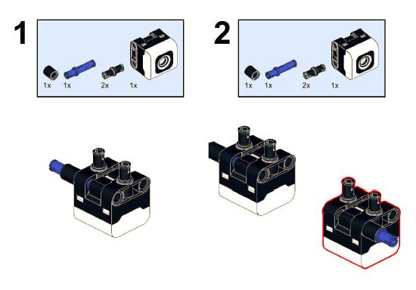
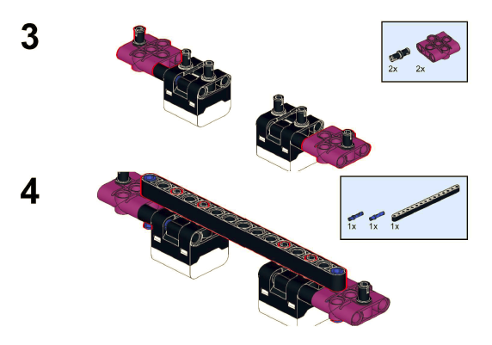
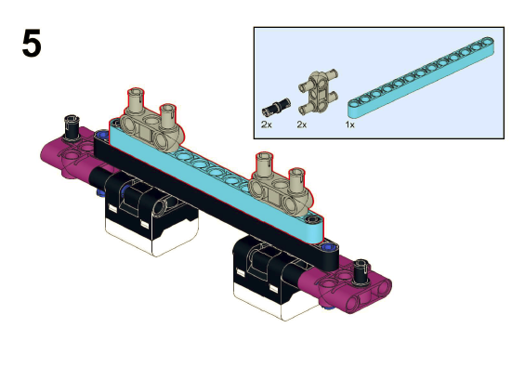
MODIFICATIONS TO ADB
Build instructions for modifying the front bumper of ADB so that the color sensors are raised one LEGO module up are included on this website

Slide 6
HOW DO YOU PROGRAM WITH A COLOR SENSOR?
The two modes you can program the color sensor in: Color Mode and Reflected light mode
Reading a color:
color_sensor.color(port.A)
Reading an intensity:
color_sensor.reflection(port.A)
Port

Slide 7
CHALLENGE 1
Program your robot to move straight until the color sensor sees black
Basic steps:
Write a color_found function that returns true if it sees black
Set the movement motors for your robot
Start moving straight
Await the color_found function
Stop moving
The solution on the next page uses Drive Base 1 with a color sensor on port A. Adjust your program accordingly.

Slide 8
CHALLENGE 1: SOLUTION USING COLOR
from hub import port
import runloop, motor_pair, sys, color_sensor, color
# Function that returns true if the color sensor sees black
def color_found():
return color_sensor.color(port.A) == color.BLACK
async def main():
# Set up the pair and start moving
motor_pair.pair(motor_pair.PAIR_1, port.C, port.D)
motor_pair.move(motor_pair.PAIR_1, 0)
# wait until color found
await runloop.until(color_found)
# stop and exit
motor_pair.stop(motor_pair.PAIR_1)
sys.exit("Done")
runloop.run(main())

Slide 9
CHALLENGE 1: SOLUTION USING REFLECTION
from hub import port
import runloop, motor_pair, sys, color_sensor
# Function that returns true if the intensity is less than 50. This works for a black-white
# mat. If your mat has more colors, use a lower threshold value for black.
def intensity_found():
return color_sensor.reflection(port.A) < 50
async def main():
# Set up the pair and start moving
motor_pair.pair(motor_pair.PAIR_1, port.C, port.D)
motor_pair.move(motor_pair.PAIR_1, 0)
# wait until intensity found
await runloop.until(intensity_found)
# stop and exit
motor_pair.stop(motor_pair.PAIR_1)
sys.exit("Done")
runloop.run(main())

Slide 10
CREDITS
This lesson was created by Sanjay and Arvind Seshan for Prime Lessons
Additional contributions by FLL Share & Learn community members
More lessons are available at www.primelessons.org
This work is licensed under a Creative Commons Attribution-NonCommercial-ShareAlike 4.0 International License.

