Slide 1
INTRODUCTION TO DISTANCE SENSOR
BY SANJAY AND ARVIND SESHAN
This lesson uses SPIKE 3 software

Slide 2
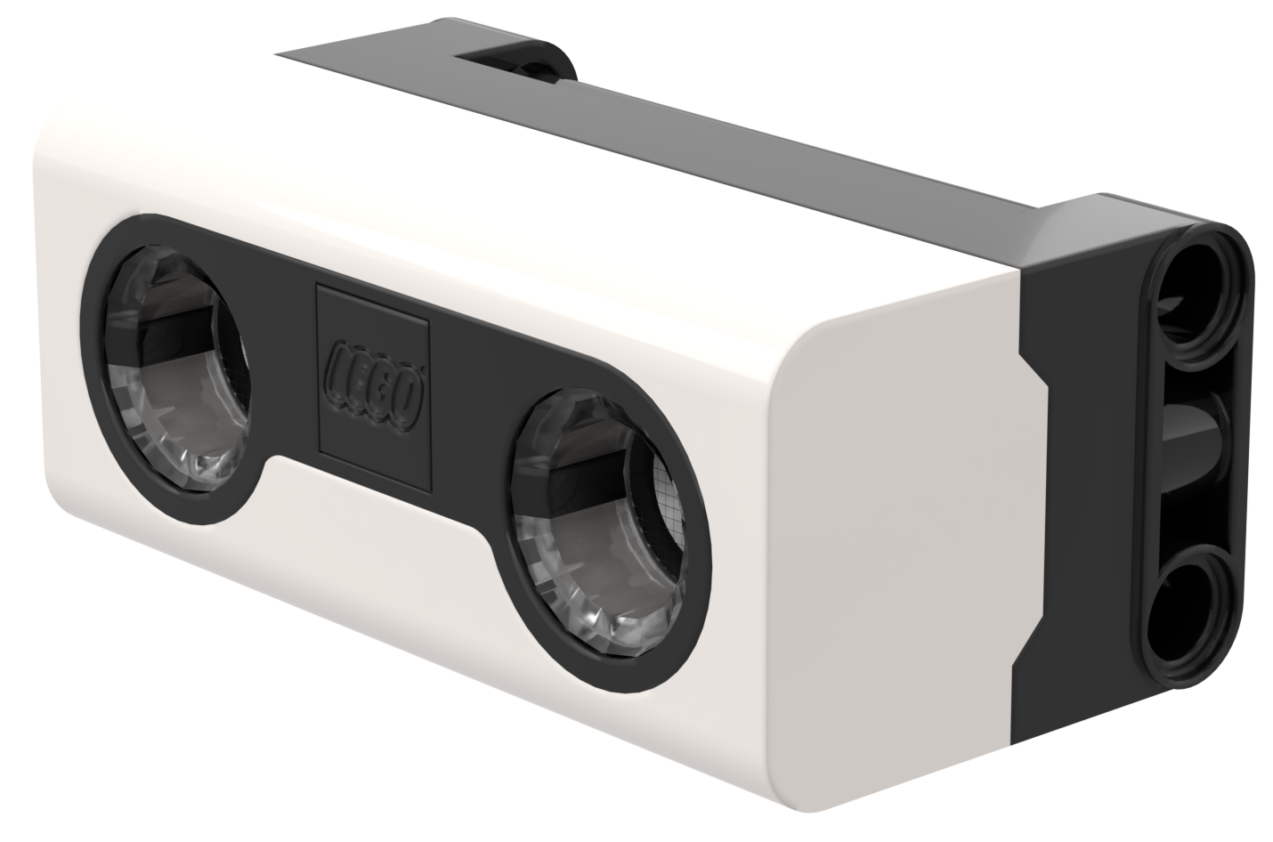
LESSON OBJECTIVES
Learn how to use the Distance Sensor

Slide 3
WHAT IS A DISTANCE SENSOR?
Measures the distance to an object or surface using ultrasonic technology
There are also lights around the ultrasonic sensor (4 segments) that can be programmed individually (see Lights Lesson)
The sensor can sense distances from 50-2000mm
There is a fast sensing capability from 50-300mm; however, the SP3 API does not provide a way to set it as of version 3.4.0

Slide 4
HOW DO YOU PROGRAM WITH A DISTANCE SENSOR
The Distance Sensor can measure the distance to an object or surface using ultrasonic waves
You can also program the lights around the sensor. This is covered in a different lesson.
The distance returned by Blocks is in CM/INCH but the Python API returns it in mm.
If it cannot sense anything, the Python API returns -1. Note this is different from the value shown in the app sensor reading and in Blocks, which will be 200cm.
You can find all the available methods in the Knowledge Base
distance_sensor.distance(port.F)
Port

Slide 5
CHALLENGE: STOP AT OBSTACLE
Move your robot forward until it is 5cm from an obstacle.
Basic steps:
Write an obstacle_found function that returns true if it senses an object closer than 5cm
Set the movement motors for your robot
Start moving straight
Await the obstacle_found function
Stop moving

Slide 6
CHALLENGE 1: SOLUTION
from hub import port
import runloop, motor_pair, sys, distance_sensor
# Function that returns true if an obstacle is found within 5cm
def obstacle_found():
distance = distance_sensor.distance(port.F)
# distance must be valid and less than 5cm (50mm)
return distance > 0 and distance < 50
async def main():
# Set up the pair and start moving
motor_pair.pair(motor_pair.PAIR_1, port.C, port.D)
motor_pair.move(motor_pair.PAIR_1, 0)
# wait until obstacle found
await runloop.until(obstacle_found)
# stop and exit
motor_pair.stop(motor_pair.PAIR_1)
sys.exit("Done")
runloop.run(main())

Slide 7
CHALLENGE 11 (ADVANCED)
Place your robot 20 cm from a wall with an opening. It should have a distance sensor mounted on the side of the robot like Droid Bot IV
You want to find the opening in the wall. Move forward until you locate the opening
Once you find the wall, turn the robot and go through the opening
20cm

Slide 8
CHALLENGE 11 (ADVANCED) HINTS
An opening is a gap where nothing is present. So, you need to move forward until your sensor senses either:
Distance greater than 20 cm. it is not looking for the wall, it is looking for the opening.
OR No distance reading (i.e. API call returns -1)
Once you find the opening, turn the robot and go through it.
You may have to make some adjustments based on where your sensor is located on the robot, i.e.
Decide between spin and pivot turns.
Move forward/backward by a fixed amount before turning.

Slide 9
CREDITS
This lesson was created by Sanjay and Arvind Seshan for Prime Lessons
Additional contributions by FLL Share & Learn community members
More lessons are available at www.primelessons.org
This work is licensed under a Creative Commons Attribution-NonCommercial-ShareAlike 4.0 International License.

