Slide 1
MOVING STRAIGHT
BY SANJAY AND ARVIND SESHAN
This lesson uses SPIKE 3 software

Slide 2
LESSON OBJECTIVES
Learn how to make your robot go forward and backwards
Learn how to use the Motor Pair Move methods

Slide 3
CREATING A MOTOR PAIR
Basic movement is done using a Motor Pair
See Configuring Robot Movement lesson for details on creating a motor pair
The following slides will cover the different methods of this pair that are used for movement
E.g., motor_pair.move_for_degrees(<parameters>)
Note that unlike SP2, SP3 does not have objects. You use functions to operate on the motor pair, and have to pass in the pair slot each time.
Do not initialize more than one motor pair with the same ports 🡪 this is redundant, will only waste memory and may cause undesired conflicts

Slide 4
MOTOR PAIR METHODS
move
move_for_degrees
move_for_time
move_tank
move_tank_for_degrees
move_tank_for_time
pair
stop
unpair
We will be covering the yellow methods in this lesson

Slide 5
MOTOR_PAIR.PAIR()/UNPAIR()
To set up a motor pair, you have to pair two motors and assign them one of three available pair names.
Since there are only 6 ports on the hub, you can’t have more than 3 pairs of motors
For Drive Base 1
motor_pair.pair(motor_pair.PAIR_1, port.C, port.D)
Once a pair is set up, you can use it in move commands it by its Pair name. You don’t have to use the port names.
To reset the name, use unpair:
motor_pair.unpair(motor_pair.PAIR_1)
Pair slot
Left motor
Right motor

Slide 6
MOTOR_PAIR.MOVE()
Move is a synchronous function that moves the pair until a stop is received
Direction and quantity to steer the robot
Pair slot
The acceleration (deg/sec²)
.move(pair, steering, velocity = 360, acceleration = 1000)
-100 to 100
0 to 10000
Motor speed (deg/sec)
Small motor (essential): -660 to 660 Medium motor: -1110 to 1110 Large motor: -1050 to 1050
velocity=360 and acceleration=1000 are the default values if nothing is set. Positive steering values turn the robot right, negative turn left. Larger values turn more sharply, e.g., 0 moves straight, +/-50 moves one wheel only, +/-100 spins the robot.

Slide 7
MOTOR_PAIR.STOP()
Stop is a synchronous function that stops a motor pair
.stop(pair, stop=motor.BRAKE)
See the “Configuring Robot Movement” lesson for a description of the Stop modes. The Knowledge Base also has good information on it.

Slide 8
MOTOR_PAIR.MOVE_FOR_DEGREES()
move_for_degrees moves the motor pair by a certain number of degrees
It is asynchronous – use await if you want to wait for it to finish
Usually, we want to move the robot by a distance
See the “Configuring Robot Movement” lesson for a description on how to write a function to take in a distance and return the degrees the motor pair needs to turn to move the robot by that distance. It depends on the physical characteristics of your robot.
.move_for_degrees(pair, degrees, steering=0, velocity = 360, stop = motor.BRAKE, acceleration = 1000)

Slide 9
MOTOR_PAIR.MOVE_TANK/MOVE_TANK_FOR_DEGREES()
These functions are similar to the move and move_for_degrees, except they let you set individual velocities for the left and right motors
Can be useful for moving each wheel independently, e.g for turning or squaring on a line

Slide 10
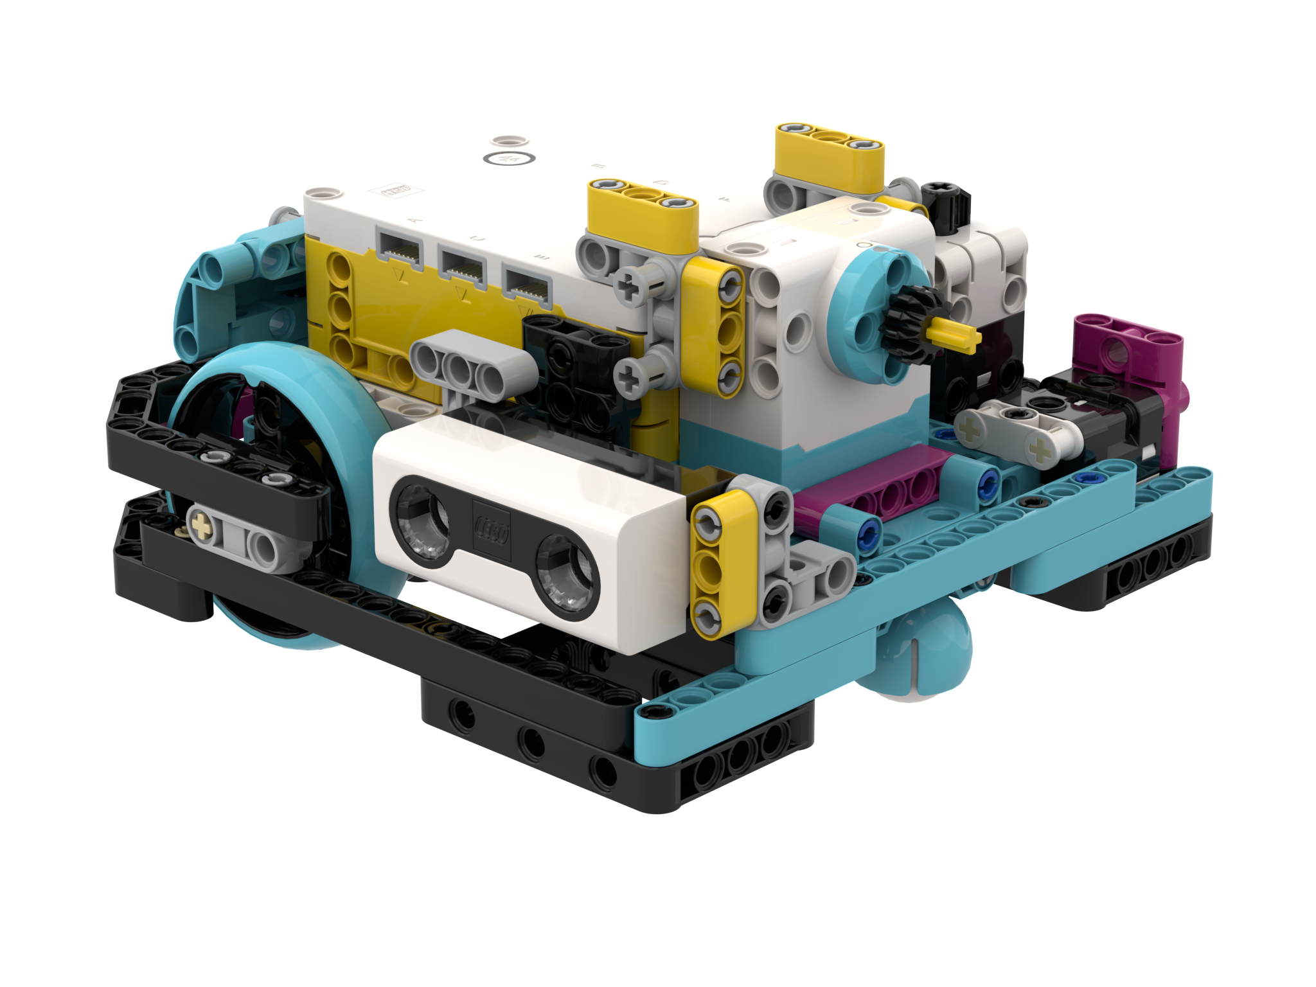
NEGATIVE VALUES
You can enter negative values for velocity or degrees
This will make the robot move backwards
If you negate two values (e.g., velocity and degrees negative), the robot will move forward.
Negative Velocity = Backwards
Drive Base 1
Negative Velocity = Backwards
Positive Velocity = Forward
C
D
Positive Velocity = Forward

Slide 11
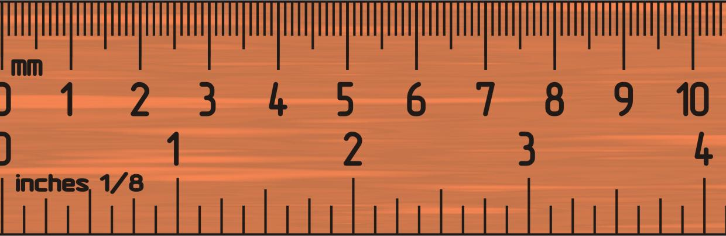
CHALLENGE 1: MOVE 10 CM
Move the robot 10 centimeters forward
Basic steps:
Configure your robot
Use a MotorPairs method (move_for_degrees() or move_tank_for_degrees()) to move forward for 10cm
Drive Base 1

Slide 12
CHALLENGE 1 SOLUTION
from hub import port
import runloop, motor_pair, sys
# cm, this is a constant for your robot WHEEL_CIRCUMFERENCE = 17.5
# input must be in the same unit as WHEEL_CIRCUMFERENCE def degreesForDistance(distance_cm):
# Add multiplier for gear ratio if needed
return int((distance_cm/WHEEL_CIRCUMFERENCE) * 360)
async def main():
# Drive Base 1
motor_pair.pair(motor_pair.PAIR_1, port.C, port.D)
await motor_pair.move_for_degrees(motor_pair.PAIR_1, degreesForDistance(10), 0)
sys.exit("Finished")
runloop.run(main())

Slide 13
CHALLENGE II: MOVE FORWARD AND BACK
Move your robot forward from the start line to the finish line (1) and back to the start (2)
Basic steps:
Configure your robot
Use a MotorPair method and move forward for the desired amount (40cm)
Use the same MotorPair method to move backwards (40cm)
FINISH
1
40CM
2
START

Slide 14
CHALLENGE 11 SOLUTION
from hub import port
import runloop, motor_pair, sys
# cm, this is a constant for your robot WHEEL_CIRCUMFERENCE = 17.5
# input must be in the same unit as WHEEL_CIRCUMFERENCE def degreesForDistance(distance_cm):
# Add multiplier for gear ratio if needed
return int((distance_cm/WHEEL_CIRCUMFERENCE) * 360)
async def main():
# Drive Base 1
motor_pair.pair(motor_pair.PAIR_1, port.C, port.D)
await motor_pair.move_for_degrees(motor_pair.PAIR_1, degreesForDistance(40), 0)
await motor_pair.move_for_degrees(motor_pair.PAIR_1, degreesForDistance(-40), 0)
sys.exit("Finished")
runloop.run(main())

Slide 15
CREDITS
This lesson was created by Arvind and Sanjay Seshan for Prime Lessons
Additional contributions by FLL Share & Learn community members
More lessons are available at www.primelessons.org
This work is licensed under a Creative Commons Attribution-NonCommercial-ShareAlike 4.0 International License.

