Slide 1
SPIKE 2 VS. SPIKE 3 AND DOWNGRADING THE HUB
BY SANJAY AND ARVIND SESHAN
This lesson uses SPIKE 3 software

Slide 2
Lesson Objectives
Learn how to downgrade your hub back to SPIKE 2 (Legacy) if needed

Slide 3
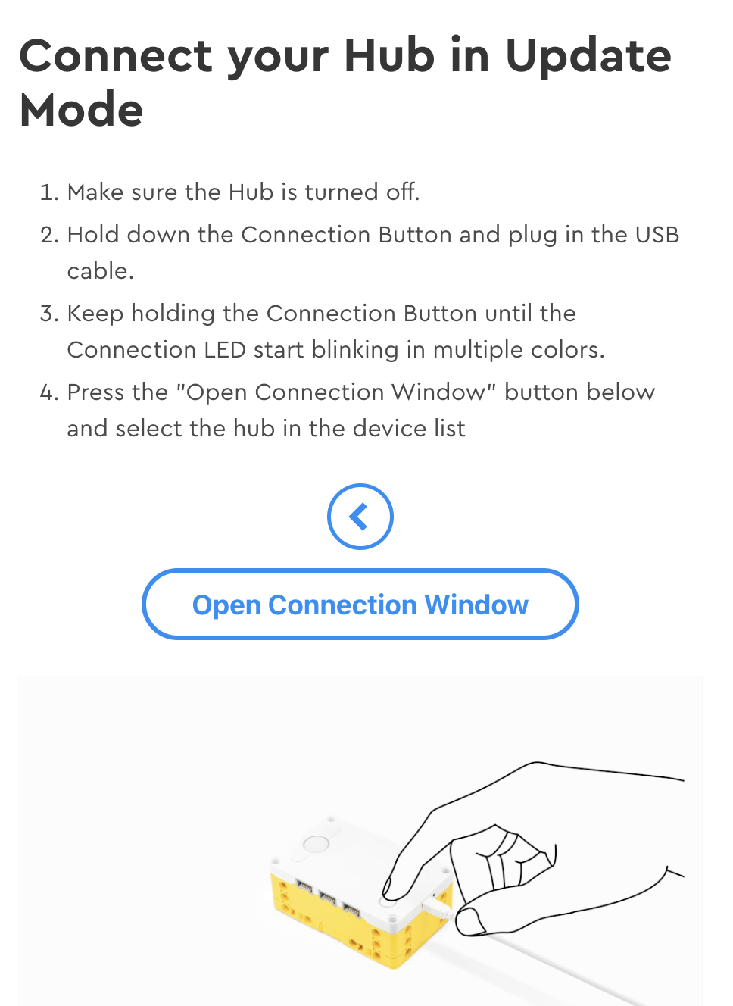
How to Downgrade Your HUb
STEP 1: Follow the instructions CAREFULLY in the Downgrade tool:
https://spikelegacy.legoeducation.com/hubdowngrade/ STEP 2: Go back to or Install the SPIKE App 2, now called SPIKE Legacy App. STEP 3: Open SPIKE 2 (LEGACY) and Update the Hub as requested in the pop-up
Your hub will now be a SPIKE 2 Hub.
Read about differences between SPIKE 2 and SPIKE 3 here: (https://legoeducation.atlassian.net/servicedesk/customer/portal/3/article/36817141835)

Slide 4
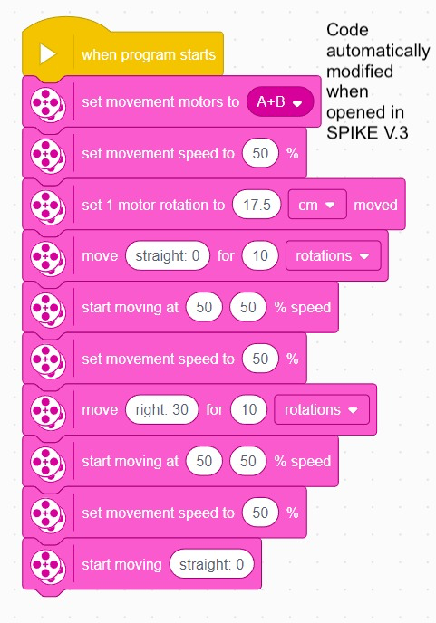
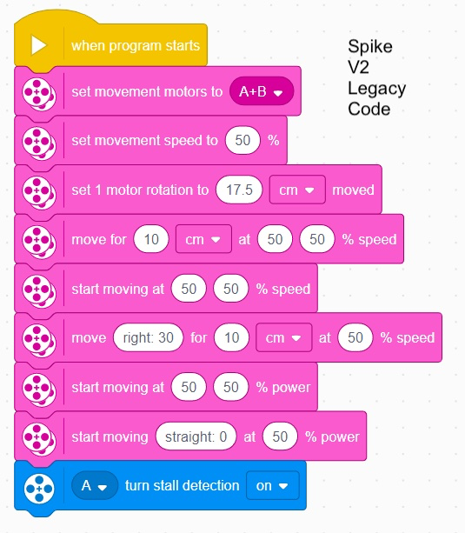
SPIKE 2 PROGRAMS CAN OPEN IN SPIKE 3
The Release Notes for SPIKE 3 indicate that you can open your SPIKE 2 (Legacy) code in the SPIKE 3 App.
Note that if you do try to open a SPIKE 2 Legacy project, it does show a pop-up saying that the code will work differently.
Code blocks get changed. Some blocks are removed and some are replaced with alternative blocks that may or may not act the same way as the original code.
Pay close attention to changes made to your code!!!

Slide 5
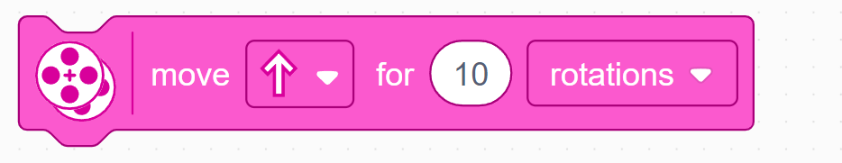
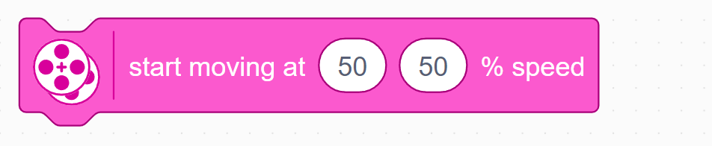
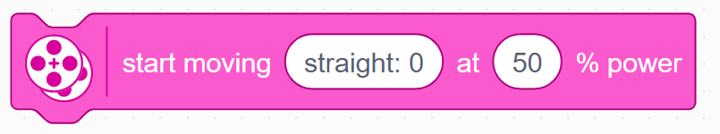
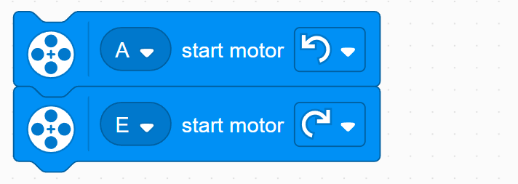
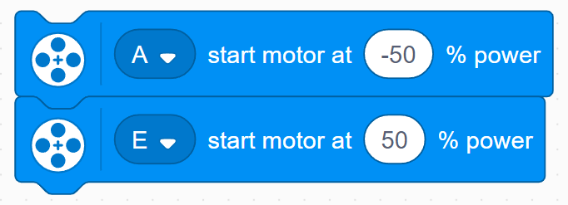
DIFFERENCES BETWEEN SPIKE 2 and SPIKE 3
SPIKE Legacy (2.0.9)
Block | Synchronization | Speed Control | Stall Detection
 | ✓ | ✓ | Permanently On
 | ✓ | ✓ | Permanently On
 | ✗ | ✗ | Permanently On
 | ✗ | ✓ | Can be enabled/disabled
 | ✗ | ✗ | Can be enabled/disabled

Slide 6
DIFFERENCES BETWEEN SPIKE 2 and SPIKE 3
SPIKE 3 (3.2.0)
Block | Synchronization | Speed Control | Stall Detection
 | ✓ | ✓ | Permanently Off
 | ✗ | ✓ | Permanently Off
 | Block no longer exists
 | ✗ | ✓ | Permanently On
 | ✗ | ✗ | Permanently On

Slide 7
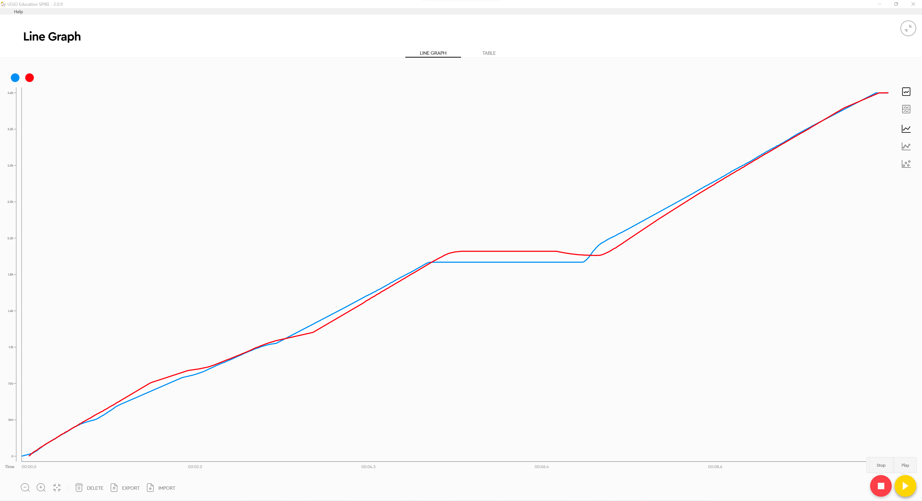
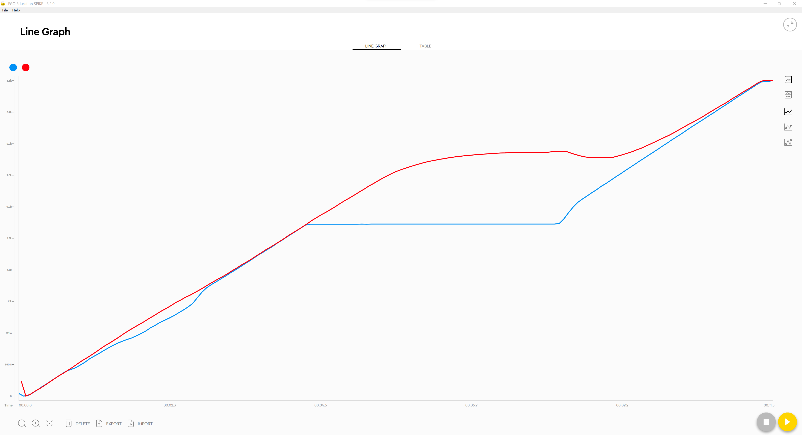
DIFFERENCES BETWEEN SPIKE 2 and SPIKE 3
SPIKE Legacy (2.0.9)
SPIKE 3 (3.2.0)
Takes much longer time to stop motor
Synchronization slows other motor down to match
Speed control increases power to motor when motor stopped, causing sudden increase in speed when released
Rub against motor
Hold motor
Rub against motor
Hold motor
Notice similar features or lack thereof in the graphs for the other blocks

Slide 8
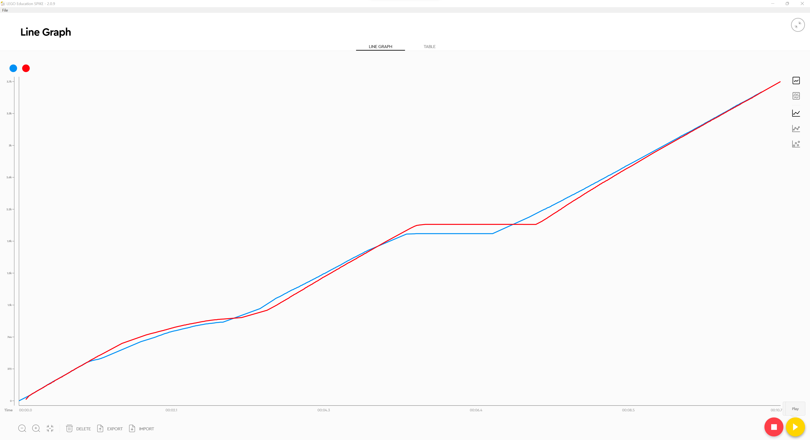
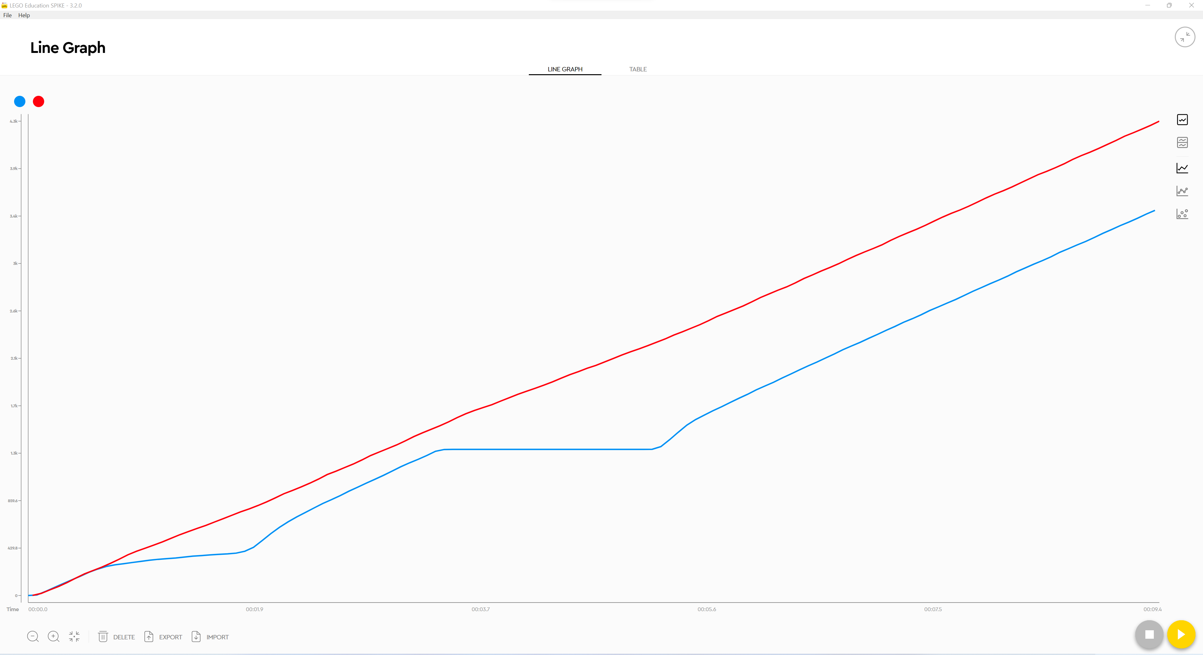
DIFFERENCES BETWEEN SPIKE 2 and SPIKE 3
SPIKE Legacy (2.0.9)
SPIKE 3 (3.2.0)

Slide 9
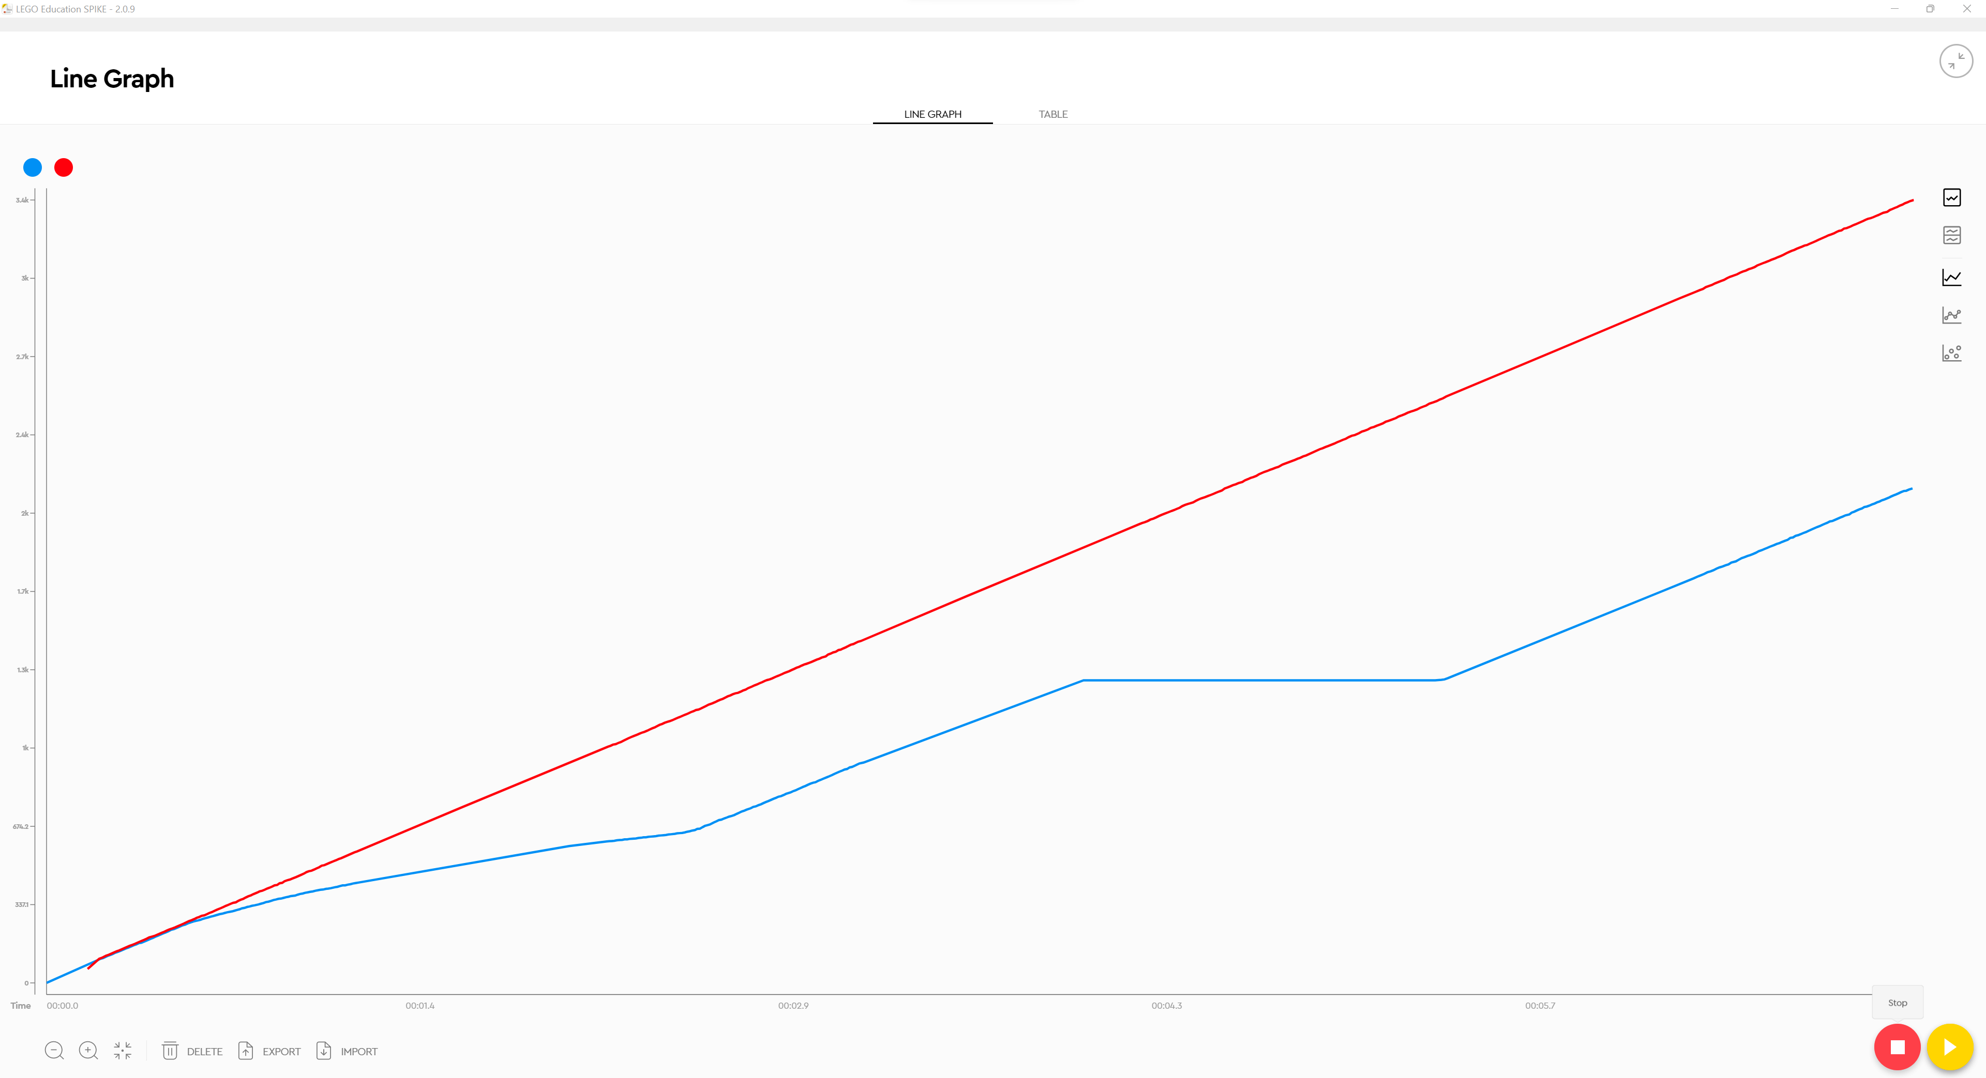
DIFFERENCES BETWEEN SPIKE 2 and SPIKE 3
SPIKE Legacy (2.0.9)
SPIKE 3 (3.2.0)
1
Block no longer exists

Slide 10
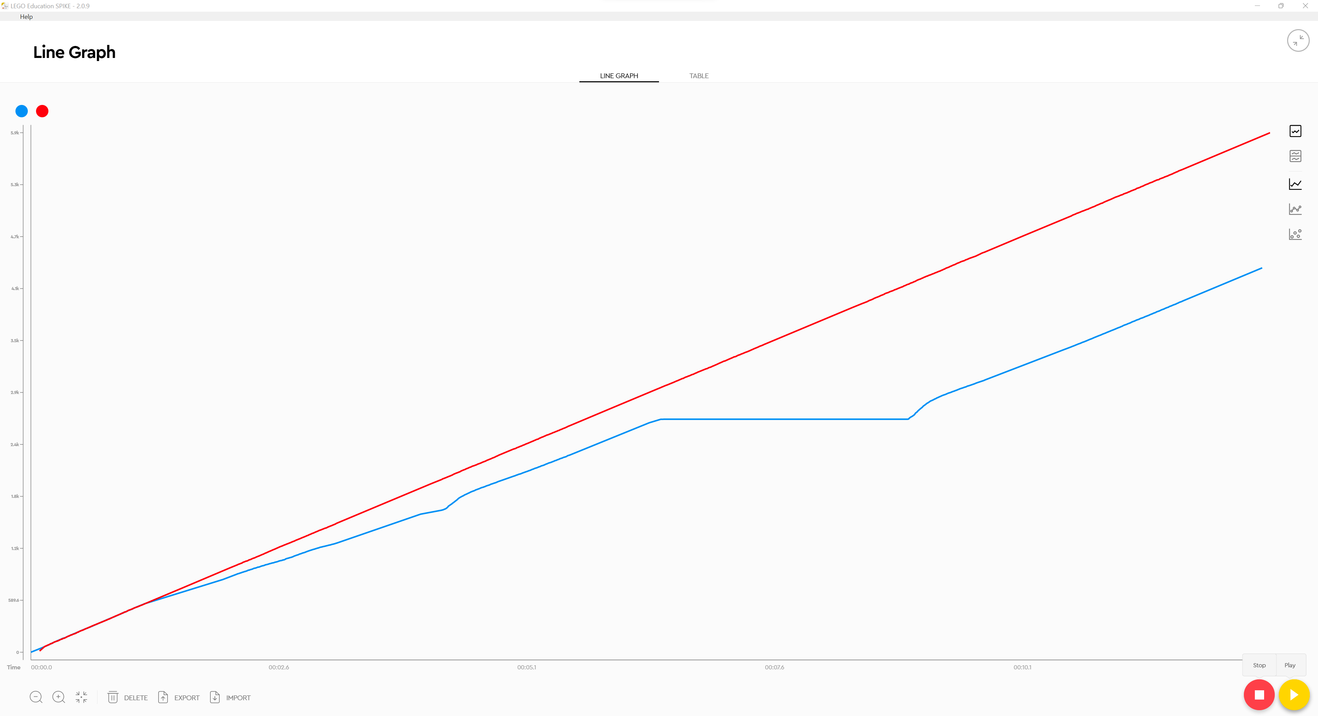
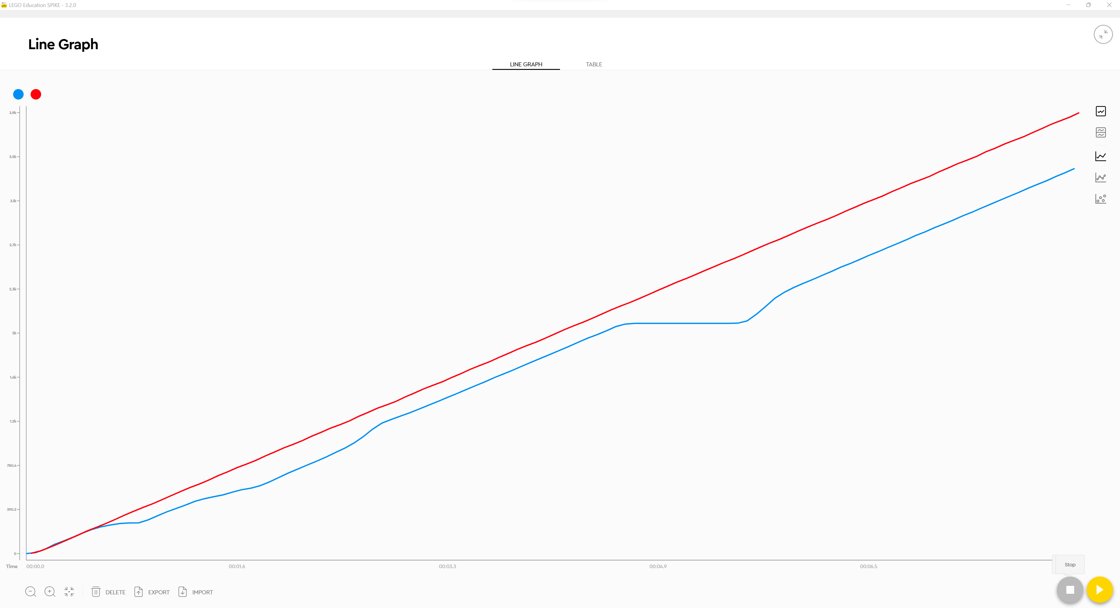
DIFFERENCES BETWEEN SPIKE 2 and SPIKE 3
SPIKE Legacy (2.0.9)
SPIKE 3 (3.2.0)

Slide 11
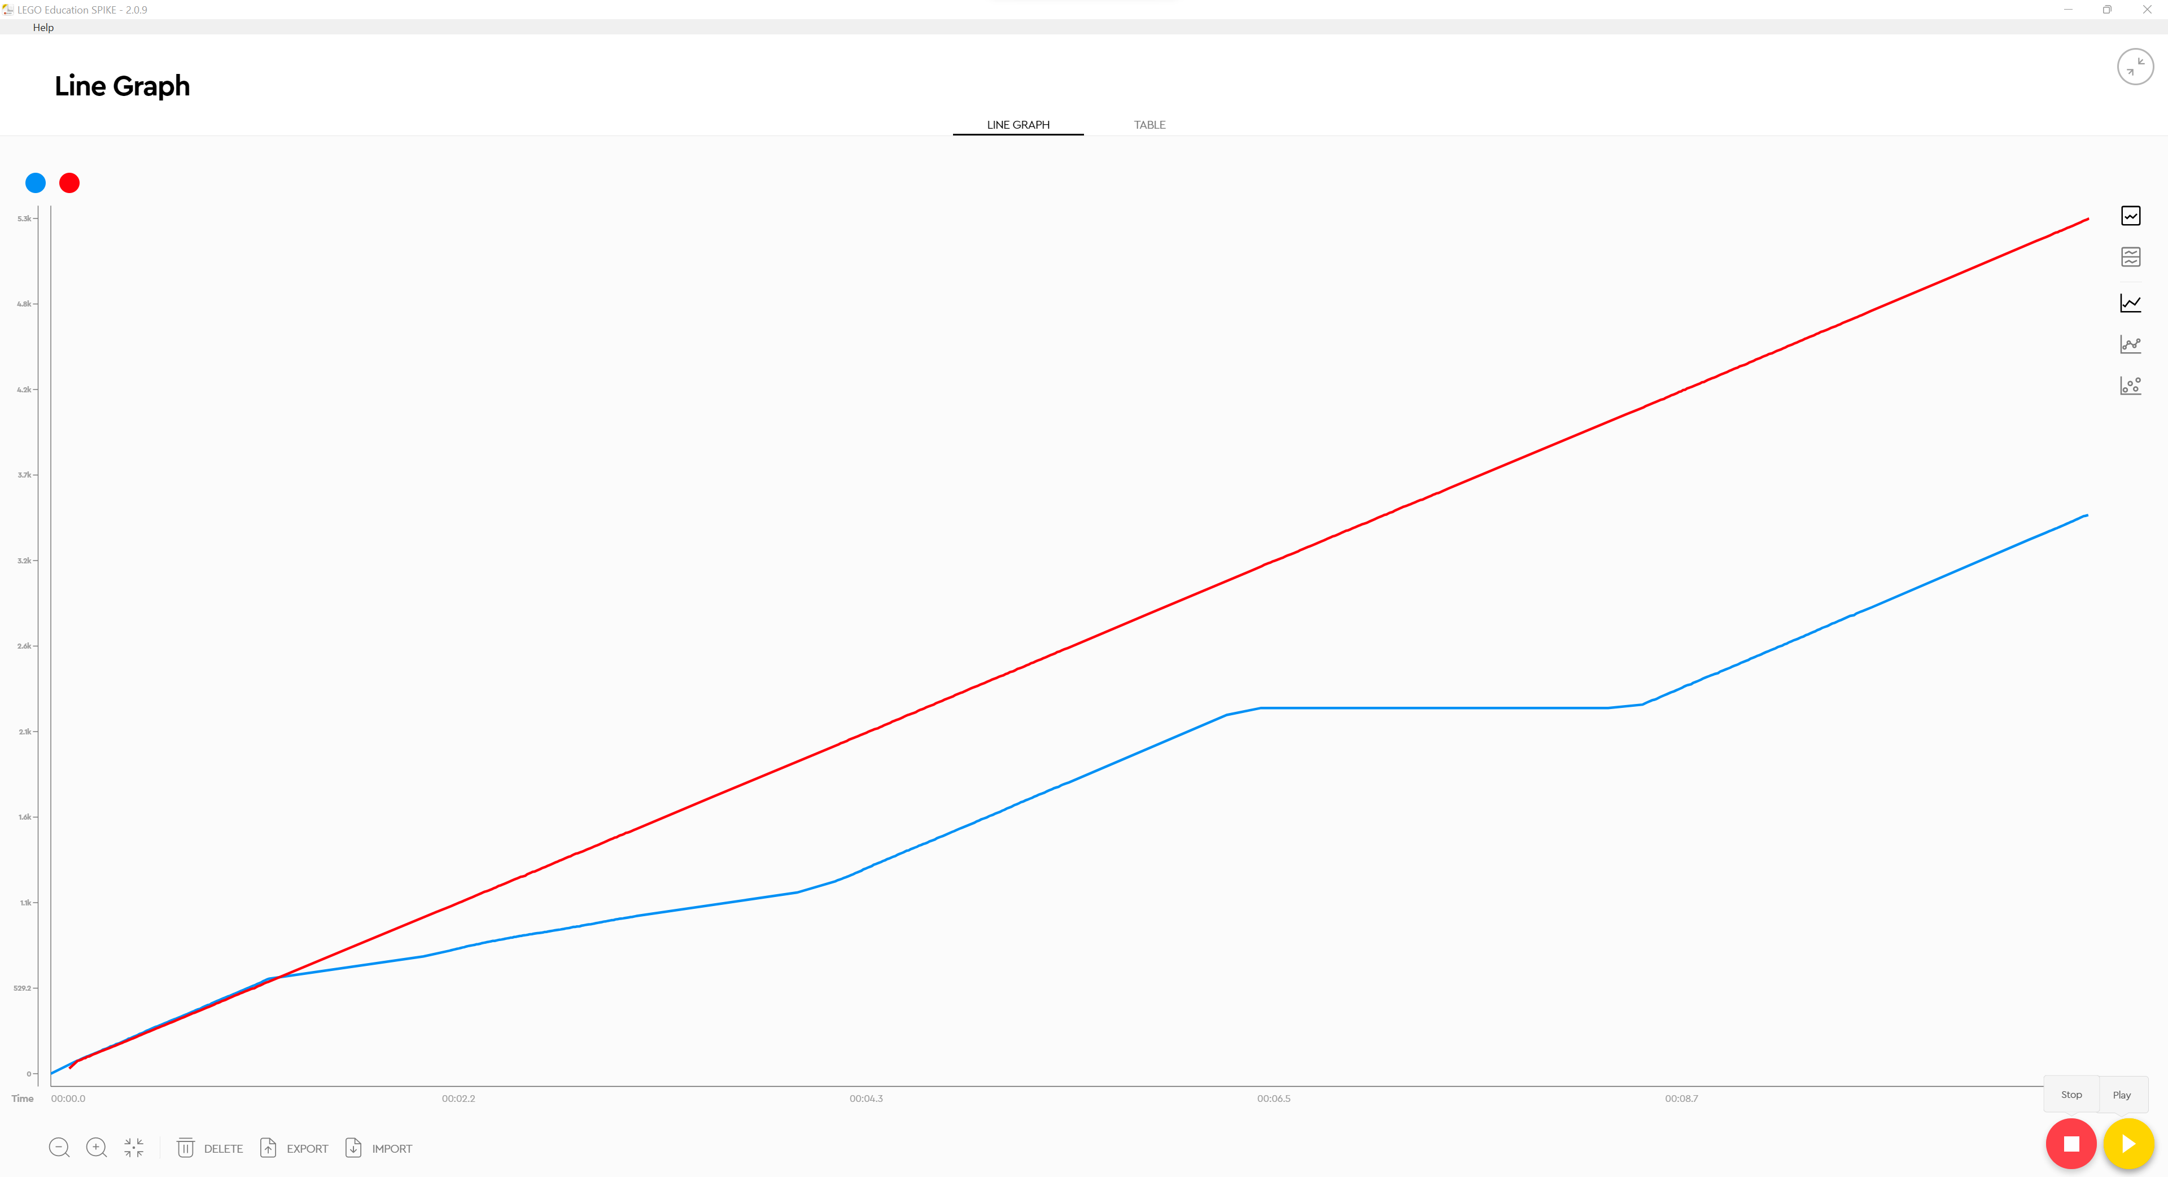
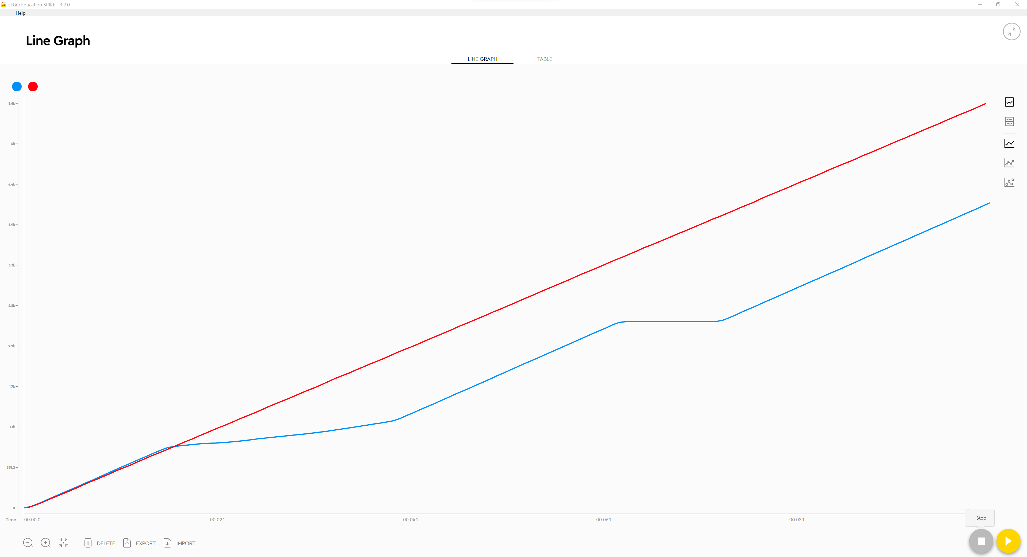
DIFFERENCES BETWEEN SPIKE 2 and SPIKE 3
SPIKE Legacy (2.0.9)
SPIKE 3 (3.2.0)

Slide 12
CREDITS
This lesson was created by Sanjay Seshan and Arvind Seshan for SPIKE Prime Lessons
More lessons are available at www.primelessons.org
This work is licensed under a Creative Commons Attribution-NonCommercial-ShareAlike 4.0 International License.

