Slide 1
My BLOCKS
BY SANJAY AND ARVIND SESHAN
This lesson uses SPIKE 3 software

Slide 2
Lesson Objectives
Learn how to make custom blocks (My Blocks)
Learn why a My Block is useful
Learn to construct a My Block with Inputs and Outputs (Parameters)

Slide 3


What is a My Block?
A My Block is a combination of one or more blocks that you create that can be grouped into a single block
My Blocks are basically your own custom blocks
Once a My Block is created, you can use it in multiple programs
Just like any other block in EV3, My Blocks can have both inputs and outputs (parameters)
The blocks above are an example of a My Block with different inputs

Slide 4

When do You Use a My Block?
Whenever the robot is going to repeat an action inside your program
When code is repeated in a different program
Organize and simplify your code

Slide 5
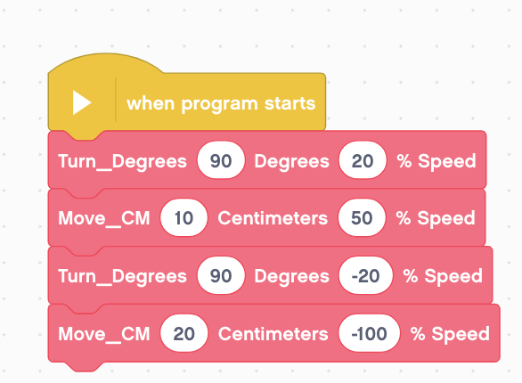
Why Should You Bother?
Because of My Blocks, your missions will look like this…
This makes your code easier to read and easier to modify!

Slide 6
What Makes a Useful My Block
Note: Making My Blocks with inputs and outputs can make them far more useful. However, you need to be careful not to make the My Block too complicated.
Question: Look at the list of three My Blocks below. Which ones do you think are useful to use?
Turn90degrees (Turns the robot 90 degrees)
TurnDegrees with an angle and power input
TurnDegrees with angle, power, coast/brake, etc. inputs
Answer:
Turn90degrees may be used often, but you will be forced to make other MyBlocks for other angles. This will not be fixable later.
TurnDegrees with angle and power as inputs is probably the best choice.
TurnDegrees with angle, power, coast/brake, etc. might be the most customizable, but some of the inputs might never be used.

Slide 7
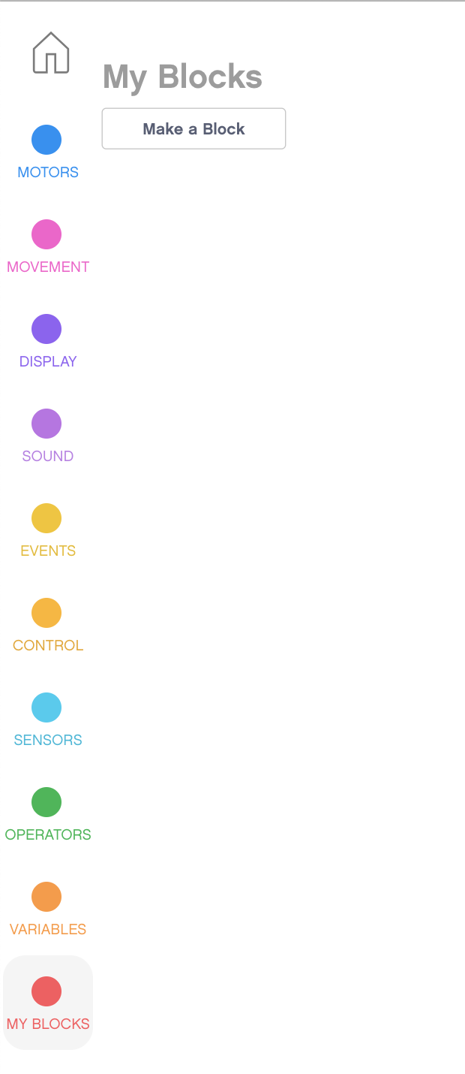
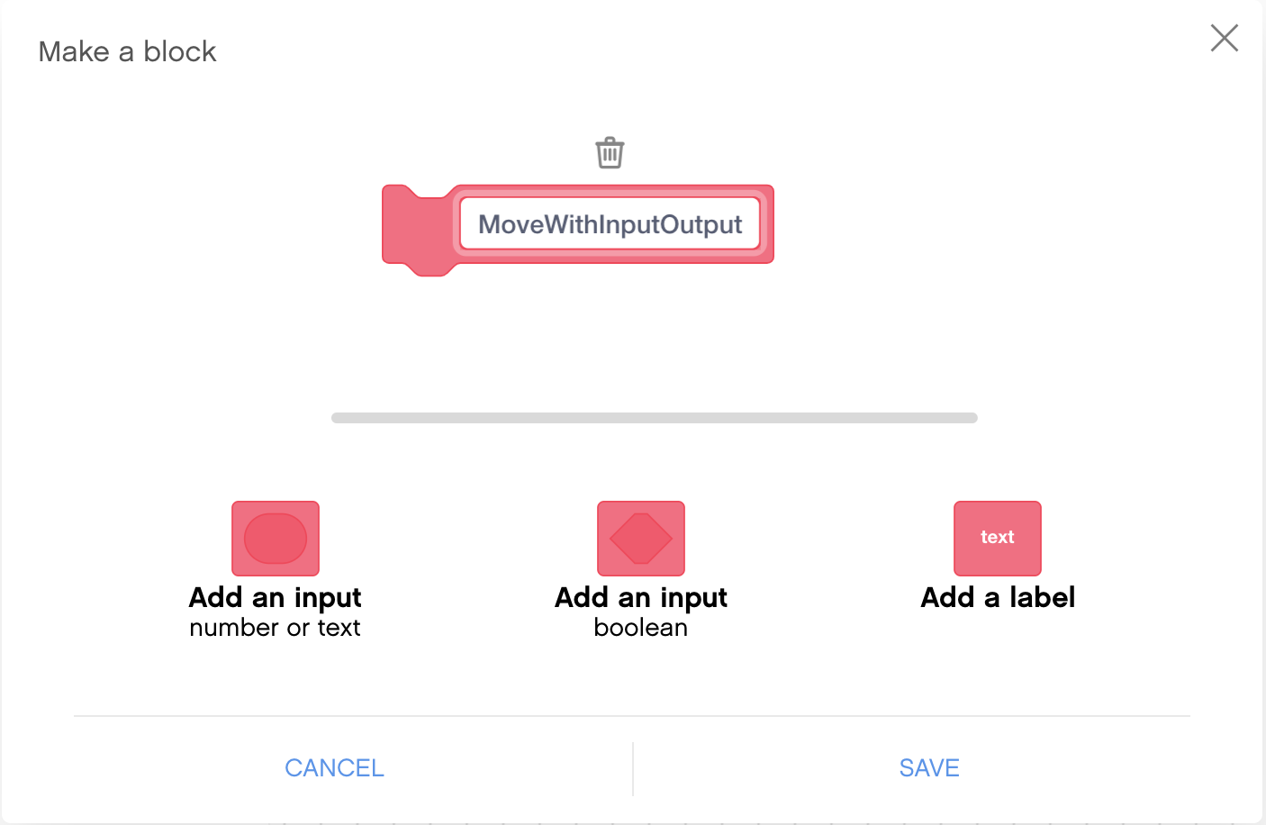
Step 1: Create a My Block
Go to the My Blocks tab on the left side and select “Make a Block.”
You are then taken to the Block Making menu.
Type in the name for the block

Slide 8
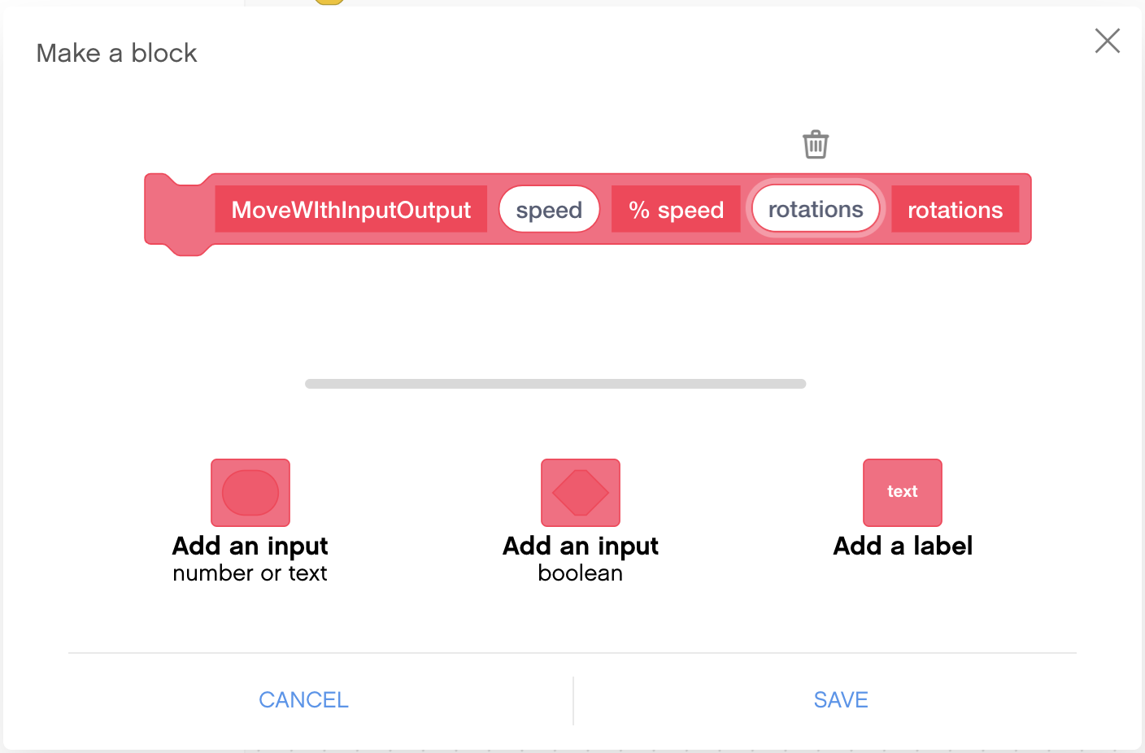
Step 2: Add Inputs and Labels
Use the buttons below the block to add inputs. You can add number or text inputs, as well as Boolean (true/false).
Labels can be used to indicate what each input is when you use the My Block in your programs.

Slide 9
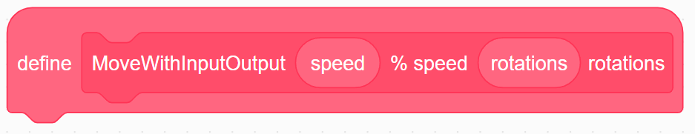
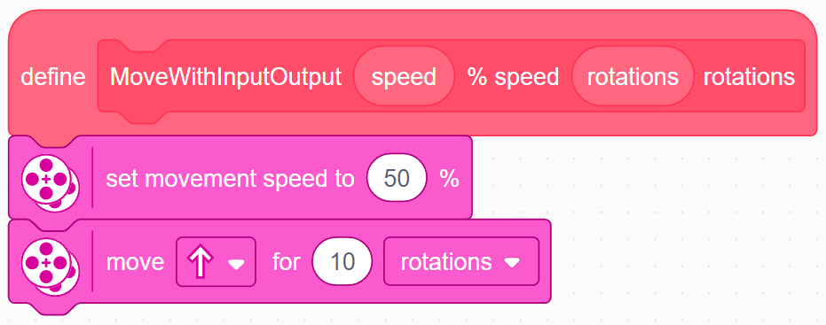
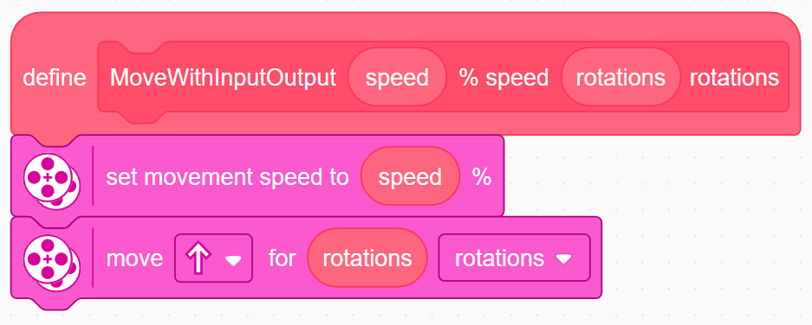
Step 3: Defining the My Block
Once you click ”Save,” a Define Block appears in the canvas.
The code for the My Block goes under the Define Block.
Add the programming blocks that you want in your My Block under the Define Block.
To use the inputs from the My Block, drag the oval inputs from the Define Block to the places where you need them as demonstrated in the images to the right.
The code on the right sets up a My Block that takes in speed and rotations and moves straight with the speed and rotations inputted.

Slide 10
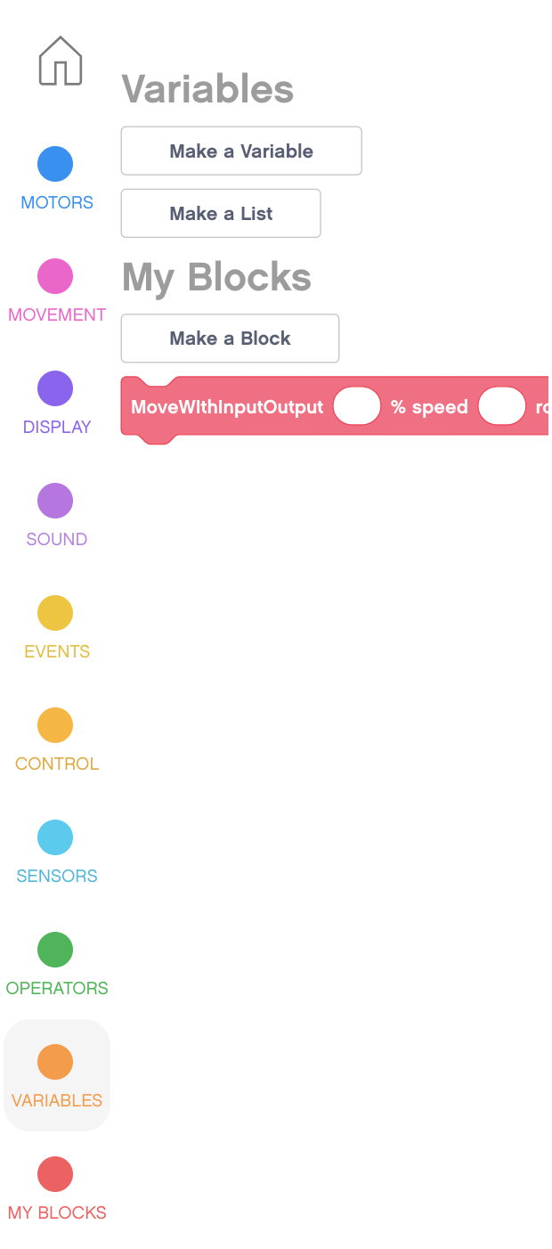
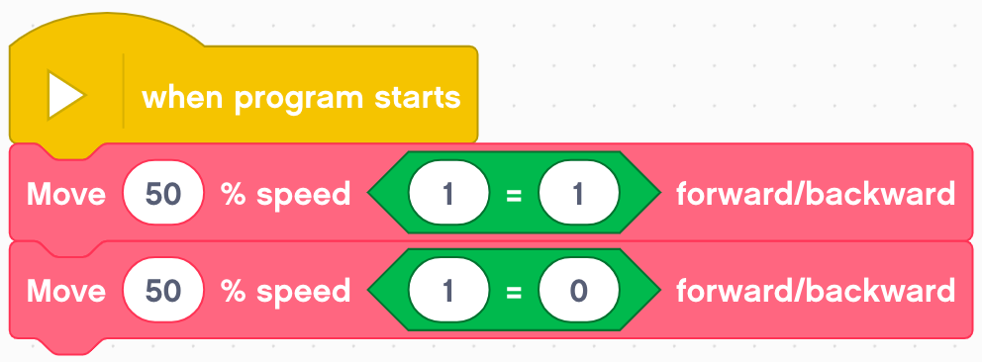
Step 4: Using the My BLock
In addition, the My Block can now be found in the My Blocks tab. To use the My Block in your code, simply drag in the block.
Number/text inputs can be directly typed into. However, you can not type in “True” or “False” into a Boolean input.
This can be done by dragging in an operator and setting values that result in true or false outputs, depending on what you want. Below, 1=1 returns true and 1=0 returns false.

Slide 11
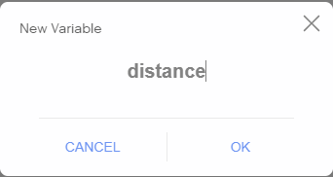
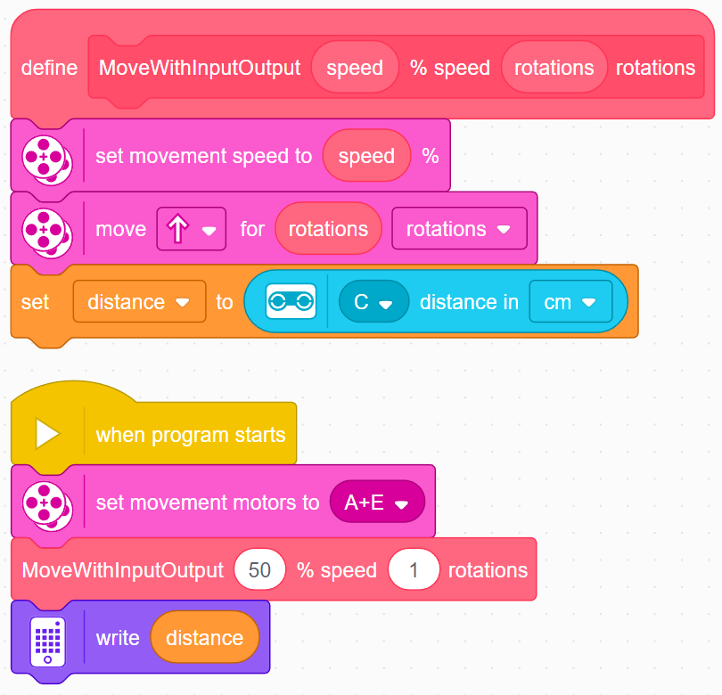
Step 5: Adding Outputs
Define a variable to store the value of your output.
Write the data you want to input to the variable inside the My Block.
Use the variable in your main code
In the code on the right, the My Block reads the distance sensor, sets it to a variable.
The value can be used later in the program such as print to the screen.

Slide 12
Sharing My Blocks Between Projects
The My Block can only be used inside one project. To use in multiple projects, copy and paste the define block and all attached blocks into another project.
To copy, click on the define block of a My Block and use your computer’s copy keyboard shortcut (e.g. Ctrl-C or Cmd-C)
Switch tabs to your second project and paste this part onto the canvas (e.g., using Ctrl-V or Cmd-V)
However, the My Block may not appear in the My Block section of the Block Palette yet.
To get it to appear, click on another project and then return this new project.
The My Block will now appear on the left Block Palette and you can use this My Block as normal within this project. Note that editing the My Block in one project will not update the My Block in other projects.

Slide 13
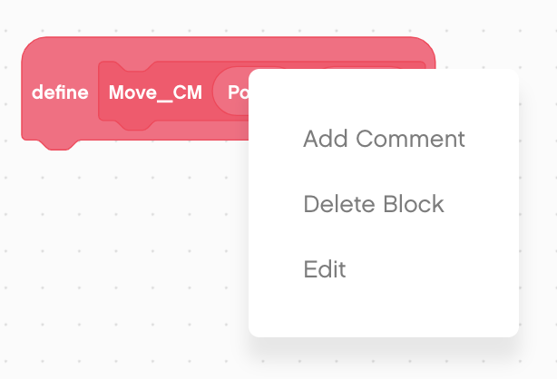
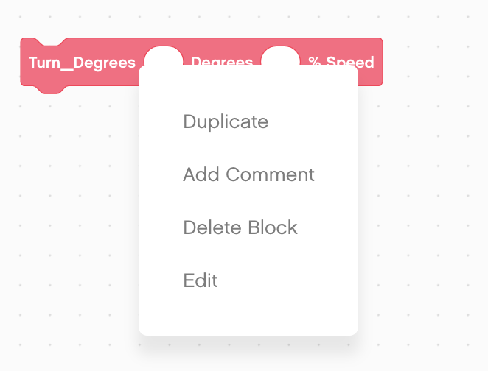
How to Edit or Delete a My Block
Right Click on a My Block in the Programming Canvas and select “Edit” to edit the My Block.
This will take you back to the My Block creation screen where you can edit the name, add inputs, or delete inputs.
To delete, you must first right click and press delete on all uses of the My Block in your program. Then, you can press delete on the definition of the My Block.

Slide 14
CREDITS
This lesson was created by Sanjay Seshan and Arvind Seshan for Prime Lessons
More lessons are available at www.primelessons.org
This work is licensed under a Creative Commons Attribution-NonCommercial-ShareAlike 4.0 International License.

