Slide 1
Turning With the Gyro
BY SANJAY AND ARVIND SESHAN
This lesson uses SPIKE 3 software

Slide 2
Lesson Objectives
Learn how to turn using the built-in gyro sensor
Learn how to use the Wait Until Block with sensors
Note: Although images in this lessons may show a SPIKE Prime, the code blocks are the same for Robot Inventor

Slide 3
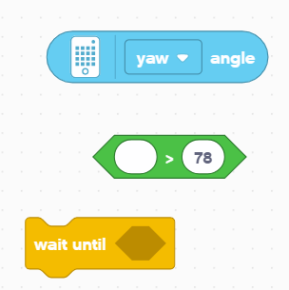
BLOCKS YOU NEED in this lesson
Reporter blocks (Float/String) – numbers and text can be placed inside oval slots. They can read sensor values or the retrieve the value stored in a variable.
Boolean Blocks – carry a true or false value and can be placed inside hexagonal slots such as the Wait Block on the right
Wait Until Block – Like the Wait for Seconds block, this block makes the program pause execution for some time. In this case, the program waits until the condition in the Boolean block is true

Slide 4
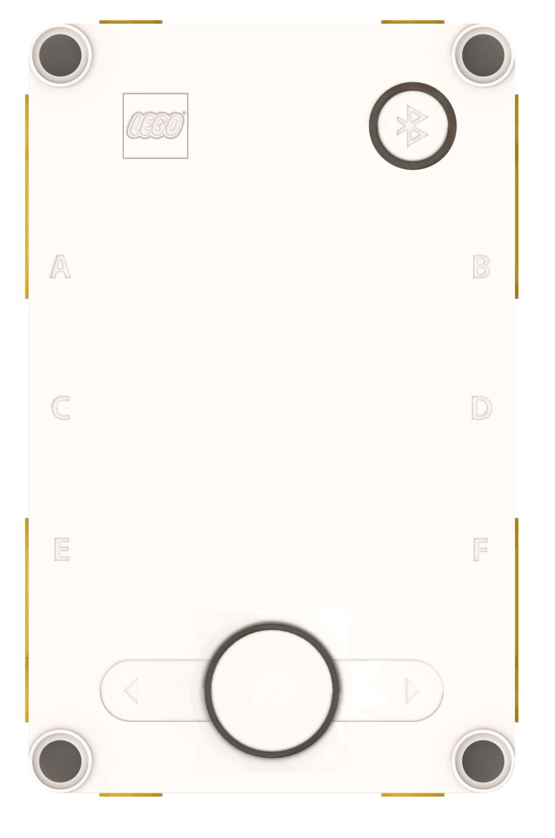
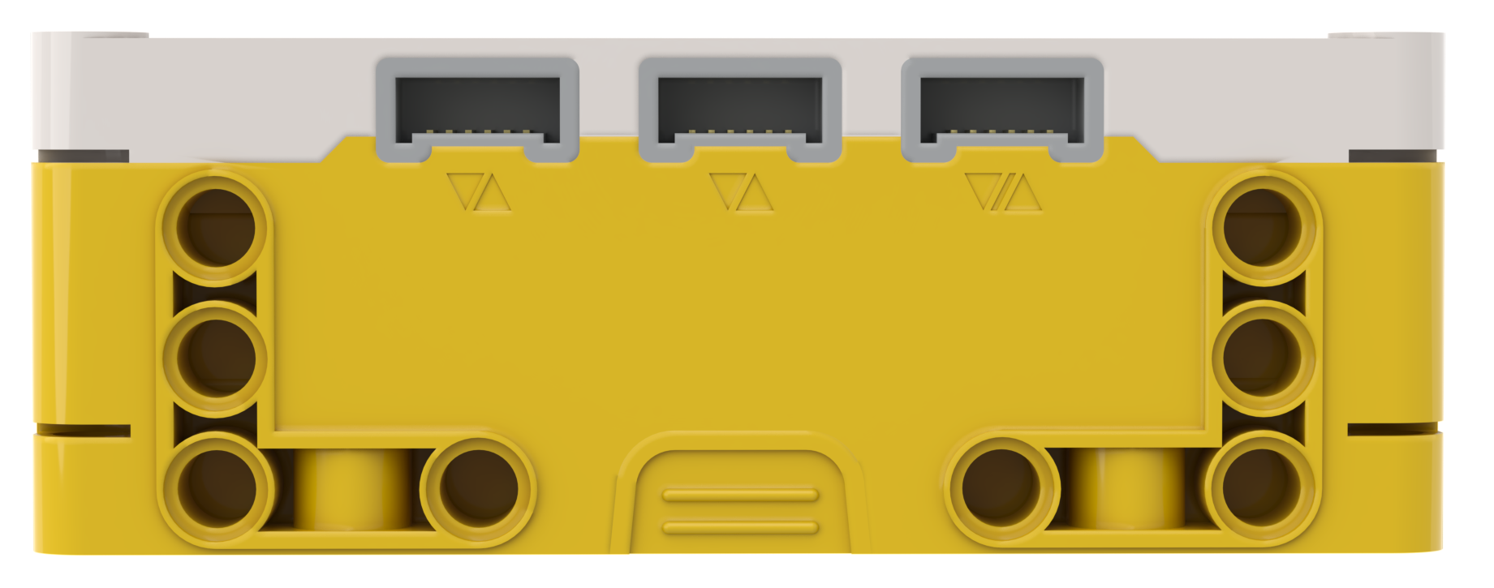
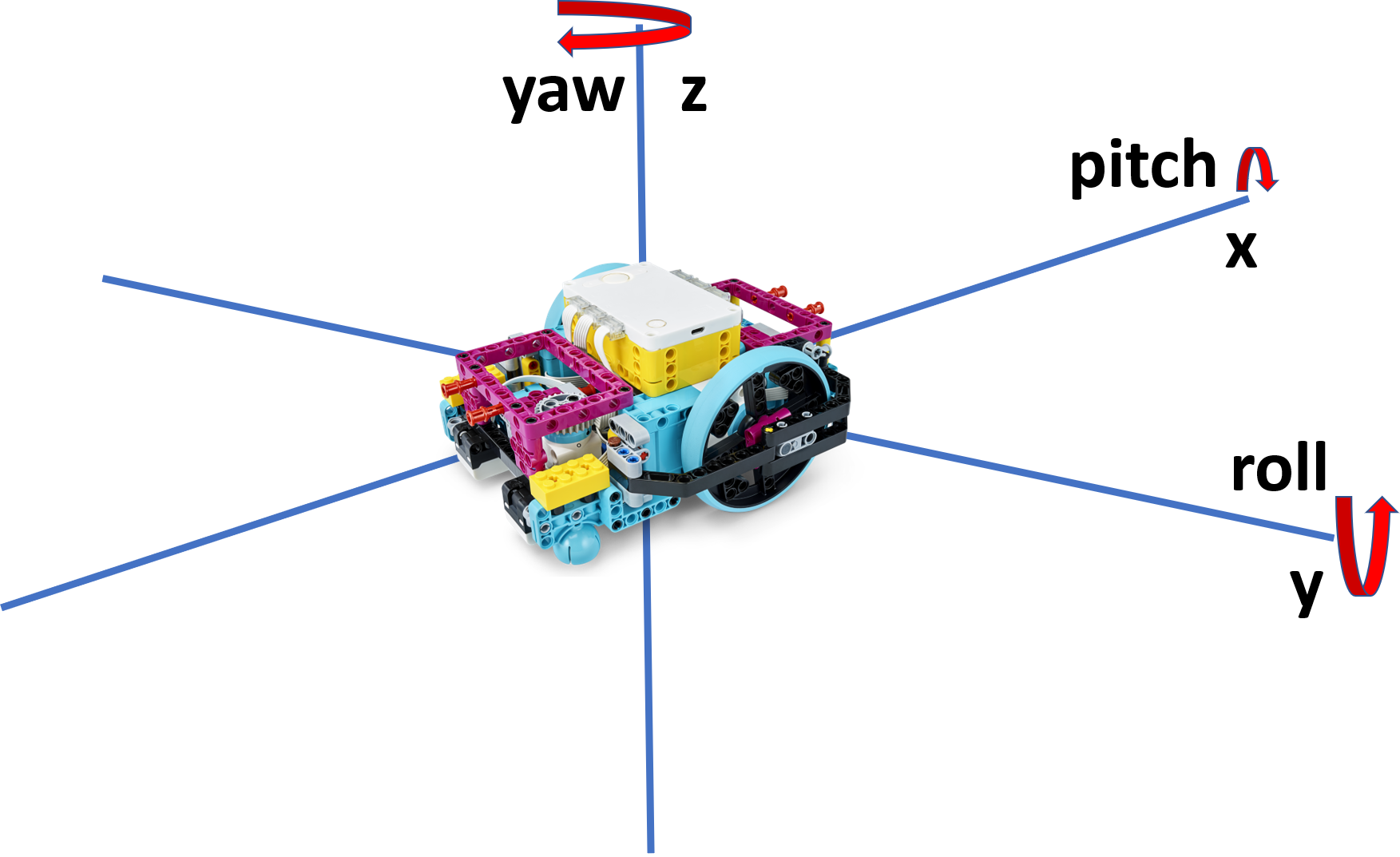
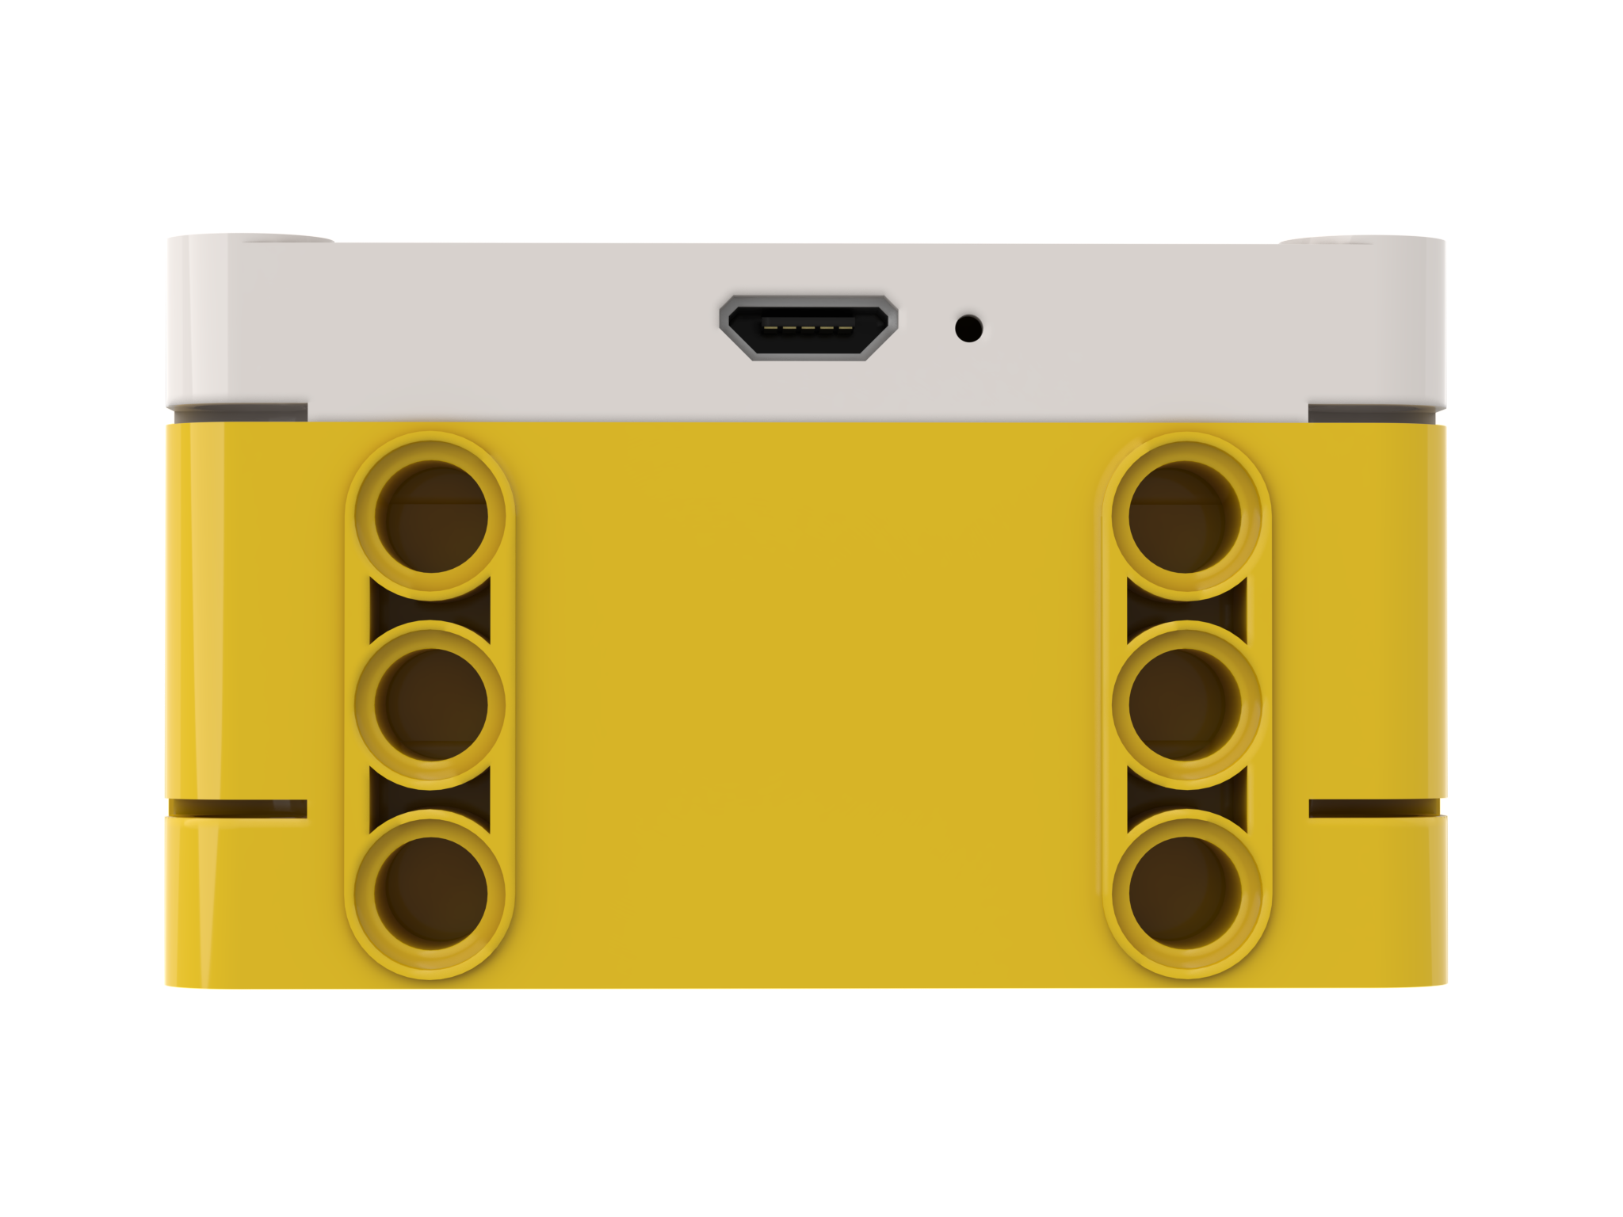
Robot Orientation: YAW, PITCH and ROLL
Yaw is turning the Hub to right or left
Pitch is turning the Hub up and down
Just like x, y and z coordinates are used to describe a robot’s position,
yaw, pitch and roll are terms used to describe a robot’s orientation.
Yaw is rotation around the z-axis. Pitch is rotation around y-axis.
Roll is rotation around the x-axis.
The built-in Gyro Sensor can measure the robot’s orientation
Roll is turning the Hub to side-to-side

Slide 5
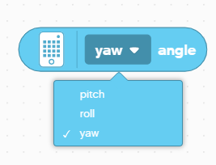

Using the gyro sensor to turn
The gyro sensor can be programmed to measure the hub’s yaw, pitch and roll
These values can be used to sense if the robot has turned around x, y, or z axes
In this lesson, we will focus on yaw which can be used to determine if a robot has turned left or right
For pitch and roll, the robot uses gravity to determine what is a zero reading. Flat on the ground is 0 pitch and 0 roll.
For yaw, the robot doesn’t have a compass to tell it what is north or south. Therefore, you need to tell the robot what it should consider zero. This is done with the “set yaw angle to 0” block.
Note that clockwise is positive in yaw measurement

Slide 6
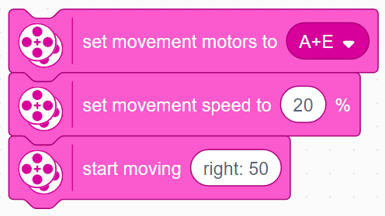

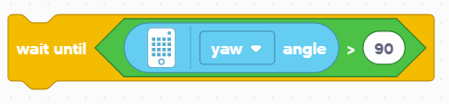
Challenge I
Write a program that turns 90 degrees to the right
Basic Steps:
Make your robot start slowly turning right using the Start Moving With Steering block
Use low speeds here to improve keep the turn accurate
reset the gyro sensor angle to 0
Wait until the gyro yaw angle has reached the degrees you want
Stop moving

Slide 7
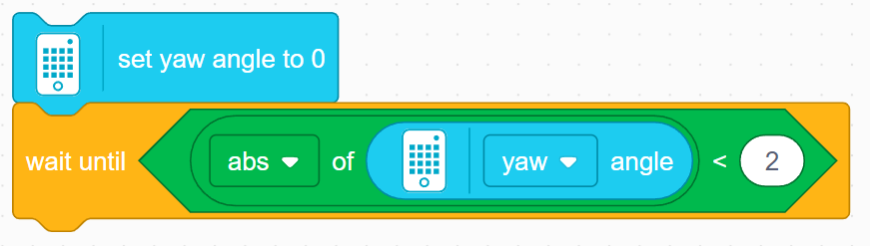
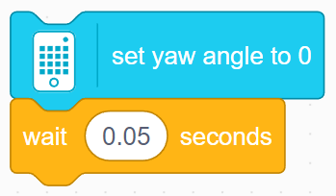
Bug In SPIKE 3
The set yaw angle to 0 block takes a small amount of time to perform, but moves on to the next block before its is completed
The problem is that the code reaches the check for if the yaw angle >90 before the yaw angle is reset, meaning that if the yaw angle read >90 before the reset, the robot will not perform the turn
To fix this, you will have to add a wait block after the gyro reset block and before the turn. There are two ways you can do this
Wait until the yaw angle reads close to 0
Wait for a small amount of time (around 0.05 seconds seems to work)
Note that some solutions provided in this lesson and other lessons involving turns/the gyro sensor may not contain this wait block
The code will function as intended in a standalone program since the gyro is reset at the beginning of all programs automatically, but may need the addition of one of these methods for your use until an update fixing this bug is released

Slide 8
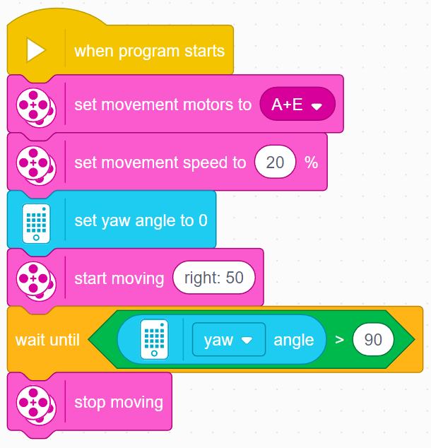
Challenge 1 Solution

Slide 9
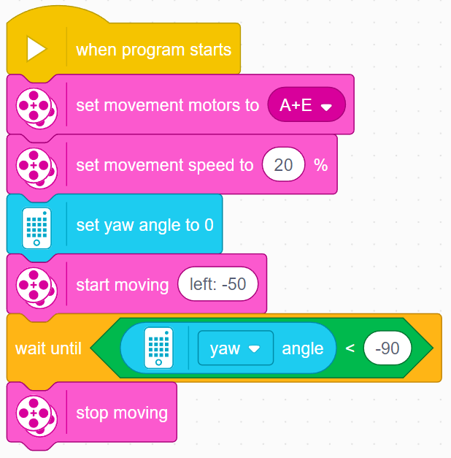
TURNING RIGHT Vs. TURNING LEFT
To change the direction of the turn, you have to:
Change which wheel should turn
The final angle should be -90 degrees instead of 90 degrees
The comparison should be “<“ instead of “>” since the angle is decreasing instead of increasing
Right Turn
Left Turn

Slide 10
There are two types of turns you can do
180 Degree Pivot Turn
Notice where the robot ends in both pictures after a 180 degree turn.
In the Spin Turn, the robot moves a lot less and that makes Spin Turns are great for tight positions. Spin turns tend to be a bit faster but also a little less accurate.
So when you need to make turns, you should decide which turn is best for you!
A
End Position
Motor
A Moves
E
A
Start Position
E
180 Degree Spin Turn
Start Position
End Position
A
A
Motors
A and E Move
E
E

Slide 11
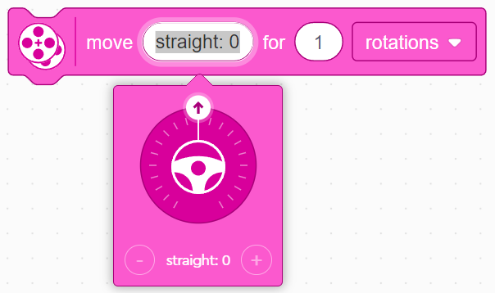
How to Make Pivot and Spin turns
Move Steering Block
Change steering values here
Move Tank Values
left: 50 | left: -50 | right: 100 | left: -100
Pivot Turn Right | Pivot Turn Left | Spin Turn Right | Spin Turn Left
A
A
A
A
E
E
E
E

Slide 12
TURNING CHALLENGES
Challenge 1
Your robot is a baseball player who has to run to all the bases and go back to home plate.
Can you program your robot to move forward and then turn left?
Use a square box or tape
Challenge 2
Your robot baseball player must run to second base, turn around and come back to first.
Go straight. Turn 180 degrees and return to the same spot.
Second Base
A
A
Start and End position
First Base
E
E

Slide 13
CHALLENGE SOLUTIONS
Challenge 1
You probably used a combination of move steering to go straight and do pivot turns to go around the box.
Challenge 2
You probably used a spin turn because it is better for tighter turns and gets you closer to the starting point!

Slide 14
CREDITS
This lesson was created by Sanjay Seshan and Arvind Seshan for Prime Lessons
More lessons are available at www.primelessons.org
This work is licensed under a Creative Commons Attribution-NonCommercial-ShareAlike 4.0 International License.

