Slide 1
Repeat blocks
BY SANJAY AND ARVIND SESHAN
This lesson uses SPIKE 3 software

Slide 2
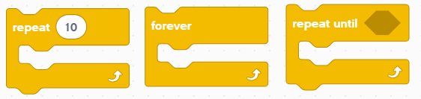
Lesson Objectives
Learn how to repeat an action using the Repeat Block

Slide 3
Repeating code
Let us say that you want the robot to repeat an action over and over again.
Would you copy the blocks over and over?
What if you wanted to repeat the action forever?
You can use the Repeat Blocks to repeat an action for a number of times or until some exit condition is met
Repeat Blocks make repeating a task multiple times easy
The added benefit is that a loop can end whenever you want (a specific number of times, run forever, a specific condition, etc.)
Loop blocks can be found in the Control Block Palette

Slide 4
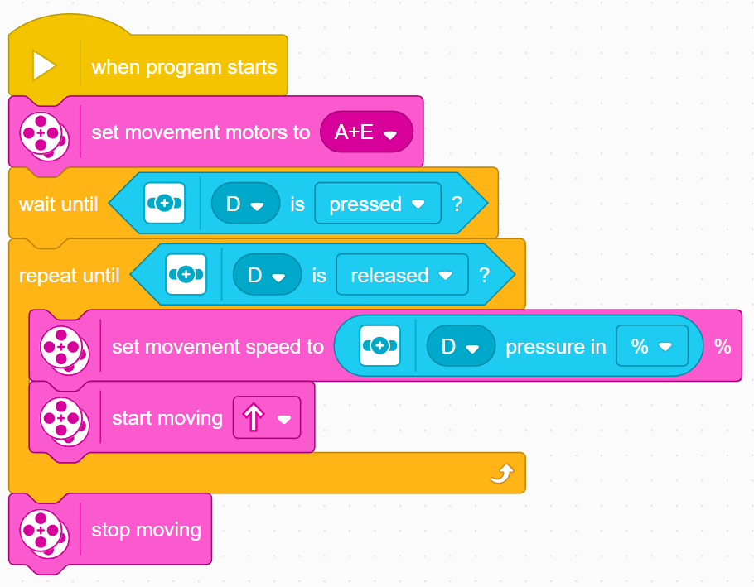
Using A Repeat Until Block
In this example, the robot adjusts the speed of the motors based on the Force sensor until the Force sensor is released. This type of loop is different than a wait until block since you can perform different actions while you are waiting
Configure your motors
Wait until the sensor is first pressed
Loop until the sensor is released
Adjust the movement speed based on the current force reading each time through the loop.

Slide 5
Challenge: Around the box
Go around the box
To do this, you will have to move forward 20 cm and turn right
Repeat this action 4 times till you are all the way around the box
You will have to remember the lesson on Moving Forward and Turning to complete this challenge
You repeat those two actions in a Repeat block
20cm

Slide 6
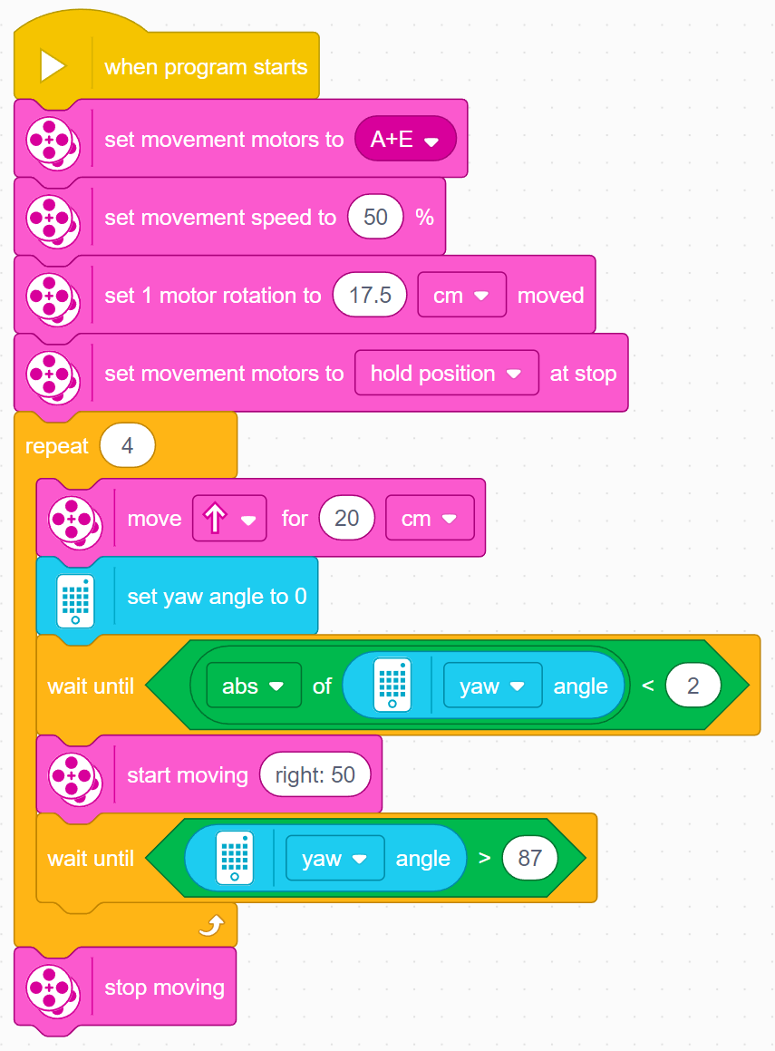
Challenge Solution
In previous lessons, you learnt how to configure your robot. The first set of blocks sets the movement motors, % Speed, Move CM and sets the motors to hold. (see Configuring Your Robot Lesson). This program has been configured for Droid Bot IV
Code to move the robot 20cm forward (see Moving Lesson) and Turning 90 degrees (see Turning with Gyro Lesson)
See next slide for reason for the addition of the wait block after the set yaw angle to 0 block

Slide 7
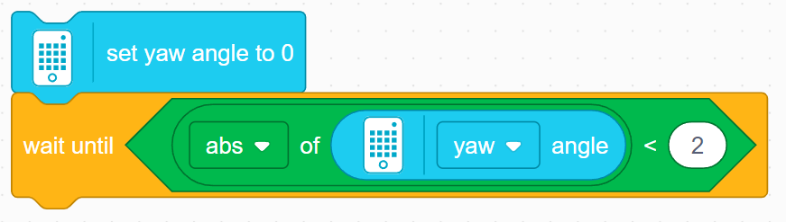
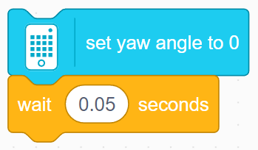
Bug In SPIKE 3
The set yaw angle to 0 block takes a small amount of time to perform, but moves on to the next block before its is completed
The problem is that the code reaches the check for if the yaw angle >90 before the yaw angle is reset, meaning that if the yaw angle read >90 before the reset, the robot will not perform the turn
To fix this, you will have to add a wait block after the gyro reset block and before the turn. There are two ways you can do this
Wait until the yaw angle reads close to 0
Wait for a small amount of time (around 0.05 seconds seems to work)
Note that some solutions provided in other lessons involving turns/the gyro sensor may not contain this wait block
Most code will function as intended in a standalone program since the gyro is reset at the beginning of all programs automatically, but may need the addition of one of these methods for your use until an update fixing this bug is released
However, in the previous slide, since multiple turns are being performed, the addition of the wait block is needed for the code to function properly

Slide 8
CREDITS
This lesson was created by Sanjay Seshan and Arvind Seshan for Prime Lessons
More lessons are available at www.primelessons.org
This work is licensed under a Creative Commons Attribution-NonCommercial-ShareAlike 4.0 International License.

