Slide 1
moving objects & Stall Detection
By Sanjay and Arvind Seshan
This lesson uses SPIKE 3 software

Slide 2
Lesson Objectives
Learn how to move non-drive motors
Learn about motor stalls

Slide 3
Single Motor Functions (Actions)
To use single motor functions, import the motor module:
import motor
Each motor function inputs the motor port as a parameter.
To run for a certain duration, use the following methods (see Knowledge Base for more info). These functions are asynchronous so use await if you want to wait for them to complete.
run_for_degrees(port, degrees, velocity)
run_for_time(seconds, duration, velocity)
To start running the motors, until stopped at a later spot
run(port, velocity)
stop()
To run the motor to a specific position
run_to_relative position(port, position, velocity)
run_to_absolute_position(port, position, velocity, direction=motor.SHORTEST_PATH)
Direction options are CLOCKWISE, COUNTERCLOCKWISE, LONGEST_PATH
These functions are asynchronous so use await if you want to wait for them to complete.

Slide 4
Single Motor Functions (Measurements/Settings)
The rotation sensor in the motor can be used to tell the number of degrees the motor has turned
To do this, use reset_relative_position(port, position) and relative_position(port)
Just like motor pairs, you can use parameters to change motor behavior
Set the stop action (BRAKE, COAST etc.)
Set acceleration, velocity etc.
You can also read different measurement methods associated with the motor
velocity(port)
relative_position(port)
absolute_position(port)

Slide 5
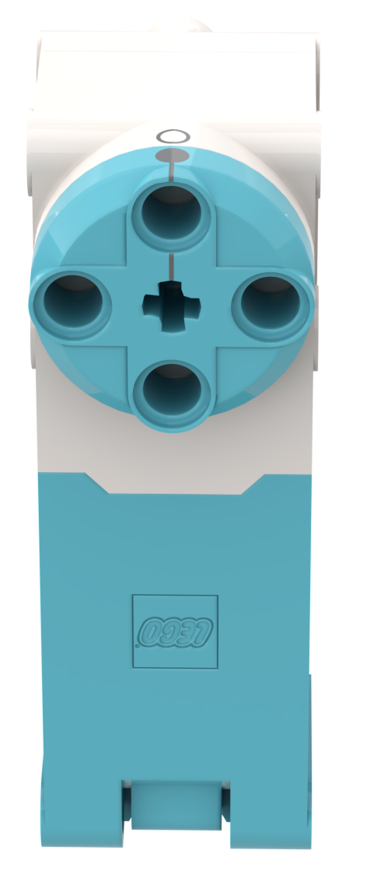
NEGATIVE Values
You can enter negative values for velocity or degrees
This will make the robot move backwards
If you negate two values (e.g., velocity and degrees or degrees and backwards direction), the robot will move forward.
Negative Power = Backwards
Positive Power = Forward

Slide 6
Stall detection
Often, you program the motor to move a particular amount. However, the motor gets stuck before it reaches that amount.
Stall Detection allows your program to automatically move on to the next line in the code when a particular motor command is stuck (unable to complete its move)
SPIKE Prime has a built-in Stall Detection
By default, Stall Detection is on when using single motor functions
As of version 3.4, SP3 does not allow stall detection to be changed or queried

Slide 7
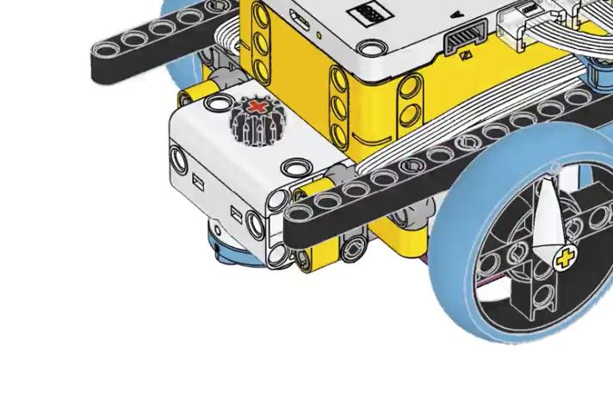
Challenge 1: Learn about stall with DB1
Write a program to turn the attachment motor E by1000 degrees.
Add a beeping sound after the motor command.
Hold the motor with your hand to prevent it from completing 1000 degrees. Hold for a couple of seconds.
Will the sound play?
Cause a stall by holding the motor blue part and preventing it from turning

Slide 8
Challenge 1 solution
Stall detection allowed the code to move on to the next line even when the motor got stuck. The beep played even though the motor did not finish completing its command.
from hub import port, sound
import motor, runloop, sys
async def main():
# Start the motor
await motor.run_for_degrees(port.E, 1000, 100)
await sound.beep()
sys.exit("Stopping")
runloop.run(main())

Slide 9
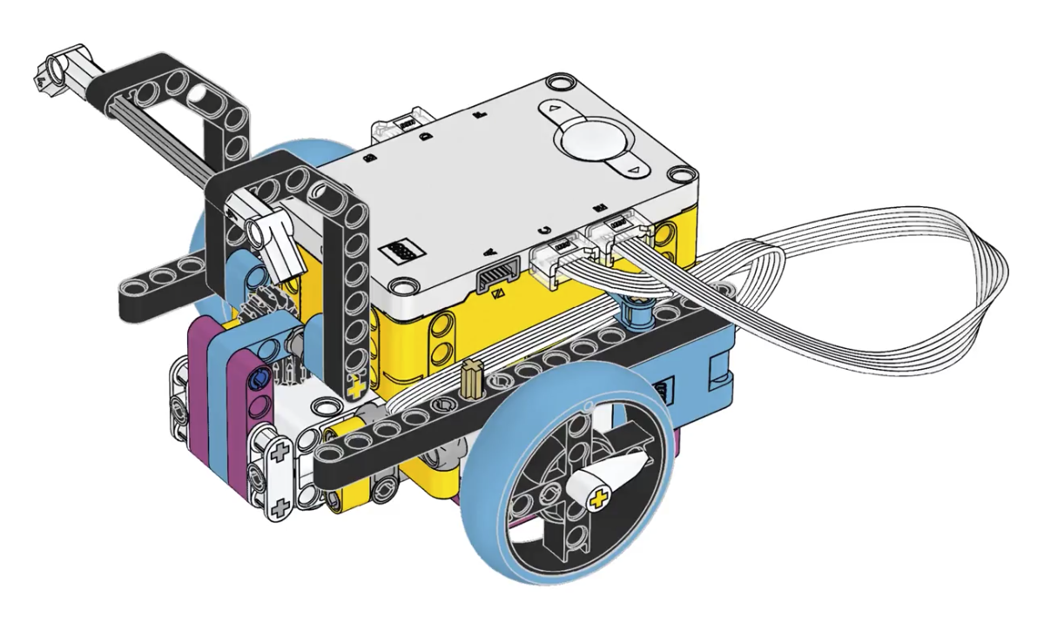
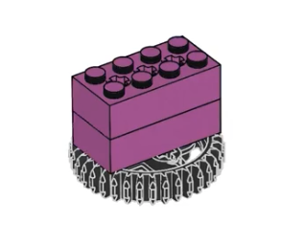
Challenge 2: grab object (DB2 challenge)
Build the attachment part of DB2
Drive forward, grab a marker and drag it back to the start and release it.
Marker is about 15cm from the front magenta-and-cyan panel.
15cm

Slide 10
Challenge 2 solution
from hub import port
import motor, motor_pair, runloop, sys
# Constants for Drive Base 1, adjust for your robot
motor_pair.pair(motor_pair.PAIR_1, port.C, port.D)
WHEEL_CIRCUMFERENCE = 17.5 # cm
# See lesson on More Accurate Turns for explanation of math
def degrees_for_distance(distance_cm):
return int((distance_cm/WHEEL_CIRCUMFERENCE) * 360)
async def main():
# Move forward 14.5cm
await motor_pair.move_for_degrees(motor_pair.PAIR_1, degrees_for_distance(14.5),0)
# lower the arm
await motor.run_for_degrees(port.E, -90, 100)
# move backward
await motor_pair.move_for_degrees(motor_pair.PAIR_1, degrees_for_distance(-14.5),0)
# raise the arm
await motor.run_for_degrees(port.E, 90, 100)
sys.exit("Done")
runloop.run(main())

Slide 11
Extensions
Think about situations in FIRST LEGO League when stall detection would be helpful
When might the robot get stuck?

Slide 12
CREDITS
This lesson was created by Sanjay and Arvind Seshan for Prime Lessons
Additional contributions by FLL Share & Learn community members
More lessons are available at www.primelessons.org
This work is licensed under a Creative Commons Attribution-NonCommercial-ShareAlike 4.0 International License.

