Slide 1
VIEWING SENSOR VALUES
BY SANJAY AND ARVIND SESHAN
This lesson uses SPIKE 3 software

Slide 2

LESSON OBJECTIVES
Learn how to view sensor values on SPIKE 3
Learn how the sensor values can differ from the values returned by the SP3 Python API, and how to adjust for those differences.

Slide 3
WHY DO YOU NEED SENSOR DATA?
Sensor data can be….
Used to help program more easily (no more guess and check!!)
Used to help program more accurately
Used to debug code as well as build issues
SPIKE Prime has no screen, but you can still view sensor data using the Hub Dashboard

Slide 4
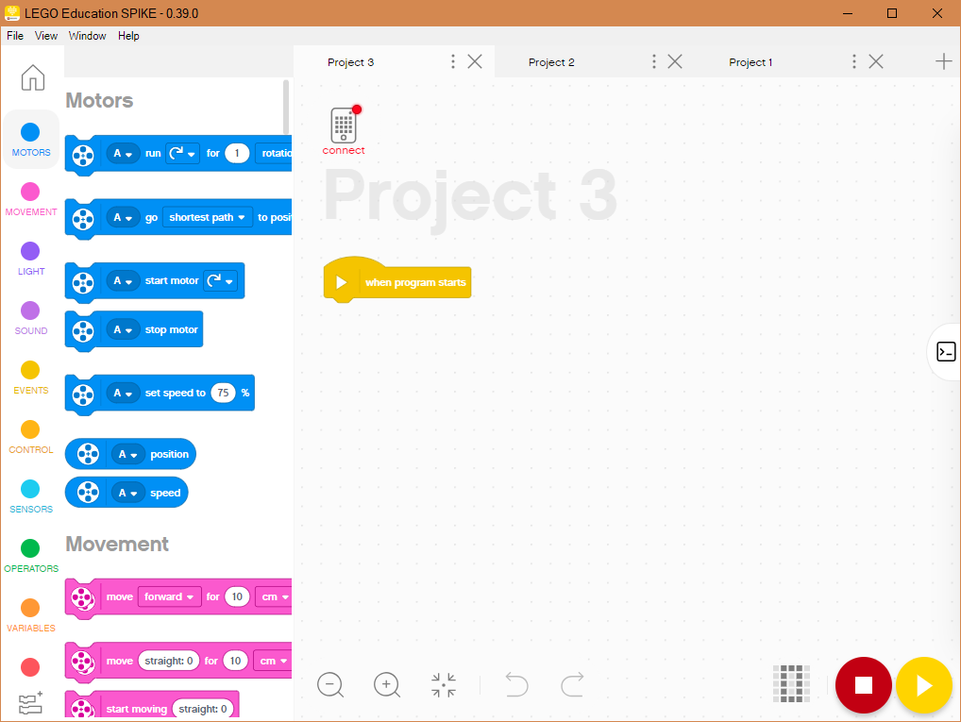
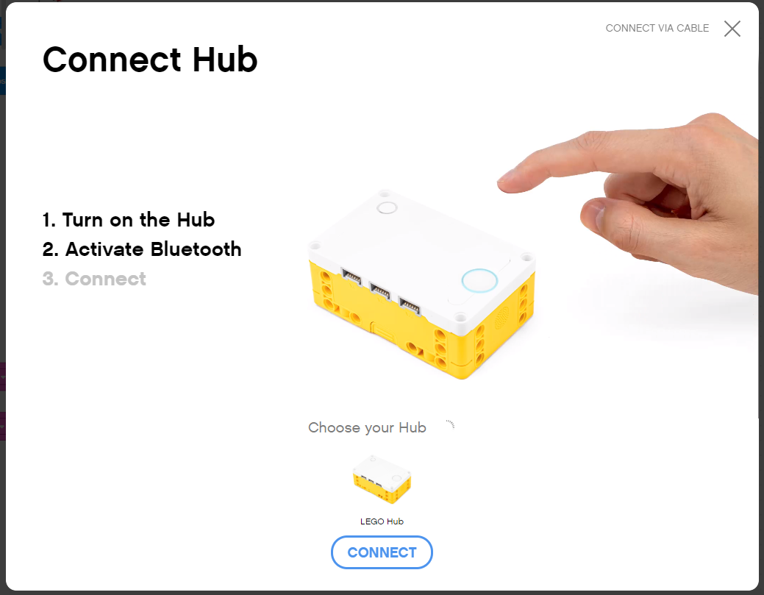
YOU MUST BE CONNECTED TO HUB
To view any sensor data, you must first be connected to the Hub (SPIKE Prime or Robot Inventor)
Click on the small Hub icon in a Project in SPIKE Prime or Robot Inventor

Slide 5
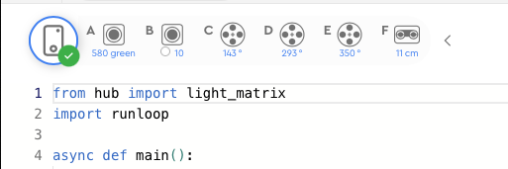
SENSOR VALUES ON PROJECT PAGE
Once connected to the Hub, Sensor and Motor Values are visible on the top of each Project page in SPIKE Prime

Slide 6
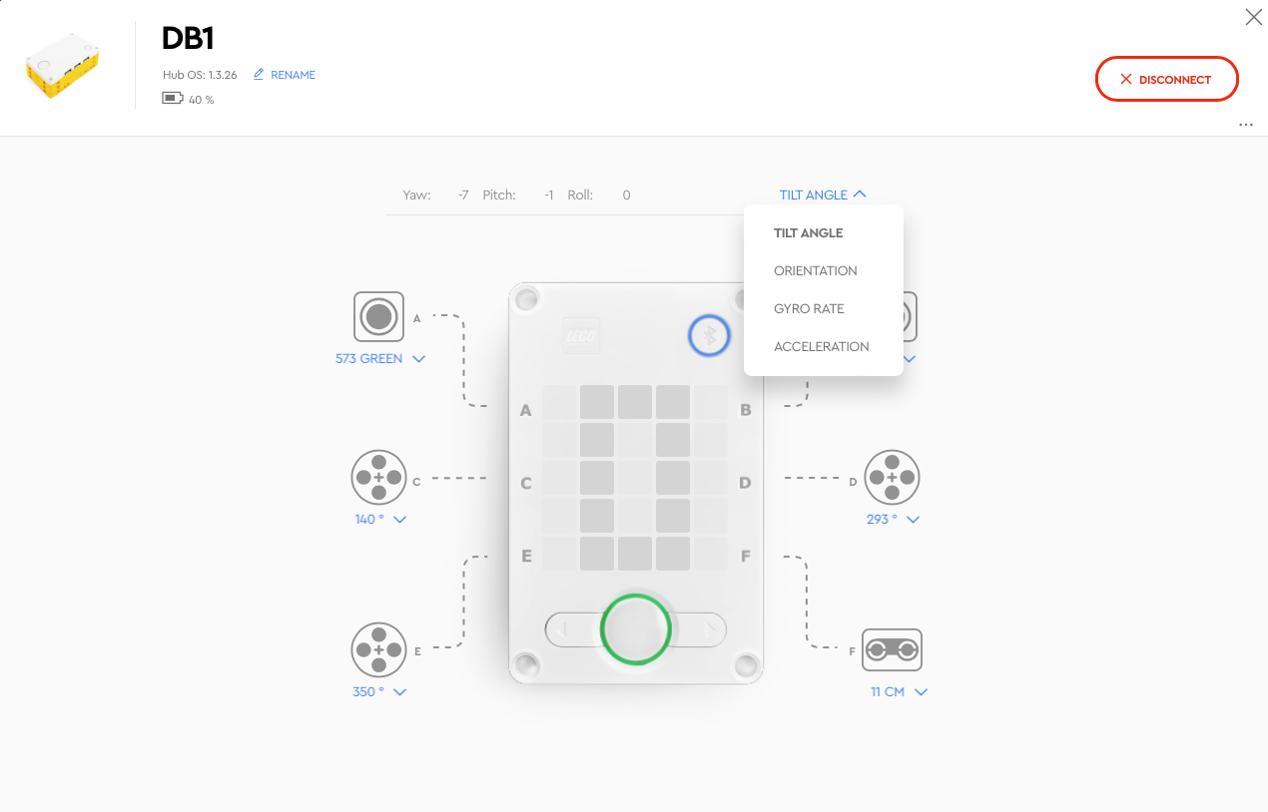
SENSOR VALUES ON DASHBOARD
Clicking on the Hub Icon in either SPIKE Prime takes you to the Hub Dashboard where you can see more sensor data

Slide 7
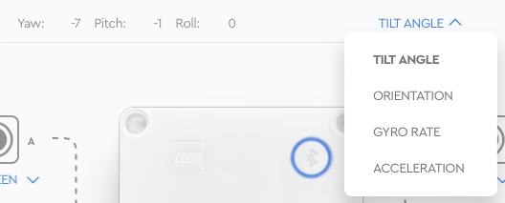
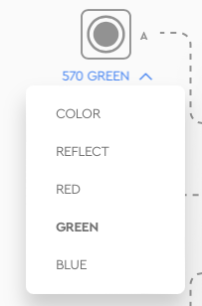
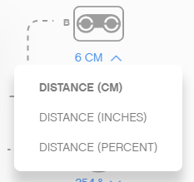
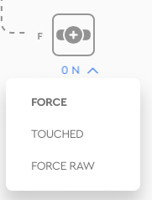
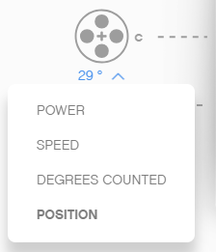
MORE SENSOR DATA ON THE DASHBOARD
From the Hub Dashboard, you can also see a lot of additional information about each sensor/motor
Select the mode using the down arrow
You can also see values for the built-in gyro sensor
Gyro Sensor
Color Sensor
Distance Sensor
Force Sensor
Motor
Note: The FORCE is 0 N i.e., 0 Newtons. Not “ON”

Slide 8
SENSOR DATA IS POWERFUL
Sensor data can help you program better and also help you debug your code
As you go through the rest of our lessons, you will use this feature often.
As you complete each challenge, think about how knowing sensor data might help you.
NOTE: Unlike Blocks, Python API for SP3 v3.4 returns values that can be different from what you see in the Dashboard. Some are outright confusing.
The next few slides describe the differences and how to adjust for them
Example programs are found in the Sensor lessons.

Slide 9
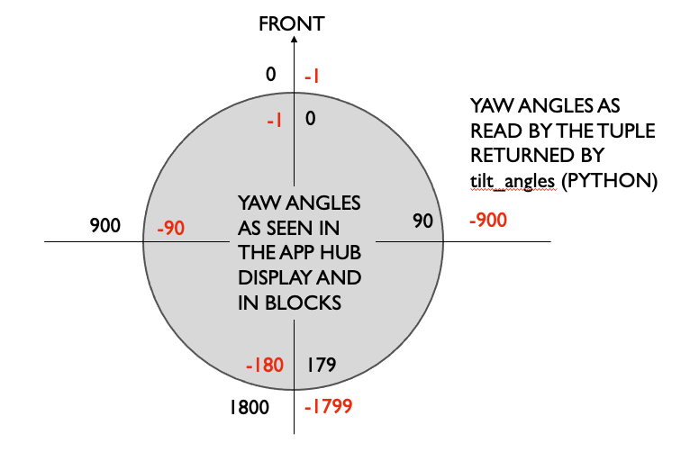
GYRO: DASHBOARD VS API
The gyro sensor in the dashboard shows yaw angle as 0 to179 clockwise, and -1 to -180 counterclockwise.
The Python API motion_sensor.tilt_angles(port)[0] returns -1to -1799 clockwise, and 0 to 1800 counterclockwise, with a sharp transition at the halfway mark.
Multiply the API reading by -0.1 to get the same value as in the dashboard.

Slide 10
COLOR SENSOR: DASHBOARD VS API
The color sensor API color_sensor.rgbi(port) returns four values, red, green, blue and an overall intensity.
The Knowledge Base as of SP3 v 3.4 does not have documentation on these values
The r,g,b values can be seen on the Dashboard and range from 0-800 by observation
The intensity is not shown on the Dashboard. By testing in a program, the values appear to go from 0 -1024.
Color and Reflection appear to work consistently with the Dashboard.

Slide 11
DISTANCE SENSOR: DASHBOARD VS API
When the distance sensor does not sense any object, i.e nothing is within its sensor range, the dashboard shows the maximum value of 200cm
The distance sensor API distance_sensor.distance(port) will return a value of -1 under the same condition.
The Dashboard shows the distance in CM or IN. This is the same as Blocks, but the Python API returns the distance in mm.
To check if an object is closer than 10cm, you have to check that the value is less than 100 and greater than 0. Remember the API returns values in mm.
Simply checking “less than 100” is not enough as -1 is also less than 100!

Slide 12
FORCE SENSOR: DASHBOARD VS API
The Dashboard has an option to show the force in:
Newtons (FORCE option): Values range from 0 - 10
deciNewtons (FORCE RAW option): Values range from 0 - 100
The Python API force_sensor.force(port) returns the result in deciNewtons. This is equal to the Dashboard FORCE RAW
The Python API force_sensor.raw(port) returns a value from ~0-700. it is not clearly documented in the KB. It is not represented anywhere on the Dashboard.

Slide 13
MOTOR: DASHBOARD VS API
The Dashboard shows motor speed as a percentage. This is the same as in Blocks
The Python APIs that input velocity defines absolute range values based on the type of motor:
Small motor (essential): -660 to 660
Medium motor: -1110 to 1110
Large motor: -1050 to 1050
The Python API motor.velocity(port) that outputs the current velocity appears to return a percentage, which is the same as the speed Dashboard value.

Slide 14
WHEN CAN SENSOR DATA CAN HELP?
Reduce Guess-and-Check: I want my robot to turn a particular amount, but I am not sure how much to turn without guessing.
Debug Code: The robot does not follow the green line like I programmed it to do. Why not? What color does the robot think that green line is?
Check Builds: I built my robot with the Force sensor a little bit inside the robot. I am not sure that the Force sensor is getting pressed enough. How can I make sure the sensor is getting pressed?
Test Sensors: I told my robot to stop when the Distance sensor is 20cm away. But it seems to stop earlier. Is the sensor working correctly? How can I see what the Distance sensor sees?

Slide 15
CREDITS
This lesson was created by Sanjay Seshan and Arvind Seshan for Prime Lessons
Additional contributions by FLL Share & Learn community members.
More lessons are available at www.primelessons.org
This work is licensed under a Creative Commons Attribution-NonCommercial-ShareAlike 4.0 International License.

