Slide 1
GRYO DRIFT
BY SANJAY AND ARVIND SESHAN
This lesson uses SPIKE 3 software

Slide 2
Lesson Objectives
Understand that the gyro sensor drifts and create a way to check for it

Slide 3
GYRO PROBLEMS
Issue 1: Watch this video. (https://youtu.be/PdQLqaILNgM). A robot using SPIKE 2 can start drifting after the hub is booted by running some simple code.
Issue 2: The gyro angle can also be stuck reading 0 all the time using both SPIKE 2 or SPIKE 3
Both issues are caused by gyro drift
In both SPIKE 2 and SPIKE 3, it seems that the gyro waits for the robot to be still before reading gyro values. However, since drift has already been introduced at this point by shaking the robot, the hub thinks that it is moving continuously even when the robot is still.

Slide 4
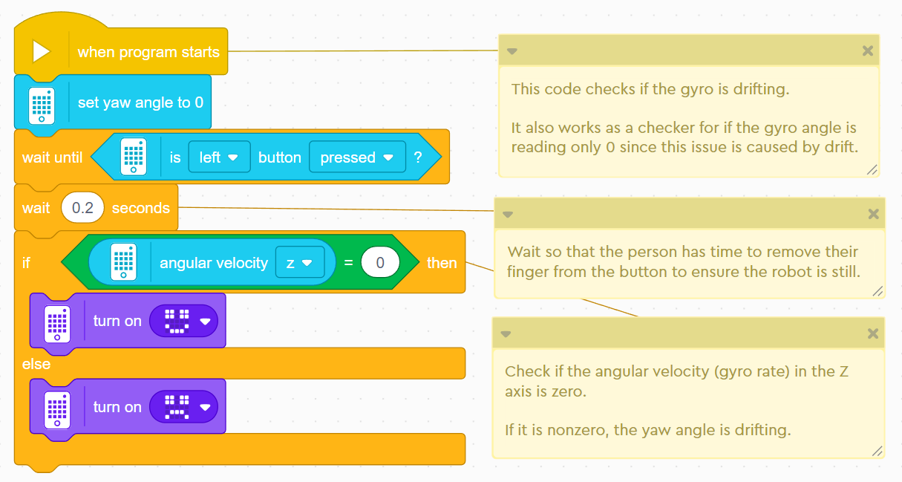
SOLUTION TO GYRO DRIFT
Check if your gyro is drifting before you launch your robot for your match
If it is drifting, reboot your robot
If the display shows an unhappy face when you press the left hub button while the hub is still, you will need to reboot your robot.

Slide 5
CREDITS
This lesson was created by Sanjay Seshan and Arvind Seshan for SPIKE Prime Lessons
More lessons are available at www.primelessons.org
This work is licensed under a Creative Commons Attribution-NonCommercial-ShareAlike 4.0 International License.

