Slide 1
PRINTING SPIKE PRIME code
BY SANJAY AND ARVIND SESHAN

Slide 2
Lesson Objectives
Learn how to print code for posters and engineering journals since there is no print feature inside the SPIKE software

Slide 3
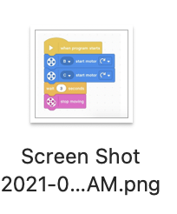
Capturing images from the Screen
On a Mac, you can easily capture screenshots of your code from inside the SPIKE software
Press 'Command', 'Shift' and '3' keys (all at the same time) to capture the entire screen.
Press "Command + Shift + 4” (all at the same time) and drag your mouse around the area you want captured to select only certain areas.
On a PC, Snipping Tool will do the same thing
Press Windows logo key + Shift + S. The desktop will darken while you select an area for your screenshot.
You can change the shape of your snip by choosing between Rectangular mode, Window mode, Full-screen mode, and Free-form mode.
Cut-and-paste these image files into another document (e.g. Power Point, Google Slides) and annotate as you need to.

Slide 4



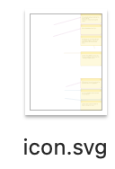
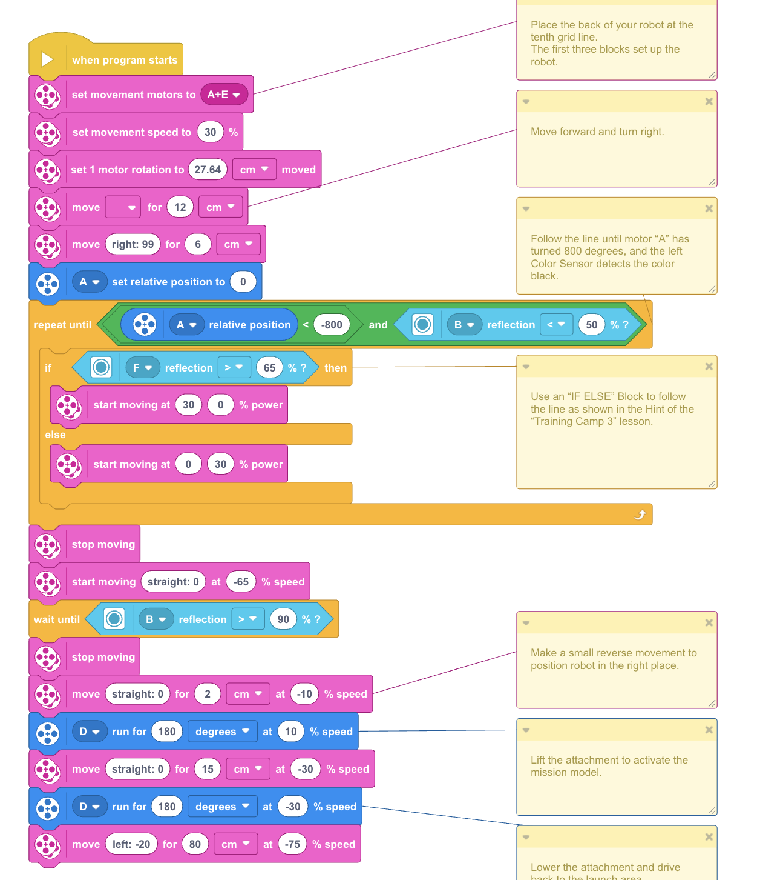
HIGH RESOLUTION IMAGES OF CODE
Find the SPIKE program files (.llsp or .llsp3) on your computer’s hard drive.
Duplicate the file and change the extension from .llsp or .llsp3 to “.zip”
Open the new .zip file you made
Inside you will find an icon.svg file which will be a high resolution image of your code
Note: SPIKE 2 uses .llsp and SPIKE 3 uses .llsp3

Slide 5
CREDITS
This lesson was created by Sanjay Seshan and Arvind Seshan for Prime Lessons
Credit for obtaining the svg file goes to a post by Wee Choon Kiat Cort
More lessons are available at www.primelessons.org
This work is licensed under a Creative Commons Attribution-NonCommercial-ShareAlike 4.0 International License.

