Slide 1
TURNING WITH THE GYRO
BY SANJAY AND ARVIND SESHAN
This lesson uses SPIKE 3 software

Slide 2
LESSON OBJECTIVES
Learn how to turn using the built-in motion sensor (gyro)

Slide 3
METHODS YOU NEED IN THIS LESSON
Motion Sensor methods – Used to read and reset the values of the gyro sensor
motion_sensor.tilt_angles()
This method returns a tuple containing 3 values. You can read more about Python Tuples in the Lists and Tuples lesson or at w3Schools Python Tuples
Each value in the tuple is in decidegrees (tenths of degrees). So to check for > 90 degrees you have to check a value of > 900.
motion_sensor.reset_yaw()
motion_sensor.stable()
This method returns true when the sensor is resting flat

Slide 4
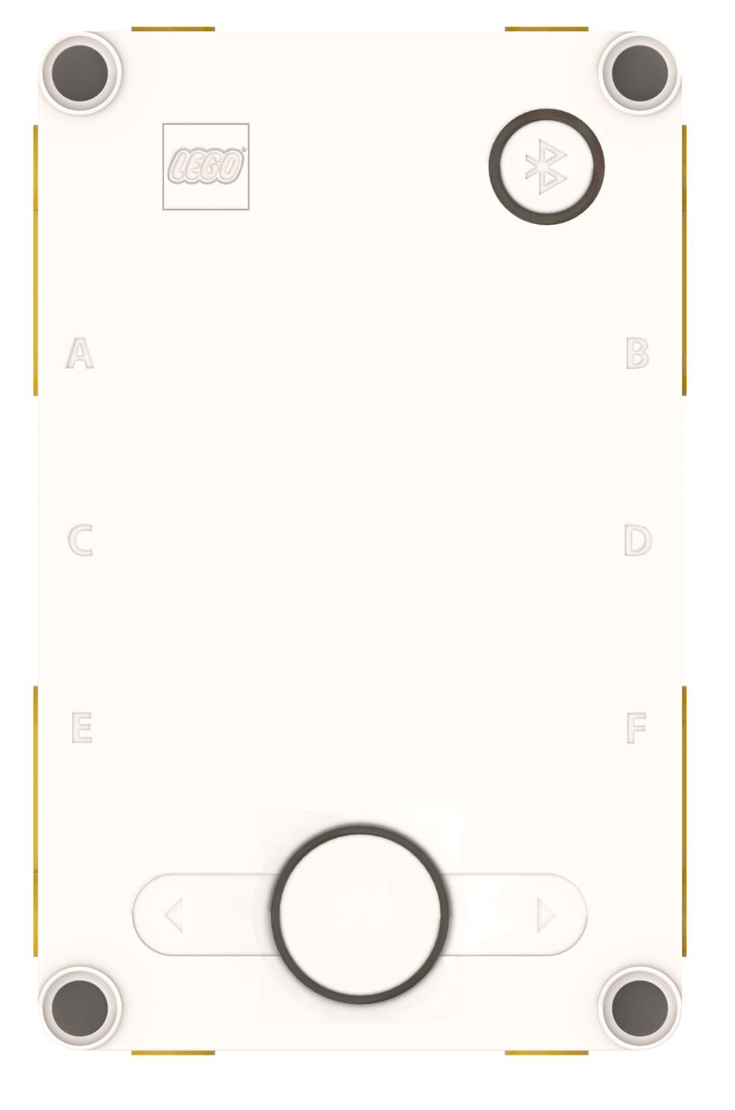
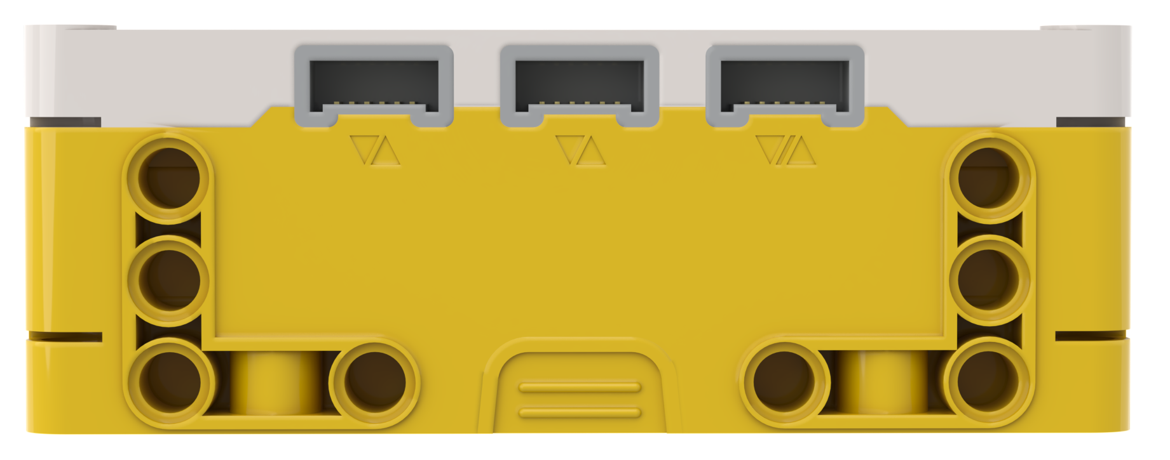
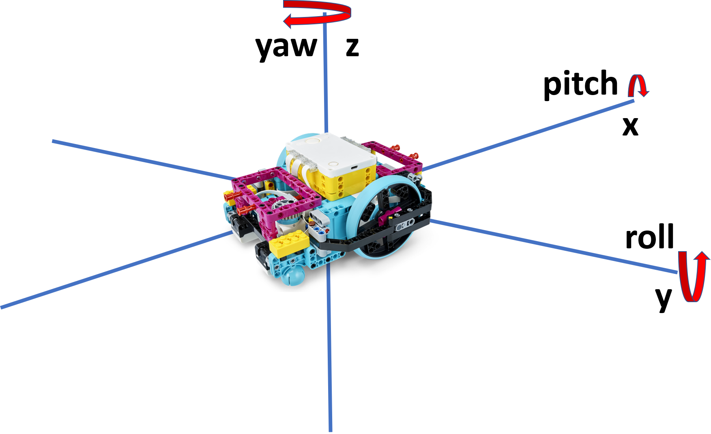
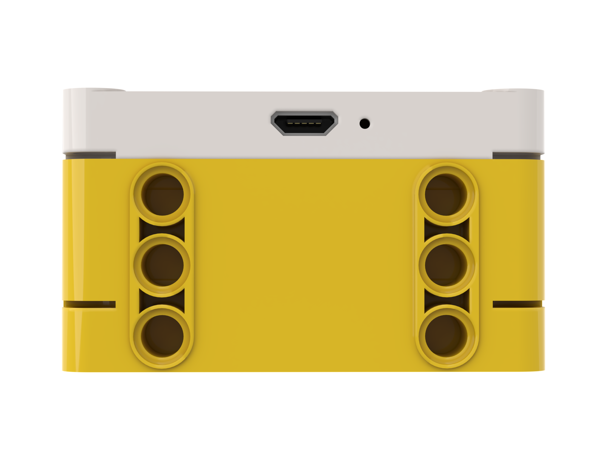
ROBOT ORIENTATION: YAW, PITCH AND ROLL
Yaw is turning the Hub to right or left
Pitch is turning the Hub up and down
Just like x, y and z coordinates are used to describe a robot’s position,
yaw, pitch and roll are terms used to describe a robot’s orientation.
Yaw is rotation around the z-axis. Pitch is rotation around y-axis.
Roll is rotation around the x-axis.
The built-in Gyro Sensor can measure the robot’s orientation
Roll is turning the Hub to side-to-side

Slide 5
USING THE MOTION SENSOR (GYRO) TO TURN
The gyro sensor can be programmed to measure the hub’s yaw, pitch and roll
These values can be used to sense if the robot has turned around x, y, or z axes
In this lesson, we will focus on yaw which can be used to determine if a robot has turned left or right
For pitch and roll, the robot uses gravity to determine what is a zero reading. Flat on the ground is 0 pitch and 0 roll.
For yaw, the robot doesn’t have a compass to tell it what is north or south. Therefore, you need to tell the robot what it should consider zero. This is done with the reset_yaw() method.
motion_sensor.tilt_angles()
motion_sensor.reset_yaw()

Slide 6
YAW ANGLE MEASUREMENTS
The Yaw value as seen in the app:
The yaw angle counts up from 0 (positive values) if the robot is turning right, and down from 0 (negative values) as the robot turns left
At the 180 degree mark, the signs change and there is a switch! The yaw reading as shown in the app will go from 179 to -180 if turning clockwise, and -180 to 179 if turning counterclockwise.
If you want to turn more than 180 degrees in a particular direction, you have to do some extra checks, explained later in the lesson.
The yaw value as read by the tilt_angles tuple:
Motion sensor tuple readings are the opposite sign as the values shown as the yaw reading in the app and in Blocks, and in decidegrees (tenths of degrees)
When moving clockwise from 0, the readings go from 0 to -1799, then to 1800 and down to 0
Multiplying the tuple reading by -0.1 converts it into the same value as in the App/Blocks.
If your turns are limited to less than 180 degrees, use absolute values to avoid bugs.

Slide 7
YAW ANGLE MEASUREMENTS (GRAPHIC)
FRONT
0
-1
0
YAW ANGLES AS READ BY THE TUPLE RETURNED BY tilt_angles (PYTHON)
-1
YAW ANGLES AS SEEN IN THE APP HUB DISPLAY AND IN BLOCKS
900
-90
90
-900
-180
179
1800
-1799

Slide 8
WAITING FOR THE GYRO TO REACH AN ANGLE
There are two options to measure if the robot has reached the desired angle
Option I: LEGO-specific API
Use the runloop.until function. It will wait until the function returns true.
The function cannot have any parameters. Use global variables as needed instead of parameters.
import runloop
await runloop.until(<function that returns true or false based on conditions/sensor readings>)
This option is easier to use and details can be found in the Spike Knowledge Base
Option II: General Python API
Use while loops
start moving....
while (motion_sensor.get_yaw_angle() < ANGLE):
<code>
stop moving....
Easier for running code while waiting. You could also use a user defined operator_function in wait_until() – but a while loop makes the code clearer.
If you do not want to run code, you can place pass in place of <code> to skip the iteration of the loop

Slide 9
THERE ARE TWO TYPES OF TURNS YOU CAN DO
180 Degree Pivot Turn
Notice where the robot ends in both pictures after a 180 degree turn.
In the Spin Turn, the robot moves a lot less and that makes Spin Turns are great for tight positions. Spin turns tend to be a bit faster but also a little less accurate.
So when you need to make turns, you should decide which turn is best for you!
C
End Position
Motor
C Moves
D
C
Start Position
D
180 Degree Spin Turn
Start Position
End Position
C
C
Motors
C and D Move
D
D

Slide 10
HOW TO MAKE PIVOT AND SPIN TURNS - 1
Using move:
Change steering value here. A value of 0 moves straight
motor_pair.move(pair, steering)
Steering Values
50 | -50 | 100 | -100
Pivot Turn Right | Pivot Turn Left | Spin Turn Right | Spin Turn Left
C
C
C
C
D
D
D
D

Slide 11
HOW TO MAKE PIVOT AND SPIN TURNS - 11
Using move tank:
Change velocity values here. Same velocity values moves straight
motor_pair.move_tank(pair, left_velocity, right_velocity)
Tank Velocity Values
200, 0 | 0, 200 | 200, -200 | -200, 200
Pivot Turn Right | Pivot Turn Left | Spin Turn Right | Spin Turn Left
C
C
C
C
D
D
D
D

Slide 12
CHALLENGE I
Write a program that turns 90 degrees to the right (clockwise) using a pivot turn
Basic Steps:
Define the motor pair
Reset yaw
Wait until motion sensor is stable
Start the motor pair using move or move_tank as you like.
Wait until the yaw has changed 90 degrees
Stop
NOTE: Always use < and > operators to compare sensor values! Never use == because the sensor may not be read at that exact value, and your loop will never stop.

Slide 13
CHALLENGE 1 SOLUTION
from hub import port, motion_sensor
import runloop, motor_pair, sys
# Function that returns true when the absolute yaw angle is 90 degrees
def turn_done():
# convert tuple decidegree into same format as in app and blocks
return abs(motion_sensor.tilt_angles()[0] * -0.1) > 90
async def main():
motor_pair.pair(motor_pair.PAIR_1, port.C, port.D)
motion_sensor.reset_yaw(0)
await runloop.until(motion_sensor.stable)
# move with a steering of 50
motor_pair.move(motor_pair.PAIR_1, 50, velocity=200)
# Alternate using tank:
# motor_pair.move_tank(motor_pair.PAIR_1, 200, 0)
await runloop.until(turn_done)
motor_pair.stop(motor_pair.PAIR_1)
sys.exit("Done")
runloop.run(main())

Slide 14
CHALLENGE 1I (ADVANCED)
Write a program that turns up to 355 degrees, clockwise or counterclockwise, using a spin turn
If you are turning counterclockwise, the yaw angle tuple reading will count up from 0 until 1800, but then it becomes negative and counts down! The reverse is true if you are turning clockwise. See the graphic.
Important steps:
Set the steering to positive if turning clockwise, and negative if turning counterclockwise
Determine what the yaw reading must be when the robot has to stop, using the standard (not tuple) convention as seen in the app:
If turning clockwise check that the yaw has become negative, AND is GREATER than the stop angle (see the graphic and try to figure out why this math works)
If turning counterclockwise check that the yaw has become positive, AND is LESS than the stop angle (see the graphic and try to figure out why this math works)
Convert the tuple reading into the standard yaw format (degrees, clockwise being positive and counterclockwise being negative) by multiplying it by -0.1 before using in any checks.

Slide 15
CHALLENGE 1I (ADVANCED) SOLUTION PAGE 1 OF 5
from hub import port, motion_sensor
import runloop, motor_pair, sys
# GLOBALS
# Set from -355 to 355. Positive numbers are clockwise.
degrees_to_turn = 0
# Yaw angle reading that indicates the robot needs to stop
stop_angle = 0
Set up a couple of globals to use in the program:
degrees_to_turn: degrees that the robot needs to turn. Positive is clockwise, negative is counterclockwise.
stop_angle: the yaw angle reading we are going to check against.

Slide 16
CHALLENGE 1I (ADVANCED) SOLUTION PAGE 2 OF 5
# Function that returns true when the yaw has turned past stop angle
def turn_done():
global degrees_to_turn, stop_angle
# convert tuple decidegree into the same format as in app and blocks
yaw_angle = motion_sensor.tilt_angles()[0] * -0.1
# if we need to turn less than 180 degrees, check the absolute values
if (abs(degrees_to_turn) < 180):
return abs(yaw_angle) > stop_angle
# If we need to turn more than 180 degrees, compute the yaw angle we need to stop at.
if degrees_to_turn >= 0: # moving clockwise
# The adjusted yaw angle is positive until we cross 180.
# Then, we are negative numbers counting up.
return yaw_angle < 0 and yaw_angle > stop_angle
else:
# The adjusted yaw angle is negative until we cross 180
# Then, we are positive numbers counting down.
return yaw_angle > 0 and yaw_angle < stop_angle
Add a function that lets the runloop know when the wait condition is reached.
The function has different checks for:
Angles whose absolute values are less than 180 i.e. they don’t cross the transition point
Angles that are more than 180 clockwise
Angles that are more than 180 counterclockwise

Slide 17
CHALLENGE 1I (ADVANCED) SOLUTION PAGE 3 OF 5
async def setupMotors():
motor_pair.pair(motor_pair.PAIR_1, port.C, port.D)
motion_sensor.reset_yaw(0)
await runloop.until(motion_sensor.stable)
Add a function that :
Sets up your motor pair
Resets the yaw angle to 0
Waits for the sensor to be stable

Slide 18
CHALLENGE 1I (ADVANCED) SOLUTION PAGE 4 OF 5
async def spinTurn(degrees):
if abs(degrees) > 355:
print("Out of range")
return
await setupMotors()
global degrees_to_turn, stop_angle
degrees_to_turn = degrees # set the global to use in the turn_done function
# set the stop_angle global to use in the turn_done function
if (abs(degrees) < 180):
stop_angle = abs(degrees_to_turn)
else:
stop_angle = (360 - abs(degrees)) if degrees < 0 else (abs(degrees) - 360)
# set the steering laue based on turn direction
steering_val = 100 if degrees >= 0 else -100
motor_pair.move(motor_pair.PAIR_1, steering_val, velocity=200)
await runloop.until(turn_done)
motor_pair.stop(motor_pair.PAIR_1)
Add a spinTurn that :
Inputs the degrees to turn and does some error checking for range
Sets up the motors and calculates the global variable values
Starts the motor pair moving with correct steering
Waits for the stop condition to be reached and then stops the motors

Slide 19
CHALLENGE 1I (ADVANCED) SOLUTION PAGE 5 OF 5
async def main():
await spinTurn(270)
sys.exit("Done")
runloop.run(main())
Put it all together:
Main function calls spin turn with desired degrees (-355 to 355), waits for completion and exits
Runloop runs the main function
You can extend these concepts to write a pivot function that can pivot the robot -355 to 355. These are good functions to add to a library.
Note that yaw readings are not accurate at fast speeds. Slower turns give better results. If you need to, you can adjust the turn angle up if it is stopping too soon.

Slide 20
TURNING CHALLENGES
Challenge 1
Your robot is a baseball player who has to run to all the bases and go back to home plate.
Can you program your robot to move forward and then turn left?
Use a square box or tape
Challenge 2
Your robot baseball player must run to second base, turn around and come back to first.
Go straight. Turn 180 degrees and return to the same spot.
Second Base
C
C
Start and End position
First Base
D
D

Slide 21
CHALLENGE SOLUTIONS
Challenge 1
You probably used a combination of the move() method to go straight and do pivot turns to go around the box.
Challenge 2
You probably used a spin turn because it is better for tighter turns and gets you closer to the starting point!

Slide 22
CREDITS
This lesson was created by Sanjay and Arvind Seshan for Prime Lessons
Additional contributions by FLL Share & Learn community members.
More lessons are available at www.primelessons.org
This work is licensed under a Creative Commons Attribution-NonCommercial-ShareAlike 4.0 International License.

