Slide 1
Introduction to Force sensor
BY SANJAY AND ARVIND SESHAN
This lesson uses SPIKE 3 software

Slide 2
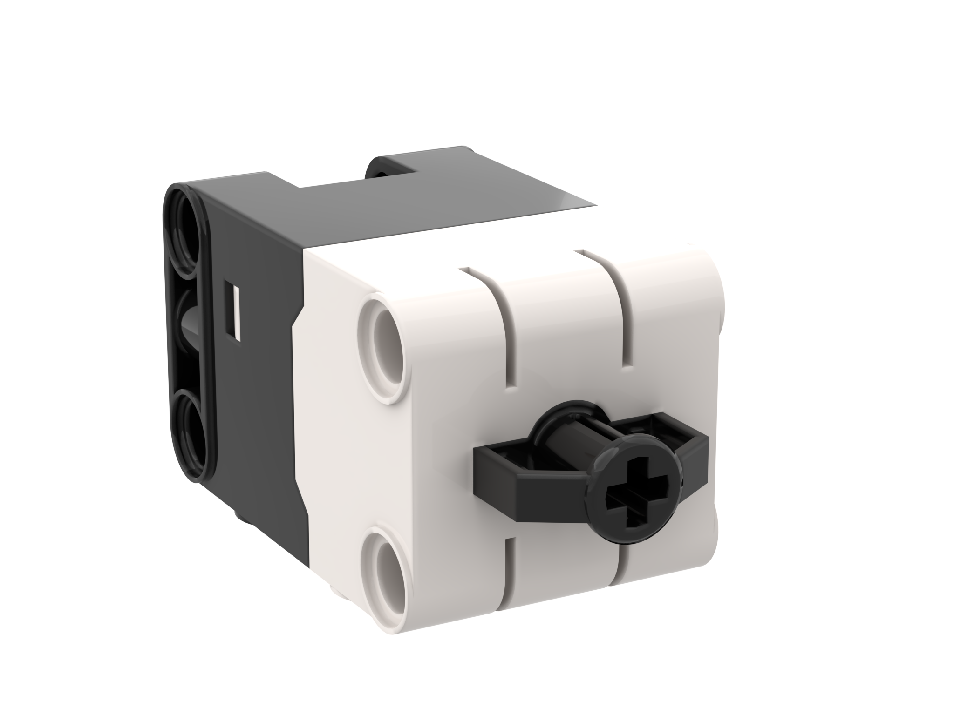
Lesson Objectives
Learn how to use the Force Sensor
Learn how to use the Wait Until Block
Note: The Force Sensor is not available in Robot Inventor

Slide 3
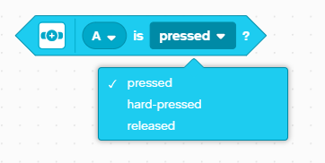
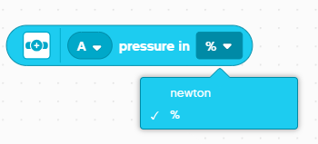
What is a force sensor?
The Force Sensor does two main types of sensing:
Touch sensing
Force sensing
You can measure the Force in percent or Newtons

Slide 4
How do you program with a force Sensor
The three modes are
Pressed – even a gentle tap is detected
Hard-pressed – pressing the sensor about 60% in
Released – sensor is not pressed

Slide 5
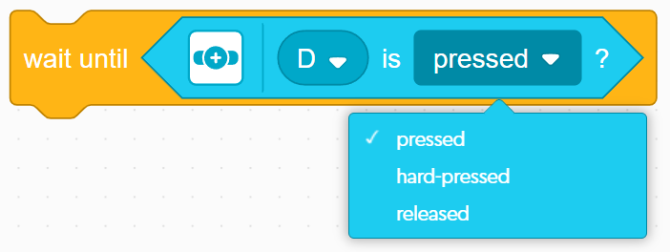
Challenge 1: Move until Pressed
Program your robot to move forward until you press the sensor with your hand
Try using the sensor in Pressed and Hard-Pressed Modes
You will use the wait until block for this challenge
Basic steps:
Set the movement motors for your robot (A and E for Droid Bot IV and ADB robot)
Set the movement speed for your robot
Start moving forward
Use the wait until block to detect when the Force Sensor is pressed
Stop moving

Slide 6
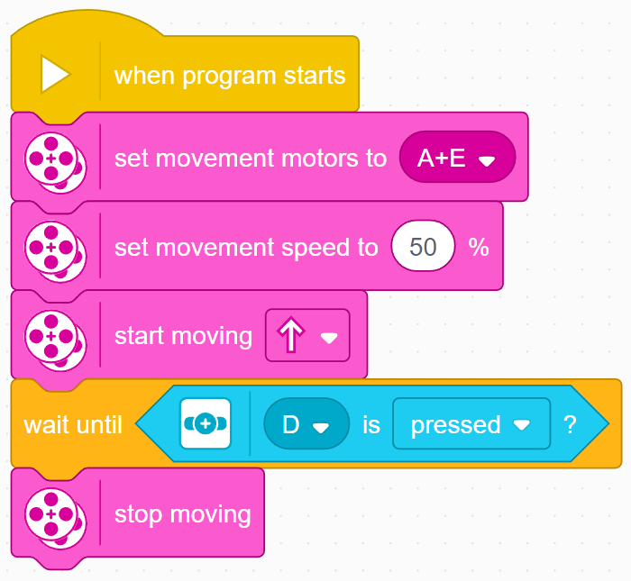
Challenge 1: Solution
In previous lessons, you learnt how to configure your robot. The first set of blocks sets the movement motors and speed. (See Configuring Your Robot Lesson)
Note: 50% is the default speed so the set movement speed block can be omitted in this case. It is provided so you can adjust the speed as needed.
Configure robot
Start moving
Wait until the Force Sensor is pressed
Stop moving

Slide 7
CREDITS
This lesson was created by Sanjay Seshan and Arvind Seshan for Prime Lessons
More lessons are available at www.primelessons.org
This work is licensed under a Creative Commons Attribution-NonCommercial-ShareAlike 4.0 International License.

