Slide 1
Domestic Service Robot
Sensing and Inspection Requirements
Author: Dorian Neumann

Slide 2
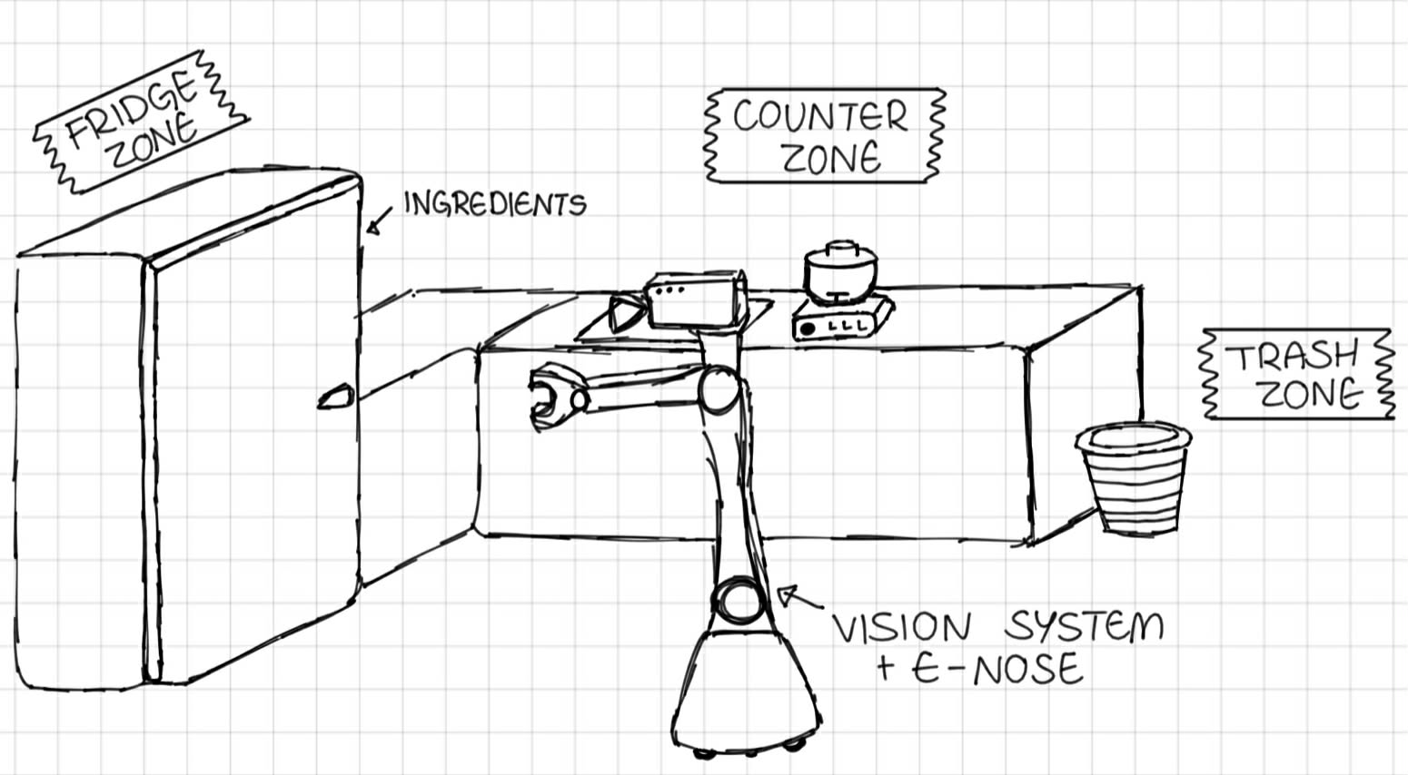
Overview
Objective: The robot must prepare a smoothie, but the state of some ingredients is unknown . The robot must inspect ingredients before use.
Main requirements:
🔶 Uncertainty – Freshness status is initially unknown for the robot.
🔶 Sensing – Inspection actions (Vision + eNose) updates robot's knowledge.
🔶 Dynamics – The food spoils over time (PDDL+)

Slide 3
Pddl Design choices
Uncertainty was modelled in classical PDDL by distinguishing reality from the robot's knowledge state by given predicates:
🔶 is-fresh (?i) – physical state of an ingredient
🔶 inspected (?I) - knowledge flag
Every sensing action has a high cost of 3 or 4 cost points forcing the robot to minimize sensing.

Slide 4
PDDL+ Design choices
Dynamics in PDDL+ was modelled by using three numeric fluents:
🔶 (spoilage-level ?i - ingredient) - tracks the continuous degradation of the ingredient;
🔶 (action-timer ?r - robot) - measures the elapsed time of a current task;
🔶 (total-cost) - metric that helps planner to find well-optimized plan.
To ensure correct physical modelling, two main processes and events were used:
🔶 spoilage-fridge – slowly increases food spoilage in the fridge (process)
🔶 spoilage-outside – increases food spoilage outside the fridge (process)
🔶 food-spoils – changes food state to unfresh if spoilage value exceeds the predefined limit.

Slide 5
REFLECTION
Main challenges:
🔶 Modelling PDDL+ time to fit into ENHSP planner;
🔶 Handling complexity of calculation in continuous time;
🔶 Forcing the robot to execute tasks in shorter time.
What would I do differently:
🔶 Easier, not overly complicated domain
🔶 Less complex differential equations
Limitations:
🔶 God-like Knowledge Paradox
🔶 Precision vs Efficiency
🔶 Goal-Oriented Constrains Limitation

