Slide 1
Campus Events Centralized Platform
Alex Trumble, Evan Rodriguez, Olumide Ayo, and Lydiah Kabiru

Slide 2
The Problem
Plenty of groups looking for experiences on campus
Lists spread throughout endless webpages and social media accounts
An online system for organizers and individuals to connect can vastly help

Slide 3
Implementation
Web-based system
Runs on EJS, Node.JS and MongoDB

Slide 4
Design and Accessibility
Plenty of feedback was given about the visuals of the testing phase
The following is an example of visual improvement...

Slide 5
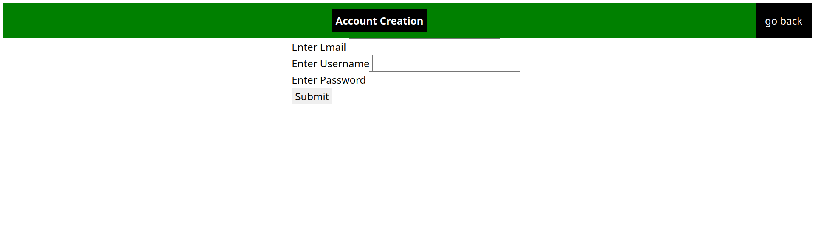

Analysis and Design

Slide 6
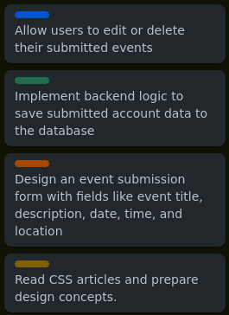
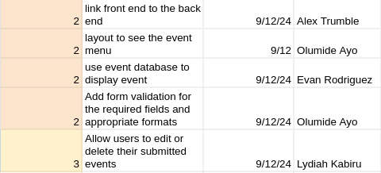
Project Management and Team Dynamics
Casual environment
Show Sprints and Production Plan

Slide 7
Future Prospects
The current system is viable, and can be scaled to a vast level
A focus on optimization for future improvement

Slide 8
Live Demonstration

Slide 9
Technical and Professional Growth

Slide 10
Thank you!

