Slide 1


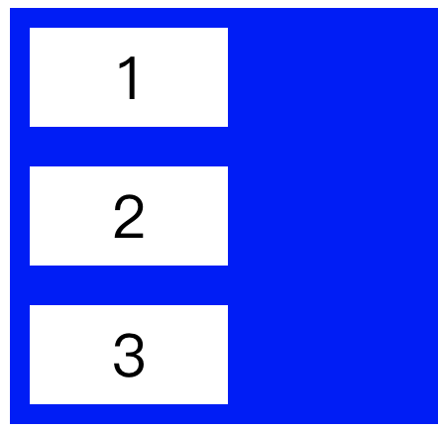
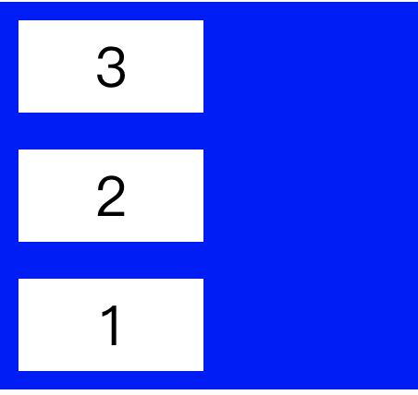
flex-direction: row;
flex-direction: row-reverse;
flex-direction: column;
flex-direction: column-reverse;

Slide 2
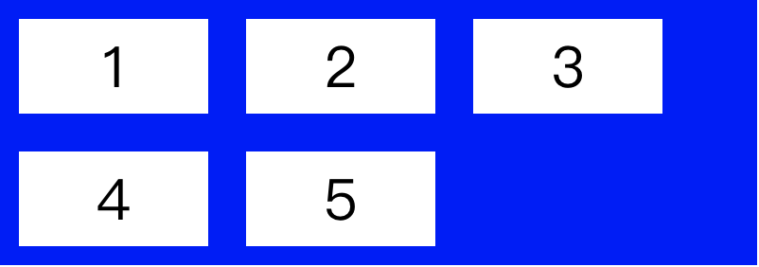
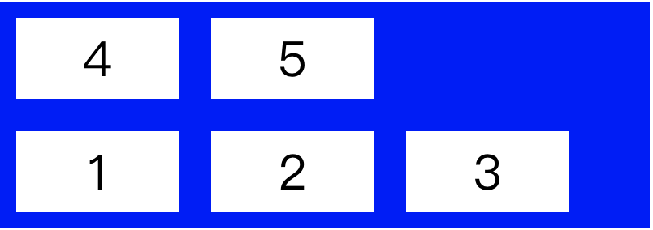

flex-wrap: nowrap;
flex-wrap: wrap;
flex-wrap: wrap-reverse;

Slide 3





justify-content: flex-start;
justify-content: flex-end;
justify-content: center;
justify-content: space-between;
justify-content: space-around;

Slide 4
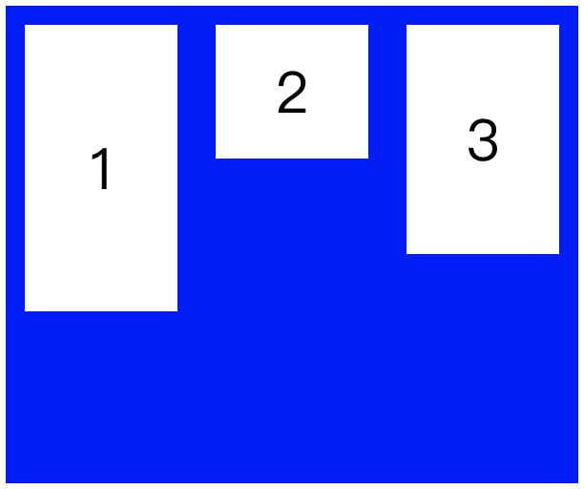
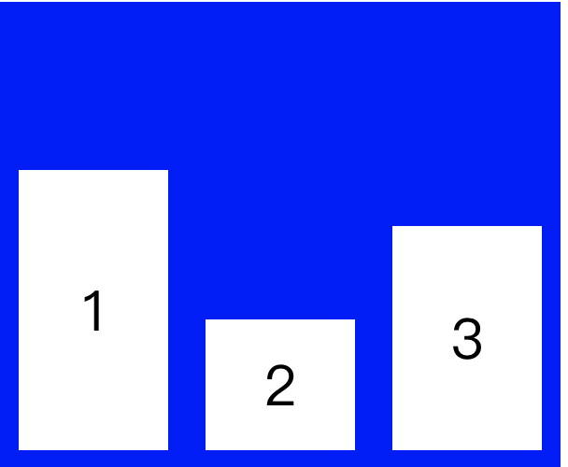
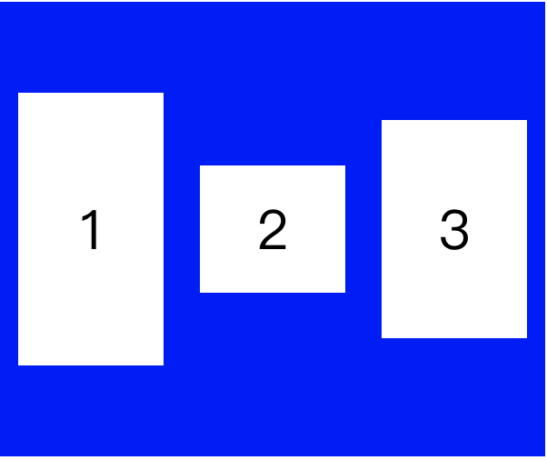
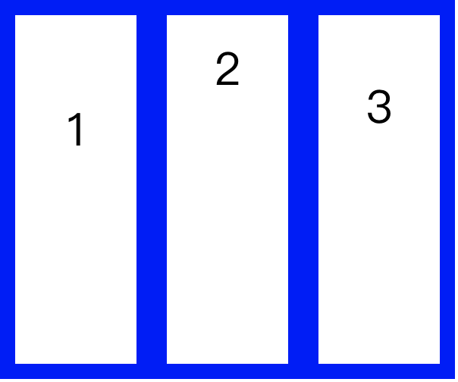
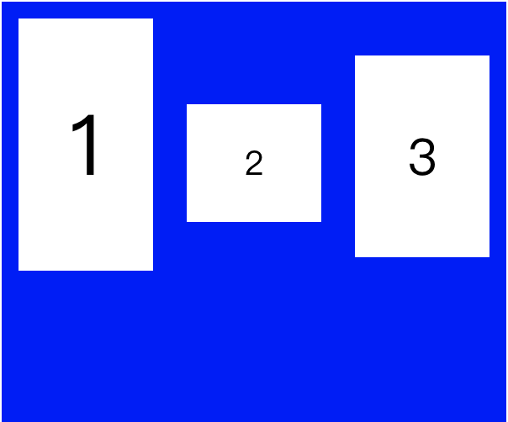
align-items: flex-start;
align-items: flex-end;
align-items: center;
align-items: stretch;
align-items: baseline;
baseline

Slide 5
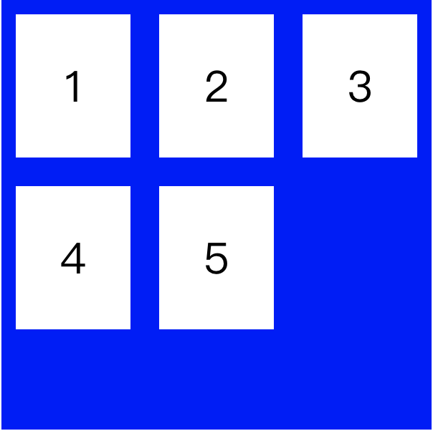
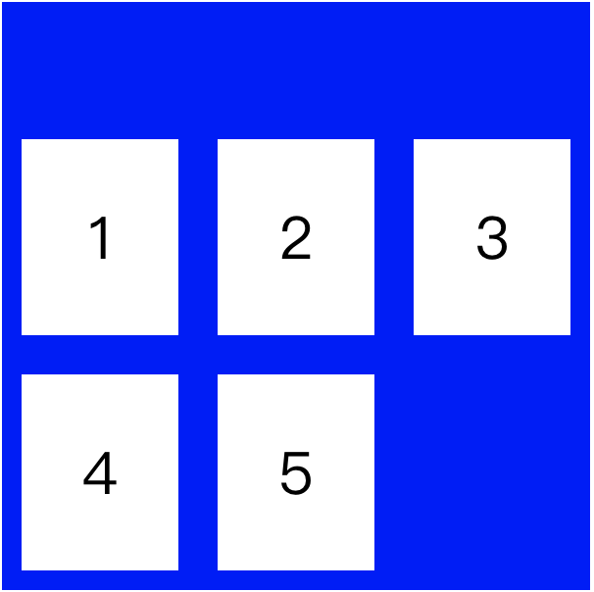
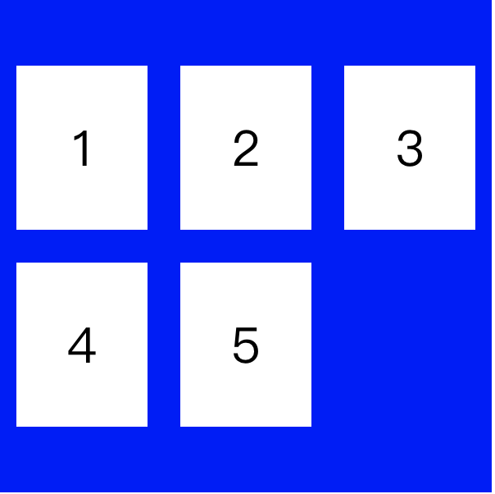
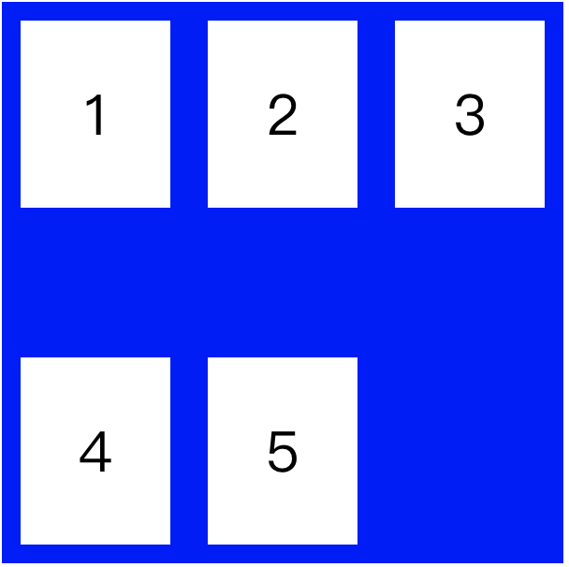
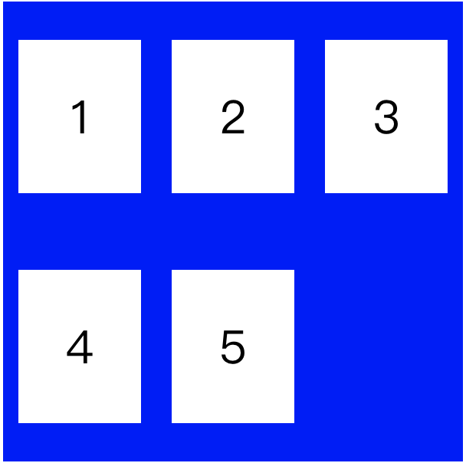
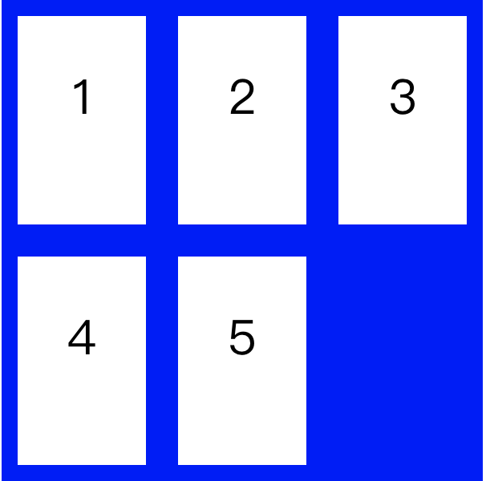
align-content: flex-start;
align-content: flex-end;
align-content: center;
align-content: space-between;
align-content: space-around;
align-content: stretch;

Slide 6




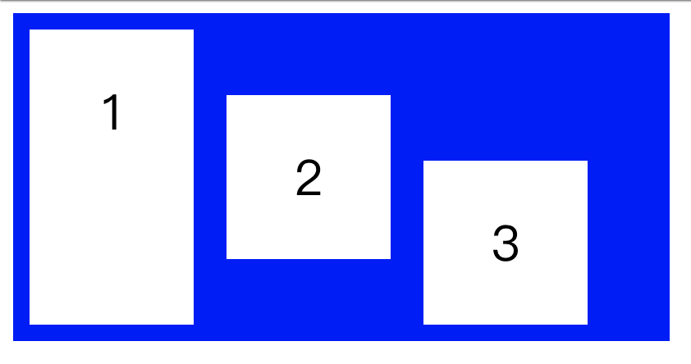


Slide 7
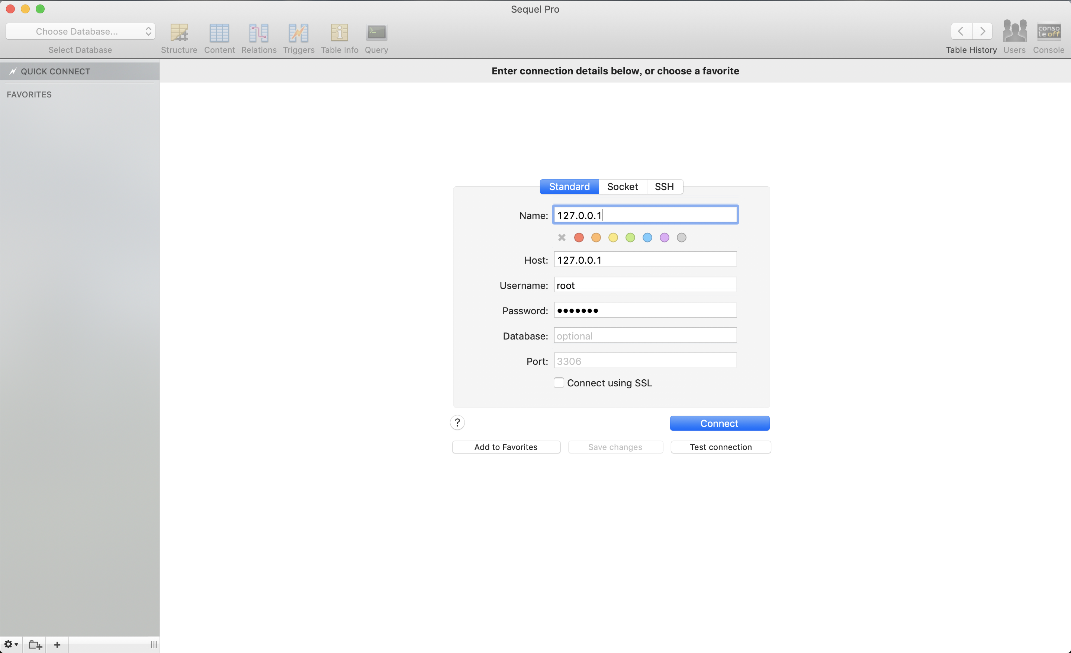
1
輸入帳號密碼資訊
2
增加至Favorites，下次登入即可快速登入

Slide 8
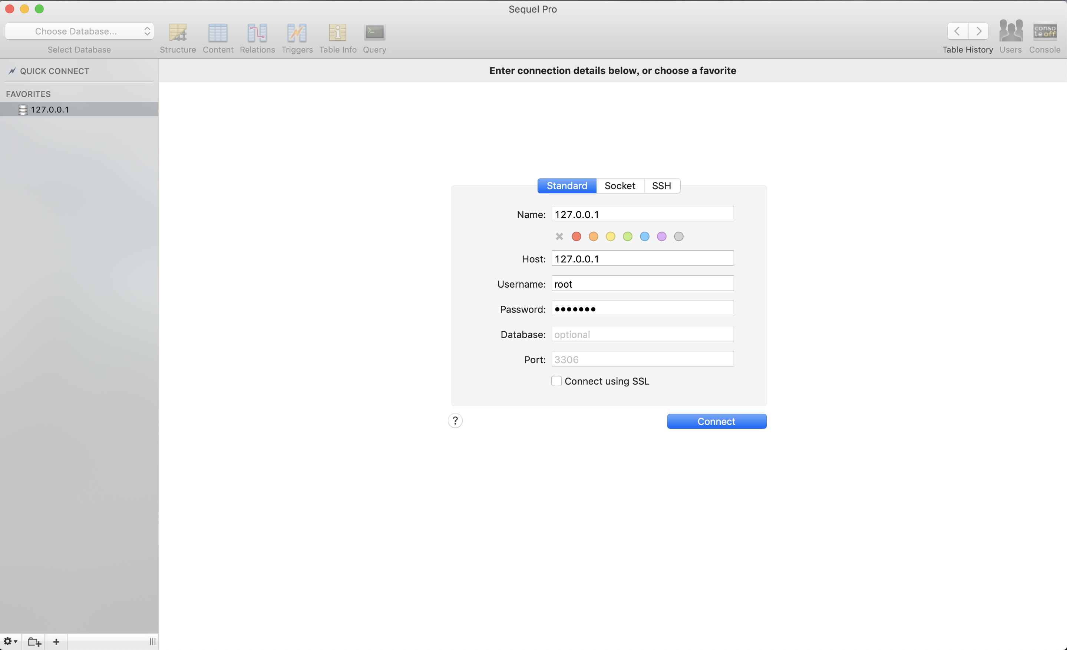
下次登入即可點擊此處快速登入

Slide 9
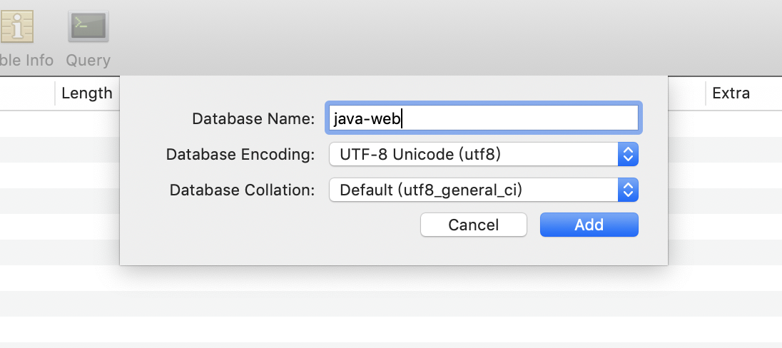
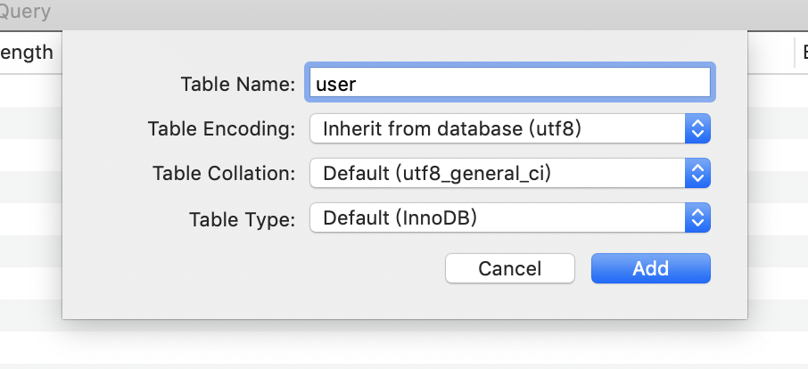
1
輸入database資訊
2
點擊Add新增資料庫
1
輸入table資訊
2
點擊Add新增資料表

Slide 10
