Slide 1


32.768kHz Crystal
5V Supply
170V DC/DC Supply
A0
A1
A2
A3
D0
D1
D2
D3
74141
Driver
0
1
...
9
10HR Nixie
SysTick 1Hz
tick=True
curr_hr
curr_min
curr_sec
GPIO_Init()
SysTick_Init()
LSE_RCC_Init()
B0
B1
B2
B3
D0
D1
D2
D3
74141
Driver
0
1
...
9
1HR Nixie
tick?
no
yes
C0
C1
C2
C3
D0
D1
D2
D3
74141
Driver
0
1
...
9
10MIN Nixie
def inc_sec(void){
If (curr_sec==59) {
curr_sec=0;
inc_min(); }
else curr_sec++}
inc_sec()
update_GPIO()
void int2bcd(int) {
return <blah>
}
update_GPIO(void) {
bcd = int2bcd(curr_sec)
GPIOF0 = bcd & 0x1;
GPIOF1 = bcd & 0x2 >> 1;
GPIOF2 = bcd & 0x4 >> 2;
GPIOF3 = bcd & 0x8 >> 3;
GPIOE0 = bcd & 0x10 >> 4;
GPIOE1 = bcd & 0x20 >> 5;
GPIOE2 = bcd & 0x40 >> 6;
GPIOE3 = bcd & 0x80 >> 7;
<repeat for GPIO A-D>
}
D0
D1
D2
D3
D0
D1
D2
D3
74141
Driver
0
1
...
9
1MIN Nixie
Btn_event?
def inc_min(void){
If (curr_min==59) {
curr_min=0;
inc_hr(); }
else curr_min++;}
no
D0
D1
D2
D3
74141
Driver
0
1
...
9
10SEC Nixie
yes
E0
E1
E2
E3
<code to write curr_* from button states>
def inc_hr(void){
If (curr_hr==12) {
curr_min=1; }
else curr_hr++}
F0
F1
F2
F3
D0
D1
D2
D3
74141
Driver
0
1
...
9
1SEC Nixie

Slide 2
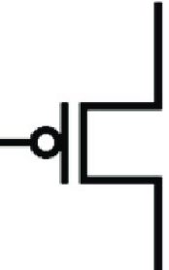
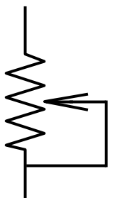
32.768kHz Crystal
200V DC/DC Supply
SysTick 1Hz
tick=True
GPIO
74141
Driver
Main loop
tick?
no
yes
inc_sec()
update_GPIO()
unset tick
buffer
DMA
ADC Continuous Polling
Interrupt when buffer is written
buffer
DMA
GPIO
brightness_flag?
no
Sec_flag?
yes
yes
Set brightness_flag
Interrupt when buffer is written
Set pwm_rate
Unset brightness_flag
Debounce buffer
Increment sec
Unset sec_flag
Set sec_flag

Slide 3
HV Supply
Cortex M4
M4 processor | LQFP64 package, STM32F405RGT6
Nixie Tubes
GPIO
Potentiometers

Slide 4
PWM Level
ADC
0-5V Potentiometer
Time Setting Increment
GPIO
Hour Set Pushbutton
Time Setting Increment
GPIO
Minute Set Pushbutton
Time Setting Increment
GPIO
Seconds Set Pushbutton

Slide 5
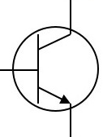
170V DC/DC Supply
10HR Nixie
GND
1HR Nixie
HR B12 Counter
10MIN Nixie
MIN B60 Counter
1MIN Nixie
…
32.768kHz Crystal
2¹⁵ Counter
SEC B60 Counter
10SEC Nixie
1SEC Nixie
GND

Slide 7
PWR
H
M
S
H
H
M
M
S
S

