Slide 1

Natural experiments using R
Improving the Design of Conditional Transfer Programs: Evidence from a Randomized Education Experiment in Colombia, Barrera-Osorio et al.
Dimitrios Papadopoulos
Eva-Maria Bonin

Slide 2
Introduction: This study is based on the hypothesis that Conditional cash transfers (CCTs) are an evidence-based intervention to increase participation in education. The paper investigates if changes in the timing of payments affect the outcomes of interest: Attendance and re-enrollment .
Dataset: The dataset used is not the one given through the lectures but the original one which contained more variables and we could implement more models in our project from the given paper. Link:

Slide 3

Procedure: In order to replicate the results of table 3, we should apply linear regression models containing specific variables. Additionally to that, the data feed in the model, should be filtered accordingly.
Above the data is filtered for grades equal or over 6, for survey selected students for area other than suba as treatment 1 and 2 (basic and savings treatment) took place in other areas except Suba.

Slide 4
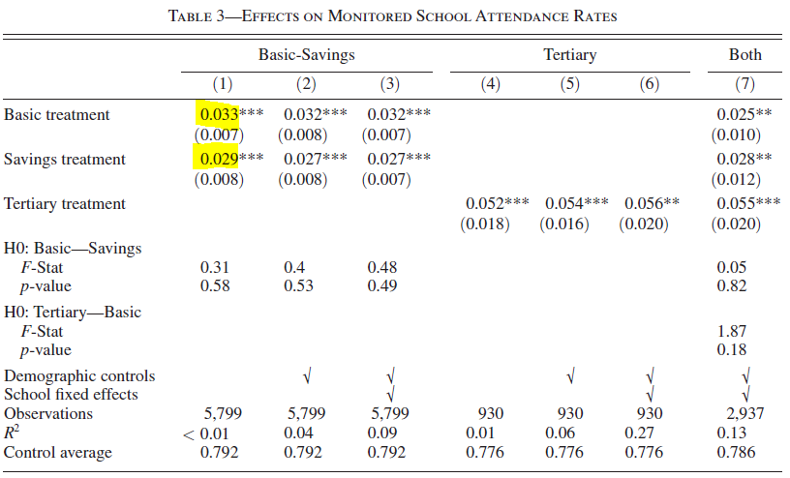
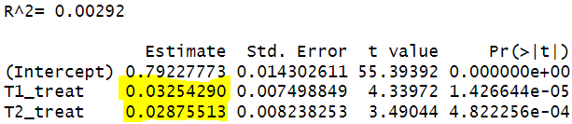
1st model: By creating the first model, clustered to school grades and run the summary we get the results below
The coefficients of the model are pretty similar to the ones of the table so one can assume that for San Cristobal the attendance rate is given by the specific model for the Basic-Savings treatment and the replication is successful.

Slide 5
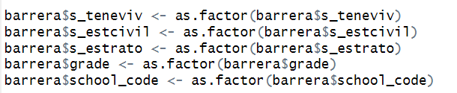
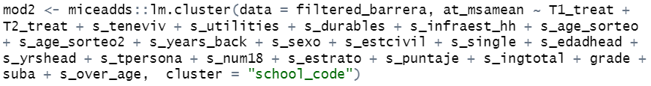
2nd model: To replicate the second model, it was necessary to include some demographic variables in it. These demographic variables are included in the dataset but needed to be transformed into factor. Then the model is created and the results are displayed for both the summary and table 3 as in the previous model.
Demographic variables:
Model:
The coefficients of the model are pretty similar to the ones of the table so one can assume that for San Cristobal the attendance rate is given by the specific model for the Basic-Savings treatment and the replication is successful.

Slide 6
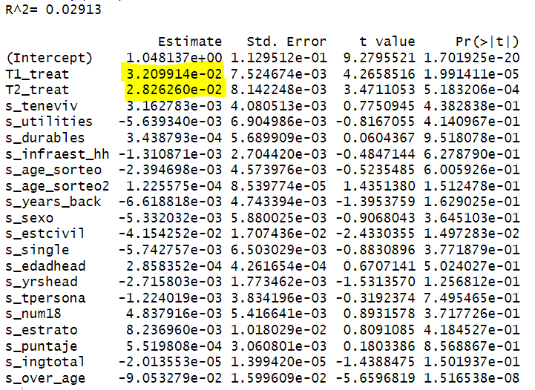
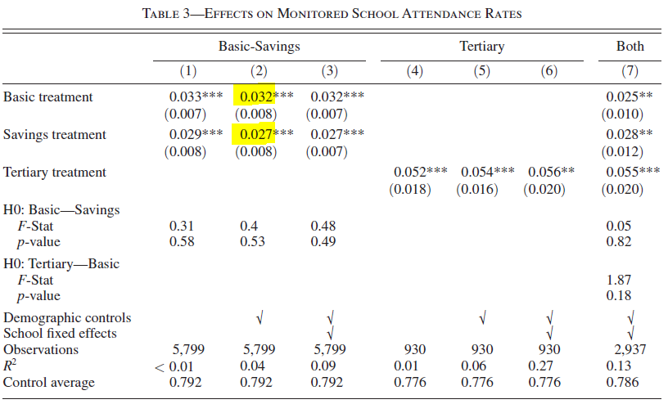
2nd model results:
The results are as expected very similar to the ones of the table 3.

Slide 7
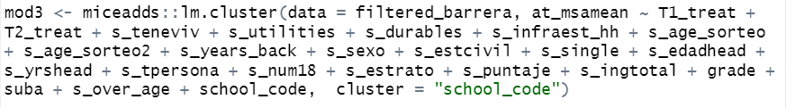
3rd model: The third model is similar to the second one but in this case we use school codeis included as factor.
School code:
Model:

Slide 8
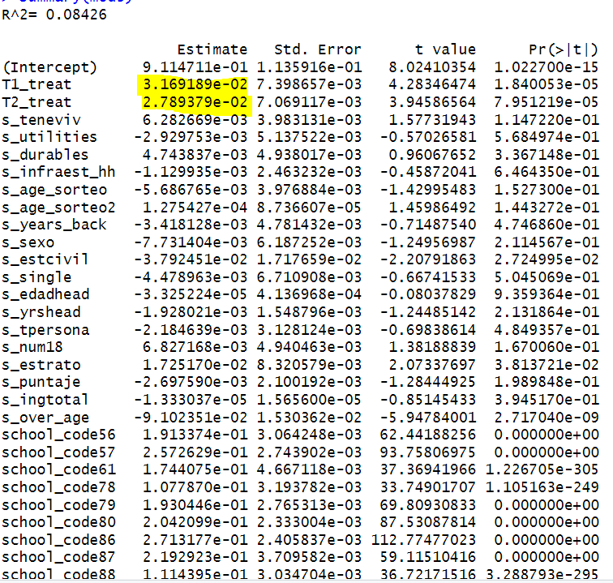
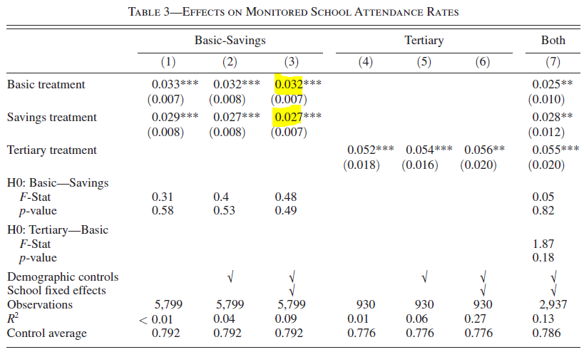
3nd model results:

Slide 9
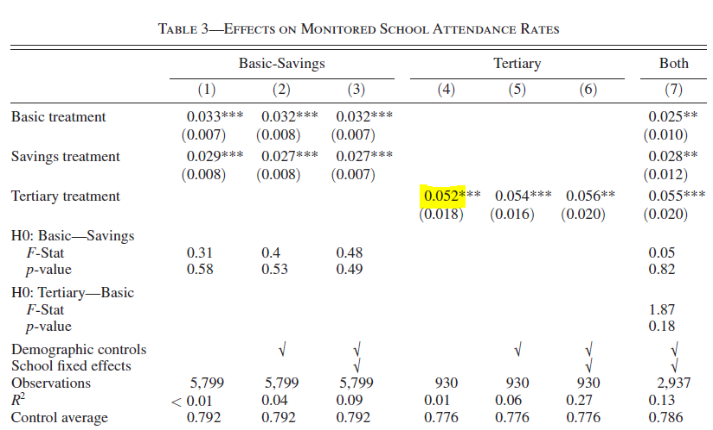
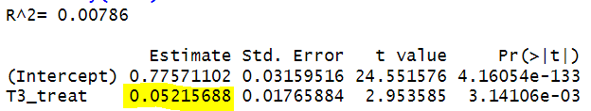
4th model: For the 4th model, the difference is that the treatment 3 which is used, took place only in Suba for grades 9 to 10, so the dataset should be filtered accordingly.
Demographic variables:
Model:

Slide 10
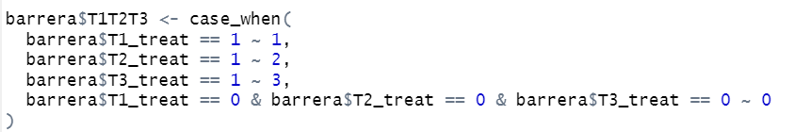
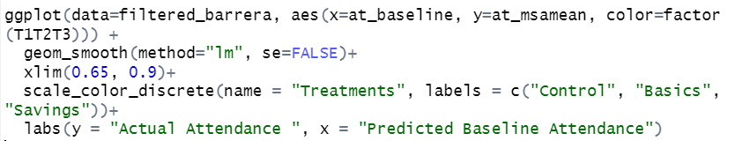
Replicating the plot Actual Attendance ~ Predicted Baseline Attendance: As the dataset contains the predicted values for baseline attendance, we attempted to replicate the plot (Figure 1) that exists on the paper. In order to achieve that we created a variable that takes values 1,2 and 3 depending on the treatment, for each row in the dataset.
T1T2T3 variable code:
Plot code (ggplot2 lib):

Slide 11
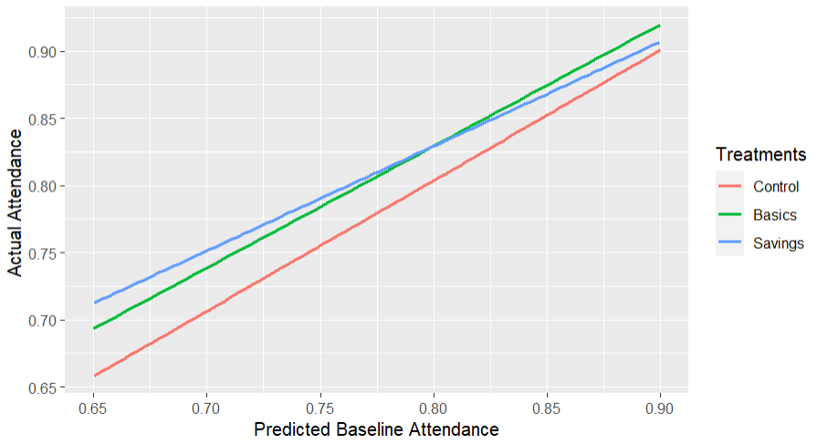
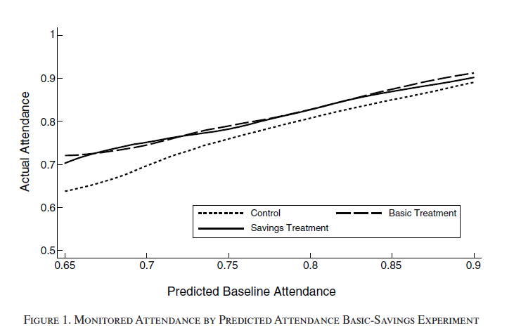
Replicated plot vs Published plot
The replicated plot is very close to the published one. The difference is that we have used a linear model method while they have used another one which makes the lines more curvy.

Slide 12
Thank you!!!
The coefficients of the model are pretty similar to the ones of the table so one can assume that for San Cristobal the attendance rate is given by the specific model for the Basic-Savings treatment and the replication is successful.

