Slide 1

Natural experiments using R
Replication of
“Improving the Design of Conditional Transfer Programs: Evidence from a Randomized Education Experiment in Colombia”,
Barrera-Osorio et al. (2018)
Dimitrios Papadopoulos
Eva-Maria Bonin

Slide 2
Background
Challenges to education in middle-income countries (Colombia):
High drop-out rates
High cost of education (incl. opportunity cost)
Hypotheses:
The “Savings” model will improve outcomes compared to the “Basic” programme.
Either intervention will lead to better outcomes than no intervention.
Data source: OpenICPSR
Collected in San Christobal
Combines 6 different sources: Routine and programme data, direct observation, participant surveys

Slide 3

Key variables and model specifications
Variables:
Outcome: at_msamean; Percentage of days absent using verified attendance measure (scale, 0-1)
Treatments: T1_treat (Basic or not), T2_treat (Savings or not); binary variable indicating whether participant is in the respective group.
Clustering variable: school_code; categorical variable with 234 levels
Model specifications:
(1)
(2)

Slide 4

Procedure: In order to replicate the results of table 3, we should apply linear regression models containing specific variables. Additionally to that, the data feed in the model, should be filtered accordingly.
Above the data is filtered for grades equal or over 6, for survey selected students for area other than suba as treatment 1 and 2 (basic and savings treatment) took place in other areas except Suba.

Slide 5
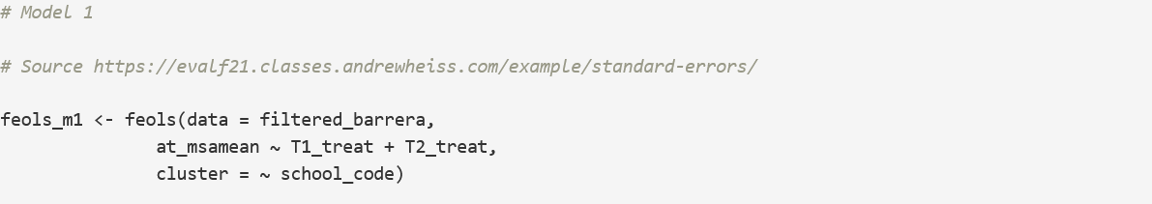
1st model: By creating the first model, clustered to school grades and run the summary we get the results below
The coefficients of the model are pretty similar to the ones of the table so one can assume that for San Cristobal the attendance rate is given by the specific model for the Basic-Savings treatment and the replication is successful.

Slide 6
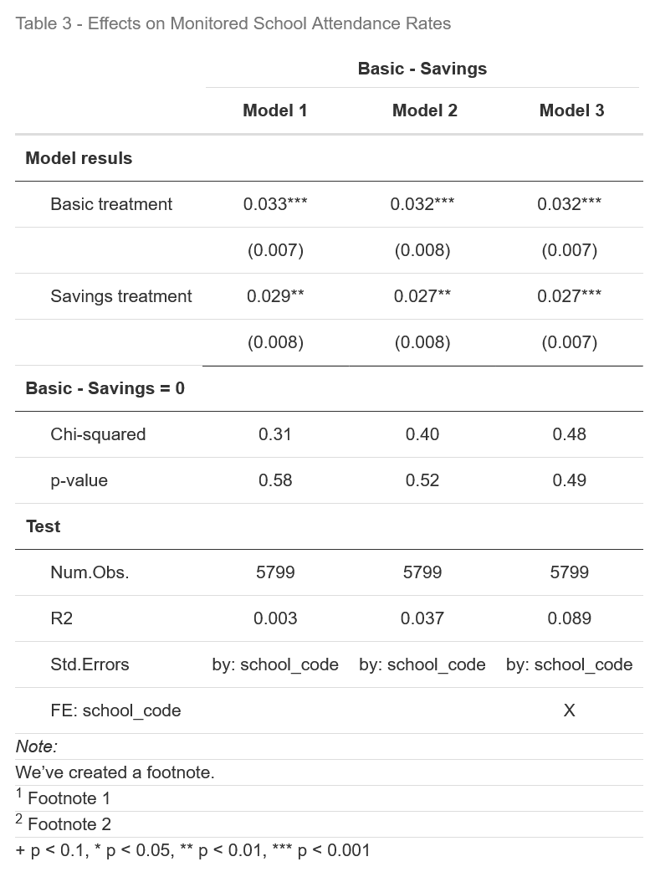
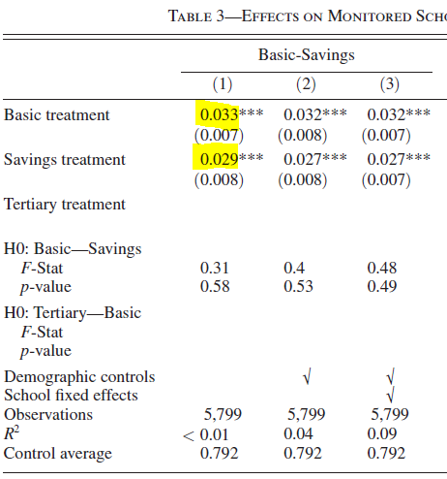
1st model results

Slide 7
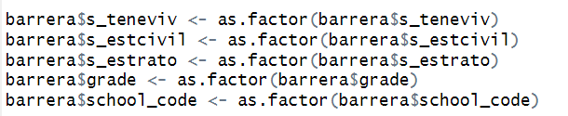
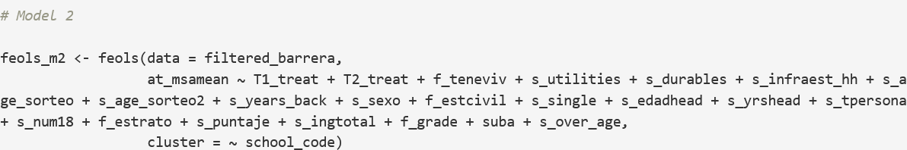
2nd model: To replicate the second model, it was necessary to include some demographic variables in it. These demographic variables are included in the dataset but needed to be transformed into factor. Then the model is created and the results are displayed for both the summary and table 3 as in the previous model.
Demographic variables:
Model:
The coefficients of the model are pretty similar to the ones of the table so one can assume that for San Cristobal the attendance rate is given by the specific model for the Basic-Savings treatment and the replication is successful.

Slide 8
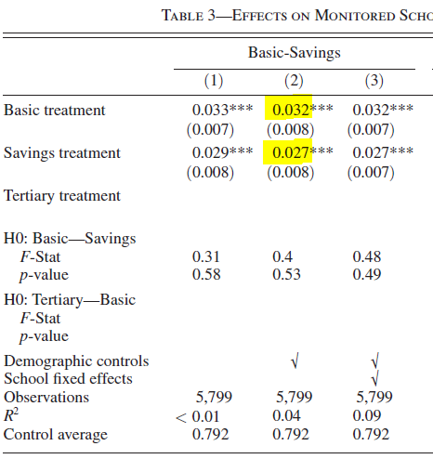
2nd model results:
The results are as expected very similar to the ones of the table 3.

Slide 9
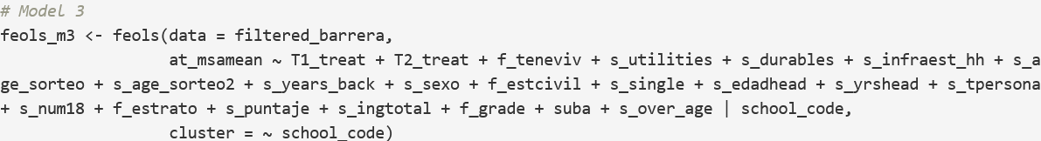
3rd model: The third model is similar to the second one but in this case we use school codeis included as factor.
School code:
Model:

Slide 10
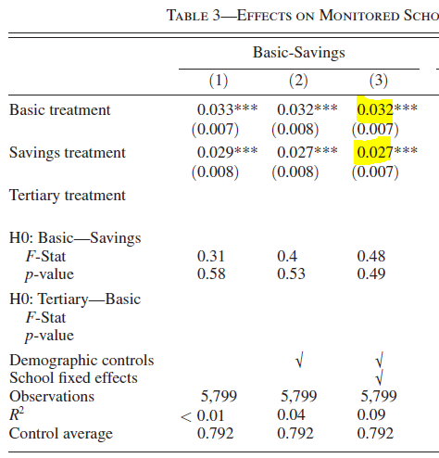
3rd model results

Slide 11
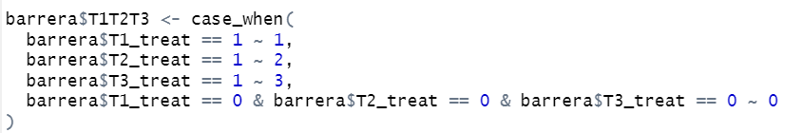
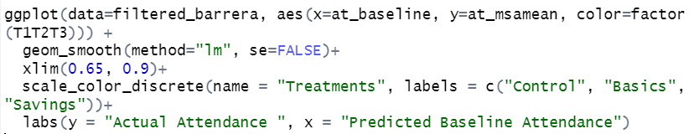
Replicating the plot Actual Attendance ~ Predicted Baseline Attendance: As the dataset contains the predicted values for baseline attendance, we attempted to replicate the plot (Figure 1) that exists on the paper. In order to achieve that we created a variable that takes values 1,2 and 3 depending on the treatment, for each row in the dataset.
T1T2T3 variable code:
Plot code (ggplot2 lib):

Slide 12
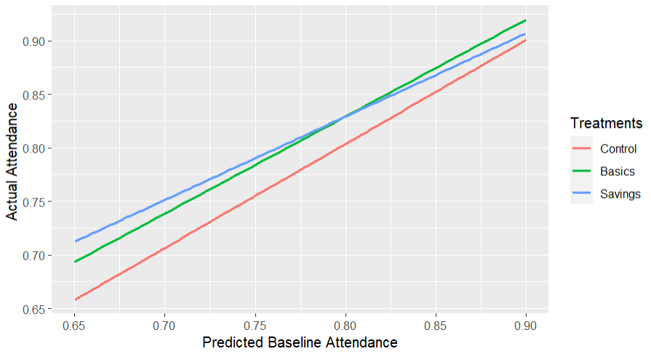
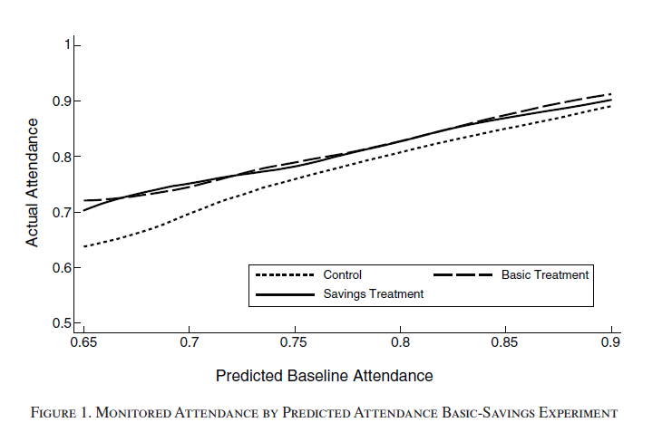
Replicated plot vs Published plot
The replicated plot is very close to the published one. The difference is that we have used a linear model method while they have used another one which makes the lines more curvy.

Slide 13
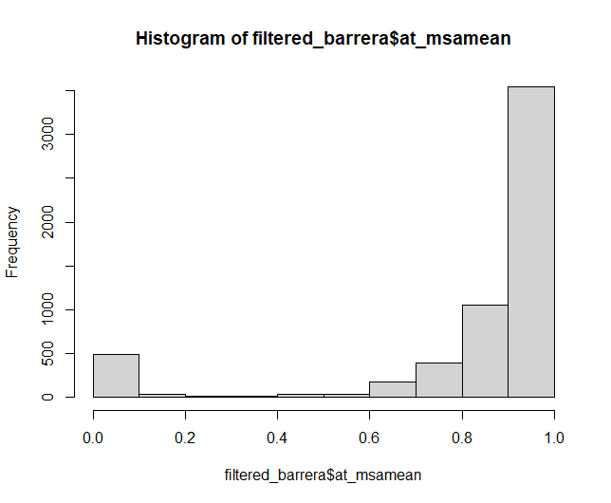
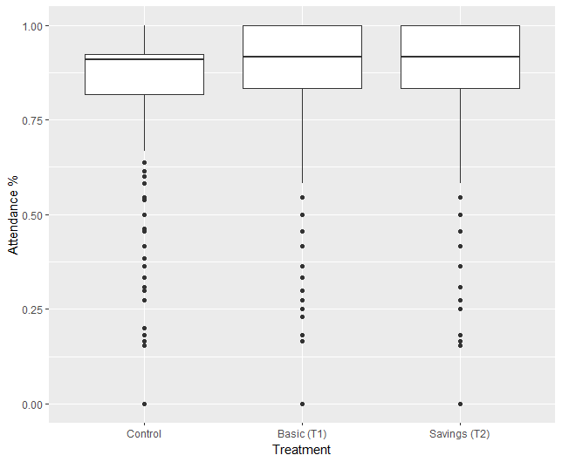
Exploration: Distribution of dependent var

Slide 14
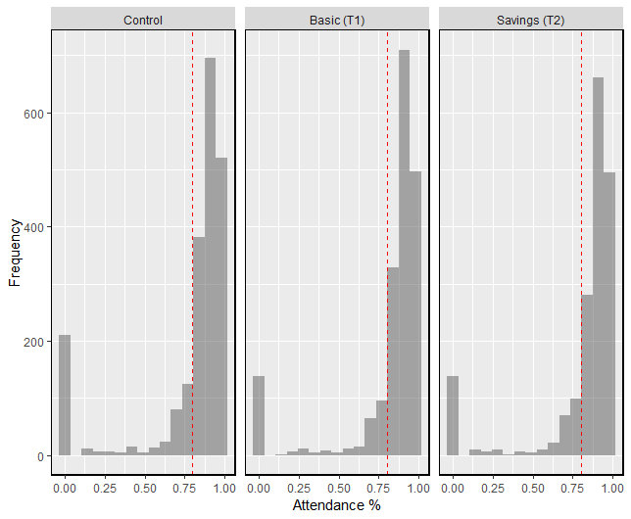
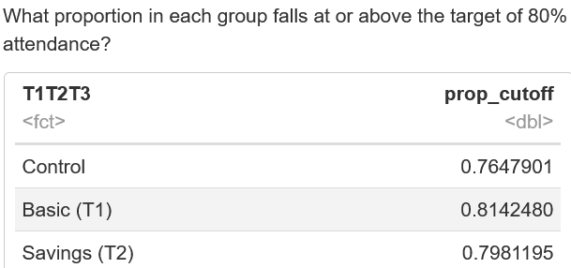
Exploration: Binary outcome

Slide 15
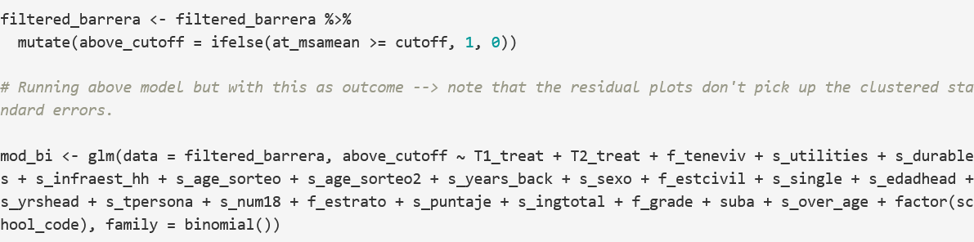
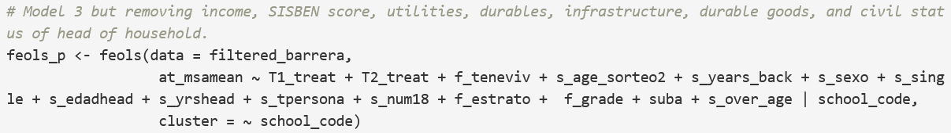
Exploration: Logistic regression and parsimonious model
Logistic regression
Parsimonious model

Slide 16
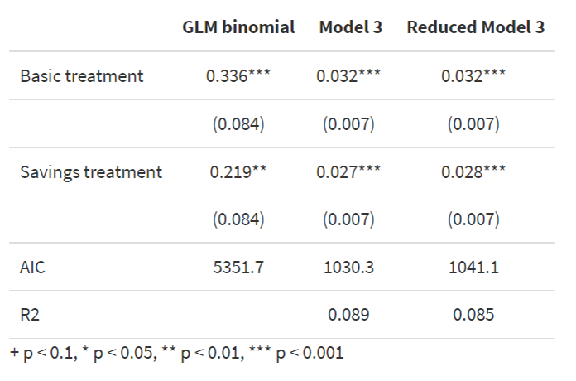
Exploration: Logistic regression and parsimonious model

Slide 17
Conclusions
Possible to replicate coefficients, p-values, R-squared from Table 3
R-squared suggest models do not explain much of variation
Correct functional form?
Choice of co-variates?
Exploratory analysis:
Linear models may not be the best fit.
Models contain redundant co-variates.
Additional considerations
Controlling for baseline scores / extend to difference-in-difference models?
GLMs accounting for skewed data (e.g. log link function)?

Slide 18
Thank you!!!
The coefficients of the model are pretty similar to the ones of the table so one can assume that for San Cristobal the attendance rate is given by the specific model for the Basic-Savings treatment and the replication is successful.

