Slide 1
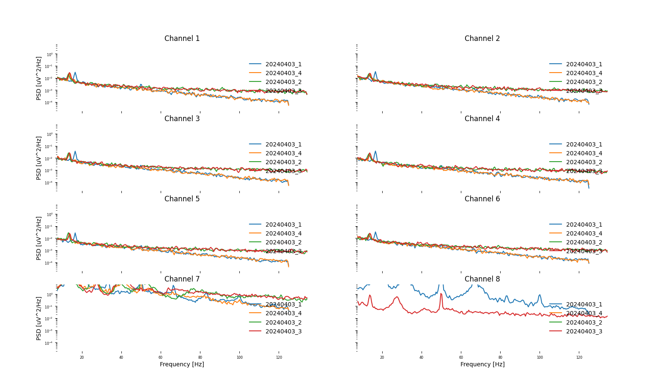
Check antialiasing

Slide 2
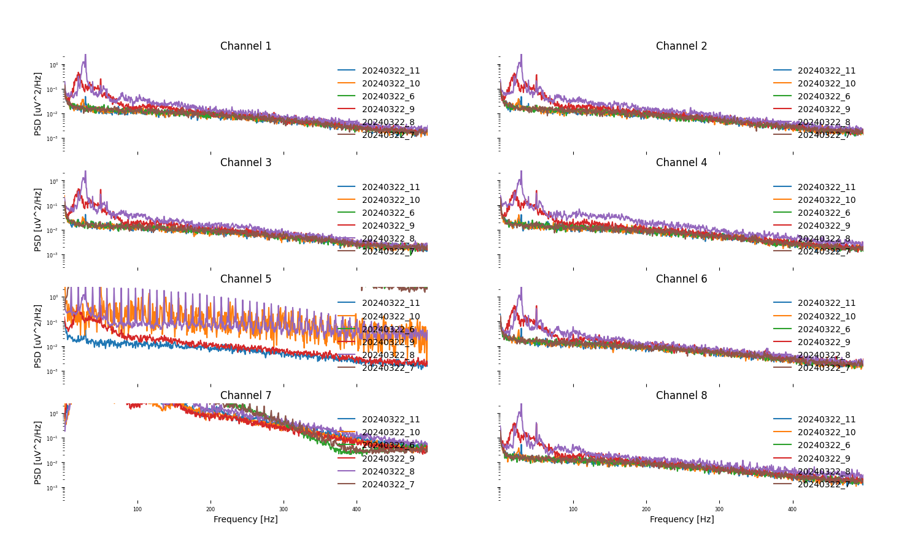
thermal noise

Slide 3
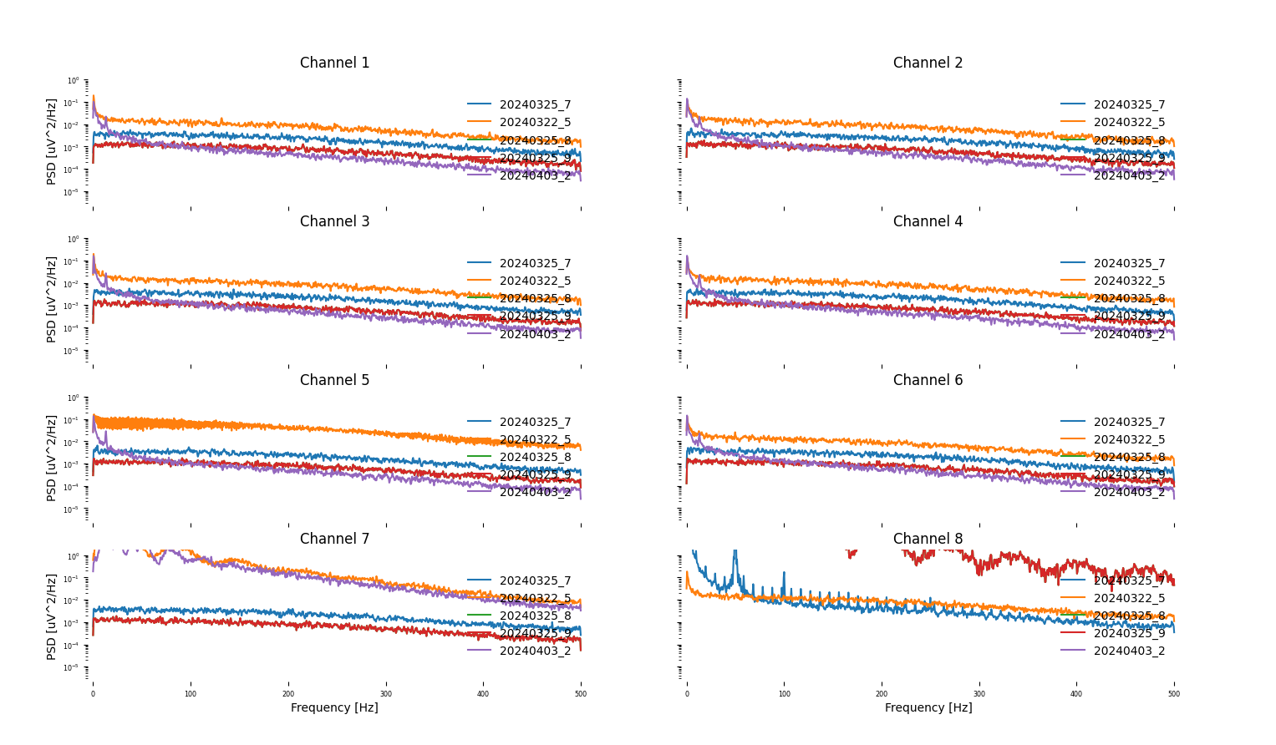
Gain and noise

Slide 4
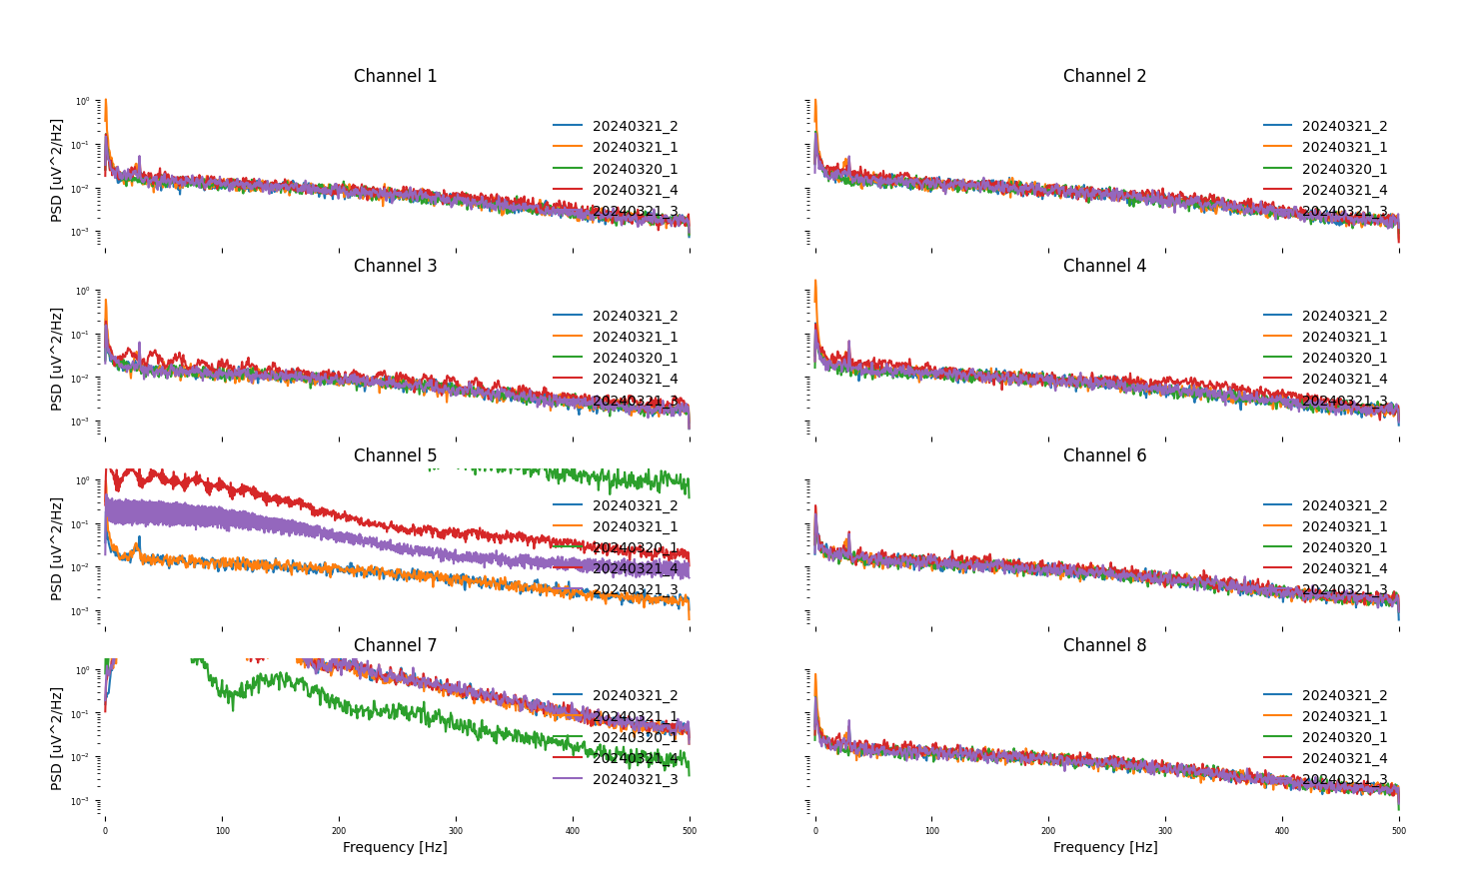
Intrinsic Noise

Slide 5
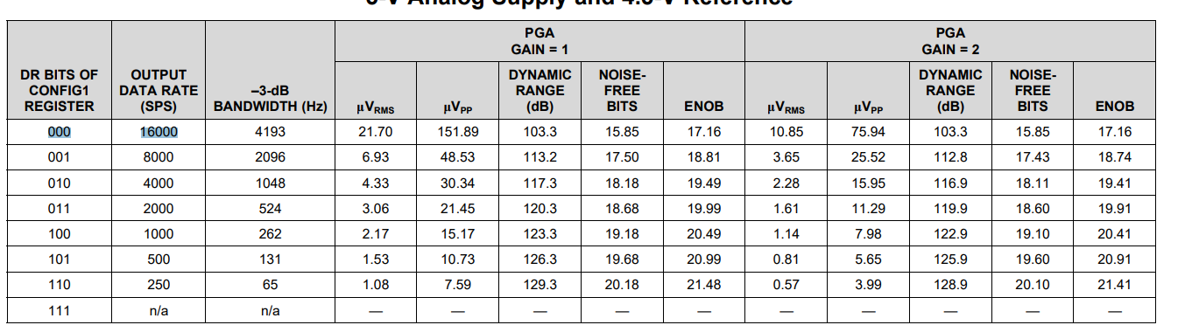
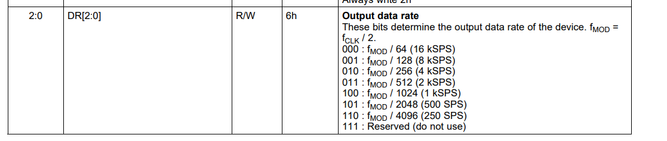
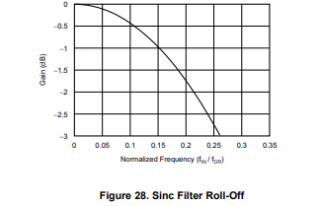
filtering at 0,5 fMOD -> ADC ΔΣ Modulator
BANDWIDTH (0,262 of fMOD)
Digital Decimation Filter

Slide 6
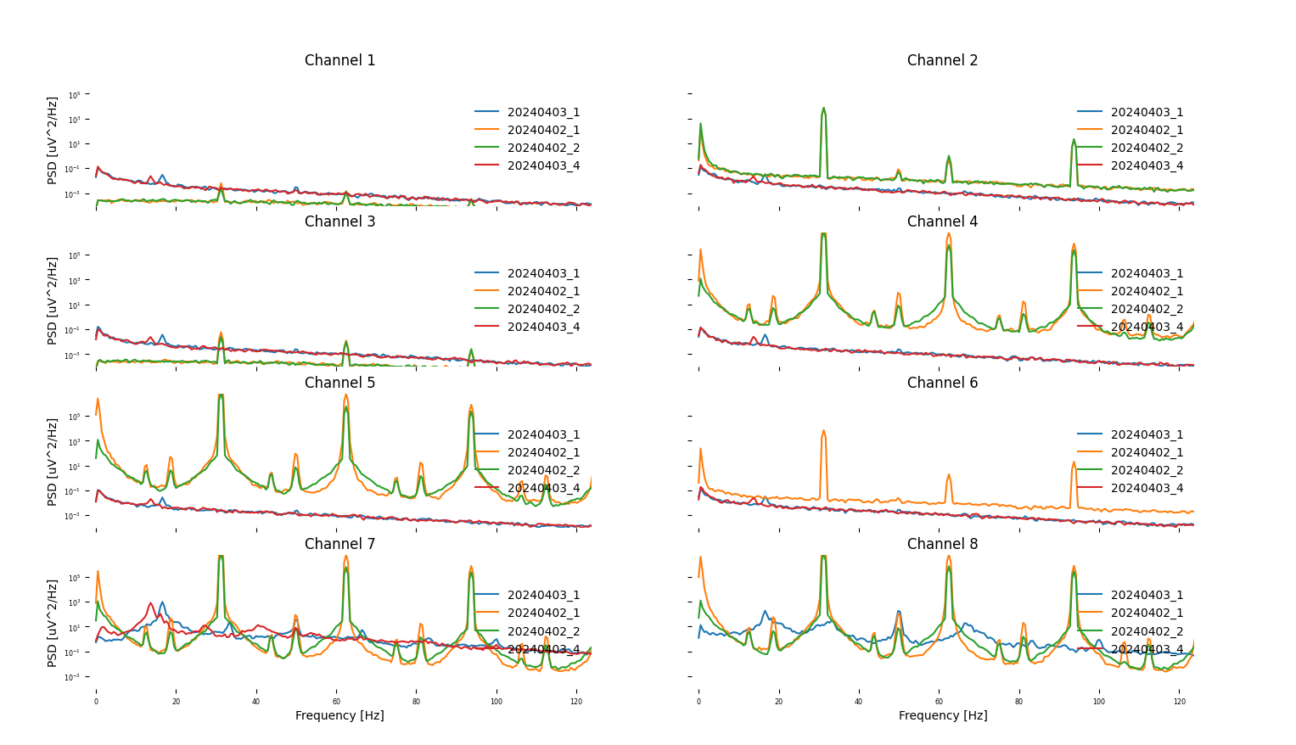
Measuring impedance or not

