Slide 1
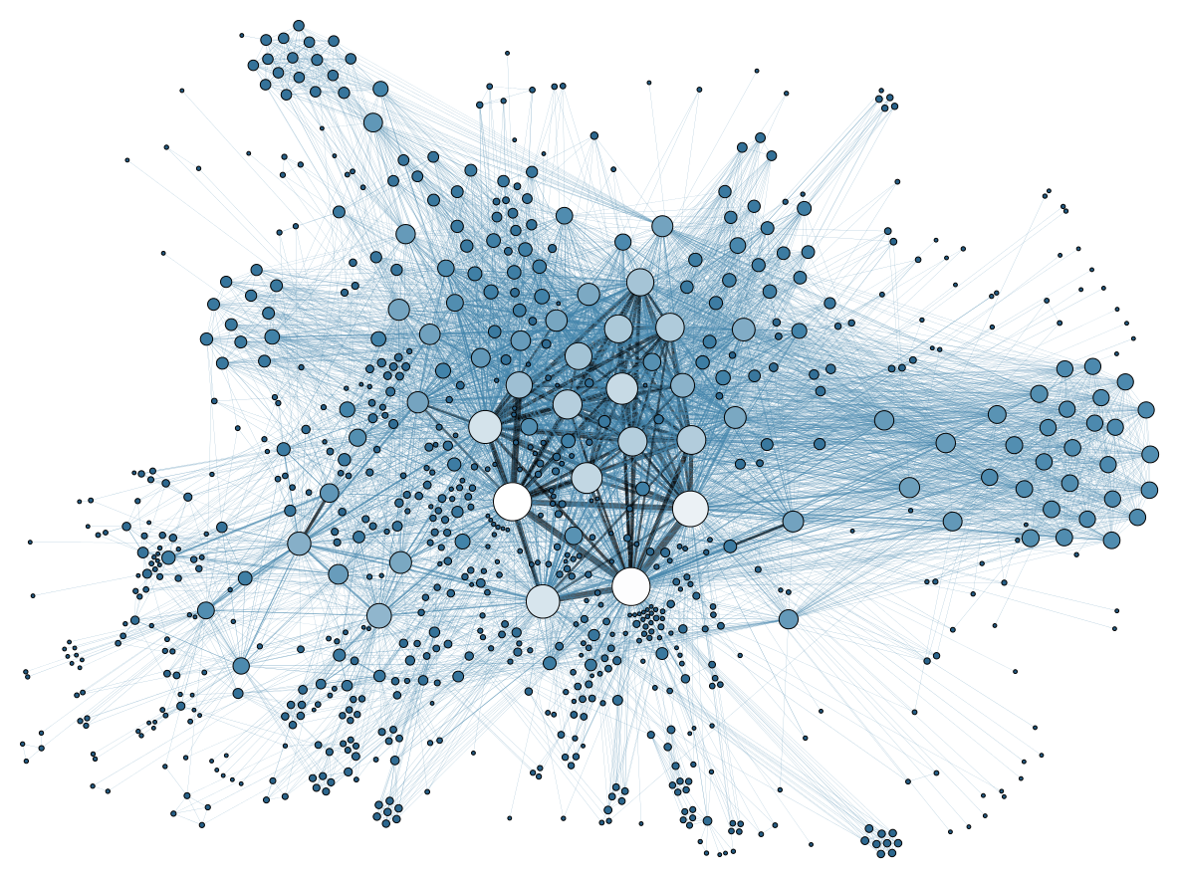
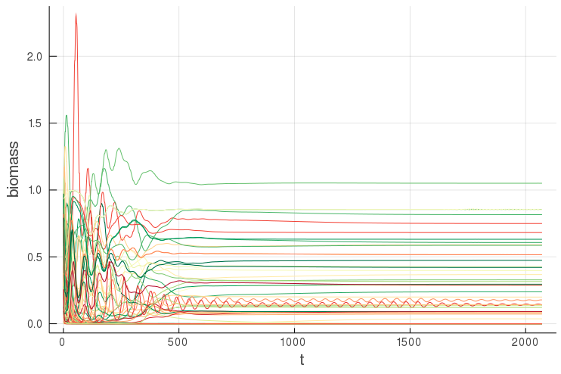
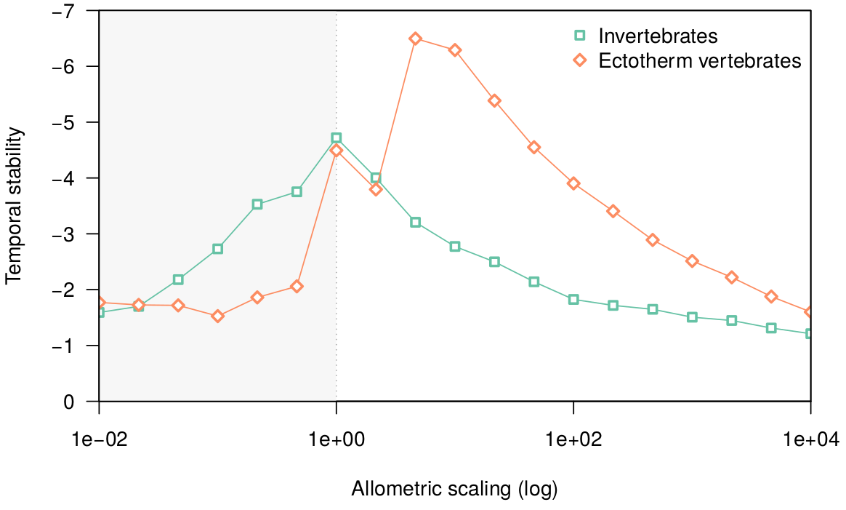
A Bioenergetic Model for Food Webs
→ Modelling population dynamics in terms of biomass flows through trophic interactions, using the principle of bioenergetics
Eva Delmas, 2019-08-21
Summer school in biodiversity modelling 2019

Slide 2


Outline
→ How to build, parameterize and use bio-energetic models to model population dynamics in food webs
Food webs: a useful abstraction of ecological communities
The principle of mass balance
Growth of basal species
  Intro. to solving differential equation
Consumption
Metabolic losses
Parameterization and sensitivity analysis
Model application: community robustness to extinctions
A brief review

Slide 3
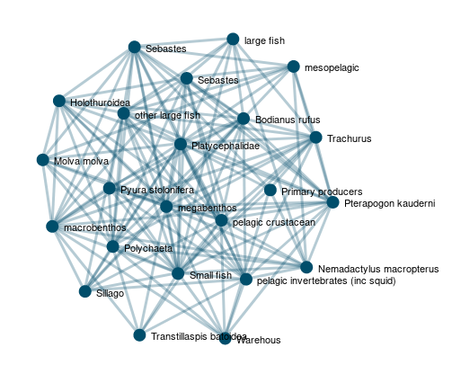
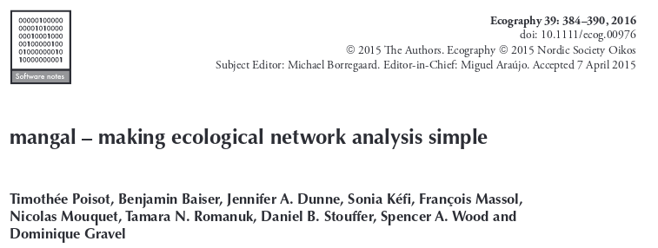

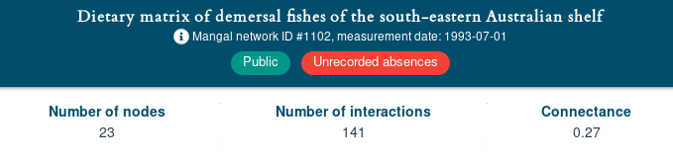
Food Webs
→ Map trophic interaction => biomass routes through the community
→ powerful abstraction to investigate stability / functioning of ecological communities
From mangal.io

Slide 4
Food Webs
→ Map trophic interaction => biomass routes through the community
→ powerful abstraction to investigate stability / functioning of ecological communities
Node: population, species, trophospecies, …
Metadata → name, traits, ...
Edge: trophic interaction
Metadata → interaction strength, direction
From mangal.io

Slide 5
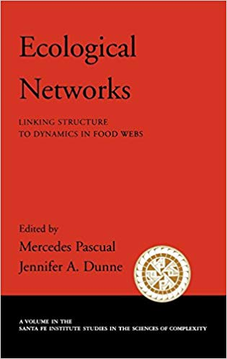
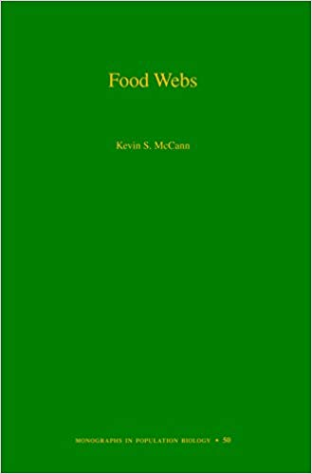

Food Webs
→ Map trophic interaction => biomass routes through the community
→ powerful abstraction to investigate stability / functioning of ecological communities
P1 P2 C1 C2 C3 C4 C5
P1
P2
C1
C2
C3
C4
C5
0 | 0 | 0 | 0 | 0 | 0 | 0
0 | 0 | 0 | 0 | 0 | 0 | 0
1 | 1 | 0 | 0 | 0 | 0 | 0
1 | 1 | 0 | 0 | 0 | 0 | 0
0 | 1 | 0 | 0 | 0 | 0 | 0
0 | 0 | 0 | 1 | 1 | 0 | 0
1 | 0 | 1 | 1 | 1 | 0 | 0
Structural properties of the food web (connectance, modularity, degree distribution, etc.)
C4
C5
C1
C2
C3
P1
P2
A = S*S interaction matrix
A[i,j] = 1 means i eats j
A[i,j] = 0 otherwise

Slide 6
Mass balance
→ Conservation of mass: in a closed physical system mass can neither be produced nor destroyed.
Mass balance is the application of the physical principle of conservation of mass to the analysis of systems flux an stocks.
Storage = Inputs - Outputs

Slide 7

Mass balance
Storage = Inputs - Outputs
time
𝑚(𝑡+Δ𝑡)=𝑚(𝑡)+𝑚_{in}(𝑡→Δ𝑡)−𝑚_{out}(𝑡→Δ𝑡)
Inputs
(nutrients, CO2, water, ...)
Outputs
(evapotranspiration)
m(t)
m(t+Δt)
𝑚_{in}(𝑡→Δ𝑡)
𝑚_{out}(𝑡→Δ𝑡)
t
Δt
t+Δt

Slide 8
Mass balance
Storage = Inputs - Outputs
Each term can be decomposed to reflect the diversity of mechanisms / compartments involved
time
𝑚(𝑡+Δ𝑡)=𝑚(𝑡)+𝑚_{in}(𝑡→Δ𝑡)−𝑚_{out}(𝑡→Δ𝑡)
Inputs
(nutrients, CO2, water, ...)
Outputs
evapotranspiration
mortality
m(t)
m(t+Δt)
𝑚_{in}(𝑡→Δ𝑡)
𝑚_{out}(𝑡→Δ𝑡)
t
Δt
t+Δt

Slide 9
Mass balance
Storage = Inputs - Outputs
Each term can be decomposed to reflect the diversity of mechanisms / compartments involved
time
𝑚(𝑡+Δ𝑡)=𝑚(𝑡)+𝑚_{in}(𝑡→Δ𝑡)−𝑚_{out}(𝑡→Δ𝑡)
Inputs
(nutrients, CO2, water, ...)
Outputs
From stocks to flux: the mass accumulation rate
evapotranspiration
mortality
m(t)
m(t+Δt)
𝑚_{in}(𝑡→Δ𝑡)
𝑚_{out}(𝑡→Δ𝑡)
t
Δt
t+Δt

Slide 10



The bio-energetic food-web model
→ Using the principle of mass balance, we can build a general model for trophic interactions

Slide 11
The bio-energetic food-web model
→ Using the principle of mass balance, we can build a general model for trophic interactions
autotrophic growth

Slide 12
The bio-energetic food-web model
→ Using the principle of mass balance, we can build a general model for trophic interactions
consumption
consumption
autotrophic growth

Slide 13
The bio-energetic food-web model
→ Using the principle of mass balance, we can build a general model for trophic interactions
metabolic losses
Mass in:
- growth
- gains from consumptions
Mass out:
- loss to consumption
- metabolic losses
consumption
metabolic losses
consumption
metabolic losses
autotrophic growth

Slide 14
The bio-energetic food-web model
→ Using the principle of mass balance, we can build a general model for trophic interactions
metabolic losses
Mass in:
- growth
- gains from consumptions
Mass out:
- loss to consumption
- metabolic losses
consumption
metabolic losses
consumption
For each population:
ΔB / Δt = G + C_{in} - C_{out} - M
metabolic losses
autotrophic growth

Slide 15
1st term: growth of basal species
ΔB / Δt = G + C_{in} - C_{out} - M
→ Basic equation: r_{i} G_{i}(B) B_{i}
Intrinsic growth rate
Biomass of the focus species
Net growth rate
Sum biomass pop. in competition for the same resources
G_{i}(B) =
1 -
Carrying capacity

Slide 16
1st term: growth of basal species
ΔB / Δt = G + C_{in} - C_{out} - M
→ General equation: r_{i} G_{i}(B) B_{i}
Intrinsic growth rate
Biomass of the focus species
Net growth rate
Logistic growth
G_{i}(B_{i}) = 1 – B_{i} / K
Differential equations solvers in Julia and R
Introducing direct competition
G_{i}(B_{i}) = 1 – (Σ_{j}α_{ij}B_{j}) / K

Slide 17
2nd and 3rd terms: consumption
ΔB / Δt = G + C_{in} - C_{out} - M
imperfect assimilation
consumption
imperfect assimilation
consumption

Slide 18
2nd and 3rd terms: consumption
ΔB / Δt = G + C_{in} - C_{out} - M
Biomass consumed / lost
imperfect assimilation
consumption
Same shape for both species?
imperfect assimilation
consumption
Resource density

Slide 19
2nd and 3rd terms: consumption
ΔB / Δt = G + C_{in} - C_{out} - M
Biomass consumed / lost
Different:
Metabolic rates x_{i}
Consumption rates y_{i}
Feeding behaviors F_{ij}(B)
Densities (biomass) B_{i}
Assimilation efficiency e_{ij}
imperfect assimilation
consumption
imperfect assimilation
consumption
Resource density

Slide 20
2nd and 3rd terms: consumption
ΔB / Δt = G + C_{in} - C_{out} - M
Biomass consumed / lost
Different:
Metabolic rates x_{i}
Consumption rates y_{i}
Feeding behaviors F_{ij}(B)
Densities (biomass) B_{i}
Assimilation efficiency e_{ij}
imperfect assimilation
consumption
Gain = Σ_{j=pred.} x_{i} y_{i} B_{i} F_{ij}
Loss =
Σ_{j=pred.} x_{j} y_{j} B_{j} F_{ji}
imperfect assimilation
e_{ji}
consumption
Resource density

Slide 21
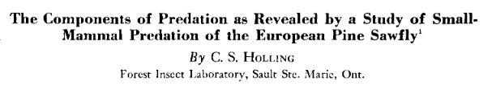
2nd and 3rd terms: consumption
ΔB / Δt = G + C_{in} - C_{out} - M
→ Functional response: intake rate of a consumer as a function of food density
Consumer time budget:
Consumer time = searching resources + handling and consuming
Max. biomass possibly captured
Time lost searching / consuming preys
a: attack rate
h: handling time
q: holling coef. controls the shape of the curve
Holling type II and III functional responses
Compare type II and type III functional response and the associated resource mortality rates.

Slide 22
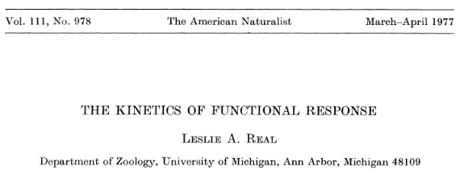
2nd and 3rd terms: consumption
ΔB / Δt = G + C_{in} - C_{out} - M
→ Multi-species functional response
Multi-species functional response
Implementation and analysis of the multi-species functional response

Slide 23
Allometric scaling of biological rates
→

Slide 24
4th term: metabolic losses
ΔB / Δt = G + C_{in} - C_{out} - M
→

Slide 25
Choosing parameters values
→

Slide 26
Brief review
→

