Slide 1
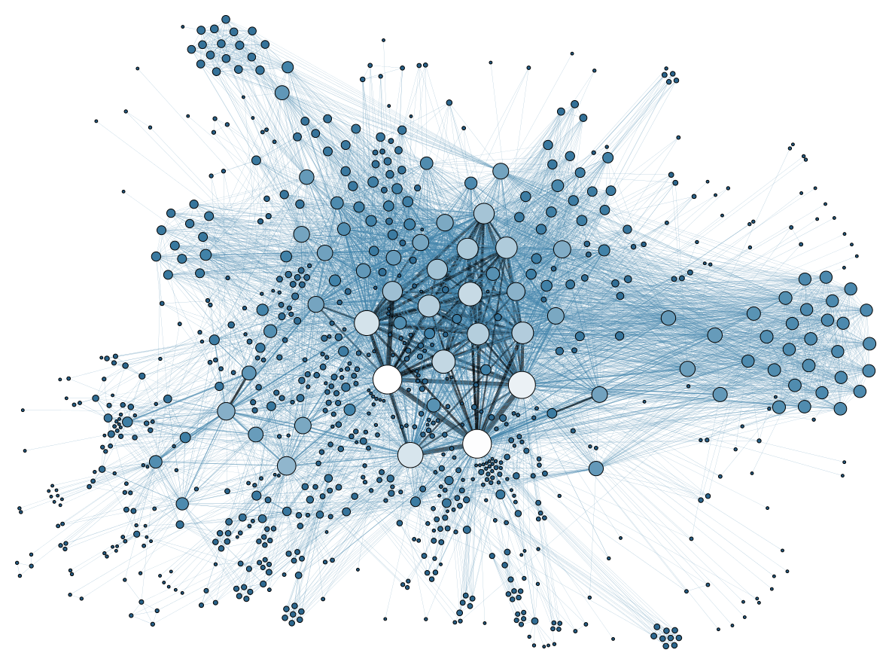
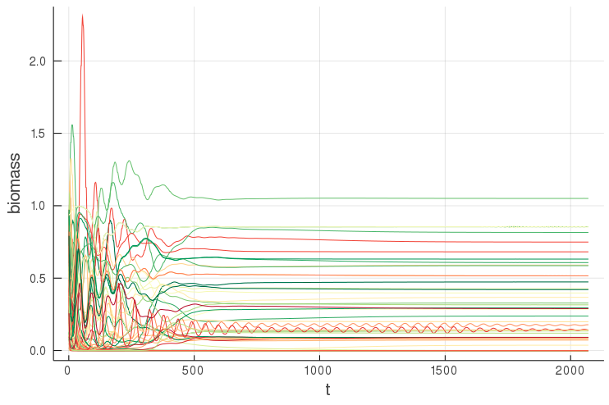
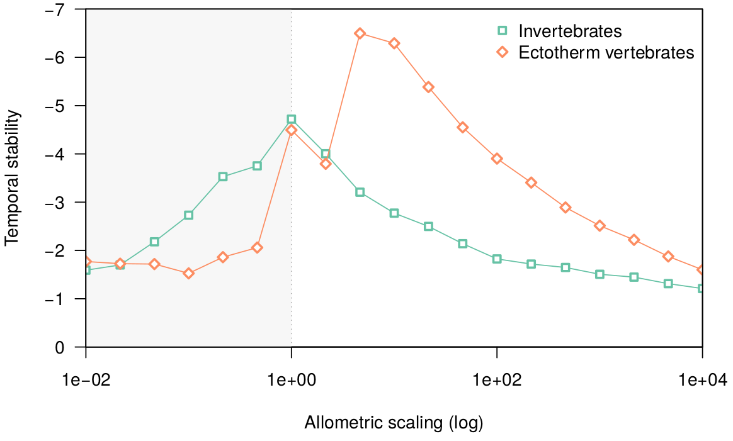
A Bioenergetic Model for Food Webs
→ Modelling population dynamics in terms of biomass flows through trophic interactions, using the principle of bioenergetics
Eva Delmas, 2019-08-21
Summer school in biodiversity modelling 2019

Slide 2


Outline
→ How to build, parameterize and use bioenergetic models to model population dynamics in food webs
Food webs: a useful abstraction of ecological communities
The principle of mass balance
Growth of basal species
  Intro. to solving differential equation
Consumption and the multi-species functional response
  Allometric scaling
Metabolic losses
Parameterization and sensitivity analysis
A brief review

Slide 3
Food Webs
→ powerful abstraction to investigate stability / functioning of ecological communities
→ map trophic interaction => biomass routes through the community

