Slide 1


update since 29 June · Q3 2026 Board Meeting
29 October 2026
Humanising Justice
ACCOUNTABILITY · COMMUNITY · EVIDENCE
Sponsor: Eva Buzo, Executive Director · Agenda item TBC · 15 minutes · Discussion

Slide 2
Three goals guide everything we do
Our 2024–29 strategy frames the year.
1
2
3
Victims secure outcomes in line with their own conception of justice.
Victims are empowered by the process of pursuing justice — not just by its results.
Justice processes are transformed to put victims at the centre.
The September retreat broadened our framing from serious international crimes to human rights violations (slide 9).
hūmānus · Q3 2026 Board Meeting · Operations & Impact Update
2 / 10

Slide 3
Where the work has sat since June
29 June – 12 October 2026, by funded programme and other significant strands.
Programme / strand | Funder
Rohingya in India — legal protection | Core funding
Rohingya dialogue — Bangladesh and Arakan | FCDO (UK) and Swiss FDFA, via Stimson Center
Accountability for business and human rights | Core funding
hūmānus · Q3 2026 Board Meeting · Operations & Impact Update
3 / 10

Slide 4
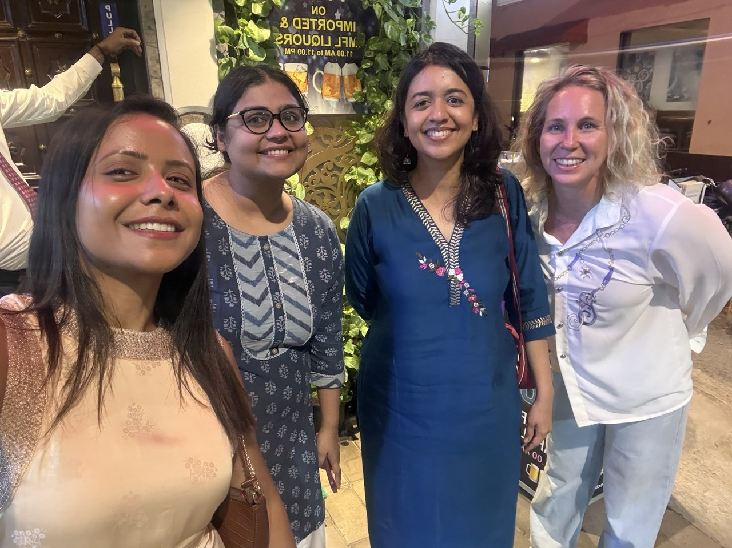
Rohingya in India — legal protection
Core funded · no project grant · Lead: Arati Ranade, India Programme Manager
What the strand is
Direct legal intervention for detained Rohingya refugees in India, building a cross-state network of lawyers and an evidentiary base on detention and deportation patterns. Funded from core — no donor restriction on case selection or strategy.
Since 29 June
Delhi detention roundtable (5 July) — lawyers from across states convened over three panels to discuss detention litigation strategy.
Right to Education — strategy note drafted on an education-rights route for detained minors, alongside the refugee route; raised with African states in Geneva (25 August).
Litigation pipeline — habeas corpus petition in drafting; bail application being finalised for counsel's review; Right to Information petitioner being identified.
Lawyer network — West Bengal, Uttar Pradesh and Delhi lawyers in place. Case-law report on Rohingya deportation in preparation.
Delhi, July 2026
hūmānus · Q3 2026 Board Meeting · Operations & Impact Update
4 / 10

Slide 5
Rohingya dialogue — Bangladesh and Arakan
FCDO (UK) and Swiss FDFA, via Stimson Center as prime · hūmānus as implementing partner
What the project is
Sustained dialogue and engagement with Rohingya leadership, building trust among Rohingya, Arakanese and Bangladesh stakeholders through bilateral engagement, capacity building and facilitated dialogue. FCDO and Swiss FDFA funding support the same project; both reimburse in arrears.
Since 29 June
Analysis — ten reports by Sawyadullah on Rohingya relationships with the United States, China, Bangladesh, India and Pakistan, to aid the dialogue and support Rohingya leadership. Website launching November 2026; a workshop on the content will be run in the Rohingya language.
hūmānus · Q3 2026 Board Meeting · Operations & Impact Update
5 / 10

Slide 6
Accountability for business and human rights
Core funded · legal action, regulatory complaint and advocacy — confirmed as a core model at the retreat
THE FRAMEWORK
Bringing together our work that holds business actors accountable for contribution to, or benefit from, serious international crimes — across litigation, regulatory complaint, and investor-facing advocacy.
ACTIVE WORKSTREAMS
Meta / Facebook
Meta has responded to our case, including a request for particulars.
Documentary narrative and video series in production with Amnesty International
Adani
Coordination and investigation work continuing, including research on Australian super-fund exposure, fiduciary-duty case law, the OFAC civil probe and Adani Defence.
Against the Tide Campaign
Supporting activists in Puerto Rico, Jamaica and Seychelles to fight development of luxury resorts in environmentally sensitive protected areas.
hūmānus · Q3 2026 Board Meeting · Operations & Impact Update
6 / 10

Slide 7
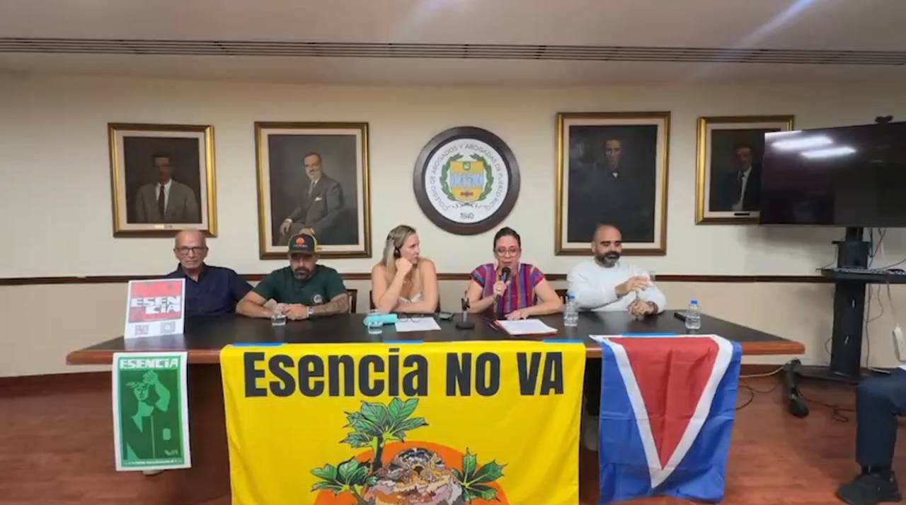
Public engagement
Core funded · Against the Tide, speaking, advocacy and donor relations
Speaking and advocacy
Berkeley (28 September) — keynote, Human Rights for Victims of Conflict in a Fragmenting World; session with Berkeley IIS clinic students on conflict monitoring.
Recording: youtu.be/_d9m1Zl0Pro
Amnesty × hūmānus side event at UNGA (25 September).
Donor relations
OSF partner retreat, Mexico — Finding Each Other on Shifting Ground, bringing together around 100 OSF partners; good connections made.
Esencia NO VA panel
hūmānus · Q3 2026 Board Meeting · Operations & Impact Update
7 / 10

Slide 8
Further activities
Advisory work outside our funded programmes
Since 29 June
Australian war crimes, victim participation — advice to two sets of clients in Australia on victim participation in prosecutions of alleged war crimes committed in Afghanistan.
Caste-based discrimination — advice on a complaint to the Australian Human Rights Commission against a New South Wales local council, concerning discrimination against Dalit, Bahujan and Adivasi communities. Instructed September 2026.
hūmānus · Q3 2026 Board Meeting · Operations & Impact Update
8 / 10

Slide 9
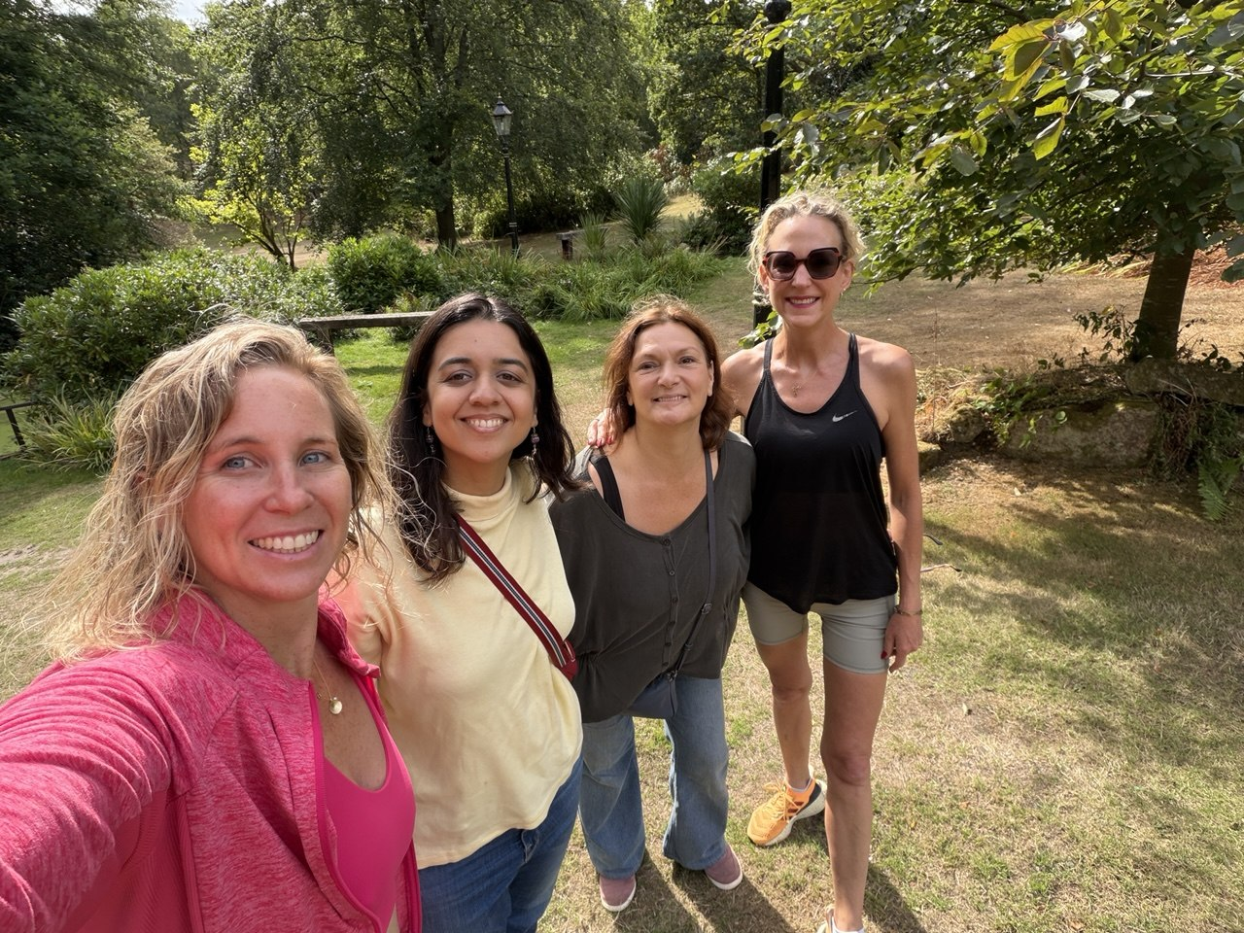
Strategy retreat — what we decided
Team retreat, September 2026 · strategy, impact and organisational focus
Strategy and impact
Plan from what clients need — an outcomes ladder linking litigation, mediation and community engagement to meaningful results.
Broaden the framing from serious international crimes to human rights violations; stay people-focused and prioritise systemic change.
Corporate accountability — legal action, regulatory complaints and advocacy — adopted as a core model, including Adani and Facebook.
Rohingya — continue the lawyer-network and coordination approach, and take stock of progress after six months.
Priorities
Keep excellence, rigour and clear accountability central; new geographies only where needs-driven.
Tell the organisation's story well and show impact to clients and funders; consider dedicated fundraising capacity.
Team retreat, September 2026
hūmānus · Q3 2026 Board Meeting · Operations & Impact Update
9 / 10

Slide 10
Humanising Justice
ACCOUNTABILITY · COMMUNITY · EVIDENCE
www.humanus.co · hello@humanus.co
Q3 2026 Board Meeting · Operations & Impact Update · Sponsor: Eva Buzo (ED)

