Slide 1

year-to-date update · Q2 2026 Board Meeting
29 June 2026
Humanising Justice
ACCOUNTABILITY · COMMUNITY · EVIDENCE
Sponsor: Eva Buzo, Executive Director · Agenda item 4 · 15 minutes · Discussion

Slide 2
Three goals guide everything we do
Our 2024–29 strategy frames the year.
1
2
3
Victims secure outcomes in line with their own conception of justice.
Victims are empowered by the process of pursuing justice — not just by its results.
Justice processes are transformed to put victims at the centre.
2026 is the first full year operating as hūmānus (stichting) under the new statutory structure.
hūmānus · Q2 2026 Board Meeting · Operations & Impact Update
2 / 11

Slide 3
Where the work has sat this year
Y2D 2026 (January–May) by funded programme and other significant strands.
Programme / strand
Funder
Y2D status
Towards a More Peaceful Arakan
Swiss FDFA via Stimson Center
Live — partnership signed Feb 2026; active from Dec 2025; runs to May 2027.
Bangladesh dialogue
FCDO (UK)
Continuing dialogue programme; Asia trip with Stimson reviewed Q1.
Rohingya in India — legal protection
Core funding
Lead: Arati Ranade. 8 cases commenced in West Bengal; UP next. RSU and Bridging Changes / HDCO consultation in flight.
Women's Dialogue
SDC (under VAI legacy entity)
Grant close-out — ends 30 April 2026; 3rd narrative + finance reports due May.
Accountability for business and human rights
Core funding
Meta Inc. proceedings; Adani / UniSuper / APRA strand (new from March); Mohib Ullah accountability continuing.
Public engagement
Core funding
Frontline Club London panel (2 April 2026); Aditi and Nazia speaker videos; BBC and AP pitches; Geneva mid-May.
Detail on each strand follows. Finance picture: see Reserves Prognosis (paper 04) and YTD Grant Spend (paper 05).
hūmānus · Q2 2026 Board Meeting · Operations & Impact Update
3 / 11

Slide 4
Towards a More Peaceful Arakan
Swiss FDFA, via Stimson Center as prime · hūmānus as implementing partner
WHAT THE PROJECT IS
An 18-month partnership to identify, create, and support trust-building opportunities among Rohingya, Arakanese, and Bangladesh stakeholders, against the backdrop of the Arakan Army's consolidation across northern Arakan. The project combines bilateral engagement, capacity building, and facilitated dialogue — and gives hūmānus a structured channel into Track-2 work on the Bangladesh–Myanmar border.
WHERE WE ARE
Partnership agreement signed 5 February 2026, effective from 1 December 2025, runs to 31 May 2027.
Y2D: workplan kicking off; bi-weekly check-in cadence with Stimson; Q1 Asia trip with Stimson reviewed against the Bangladesh political transition.
Programmatic focus reflected in the 2025 dialogue model — sustained weekly engagement with Rohingya leadership and inter-ethnic dialogue with Rakhine and Bangladeshi counterparts.
hūmānus · Q2 2026 Board Meeting · Operations & Impact Update
4 / 11

Slide 5
Bangladesh dialogue programme
FCDO (UK) · continuing programme
WHAT THE FUNDING SUPPORTS
Sustained dialogue and engagement work with Rohingya leadership in Bangladesh, complementing the Swiss/Stimson Arakan partnership. Operates in a deficit / reimbursement model — hūmānus spends and is reimbursed in arrears, which is why cash-flow management is a standing board item.
WHERE WE ARE
Continuing engagement through Q1; programme management transitioned to Shafi following Jaya's departure.
Asia trip with Stimson reviewed Q1 against the Bangladesh political situation; status to be confirmed at the meeting.
Cash-flow discipline: deficit-model reimbursement remains a watch-item — addressed in papers 04 and 05.
hūmānus · Q2 2026 Board Meeting · Operations & Impact Update
5 / 11

Slide 6
Rohingya in India — legal protection
Core funded · no project grant · Lead: Arati Ranade, India Programme Manager
WHAT THE STRAND IS
Direct legal intervention for detained Rohingya refugees in India, building a cross-state network of lawyers and an evidentiary base on detention and deportation patterns. Funded from core — no donor restriction on case selection or strategy.
Y2D STREAMS
Litigation — 8 cases commenced in West Bengal; UP scoping under way as the next state to open up.
Supporting work — habeas corpus drafts, bail applications, RTI / petitioner-search, lawyer outreach in J&K; quarterly developments report commissioned end-March.
India detention database — continuing partnership with the Azadi Project; remains live and in active use.
Rohingya Student Union — stakeholder-analysis partnership in flight; formal kick-off status to be confirmed at the meeting.
Bridging Changes Coalition / HDCO — Rohingya-in-India closed-door consultation in flight (scoped Q1); date and outputs to be confirmed at the meeting.
hūmānus · Q2 2026 Board Meeting · Operations & Impact Update
6 / 11

Slide 7
Women's Dialogue — grant close-out
SDC (Swiss) · contracted under VAI legacy entity · grant ends 30 April 2026
WHERE THE WORK HAS SAT IN 2026
Y2D activity has been close-out, not new convenings — spending plan for the remainder of the grant, plus the 3rd narrative report and 3rd finance report (due 15 May 2026).
Grant terminated 30 April 2026; final reporting and reconciliation in train.
Project sits under the VAI legal entity. Audit report in this pack is VAI 2024 (paper 06) — implications for donor-renewal positioning are touched on under strategic outlook.
WHY THIS MATTERS FOR THE BOARD
Closing out an SDC grant under VAI while building a Swiss FDFA relationship under hūmānus (via Stimson) — this is the entity transition playing out across two live Swiss-funded workstreams. Worth attention on continuity of relationships in Bern and Dhaka.
hūmānus · Q2 2026 Board Meeting · Operations & Impact Update
7 / 11

Slide 8
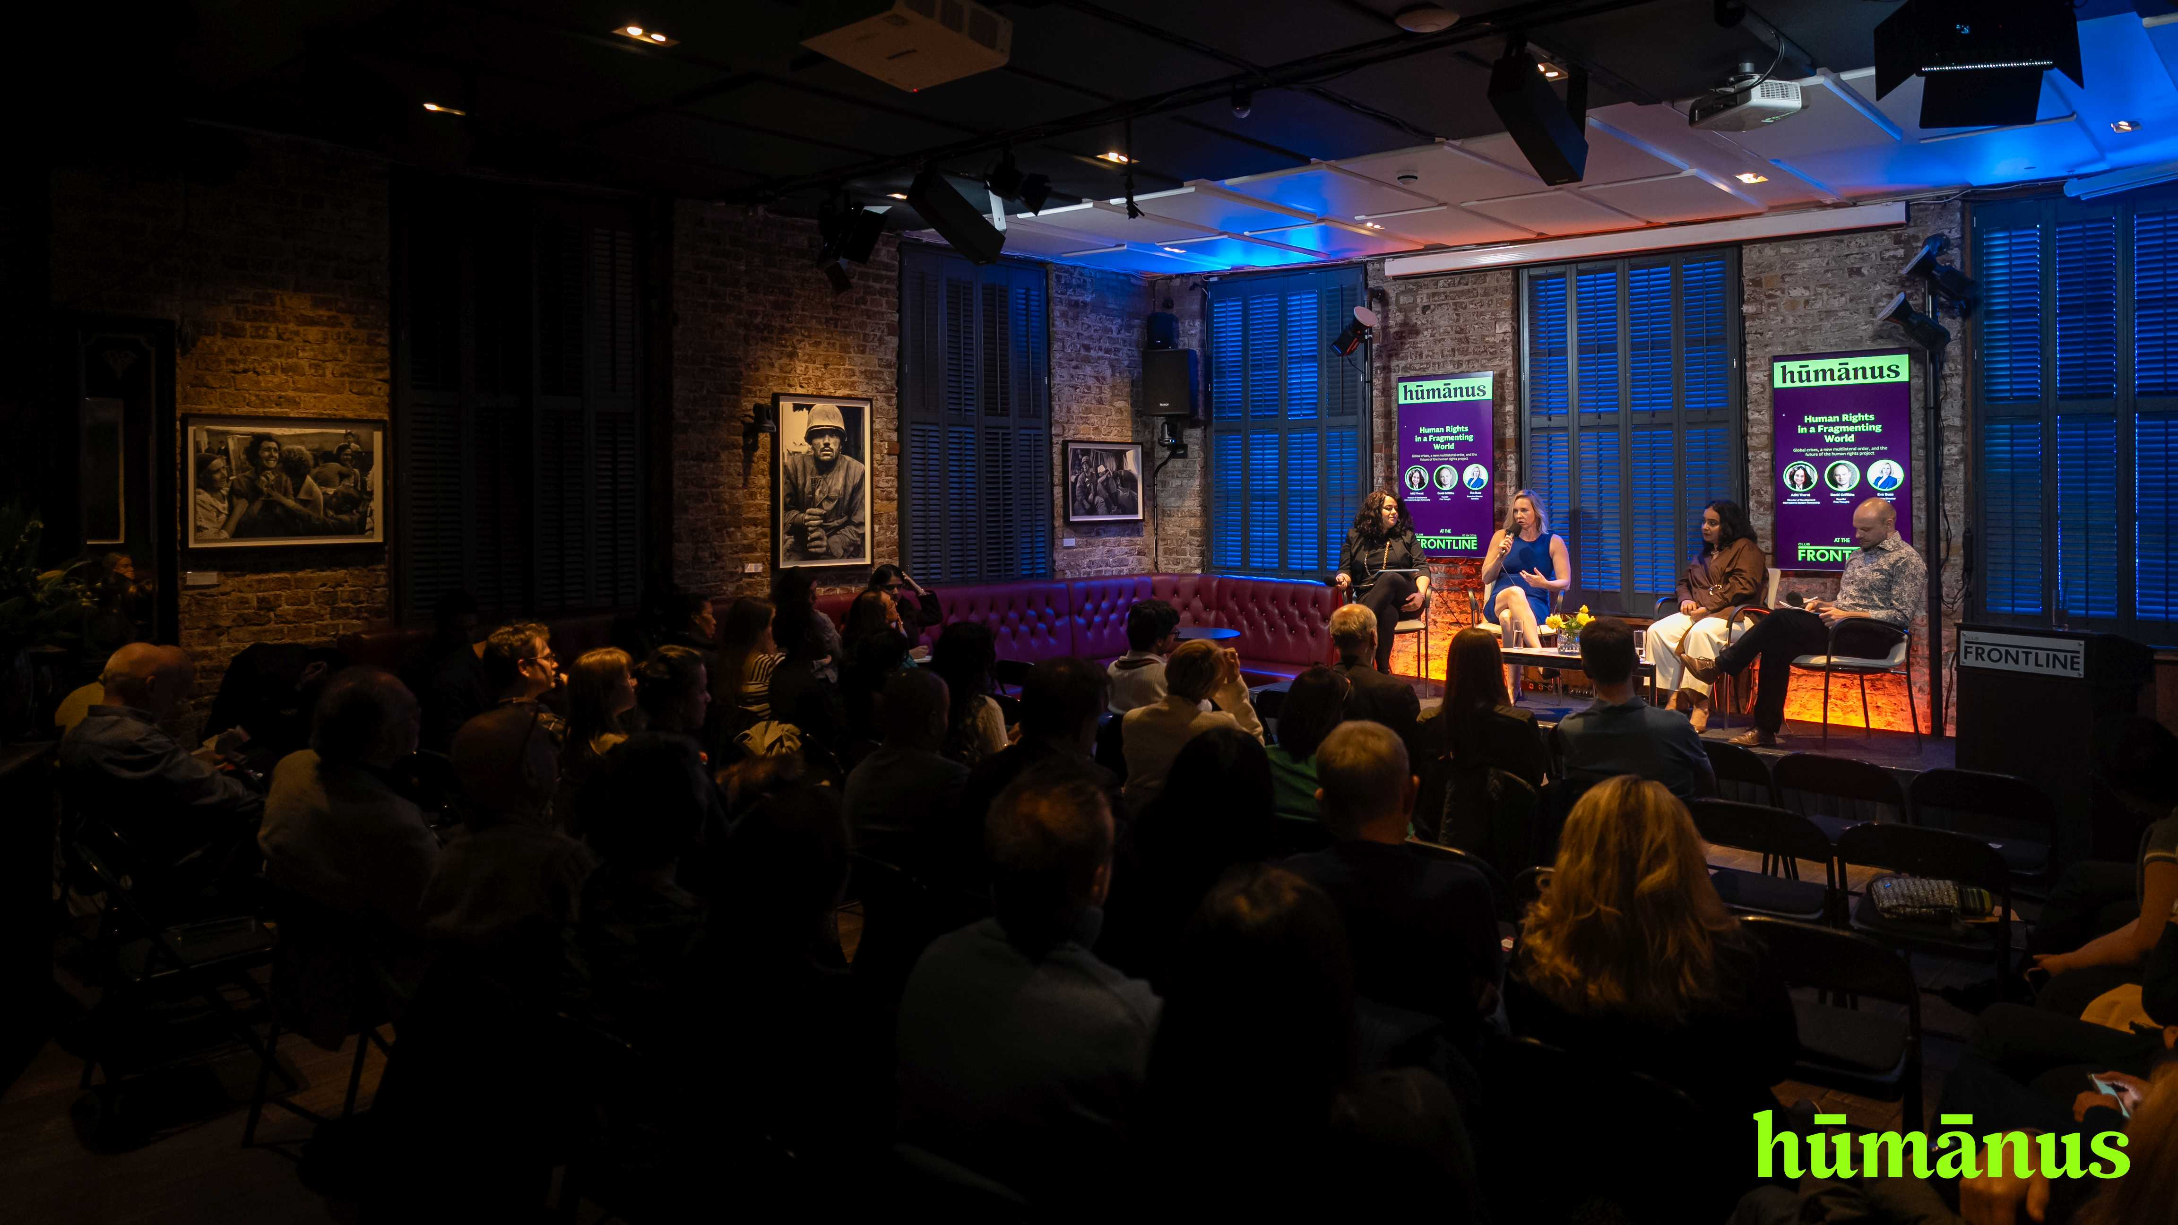
PUBLIC ENGAGEMENT
Frontline Club
panel — London
Human Rights in a Fragmenting World
2 April 2026
A hūmānus-branded panel at the Frontline Club, bringing together our Rohingya-in-India work, dialogue work, and wider accountability practice in front of a London press and policy audience. Featured-speaker videos (Aditi and Nazia) approved end-May for onward circulation.
hūmānus · Q2 2026 Board Meeting
8 / 11

Slide 9
Accountability for business and human rights
Core funded · programmatic framework for our corporate-accountability work
THE FRAMEWORK
Bringing together our work that holds business actors accountable for contribution to, or benefit from, serious international crimes — across litigation, regulatory complaint, and investor-facing advocacy.
ACTIVE WORKSTREAMS
Meta Inc.
Adani / UniSuper / APRA
Civil proceedings in Ireland continuing on behalf of sixteen plaintiffs. SEC pathway active. Underpinned by 2025 evidence-base work (RJI / ARSPH merge, CRA reparations analysis).
New active strand from March 2026: APRA complaint (Cbus deep-dive), Adani Investors briefings on Australian fiduciary case law and super-fund exposure to Adani / GQG, Adani Defence scoping, OFAC Iran civil-probe briefing, UniSuper PHD review.
Mohib Ullah accountability
Note for the Board
UN Special Rapporteur submission progressed Q1 (Hashmat feedback). ARSA designation advocacy continuing.
Adani / UniSuper has grown enough in three months to warrant its own briefing — proposed as a dedicated paper at Q3.
hūmānus · Q2 2026 Board Meeting · Operations & Impact Update
9 / 11

Slide 10
Strategic outlook and watch-items
Things to keep in view between now and the Q3 meeting.
Reserves and deficit-model donors
FCDO and Swiss reimburse in arrears; cash-flow discipline remains critical. Detail in papers 04 (Reserves Prognosis) and 05 (Y2D Grant Spend).
VAI ↔ hūmānus entity transition
Two active Swiss-funded workstreams straddle the transition — SDC Women's Dialogue closing out under VAI; Swiss/Stimson Arakan running under hūmānus.
Bangladesh operating environment
Political situation under the new government continues to shape Bangladesh dialogue and Stimson partnership delivery.
Beyond 2029 / post-OSF horizon
Picked up under agenda item 6 (strategic discussion) — matching ambition to a minimal-fundraising posture.
Hiring posture
Cautious on new permanent hires after Q1 reflection; no new joiners Feb–May 2026.
Governance and external engagement
Els onboarding closed Q1 action 9 (contracts, notary, statutes, insurance — April). BBC and AP pitches drafted in April; Geneva convening mid-May. Frontline Club post-production complete.
hūmānus · Q2 2026 Board Meeting · Operations & Impact Update
10 / 11

Slide 11
Humanising justice
ACCOUNTABILITY · COMMUNITY · EVIDENCE
www.humanus.co · hello@humanus.co
Q2 2026 Board Meeting · Operations & Impact Update · Sponsor: Eva Buzo (ED)

