Slide 1


annual report
2025
Humanising Justice
ACCOUNTABILITY · COMMUNITY · EVIDENCE

Slide 2

Our Mission
Empowering victims of serious international crimes
ACCOUNTABILITY · COMMUNITY · EVIDENCE
Our mission is to empower victims of serious international crimes and transform accountability processes. Working alongside victim groups, we support them to get justice that matters to them. Too often, victims are not included in legal processes. We strive to amplify their voices, ensuring they are heard and respected on the global stage.

Slide 3

Contents
Executive Director's Statement
4
OUR PROGRAMMES
1. Rohingya in Bangladesh
7
Rohingya Atrocities Archive
8
Dialogue & Leadership
9
Meta Accountability
9
2. India: Tracking Detention, Securing Freedom
10
3. Somalia: AFRICOM Responses on Civilian Harm
12
4. Colombia: Forces of Inspiration
14
ORGANISATIONAL
Financial Report
16
Our Partners
17

Slide 4
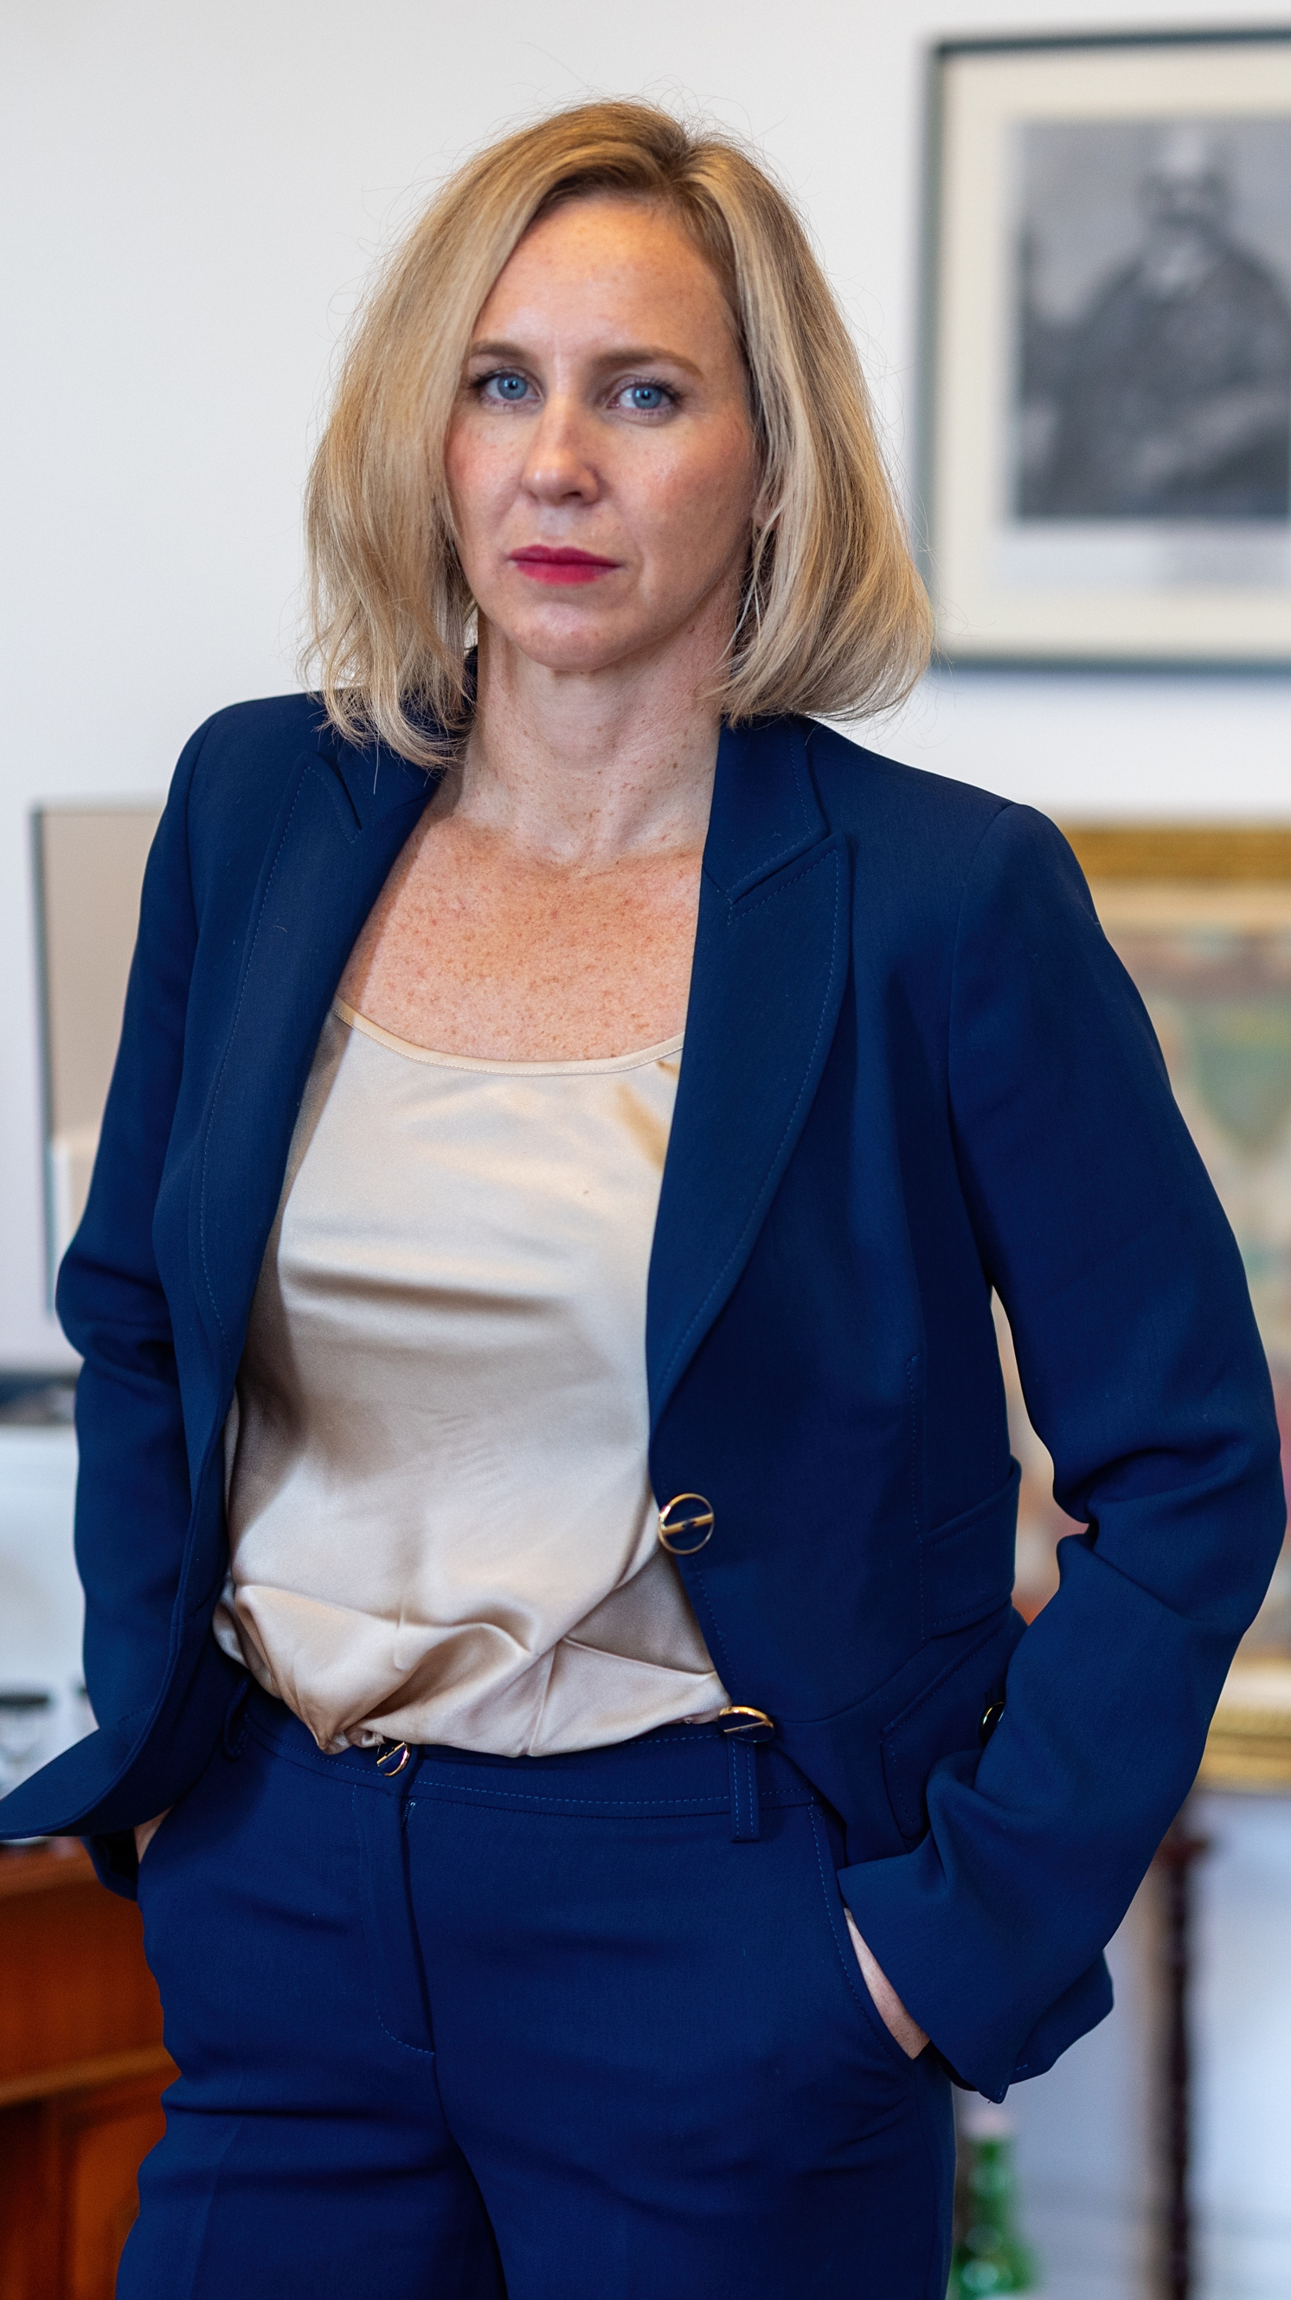
Executive Director's Statement
Executive Director's
Statement
In 2025, hūmānus strengthened a simple commitment: accountability work is most credible and most durable when it is built with the communities who live the consequences of atrocity, displacement, and unlawful detention.
Our mission is to empower victims of serious international crimes and transform accountability processes. Working alongside victim groups, we support them to get justice that matters to them. Too often, victims are not included in legal processes. We strive to amplify their voices, ensuring they are heard and respected on the global stage.
2025 was also the year in which we adopted our five-year strategy for 2024–29, setting the direction for hūmānus as we enter a crucial period of growth. The strategy is organised around three goals that guide everything we do. First, that victims of serious international crimes secure outcomes in line with their own conception of justice. Second, that victims are empowered by the process of pursuing justice—not just by its results. And third, that justice processes in the wake of international crimes are transformed in order to centralise victims. Each of the programmes described in this report is designed to advance one or more of these objectives.
In 2025, that mission found expression across three geographies and four distinct lines of work. Across our Rohingya programming, we supported community-led documentation and dialogue that connected lived experience to legal strategy, while protecting participants in an increasingly constrained operating environment.
hūmānus
4

Slide 5
Executive Director's Statement
Our dialogue work created sustained channels for communication and analysis, including weekly workshops and inter-ethnic engagement that helped participants interpret political dynamics and prepare for international advocacy moments, including the United Nations High-level Conference on the Situation of Rohingya Muslims and Other Minorities in Myanmar in September 2025 in New York.
Alongside this, we continued to build practical tools that convert information into action. In India, our detention-tracking work expanded into a living database used to support bail and legal advocacy for Rohingya detainees, while also capturing the scale and patterns of detention and deportation across multiple states.
In Somalia, our work pursued answers, acknowledgment, and remedy. In 2025 we received written determinations from AFRICOM across three civilian harm cases we supported, including findings that recognised civilian harm, even as significant gaps remained in delivery of payments and meaningful redress.
“
Accountability must be built with affected communities, not about them, and it must be made tangible through evidence, advocacy, and practical pathways to remedy.
— Eva Buzo, Founder & Executive Director
I was honoured to speak at the American Society of International Law conference in a panel debate on international accountability and also had the opportunity to address a side event on the Youth of Myanmar on behalf of our client Maung Sawyeddollah.
We closed the year by bringing our team together for a retreat in Bangalore, India—a chance to connect, reflect on the year's work, and sharpen our shared direction.
Eva Buzo
Founder & Executive Director
hūmānus
5

Slide 6
OUR 2024–29 STRATEGY
Three goals guide everything we do
1
2
3
Victims of serious international crimes secure outcomes in line with their own conception of justice.
Victims are empowered by the process of pursuing justice—not just by its results.
Justice processes in the wake of international crimes are transformed to centralise victims.
hūmānus
6

Slide 7
1
Rohingya in
Bangladesh
Preserving evidence, sustaining dialogue, pursuing corporate accountability
hūmānus
7

Slide 8
1. Rohingya in Bangladesh
Rohingya Atrocities Archive
The Rohingya Atrocities Archive (RAA) is a digital archive initiative designed to preserve and organise evidence of international crimes committed against Rohingya communities, and to strengthen access to structured information for accountability efforts. The RAA is the product of hūmānus' long-term partnership with the Arakan Rohingya Society for Peace and Human Rights (ARSPH), the organisation founded by Mohib Ullah, the Rohingya leader who was assassinated in 2021. The archive represents the first time that Mohib Ullah's documentation work has been made public.
Evidence deteriorates, disappears, and is contested. The RAA exists to ensure that Rohingya survivors and community-led documentation are not treated as "inputs," but as enduring records that can support legal strategy, advocacy, and historical truth-telling.
Why this matters
Accountability processes depend on credible, structured evidence. The RAA ensures that documentation produced and preserved by Rohingya communities retains its integrity, remains accessible, and can be deployed in legal and advocacy settings for years to come.
In 2025, we continued development of the digital archive, including work to create a machine-readable platform that supports advanced searching and structured use of data. We advanced work on AI-supported classification and search tooling. Public-facing engagement included exhibitions and launch events in Ontario, Canada and London, England that helped translate evidence preservation into wider awareness and support, alongside strategic outreach to media, decision-makers and stakeholders.
hūmānus
8

Slide 9
1. Rohingya in Bangladesh
Dialogue & Leadership
In partnership with the Stimson Centre, hūmānus continued our work with Rohingya leadership on dialogue and engagement. At the centre of this work are the wishes of our clients: there can be no accountability if we are not allowed to return home. Activities during the reporting period included weekly workshops that strengthened leadership confidence, with explicit focus on representation, participation, and rights-based advocacy. We facilitated inter-ethnic dialogue between Rohingya women and Rakhine women, and supported separate engagement between Bangladeshi officials and ULA personnel.
Our dialogue model contributes “ground-truth” inputs that help external stakeholders, including state actors, better understand community priorities and the risks and realities of representation. This is anchored in sustained dialogue channels and real-time analysis rather than one-off consultation. The weekly rhythm of engagement means that the perspectives shared with decision-makers are current, tested in discussion, and reflective of genuine community deliberation rather than extracted talking points.
In the lead-up to the High-Level Conference on Rohingya Muslims and other Ethnic Minorities, hūmānus played a pivotal role in the setting of the terms of reference including having our proposed language on social cohesion adopted for the modalities resolution. To this end we closely engaged with Member States, including our Executive Director being asked by the Canadian Permanent Representative to the United Nations to address the United Nations Informal Working Group on Myanmar on strategies to stabilise Rakhine State. Throughout the year we worked closely with the High Representative for the Rohingya crisis and at the request of Bangladeshi officials led stakeholder consultations to feed into the strategy for the High-Level Conference.
Meta Accountability
Our work seeking accountability against Meta Inc. advanced significantly in 2025. In Ireland, we filed statements of claim, and civil proceedings continue on behalf of our sixteen plaintiffs. We also pursued accountability through the Securities and Exchange Commission, working alongside Open Society Justice Initiative and Amnesty International. We undertook an advocacy trip to Washington, D.C. with our client Sawyeddollah.
Our OECD complaint against Meta came to an end in 2025 when we withdrew after mediation terms broke down. The experience underscored both the limitations of non-judicial mechanisms and the importance of maintaining parallel legal strategies.
hūmānus
9

Slide 10
2
India: Tracking
Detention,
Securing Freedom
Building a living record of detained Rohingya refugees to support legal intervention
hūmānus
10

Slide 11
2. India: Tracking Detention, Securing Freedom
94
9
120+
detention cases
documented
Indian states
covered
deportations
recorded
The India detention database project, led by Advocate Arati Ranade, builds a living record of detained Rohingya refugees across India to support legal intervention, track trends, and enable faster response to new detentions and deportation risks. The project is a partnership between hūmānus and the Azadi Project working together with community-led women field researchers.
By the end of the reporting period, the project had documented 94 detention cases across nine Indian states: Delhi, Assam, West Bengal, Uttar Pradesh, Haryana, Telangana, Rajasthan, Jammu, and Tripura. It recorded over 120 deportations, and the data is now actively used to support bail applications and legal advocacy.
Three key outcomes
Building a cross-state network of human rights lawyers equipped to take on Rohingya detention cases.
2. A growing body of legal research including bail applications and rights-based documentation.
3. Direct legal intervention through petitions and representation before local courts.
The work responds to persistent gaps in protection. UNHCR does not track Rohingya refugees after issuing identity documents, and UNHCR cards are not recognised by Indian authorities. The database serves both an immediate protective function—enabling faster legal response—and a longer-term evidentiary function, building a structured record of detention patterns that can inform policy advocacy.
hūmānus
11

Slide 12
3
Somalia: AFRICOM
Responses on
Civilian Harm
Pursuing remedy-focused accountability for civilian harm
hūmānus
12

Slide 13
3. Somalia: AFRICOM
In Somalia, hūmānus pursued remedy-focused accountability by supporting civilian harm cases and pressing for transparent determinations and meaningful redress from the United States Africa Command (AFRICOM).
3
civilian harm cases
recognised by AFRICOM
In 2025, AFRICOM communicated written determinations across three cases we supported, including recognition of civilian harm in all three. Determination letters dated September 2025 formally recognised civilian harm. Despite these determinations, condolence payments were refused and broader questions of remedy continued to require sustained advocacy.
Acknowledgment without remedy is not accountability.
The written determinations represent a significant step: AFRICOM formally acknowledged that its operations caused civilian harm. However, the gap between acknowledgment and actual compensation remains a persistent challenge. hūmānus continues to press for full implementation, including financial payments and transparency about assessment processes.
hūmānus
13

Slide 14
4
Colombia:
Forces of
Inspiration
Sport, solidarity, and the power of visibility
hūmānus
14

Slide 15
4. Colombia: Forces of Inspiration
open water swim
Juanchaco to Buenaventura
increase in hotel
occupancy post-event
In 2025, hūmānus' Executive Director Eva Buzo undertook a 40-kilometre open water swim from Juanchaco to Buenaventura along Colombia's Pacific coast, hosted by the Open Society Foundations as part of their "Forces of Inspiration" campaign. The swim was designed to celebrate and amplify the work of civil society groups in Buenaventura leading anti-violence initiatives.
The event took place against a challenging backdrop. In the week before the swim, Colombia was struck by attacks by armed actors, including in Buenaventura and nearby Cali. After consulting with local partners, the decision was made to proceed.
A message of peace and resilience was needed more than ever.
The swim was gruelling: starting at 2:00 a.m. in darkness, navigating torrential storms, unpredictable tides, and the notoriously rough stretch known locally as el paso de tigre. Thousands gathered at Buenaventura's Malecón to welcome the completion. Hotel occupancy increased by 40 percent. The swim served as a circuit breaker from the city's narrative of violence, and provided a platform for local civil society groups to be recognised for their work building peace.
hūmānus
15

Slide 16
Financial Report
Financial Report
Profit and Loss for the year ended 31 December 2025. All figures in USD.
Category | 2025 (USD) | 2024 (USD)
Income
Grant income | 171,034 | 599,292
Interest income | 2,783 | 4,353
Total Income | 173,818 | 603,645
Programme Costs
Personnel | 301,370 | 298,797
Partner grants | 57,921 | 33,553
Travel & subsistence | 109,634 | 80,842
Volunteer stipends | 12,615 | 5,916
Total Programme Costs | 481,540 | 419,109
Operating Expenses
Branding & communications | 35,438 | —
Professional services | 55,917 | 35,441
IT, administration & other | 8,570 | 2,441
Currency adjustments (net) | (14,566) | 6,881
Total Operating Expenses | 85,359 | 44,762
Net Result | (393,081) | 139,774
Personnel includes Executive Director, project staff, and project consultants. Travel & subsistence includes international and domestic flights, accommodation, per diem, meeting expenses, local transportation, and cost of living allowances. Professional services includes accounting, legal fees, and strategy & advisory services. The net deficit reflects the timing of multi-year grant disbursements against programme delivery.
hūmānus
16

Slide 17
Our Partners
We Are Grateful to
Our Partners for 2025
hūmānus' work in 2025 was made possible by the generous support of the following partners.
Cowater
Swiss Embassy, Dhaka
Open Society Foundations
FCDO
Swiss Embassy, Yangon
hūmānus
17

Slide 18
hūmānus
Humanising justice
ACCOUNTABILITY · COMMUNITY · EVIDENCE
www.humanus.co
hello@humanus.co
2025

