Slide 1
Black-Box Methods for Restoring Monotonicity
Evangelia Gergatsouli¹, Brendan Lucier², Christos Tzamos¹
¹University of Wisconsin-Madison
²Microsoft Research
ICML, July 2020
Notes:
<intro> We’ll start with some motivating examples and an overview of our work and then move on into some details.

Slide 2


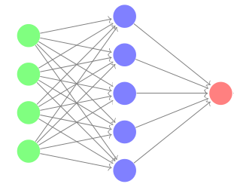
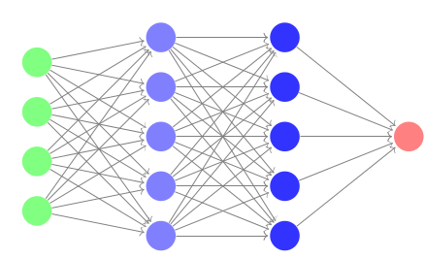
Overview - Motivation
Example 1: the deadline is approaching!
Delete sentence
ICML Page limit: 10
11 pages
12 pages
Example 2: hyperparameter tuning
Add layers
How do we fix monotonicity, in a black box way?
error k
error 3k
Notes:
Imagine you’re writting a paper for icml, and the limit is 10 pages. Your document now is 11 pages, so you try deleting some redundant sentence to get closer to the target, and you recompile and the document becomes 12 pages!
Think also of another more relevant to machine learning example: in hyperparameter tuning, say your favourite NN, you train it and you observe error k, since this is not good enough for you, you decide to add some more layers and now you observe that the error increased!
In both of these settings, we would expect some kind of monotonicity to hold for wither the number of pages wrt the sentences of the document and the error wrt the complexity of the NN.
These are some simple settings where monotonicity is a property that is naturally expected, but not always there. 1 reason this might happen: various opt algos/heuristics used in the background might not always find the best solutions
The question is how do we fix such non monotonicities in a black box way without knowing how the algorithm works.

Slide 3
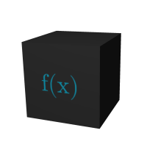
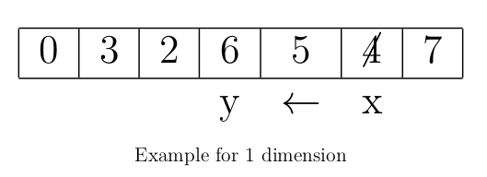

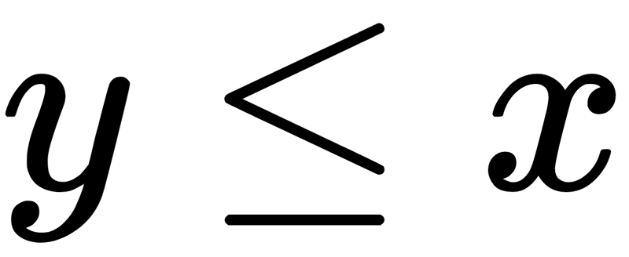
Our Model
What is f(x)?
x
f(x)
f’(x) = 1 or 7 may not be feasible but
f’(x) = 6 is feasible
f might not be monotone!
Change f to be monotone & satisfy feasibility
Feasibility: Unclear what solutions/values are feasible
Solutions for smaller inputs feasible for larger ones
Output any f(y) from
Notes:
Let’s see our model in a bit more detail. We have this black-box algorithm that returns values f(x). Suppose this curious cat here wants to find out the value of x, the first thing she can do is to ask directly function value. As we saw though, this might result in non monotone answers
Unclear what feasibility is? Only make assumption that solutions for smaller inputs are feasible for larger ones

Slide 4
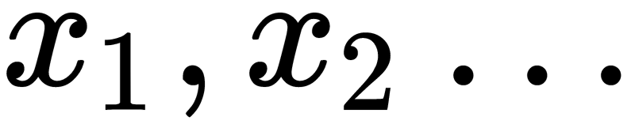
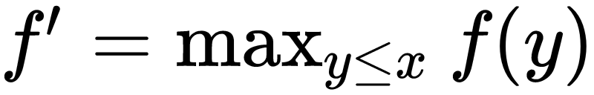


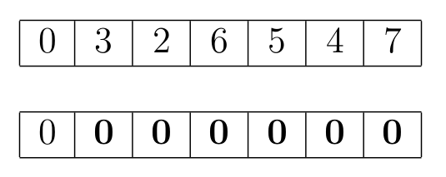
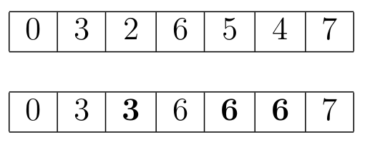
Our Model
Ask f for points
What is f(x)?
x
Meta-Algo/Filter
f’(x)
Idea 1: f’ = 0 for all inputs
f’ monotone
f’ better than f
Filter is query efficient
Idea 2:
f’ monotone
f’ better than f
Filter is query efficient
Notes:
So what can we do to ensure these properties? We need to somehow correct the values of f,. In order to do that, we design a filter or a meta algoroithm that exists between the black box f function and our user.
Now when the user asks a question to the filter, this filter interacts with the black box, possibly making a number of different quereis, and then returns to the user some f’(x) for the value she asked.
How do we design this algo?
Idea 1: output the lowest possible outcome for every input, for example say we have this table… and the dfunction we return only has 0, This is certainly monotone, and is fast to compute but the new function has almost nothing to do with the original one, in other words there are no performance guarantees preserved.
Idea 2: If we output for every point the maximum possible over the smaller points. Again in this case our function is monotone, and the performance guarantees are preserved, but the time needed to compute every output can potentially be ectremely large.
As you can see it is not trivial to guarantee all these nice properties for the filter.

Slide 5
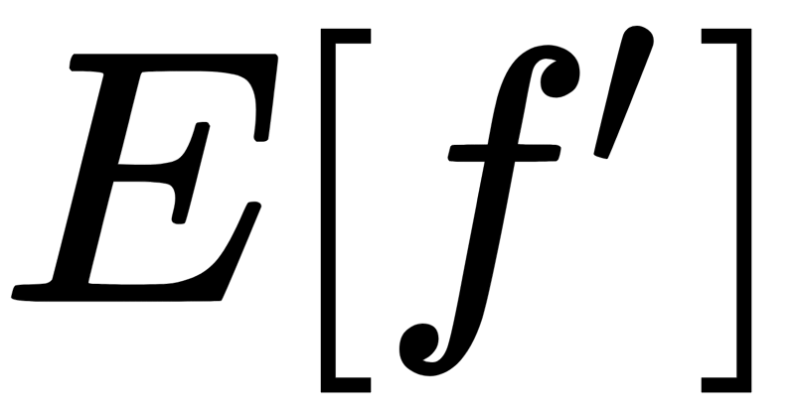
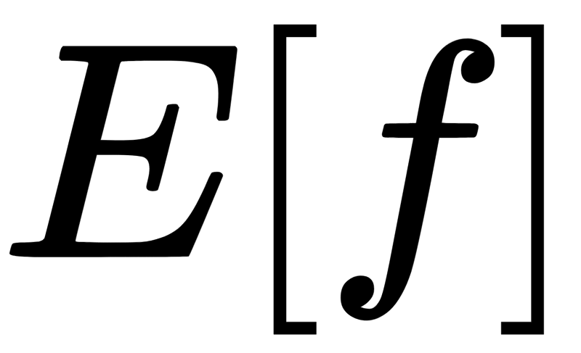
Our Model
What is f(x)?
x
Meta-Algo/Filter
f’(x)
Ask f for points
Goals:
f’ monotone!
Feasible
better than
Query efficient
Notes:
More specifically, our goal in this work is to design such a filter such that the outpout function is monotone, feasible in the sense we described before, it preserves the performace guarantees in expectation and is query efficient, meaning is fast to cpmpute.

Slide 6
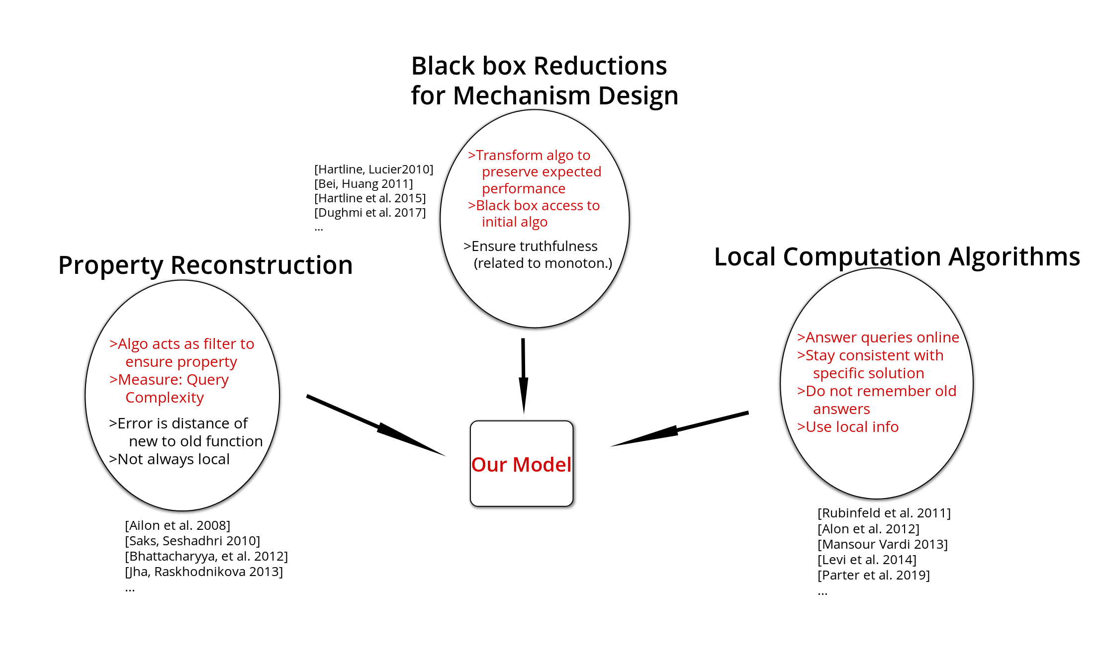
Model
Notes:
So let’s put our model in context, and see why we designed it like this. There are 3 mail areas we borrow ideas from.
First there is the black box reductions for mech design literature, where teh goal is to transform an algorithm in a black box way in order to preserve performace guarantees, which is what we also do in our model. Additionally they also want to guarantee other properties like truthfullness which is bvery closely related to monotonicity.
Second there is the LCAs literature, where the goal is to answer queries in an online fashion, without remembering old answers to the questuions: essentially only use local info to answer the questions.
Finally in statistics they look at property reconstruction algorithms, where the algoirhmt is a filter that guaranteees a property, and monotonicity is one of the properties that they but their algorithms are not always local and the error is the distance of the new to the old function.
So all in all, we borrow the model from the bbox reductions literature and the more algorithmic aspects from LCAS and Property reconstruction. Essentially oiur model in somewhere in the middle of these.

Slide 7
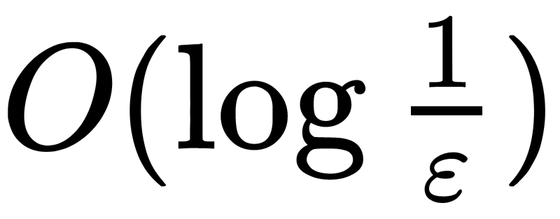
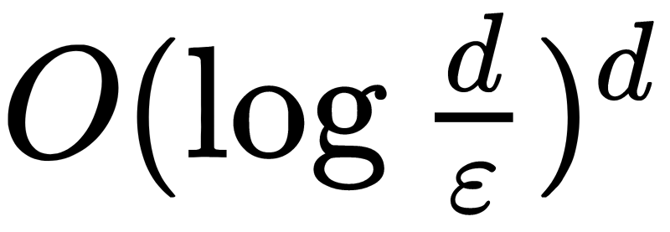
Our Results
Theorem 1: There is a meta-algorithm that “monotonizes” any univariate function and
Is feasible
Has expected performance loss at most ε
Uses at most queries.
The algorithm extends to d-variate functions and uses at most queries
Theorem 2: Any meta-algorithm that “monotonizes” functions with non-trivial performance guarantees must make exponential in d queries.
Notes:
Even though we discussed about replacing values, essentially we replace the whole solution with another
Our first theorem sau that …
And it turns out we can actually extend this in d dimensions using…
Observe that the above algo has an exponential dependence on the dimension, and we show that this is unavoidable and any meta algo that monotonizes functions must make exp in d in order to maintain the performance guarantees

Slide 8
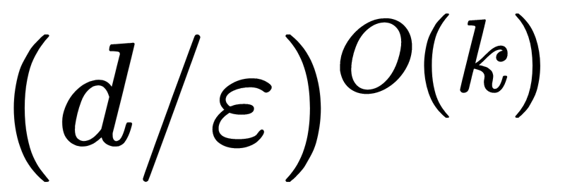
Our Results
We can escape this exponential hardness by considering a weaker notion of monotonicity: monotonicity of marginals
Theorem 3: There is a meta-algorithm that corrects k marginal monotonicity of any f and
Is feasible
Has expected loss at most ε
Uses at most queries.
This talk: focus on Theorems 1+2
Notes:
The next question we asked was whether we can escape this exponential hardness by considering weaker notions of monotonicity.
And it turns out that for k marginal monotonicity, we can avoid this exponential dependence and get d/e^k queries
In this talk focus...

Slide 9
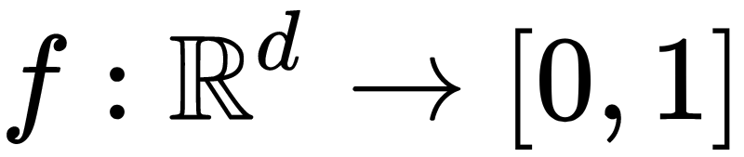
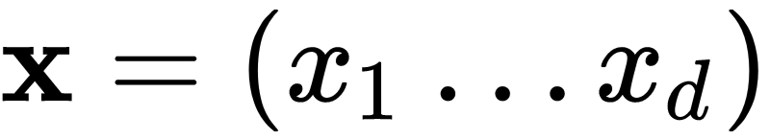

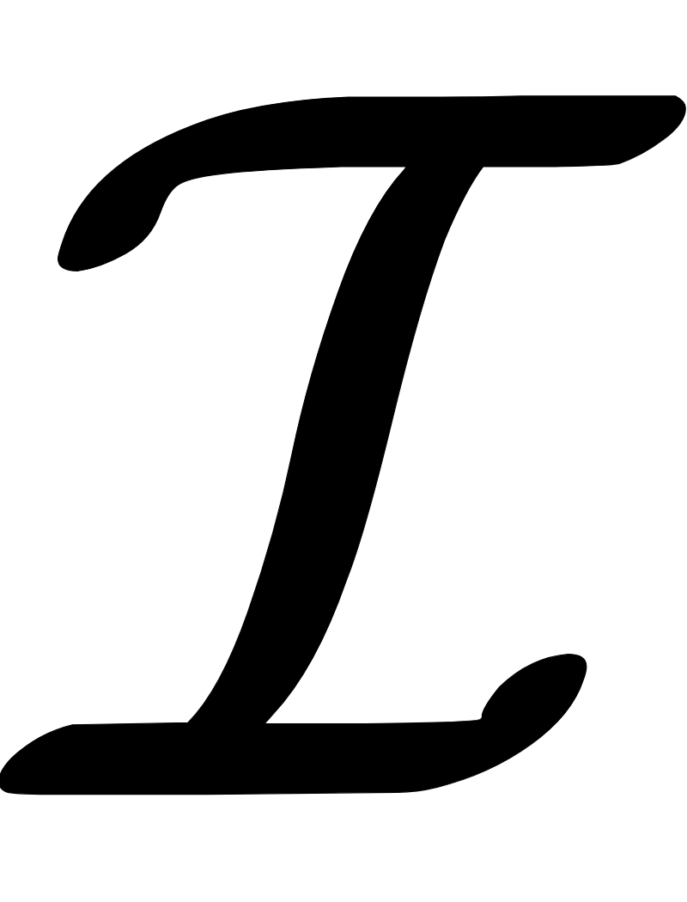

Formal Model
Oracle access to
Input
Product distribution
Monotonicity: f(x) ≤ f(y) whenever x ≤ y coordinate-wise
Marginal monotonicity: is monotone
k-marginal monotonicity: for any subset of coordinates,
is monotone
Notes:
Formally our model says that we are given oracle a
The input comes froma produxt distr
And monotonicity isdefined as some f(x) less thatn f(y) whenever x<y coordinate wise
Marginal mnotonicity means that we want any of the k marginal distributions to be monotone,

Slide 10
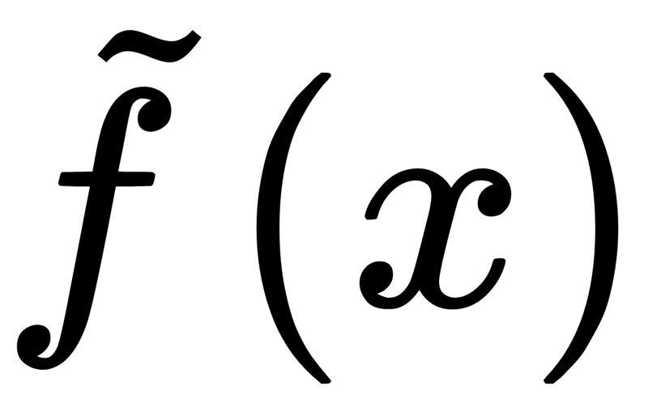
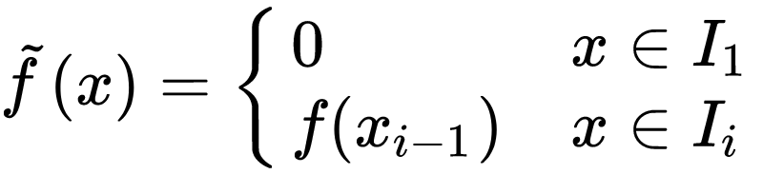
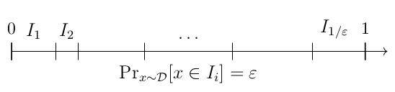
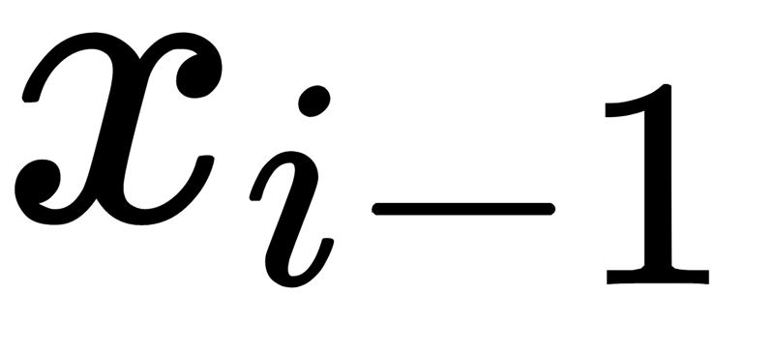
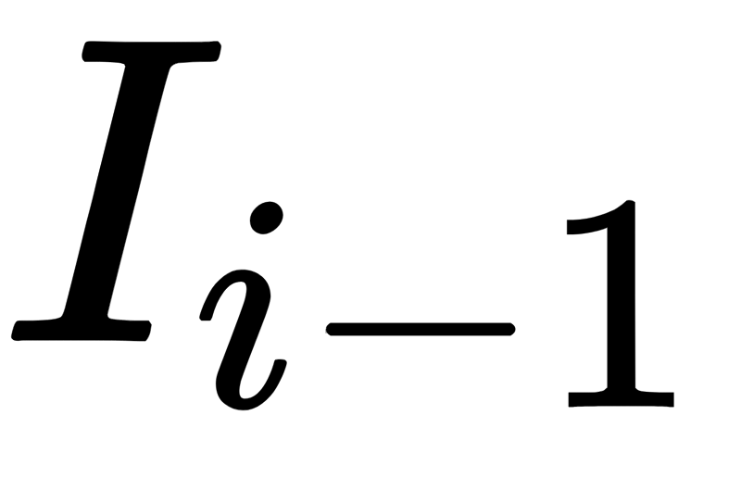
Discretization
Output a piece-wise constant function
Split into 1/ε pieces of equal probability
Define
for a random drawn from
:
is feasible
loses at most ε in expectation
We only need to monotonize which is discrete
Notes:
The first step is to discretize our domain
To do that…

Slide 11
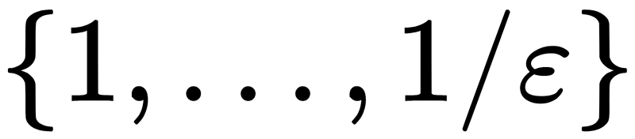
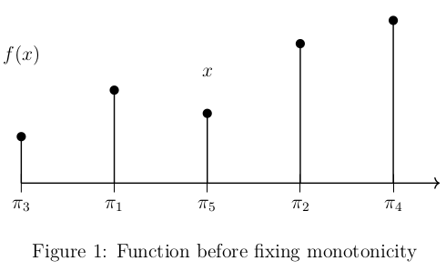
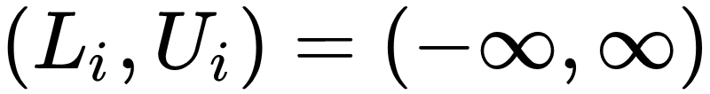
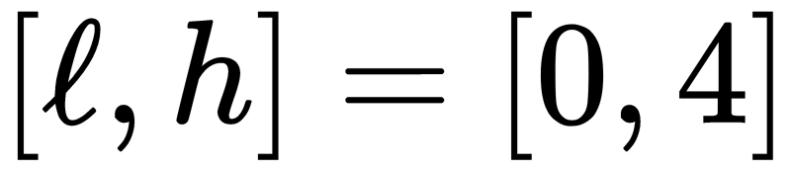
Monotonicity in 1 dimension
Input x
Randomly permute points
Keep track of Lower & Upper bounds
Keep track of relevant interval
Notes:
How we handle monto in 1d, someone asks us for value of x, how can we answer this question fast and without violating monotonicity with previous answers?
After randomly permuting the points, we keep track of LB UB and a releant interval. Then essentially by looking at these poitns in this random order, we throw out part of the ionterval as “irrelevant” and decide on a new upper or lower bound for f (x) depending on whether the point in the perm was lower or higher than x.
A key property is that This permutation is the same for every input, and thjis is how we ensure that monoton is not violated.
Let;s see a small example with this process…
Fix values one by one in eandom order. Fix each one in a feasible value, using the order.
Relevant interval in case the value violates previous values, we have a feasible interval
If value violates monotonicity, we give the closer possible in [LB,UB] (upper means I have something above with this value, same for LB)
Question: how we find x’s value locally? There is a greedy rule to enforce this locally, without many queries
Essentially every time we

Slide 12
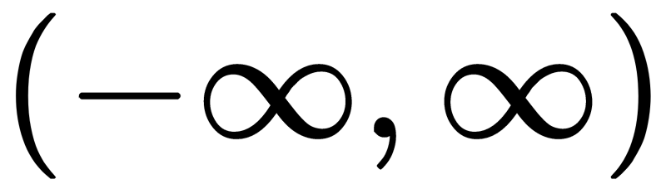
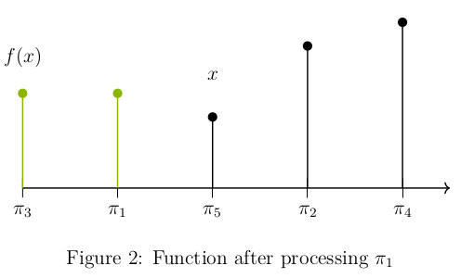
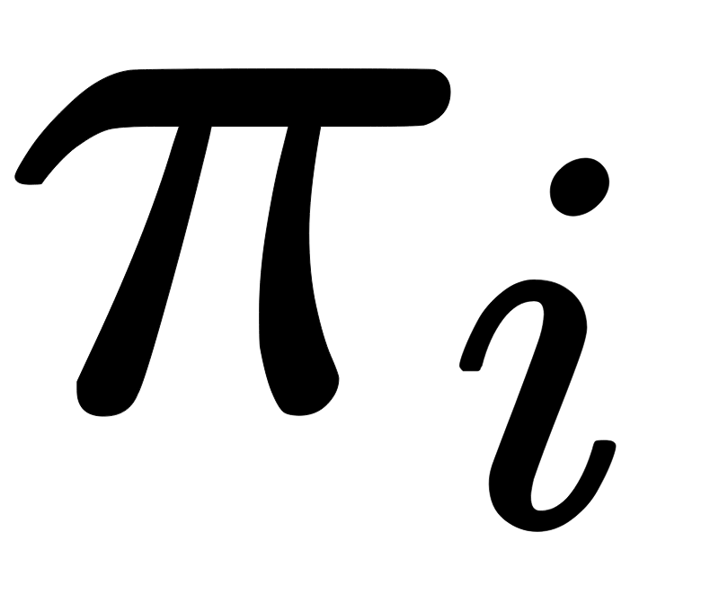
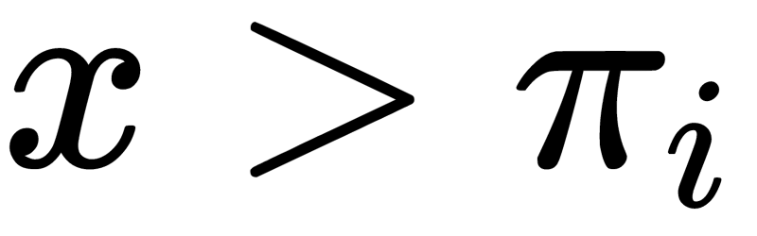
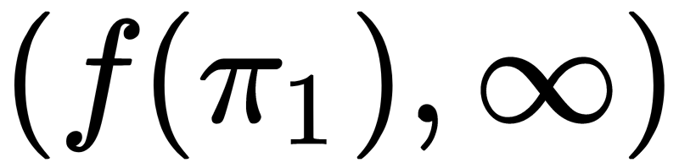
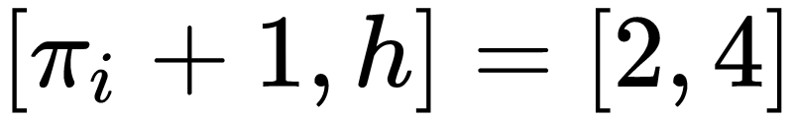
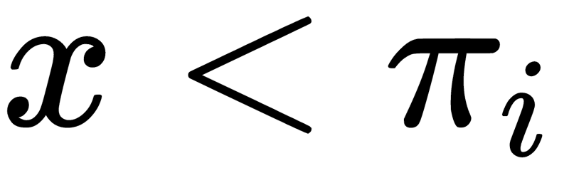
Monotonicity in 1 dimension
Lower & Upper bounds
Relevant interval
Pick next point in permutation
If then
new Bounds:
Relevant interval is
If
...
Notes:
How to find LB and UB for x, this is where f(x) hsould be

Slide 13
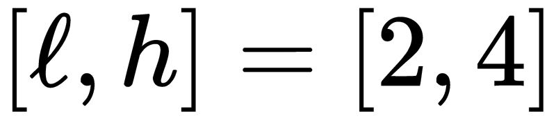
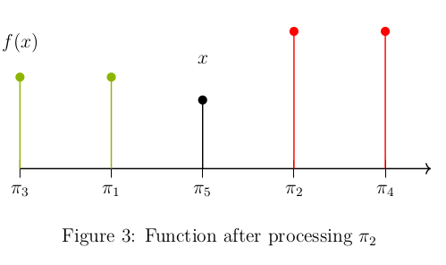
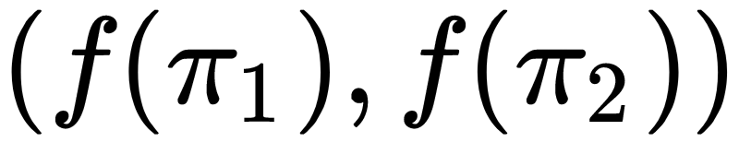
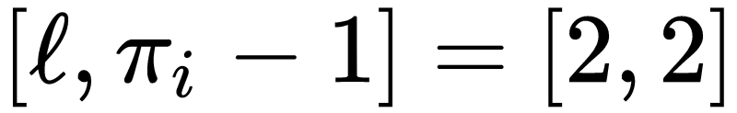
Monotonicity in 1 dimension
Lower & Upper bounds
Relevant interval
Pick next point in permutation
...
If then
new Bounds:
Relevant interval is
Notes:
Now we pivck a number inthe permutation that si abovce x, → we get upper bound for x since there is something that has this value→ x cannot go above

Slide 14
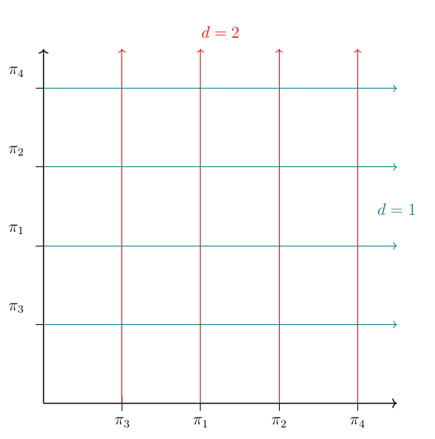
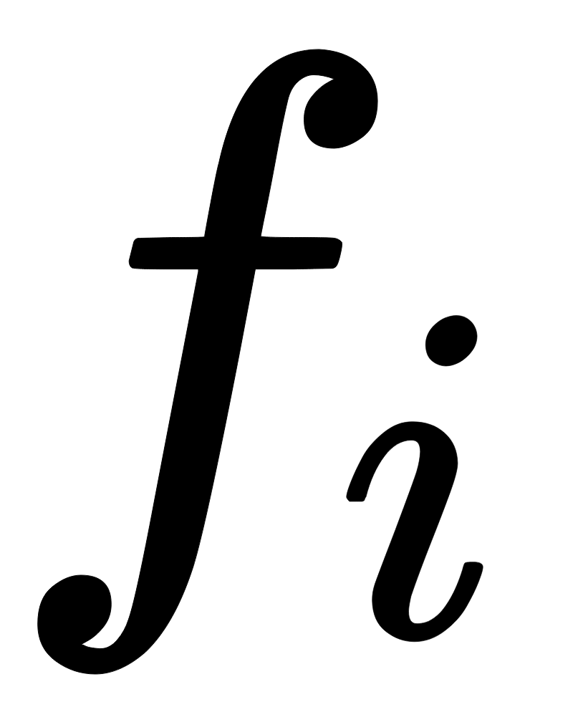

Many Dimensions
Fix monotonicity in every dimension, how?
Key Lemma: Given a function monotone in the first i-1 dimensions, we can fix i’th without violating the i-1
Pick permutations from the beginning
Starting from f, fix every dimension sequentially
Function with the first i dimensions “fixed”
Query complexity
Notes:
Many dims, how do we fix monotonicity taking into account all dimensions? The key property that holds in this case, and allows us to get the logarithmic factor in d dimensions is that give an function that is monotone in the first i-1 dimensions we can “fix” the monotonicity, the way we did for the one dimension, without violating the property in the already fixed dimensions. In order to do this, we fix the permutation in the beginning, and using this, we run sequentially the 1-dim algo for each fimension.

Slide 15
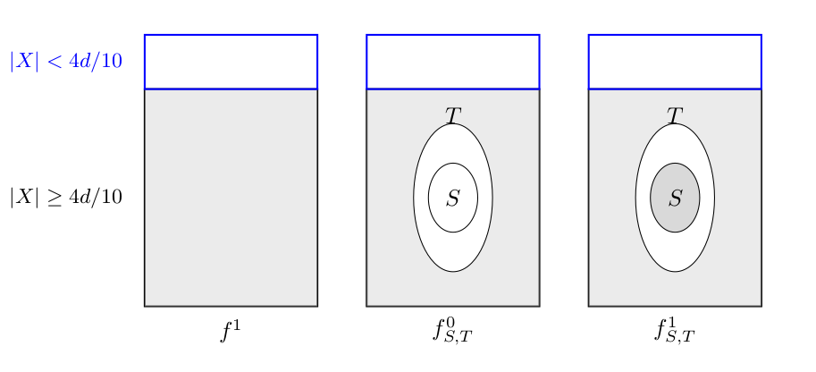
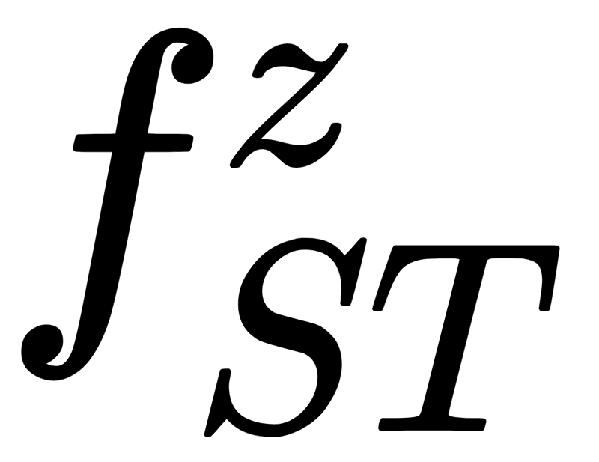
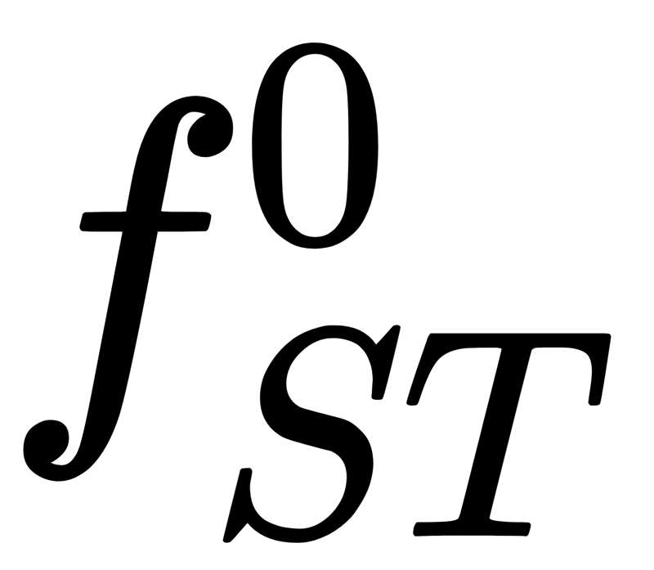
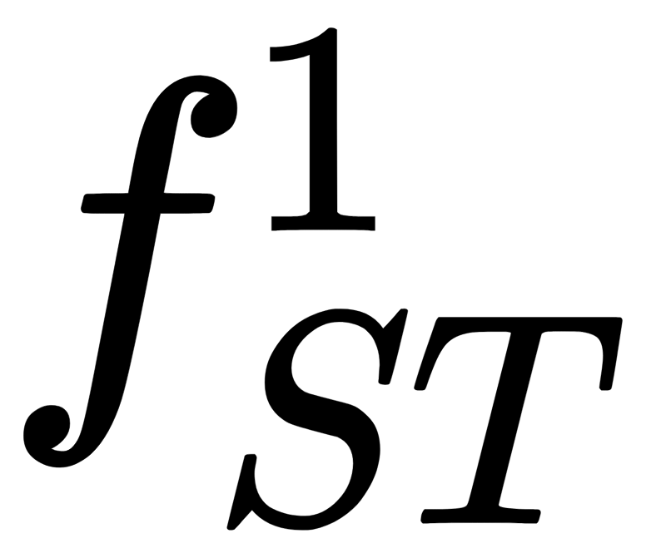

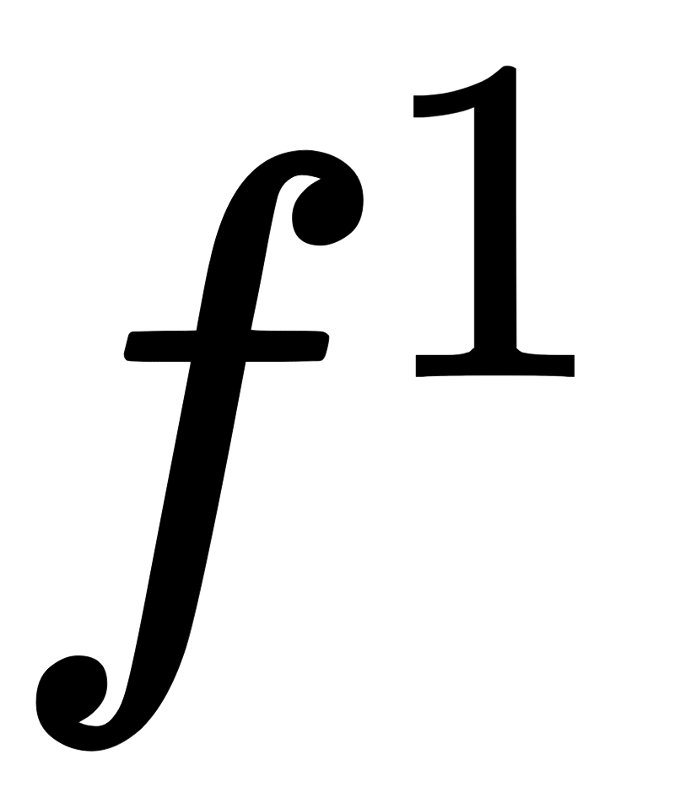
Lower Bound
For some domain and distribution
Original function f¹, has high expectation
Randomized functions based on random sets S, T
has low expectation, has high
Cannot distinguish between and
Cannot distinguish between and
With fewer than exponential queries

Slide 16
Conclusion & Open problems
An algorithm to fix non-monotonicity in d dimensions with black-box queries
Unavoidable exponential dependence in d
Relaxed versions of monotonicity (k-Marginal Monotonicity) fixable efficiently
Open problems:
Thank you!
Correlated coordinate distributions?
Other properties beyond monotonicity?

Slide 17

Overview
Can f’ be monotone?
Is Meta-Algo efficient?
How many queries are needed?
How close is f’ to f ?
How about less strict monotonicity properties?
Algorithm requires f to be monotone
f is not monotone!
Meta-Algorithm
x₁
ML ALGO
x
Meta ALGO
f(x₁)
...
f’(x)
x_{k}
f(x_{k})
dataset
Notes:
Instead of going over the dataset, and changing those non-monotonicities, we can use a meta-algorithm to interact instead of the dataset, that uses the dataset as a black box and always returns monotone points. The question is what do we need from this meta algo? First we want f to be monotone, but also get the point fast (efficiency). So how many queries do we need? Also ideally we want to preserve the information given by the initial f. What happens if we

Slide 18
Our Model
Ask f for points
What is f(x)?
x
Meta-Algo/Filter
f’(x)
Idea 1: f’ = 0 for all inputs
f’ monotone
f’ better than f
Filter is query efficient
Idea 2:
f’ monotone
f’ better than f
Filter is query efficient
0 | 3 | 2 | 6 | 5 | 4 | 7
0 | 3 | 2 | 6 | 5 | 4 | 7
0 | 0 | 0 | 0 | 0 | 0 | 0
0 | 3 | 3 | 6 | 6 | 6 | 7
Notes:
Assume now that we put a filter or a meta algo between our black box oracle for f. We want this filter to

Slide 19
Overview
Algorithm requires f to be monotone
f is not monotone!
Meta-Algorithm
ML ALGO
x
f’(x)
dataset
Notes:
We’ll give a brief overview of the topic of the paper, and outline the results before getting into more details. Imagine an ML algorithm that gets pairs (x,f(x)) from a dataset, and for some reason this algo requires the points to be monotone (meaning that for less x we get smaller labels f(x)). Now what happens if this is not the case?

Slide 20
E.g. In 1-D
Our Model
0 | 3 | 2 | 6 | 5 | 4 | 7
y
x
What is f(x)?
x
f’(x) = 1 or 7 may not be feasible but
f’(x) = 6 is feasible
f(x)
f might not be monotone!
Change f to be monotone & satisfy feasibility
Feasibility: Unclear what solutions/values are feasible
Solutions for smaller inputs feasible for larger ones
Output any f(y) from
E.g. In 1-D
0
y
x
100
Notes:
Let’s see in more detail what are we gonna do. Say this curious cat here wants to find out the value of x, the first thing she can do is to ask directly function value. As we saw though, this might result in non monotone answers, when we ask more queries.
Unclear what feasibility is? Only make assumption that solutions for smaller inputs are feasible for larger ones

Slide 21
The meta-algorithm
What is f(x)?
Meta Algo (3)
x
f’(x)
f(x_{k})
x_{k}
f(x₁)
Relaxations?
...
x₁
f’ marginally monotone
# queries=polynomial in dimension
E[f] ε-close to E[f’]
f’ k-marginally monotone
# queries=polynomial in dimension
E[f] ε-close to E[f’]
Notes:
> what about relaxations→ describe results here

Slide 22
Monotonicity - First Try
What is f(x)?
x
Meta Algo (3)
f’(x)
f(x_{k})
x_{k}
f(x₁)
Idea 1: f’ = 0 for all inputs
f’ monotone
f’ better than f
f’ efficient
Idea 2: f’ = max_{y≤x} f(y)
f’ monotone
f’ better than f
f’ efficient
...
x₁

