Slide 1

Flag Dataset
Classification & Clustering Techniques
Statistics for BA II
By Eva Giannatou

Slide 2
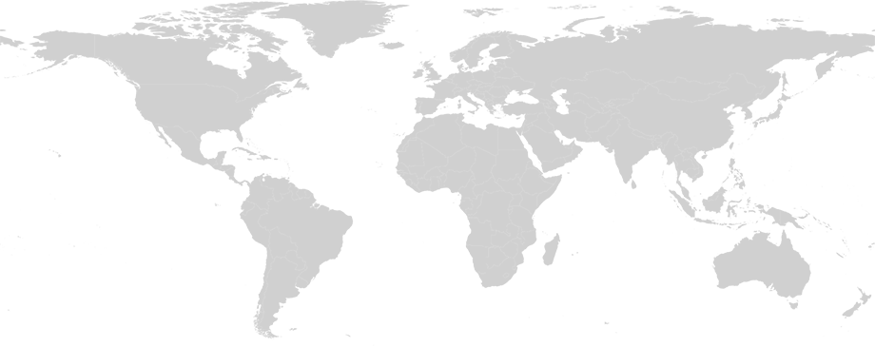
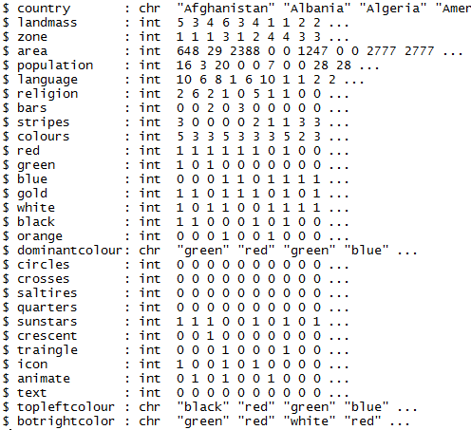
The Dataset
Data from the UCI Machine Learning Repository
containing details of various nations and their flags.
Dataset included
List of countries with demographics, geographic information and flag descriptions
Dataset consists of
Your Great Idea 2
194 countries and 30 attributes (10 numeric and the rest of them were either Boolean or nominal)
Project purpose
Predicting the religion of a country from its flag’s characteristics

Slide 3
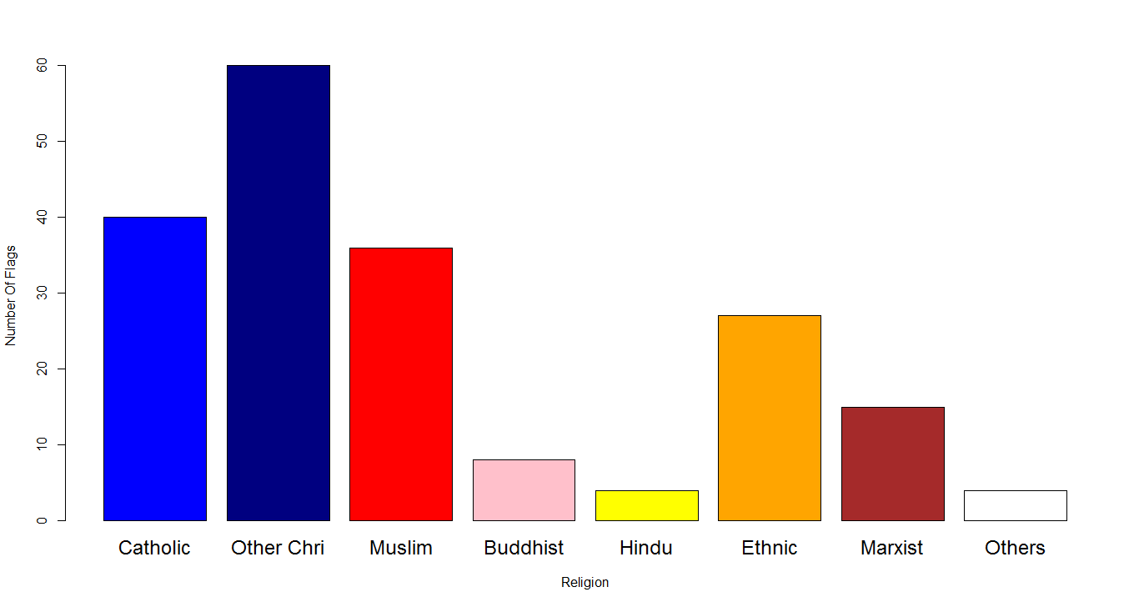
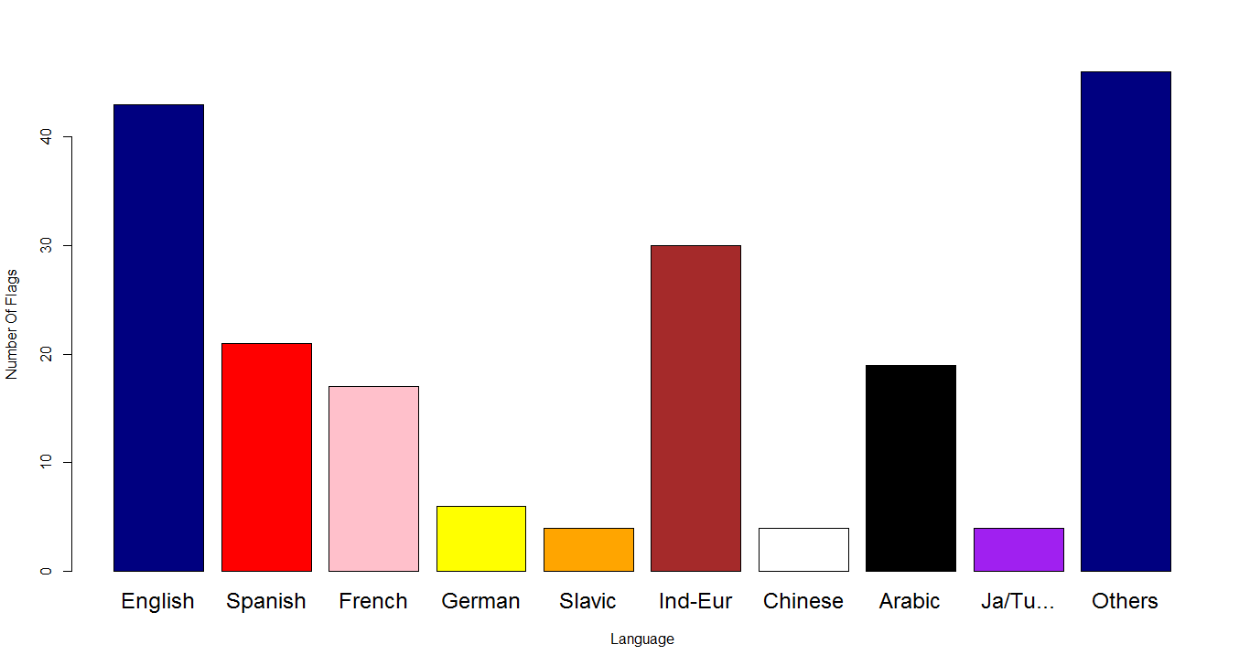
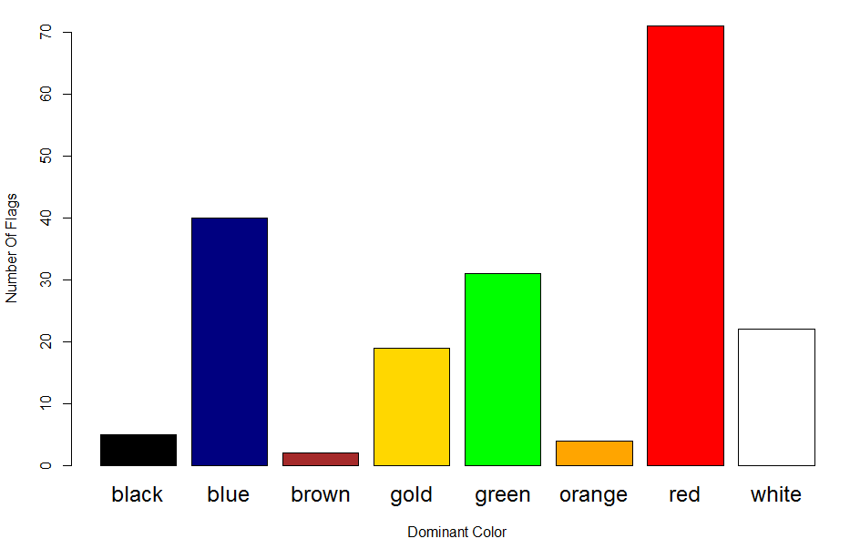
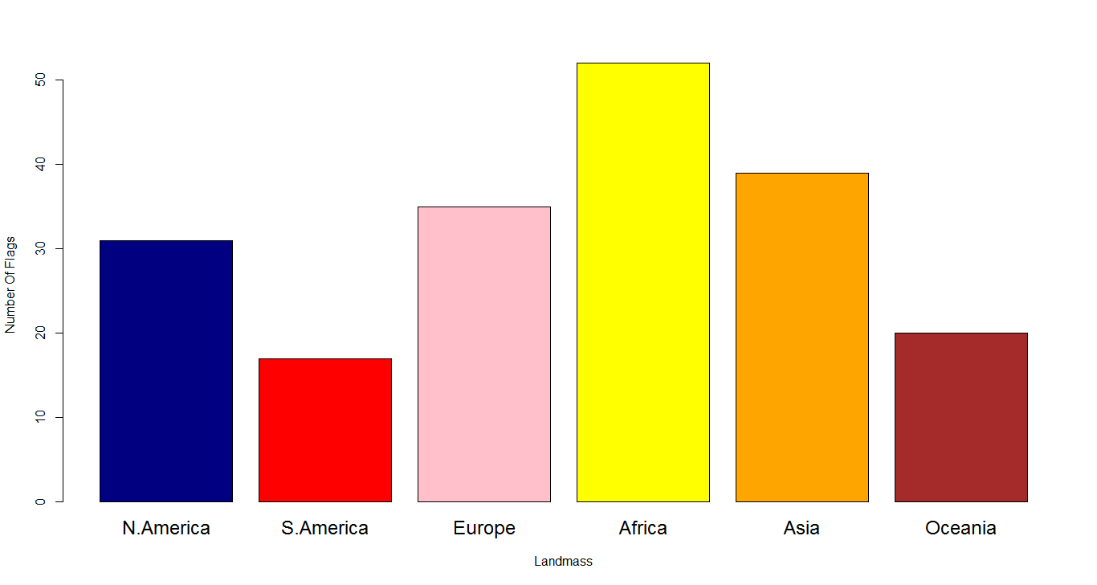
Data Visualization

Slide 4
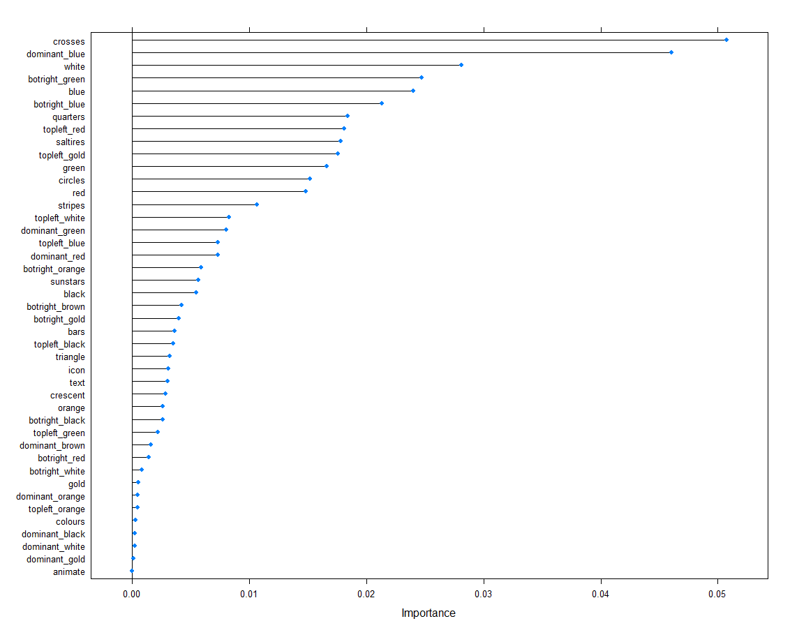
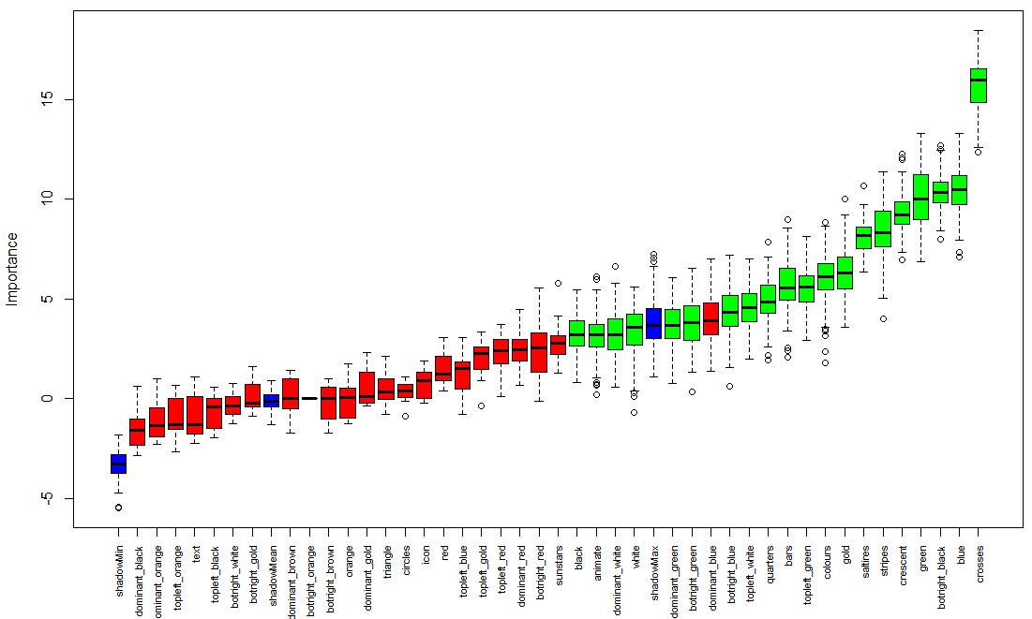
Important Variables
Which flag characteristics are correlated to the religion of a country?

Slide 5
Classification Models
Train models using training set
Test models using test set
Top Performing Models
Rpart
Accuracy 84%
PCs Used 5
C5.0
Accuracy 61%
PCs Used 9
J48
Accuracy 58%
PCs Used 10
Bagging cart
Accuracy 55%
PCs Used 9
1
2
5
4
1
INPUT
Flag Characteristics
2
OUTPUT
Religion

Slide 6
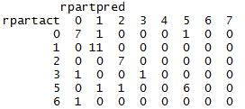
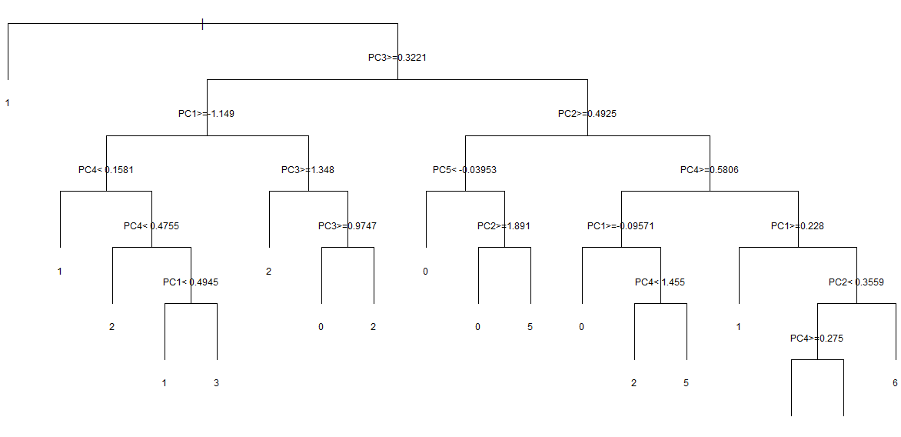
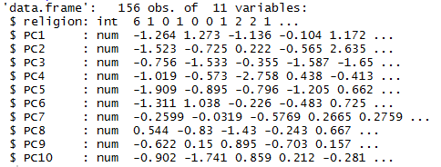
Better Performing
Classification Model
Rpart Classification:
accuracy 84%
Output
Decision Tree
Input

Slide 7
Clustering Models
Find clusters of flags with respect to their characteristics
Discover the common characteristics of the countries within each flag cluster
Investigate possible connection between the clusters and the religions of the within countries
Models
Hierarchical
PAM
Mcluster
KMeans
1
2
5
4
1
INPUT
Flag Characteristics
2
OUTPUT
8 Unknown Clusters

Slide 8
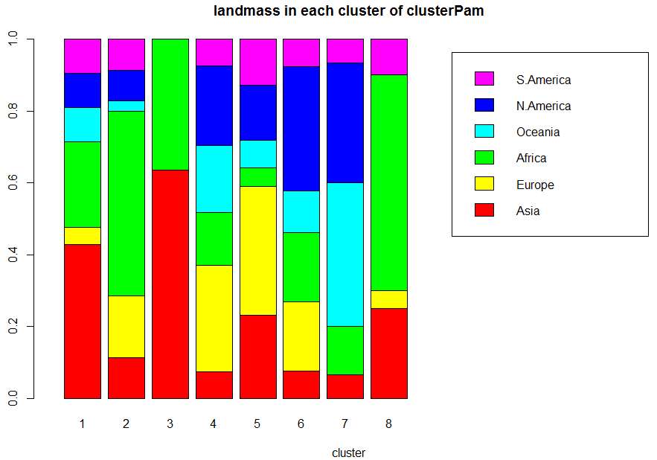
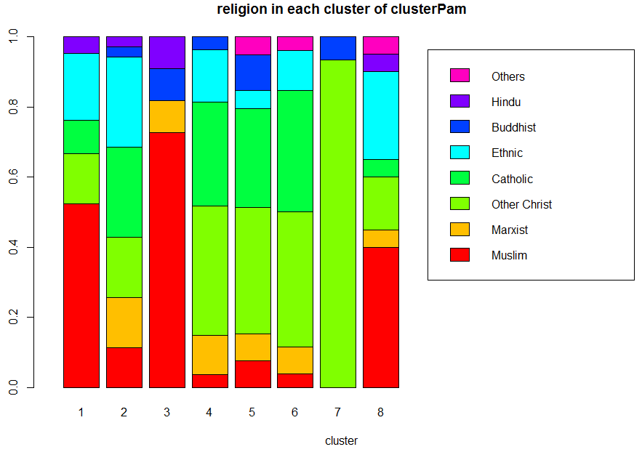
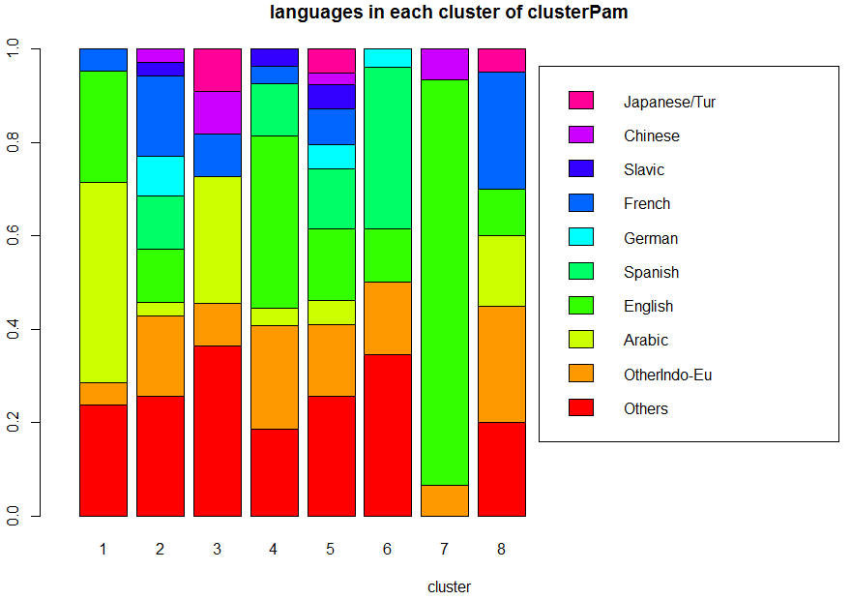
Cluster Analysis
Visualization of Cluster Characteristics
8 Clusters

Slide 9
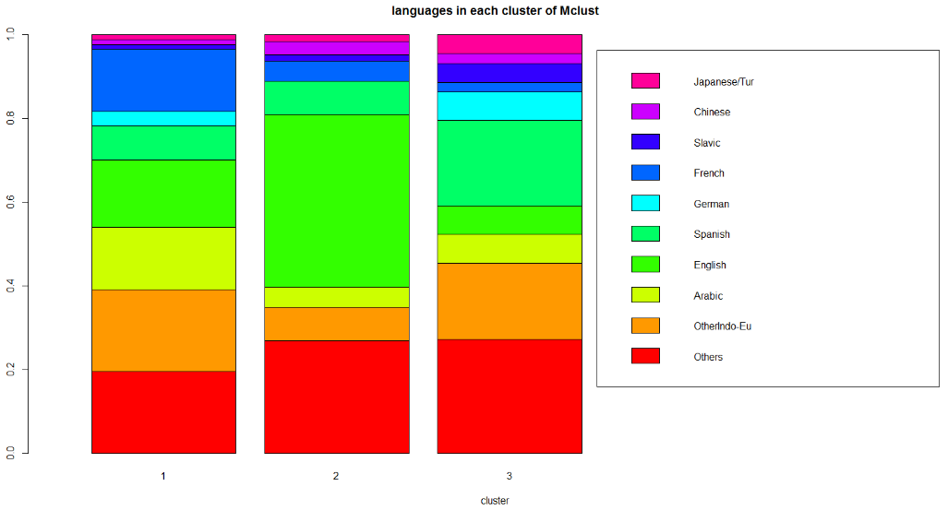
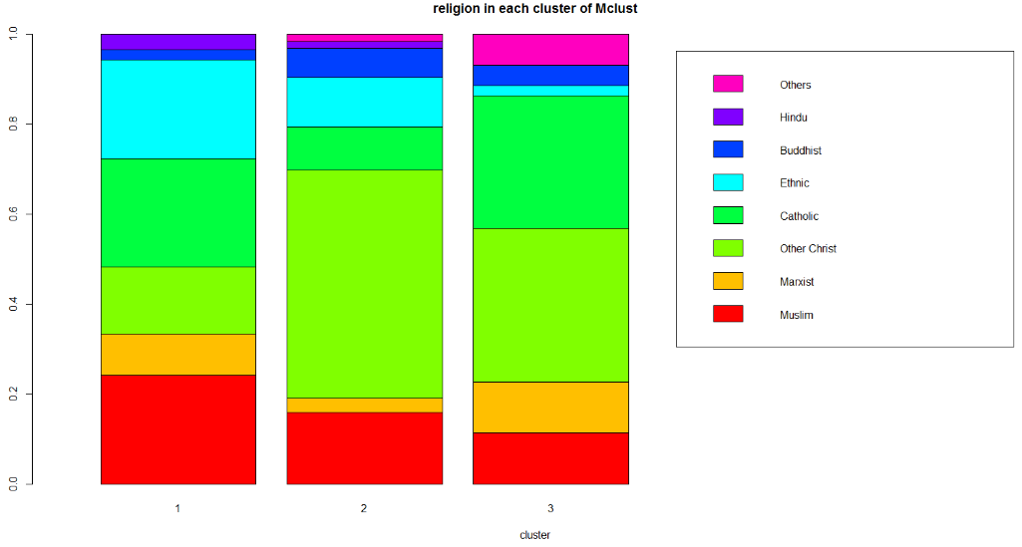
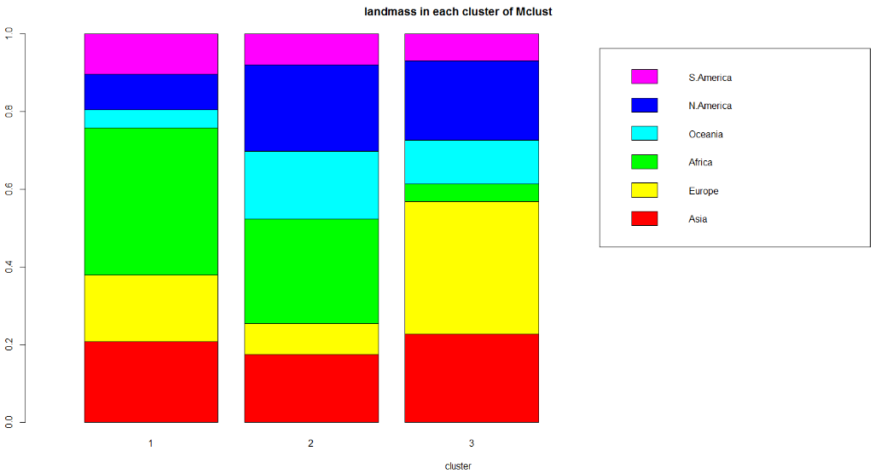
Improved Cluster Analysis
Visualization of Cluster Characteristics
Recommended number of clusters: 3

