Slide 1
Scrum Master: Sprint 1
HELP APP Project
Team: Helpers

Slide 2
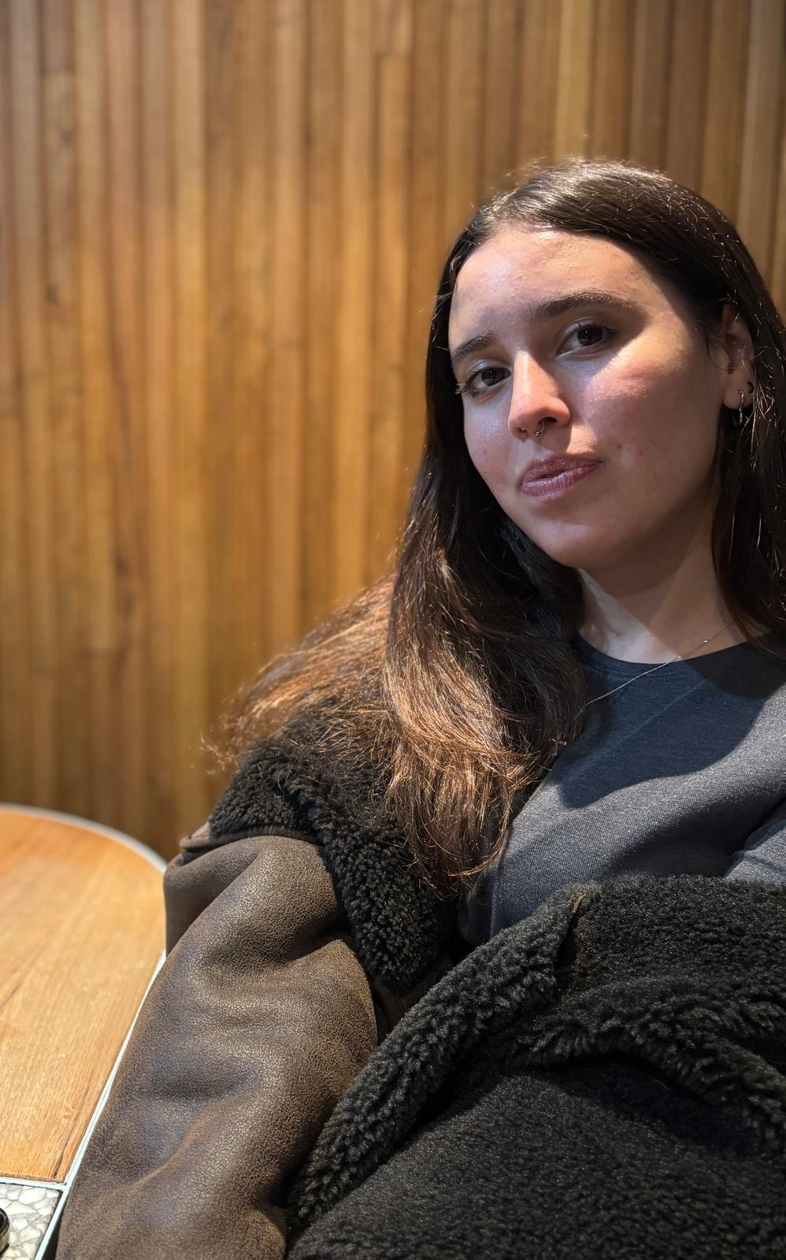
Scrum Master: Week 1
Eva Konstantinova
Bachelor of Software Engineering

Slide 3



Professional Overview
Preferred operational system: Windows
Companies I would like to work in: Major Consulting Firms like McKinsey & Company, PricewaterhouseCoopers (PwC) Advisory Services or EY (Ernst & Young) Advisory Services.
My Specialization: I specialize in data visualization and analytics, web development and design.

Slide 4
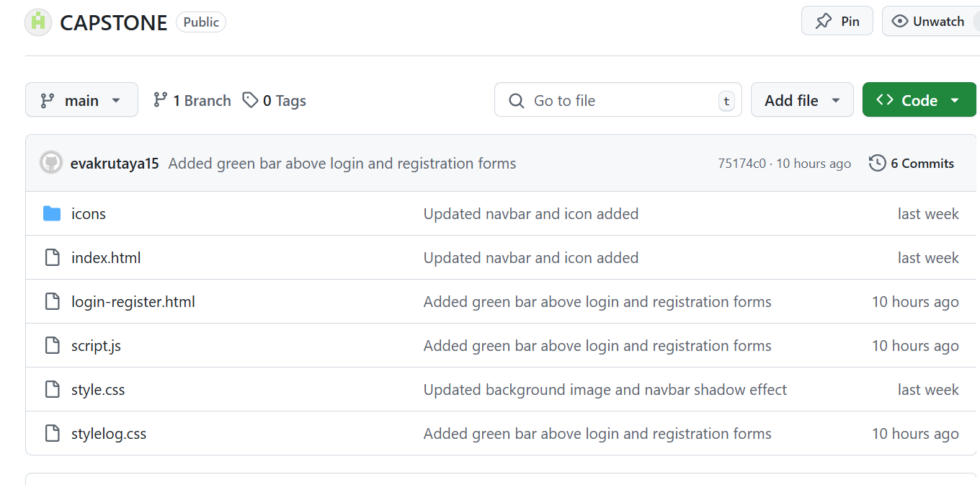
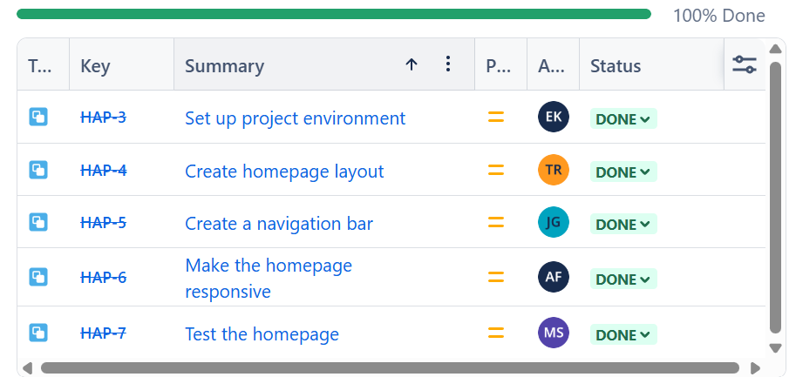
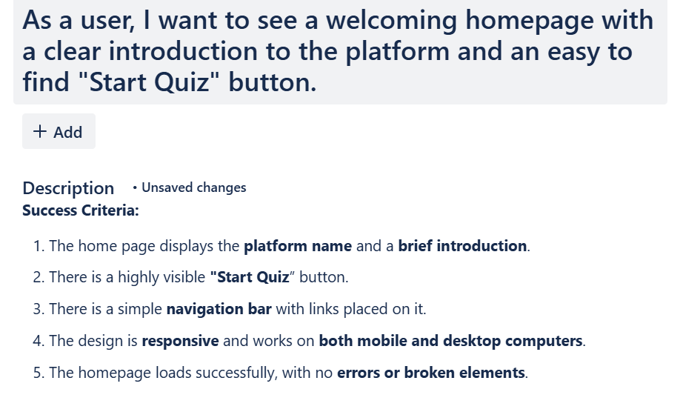
Project Tracking

Slide 5
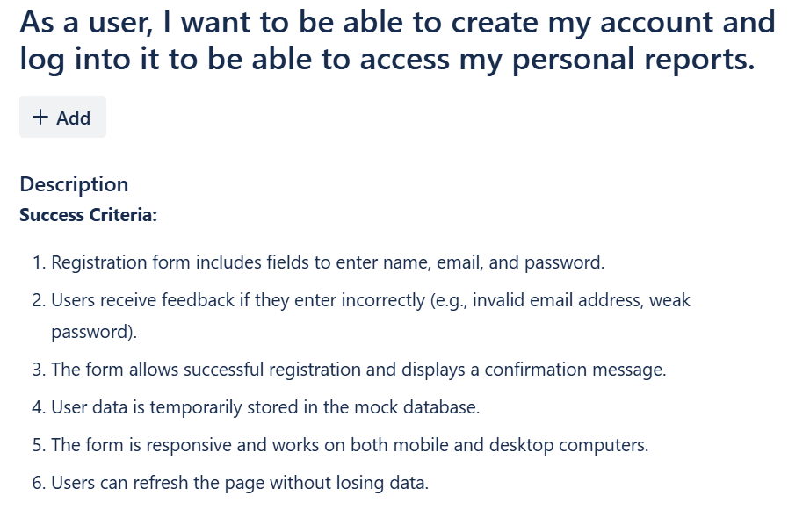
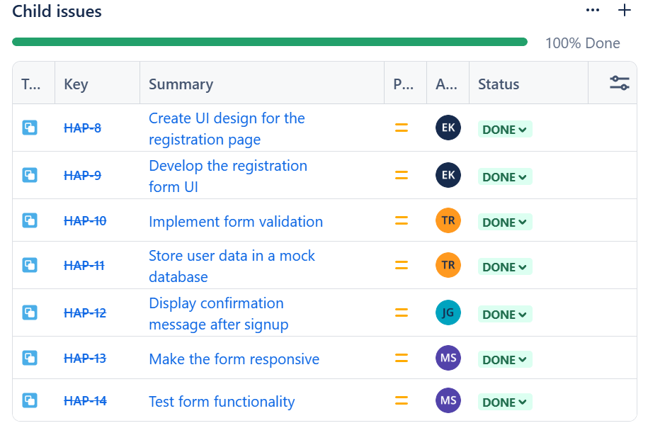

Slide 6

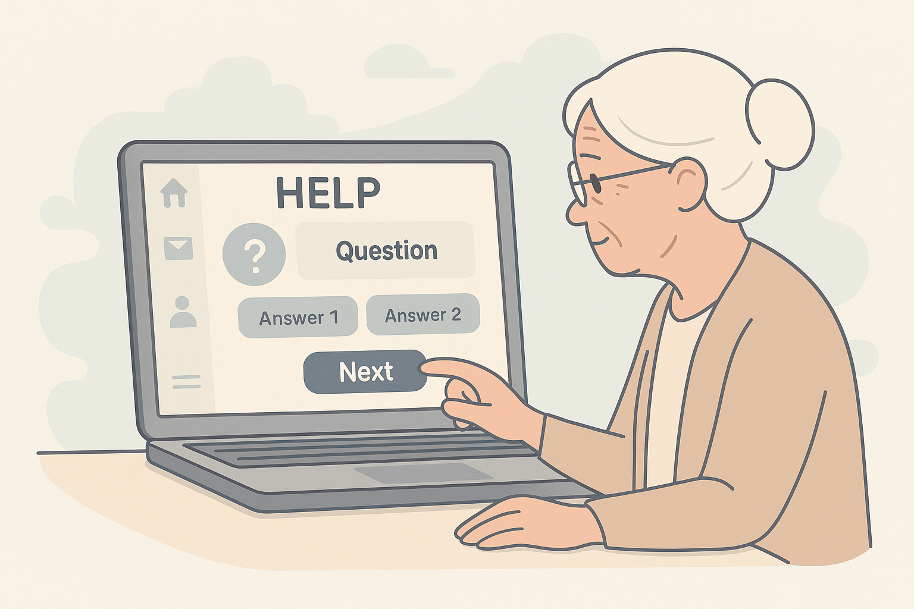
Design Concept
For the design of the platform, we’ve chosen a soft, whitish color palette with light, calming tones to create a comfortable and easy-to-use environment, especially tailored for elderly users and their families. To enhance usability, we've included large buttons and clear icons, ensuring that the interface is intuitive and accessible for users with varying levels of tech proficiency.

Slide 7
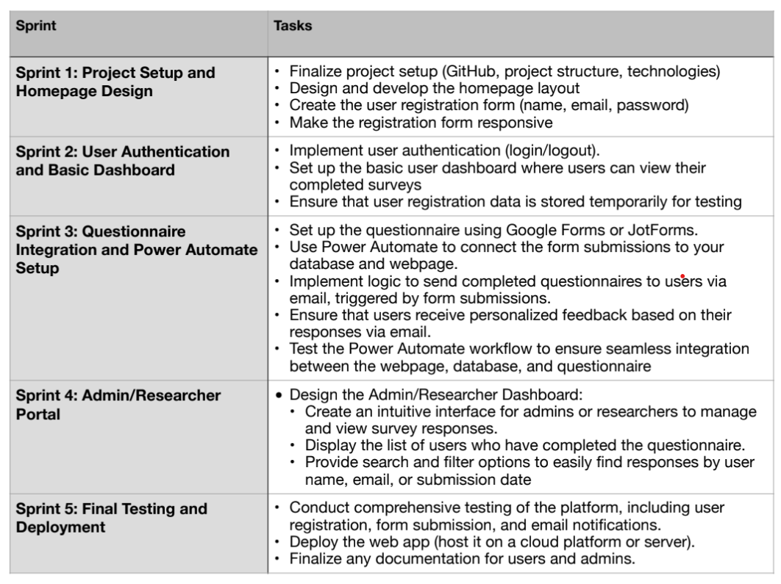
Project Milestones

Slide 8
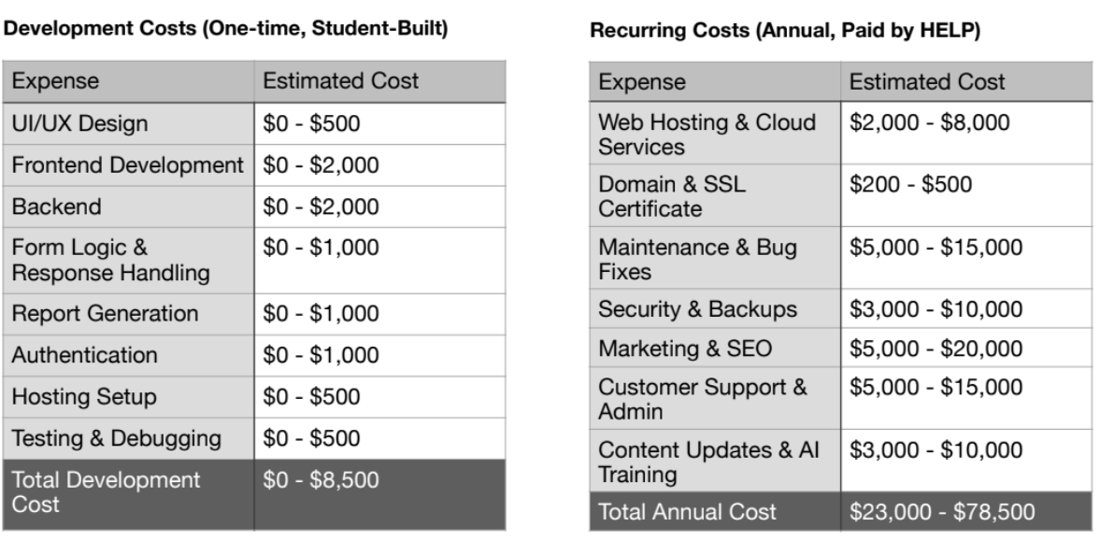
Budget Forecast

Slide 9
Tanmai Ravula StudentID: 21381288
Tanmai was creating presentation and brochures.

Slide 10
Atha Zaidei Hussain Farzan Student ID: 21051987
Tanmai was creating presentation and brochures.

Slide 11
Jaskirat Ghuman Student ID: 21193026
Jaskirat was in the visualization team, helping with Figma UI/UX.

Slide 12
Bug Report

Slide 13
Key Team Decisions

Slide 14
Allocation of new Tasks

Slide 15
Reflection

