Slide 1
PLANET TRACK · CLIMATE RESILIENCE
Teduh
Small changes. Cooler journeys.
A map that shows a township where its next ringgit of shade, a tree row or a covered walkway, helps the most people walking every day.
Hong Thien Gen, Evan Lo Jen Zhen & Chang Juan Jue
Team One · Mixed Universities
Sime Darby Property University Hackathon 2026 · Township of Tomorrow
Notes:
TIME 0:00–0:15 (15 s) in the 5-minute run
[0:00] STEVEN
SAY: “Hi, we are Team One. I’m Steven, this is Thien Gen. Teduh is Malay for shaded or sheltered. Our track is Planet, focus climate resilience.”
DO: Deck on the cover slide.

Slide 2
The walk from the station is the hottest part of the trip
PROBLEM
592
walks a day from SS15 LRT station to the mall, scaled from real ticket-gate counts
218 m
of that walk in one unbroken stretch of direct sun at 2 pm
A township can have trees and footpaths and still leave exposed gaps between them.
Managers have a small budget and no way to see which gap matters most.
SS 15, Subang Jaya. Walks modelled from OpenStreetMap and Prasarana ticket-gate data (about 5,165 exits on a weekday). Estimates, not measurements.
Notes:
TIME 0:15–0:50 (35 s) in the 5-minute run
[0:15] STEVEN
SAY: “Picture SS 15 in Subang Jaya at 2 pm. About 5,000 people leave the LRT station on a weekday; that is real Prasarana ticket-gate data. Our model sends about 590 of them a day to the mall next door, and on that walk there’s a 218-metre stretch with no shade at all. The township has trees and footpaths. The problem is the gaps between them, and a manager with a small budget can’t see which gap matters most.”
DO: Next slide: Problem.
CHECK: ◆592 and ◆218 m on the slide

Slide 3
“With our budget, which shade helps the most everyday walks?”
TARGET USER
DECIDES
Township managers
Set the budget and priorities, compare plans, choose what to build.
BUILDS
Landscape & maintenance teams
Check the site, get a spec pack a contractor can quote from, update the map.
BENEFITS
Residents on foot
Students, commuters and older residents walking to the train, the bus, school and the shops.
Notes:
TIME 0:50–1:10 (20 s) in the 5-minute run
[0:50] STEVEN
SAY: “Our user is the person who holds the budget: the township manager. The landscape team builds it, and residents on foot benefit.”
DO: Next slide: Target user.

Slide 4
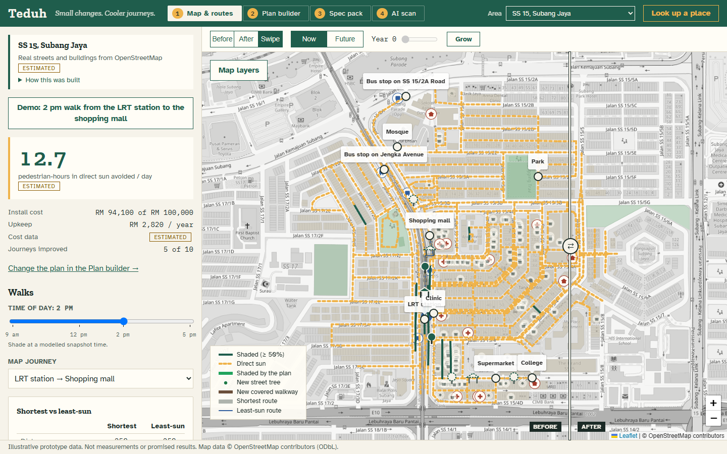
Teduh picks the shade that helps most
SOLUTION
Recommend the best mix of tree rows and covered walkways for the budget.
Show before and after on the map, now and in ten years.
Hand off a bill of materials and a drawing for each item.
Notes:
TIME 1:10–1:30 (20 s) in the 5-minute run
[1:10] STEVEN
SAY: “Teduh answers one question: with this budget, which shade helps the most walks? It recommends trees and covered walkways, shows before and after, and hands off a build pack. Thien Gen will show you on a real township.”
DO: Next slide: Solution, then the Live demo slide. Move aside; Thien Gen takes the keyboard.

Slide 5
2 pm. LRT station to the mall.
RM 100,000.
LIVE DEMO · 2 MINUTES
Recommend a plan
Swipe before / after
Grow trees 10 years
Open the spec pack
Scan a path photo
Notes:
TIME 1:30–3:45 (135 s) in the 5-minute run
[1:30] THIEN GEN
SAY: “Thanks, Steven. This is the real SS 15. Streets and buildings are from OpenStreetMap. Here is the 2 pm walk from the LRT station to the mall.”
DO: Alt+Tab to the app. Left panel: click Demo: 2 pm walk from the LRT station to the shopping mall.
CHECK: Headline ◆12.7. Under Journeys: LRT station → Shopping mall, “sun 3.0 → 1.9 min · exposed 218 → 149 m”
[1:45] THIEN GEN
SAY: “With RM 100,000, Teduh tried every affordable combination and recommends one covered walkway and two tree rows, for RM 94,100. The walkway from the station on Jengka Avenue does most of the work.”
DO: Top bar: 2 Plan builder. Point at the Best card, then scroll to What each one adds.
CHECK: Best: 1 covered walkway + 2 tree rows, RM ◆94,100 · ◆12.7. Walkway ◆539 min/day
[2:05] THIEN GEN
SAY: “Before on the left, after on the right.”
DO: On the map, drag the round ⇄ handle from the middle to the left, slowly, past the LRT station marker.
CHECK: Amber dashed paths by the station turn solid green
[2:20] THIEN GEN
SAY: “That’s the key idea: one walkway on a shared stretch helps the mall, the college and the clinic walks at once.”
DO: Keep the mouse still on the walkway.
[2:30] THIEN GEN
SAY: “Trees take years; a walkway works on day one. Let’s grow them ten years.”
DO: Top of the map: Future, then Grow. Wait about 5 s for Year 10.
CHECK: Best plan flips to 5 tree rows, RM ◆51,700 · ◆26.5
[2:50] THIEN GEN
SAY: “Twice the benefit for about half the money, if you can wait, and if the trees grow as modelled.”
[2:55] THIEN GEN
SAY: “Every item comes with a spec pack a contractor can quote from.”
DO: Click Now. Left panel, under Candidates: Details next to Covered walkway from the LRT station on Jengka Avenue (69 m).
CHECK: 3 Spec pack: ◆69 m, RM ◆79,000, drawing, bill of materials, Download CSV
[3:15] THIEN GEN
SAY: “OpenStreetMap has almost no trees mapped here, so our shade is a model. A survey photo fills that gap. A vision model running on this laptop estimates the shade, and nothing reaches the map until a person confirms it.”
DO: 4 AI scan. Path segment already reads Jengka Avenue (Main road) · seg-116. Choose File → photo → Estimate shade.
CHECK: “Estimating…” for about 10 s
[3:25] THIEN GEN
SAY: Talk over the wait: “Photos stay on this laptop, and there’s no cloud cost per photo.”
CHECK: “AI estimate: N% shaded”, “Estimated by a local model (qwen2.5vl:7b)”
[3:35] THIEN GEN
SAY: “I’ll check it against the photo, adjust, and confirm. Back to Steven.”
DO: Drag Your value if needed, then Confirm and apply to map. Alt+Tab back to the deck and hand the keyboard back.
CHECK: “Applied … as AI-CONFIRMED”. The headline may drop: see the note below
If the headline drops after Confirm (for example 12.7 → 7.9), that is correct: the photo says the walkway’s path already has some shade, so the walkway is worth less. With time to spare, say: “One photo changed the decision. That’s why the survey matters.” Before the next run, click Undo all, or the Demo button again.
HANDOVER: One laptop. Steven sits at the keyboard and advances the slides (arrow keys or a clicker). At 1:30 Thien Gen takes the mouse and keyboard and Alt+Tabs to the app. At 3:40 Thien Gen Alt+Tabs back to the deck and hands back. Steven stays silent during the demo; Thien Gen stays silent during the slides.

Slide 6
Open data in, a build pack out
HOW IT WORKS
1
2
3
4
5
Map
Streets and buildings from OpenStreetMap. Shade from the real sun position at 4 times of day.
Walks
Stations and bus stops to shops, school and clinic. Scaled to real ticket-gate counts.
Options
Tree rows and covered walkways on exposed gaps, priced from unit costs.
Optimise
Tries every affordable combination (up to 4,096) in under a second.
Hand off
Spec pack, bill of materials, CSV. Field photos update shade after a person confirms.
Score = pedestrian-hours in direct sun avoided per day, weighted by how many people make each walk. The maths is inspectable: no black box.
Notes:
TIME 3:45–4:05 (20 s) in the 5-minute run
[3:45] STEVEN
SAY: “Under the hood: open map data, the real sun position, real station counts, and a score anyone can inspect: hours walked in direct sun, avoided.”
DO: Next slide: How it works.

Slide 7
One well-placed walkway does most of the work
IMPACT (SS 15 DEMO SCENARIO)
12.7
pedestrian-hours a day out of direct sun, for RM 94,100 (1 walkway + 17 trees)
149 m
longest sunny stretch on the station-to-mall walk, down from 218 m; 5 of 10 modelled walks improve
26.5
pedestrian-hours a day by year 10 from 58 trees alone, for RM 51,700, if they mature as modelled
All figures are model estimates from the prototype, not measurements. Shade is not the same as comfort or safety. A pilot measures the real effect.
Notes:
TIME 4:05–4:20 (15 s) in the 5-minute run
[4:05] STEVEN
SAY: “In this scenario, RM 94,000 takes 12.7 pedestrian-hours a day out of direct sun. These are model estimates; a pilot measures the real effect.”
DO: Next slide: Impact.

Slide 8
Routing apps help a walker. Teduh helps a township build.
INNOVATION
 | Shade-aware routing (e.g. Undercover, Singapore) | Teduh
Question | Which way should I walk? | Where should we build shade first?
Money | Not the focus | Every option priced: install and upkeep, within a budget
Time | Not the focus | 4 times of day, and trees growing over 10 years
Output | A route | A spec pack a contractor can quote from
Field data | Not the focus | Photo → AI shade estimate → a person confirms
Notes:
TIME 4:20–4:30 (10 s) in the 5-minute run
[4:20] STEVEN
SAY: “Routing apps like Singapore’s Undercover help a walker. Teduh helps a township decide what to build.”
DO: Next slide: Innovation.

Slide 9
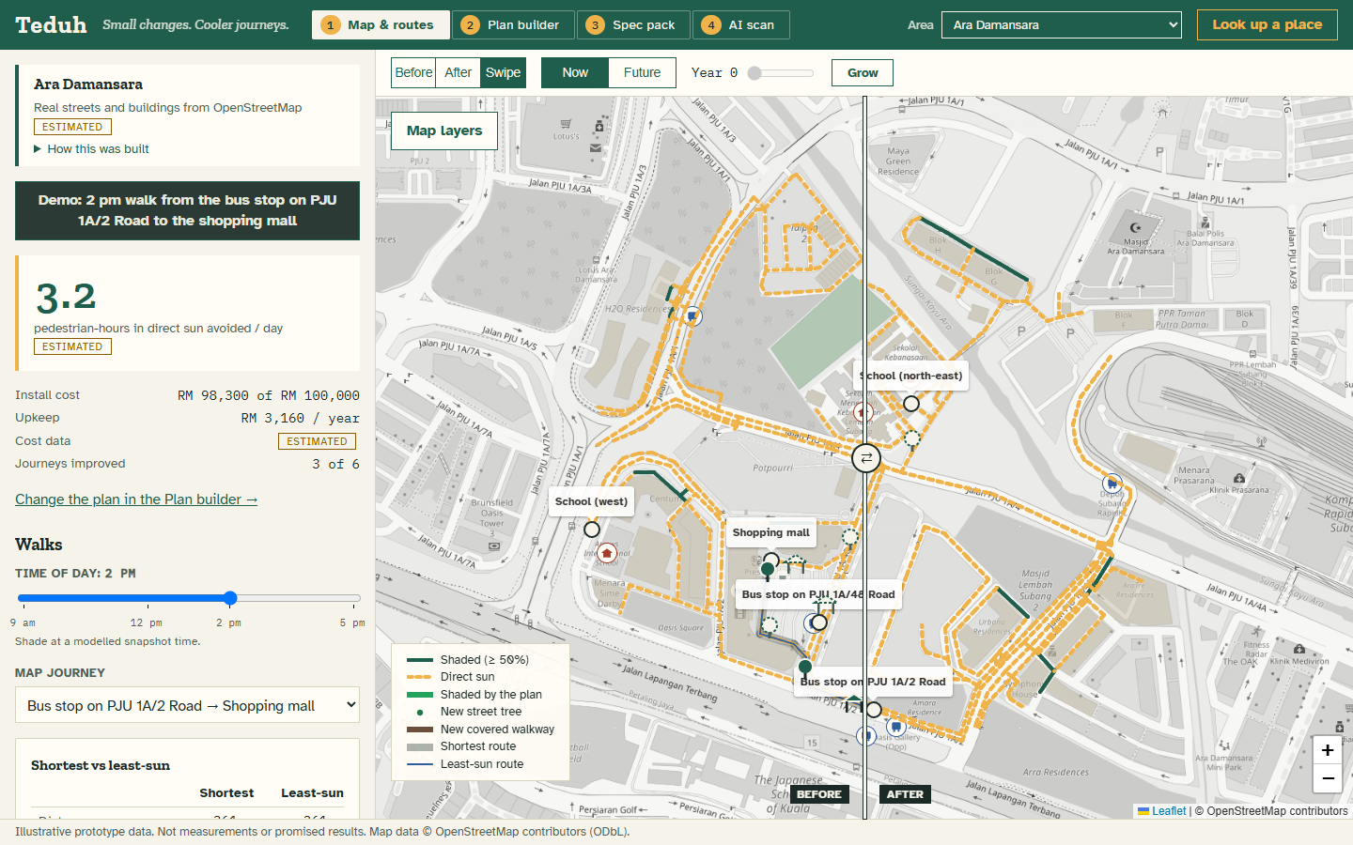
It already runs, on any township
FEASIBILITY
15 Klang Valley areas built in, and any other place in about 40 seconds. Right: Ara Damansara.
Open data only: OpenStreetMap and data.gov.my ridership. No sensors to install.
AI runs on a laptop (an open vision model via Ollama), so photos stay local and cost nothing per call.
515 automated tests. Unit costs are editable, so quotes replace estimates.
Notes:
TIME 4:30–4:45 (15 s) in the 5-minute run
[4:30] STEVEN
SAY: “It already runs on 15 Klang Valley areas and any other place in about 40 seconds: this is SDP’s own Ara Damansara.”
DO: Next slide: Feasibility.

Slide 10
Pilot one SDP township, then scale to 28
IMPLEMENTATION
MONTH 1
Survey
Map paths and shade at 4 times; photo-scan gaps; count walkers at the station and mall.
MONTHS 2–3
Build
One walkway and a few tree rows from the plan, with real contractor quotes.
MONTHS 4–6
Measure
Predicted vs observed shade, walker counts before and after, resident feedback.
FITS SDP’S 2025–2030 STRATEGY
Climate resilience and urban biodiversity pillars: puts SDP’s tree planting where people walk, and shows the result.
OUR ASK
One township, a landscape contact and a small budget line to build and measure.
Notes:
TIME 4:45–5:00 (15 s) in the 5-minute run
[4:45] STEVEN
SAY: “Our ask: one SDP township to pilot, a landscape contact and a small budget line. Survey, build, measure in six months. Thank you.”
DO: Next slide: Implementation. Stop at 5:00.

Slide 11
APPENDIX
Timing, limits, screens and sources
The run order for the 5-minute pitch, what the model does not know yet, the other demo screens, and where every number comes from.
Notes:
Backup material for Q&A, not part of the 5-minute run. If the live demo fails, use the screen slides that follow to tell the same story.

Slide 12
Steven presents, Thien Gen demos
RUN ORDER
Time | On screen | Who speaks | Length
0:00–0:15 | Cover | Steven | 15 s
0:15–0:50 | Problem | Steven | 35 s
0:50–1:10 | Target user | Steven | 20 s
1:10–1:30 | Solution | Steven | 20 s
1:30–3:45 | Live demo (in the app) | Thien Gen | 135 s
3:45–4:05 | How it works | Steven | 20 s
4:05–4:20 | Impact | Steven | 15 s
4:20–4:30 | Innovation | Steven | 10 s
4:30–4:45 | Feasibility | Steven | 15 s
4:45–5:00 | Implementation | Steven | 15 s
The handover
One laptop. Steven advances the slides. At 1:30 Thien Gen takes the keyboard and Alt+Tabs to the app; at 3:40 Thien Gen Alt+Tabs back and hands over.
The full words
Each slide’s speaker notes hold its time window, the speaker, the lines and the clicks. The Word script adds setup, cue cards, the 10-minute version, recovery steps and Q&A.
Notes:
10-MINUTE VERSION (14 Nov, if Top 10)
Same split: Steven presents, Thien Gen demos. Same opening as Part A; Thien Gen’s demo runs longer, adding these after the AI scan step (at 3:35 Thien Gen carries on instead of handing back), and Steven takes back at 7:30. Do the Ara Damansara lookup once the evening before in the same browser: it is saved there, so on the day you can pick it from the Area dropdown if the Wi-Fi is slow.
[3:45] THIEN GEN: “Time of day matters.” DO: 1 Map & routes: drag Time of day from 2 pm to 5 pm and back. Exposed paths change.
[4:15] THIEN GEN: “Managers know their site. They can place their own.” DO: 2 Plan builder → Plant a tree row → click 2–3 connected paths on the map → Add. It is priced and scored like the others.
[5:00] THIEN GEN: “A written summary for the manager, built only from the numbers on screen.” DO: 4 AI scan → Explain this plan (about 20 s). A TEMPLATE badge means the model’s text was rejected for inventing a figure; say so, it is a safeguard.
[5:30] THIEN GEN: “And it works on SDP’s own township.” DO: Look up a place → Ara Damansara → Search → pick Petaling Jaya, Petaling, Selangor. About 40 s: talk over it (“it is downloading streets, buildings and bus stops from OpenStreetMap and running the same model”). Then click the Demo button for Ara Damansara.
[6:30] THIEN GEN: “Change the budget, untick a candidate, prioritise the college.” DO: Hand the mouse to a judge. Everything recalculates instantly. At 7:25 say “Back to Steven”, Alt+Tab to the deck and hand back.
[7:30] STEVEN: How it works, Impact, Innovation, Feasibility and Implementation slides, about 30 s each. DO: Advance the slides.
[10:00] STEVEN: “Thank you. We’re happy to take questions.” Q&A: Thien Gen takes the technical ones.

Slide 13
What we model, and what we do not claim
HONEST LIMITS
Shade is modelled
From mapped buildings and the real sun. OpenStreetMap has few trees here, so midday shade is understated until a survey adds them.
Walks are part real
Station exits are real ticket-gate counts. How they split between places, and bus stop trips, are estimates.
Shade is not comfort
We claim no temperature drop and never call a route safe or healthy.
A person signs off
AI estimates need a person to confirm. Costs are estimates, not quotes. Structures need an engineer.
Notes:
Use in Q&A when judges ask how accurate it is. Key line: every number in the app carries a label (surveyed, estimated, AI-confirmed or missing), and the pilot is designed to replace estimates with measurements.

Slide 14
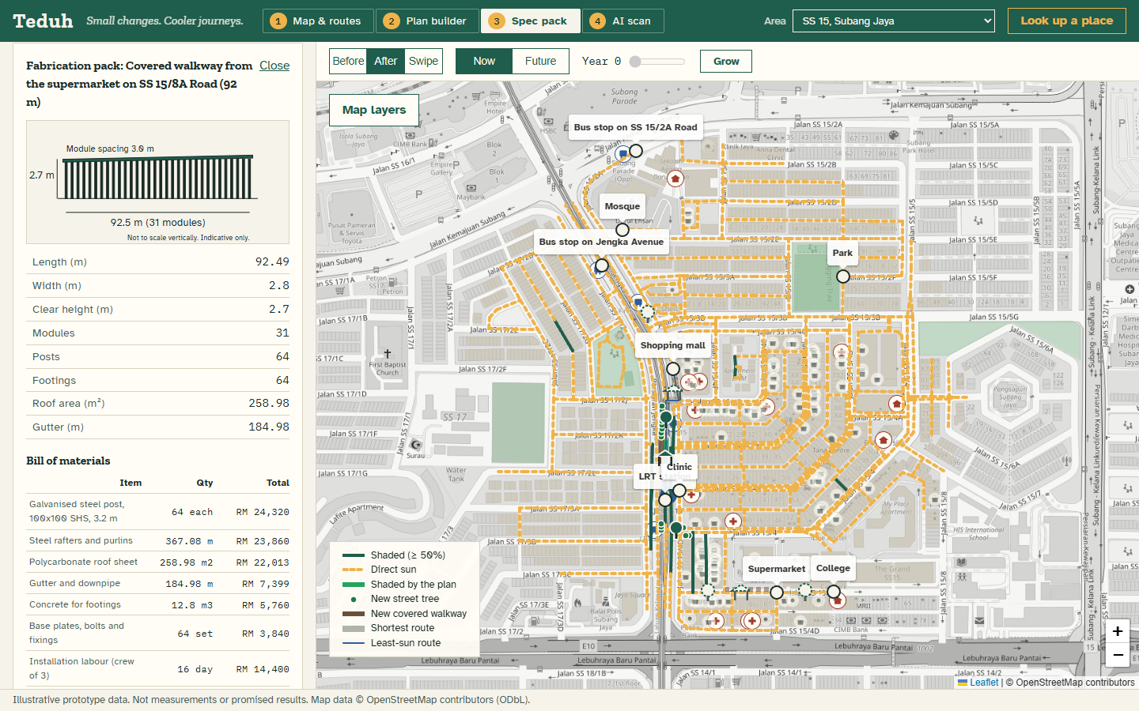
From plan to contractor quote
SCREEN · SPEC PACK
Posts, footings, roof area, a priced bill of materials and an elevation drawing. Downloads as CSV or JSON. Indicative only: an engineer signs off.
Notes:
Backup for the spec pack step (2:55) if the live demo fails.

Slide 15
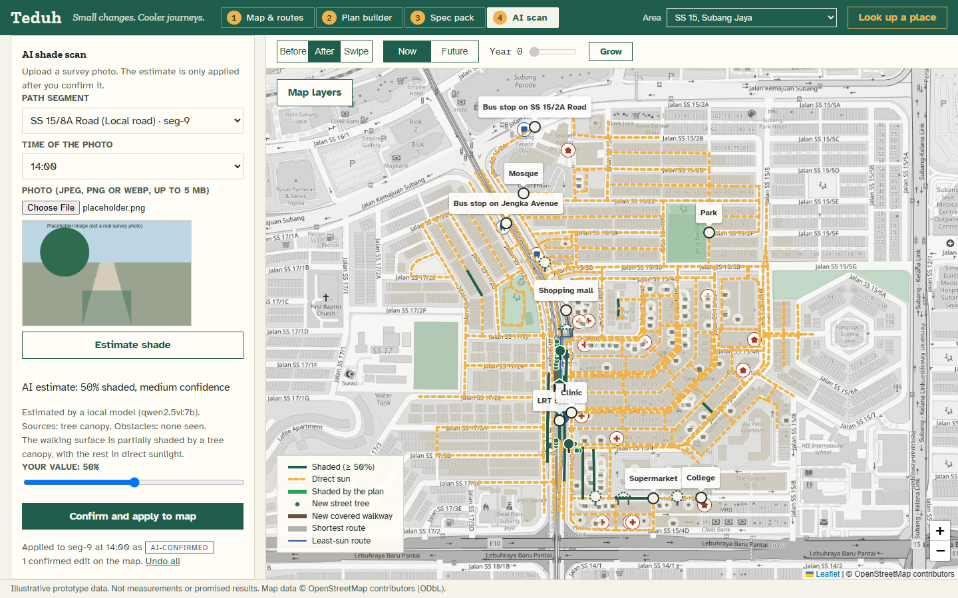
A photo fills the gap the map can’t
SCREEN · AI SCAN
A vision model estimates the shade on a path. It reaches the map only after a person adjusts and confirms it, labelled AI-confirmed.
Notes:
Backup for the AI scan step (3:15) if the live demo fails.

Slide 16
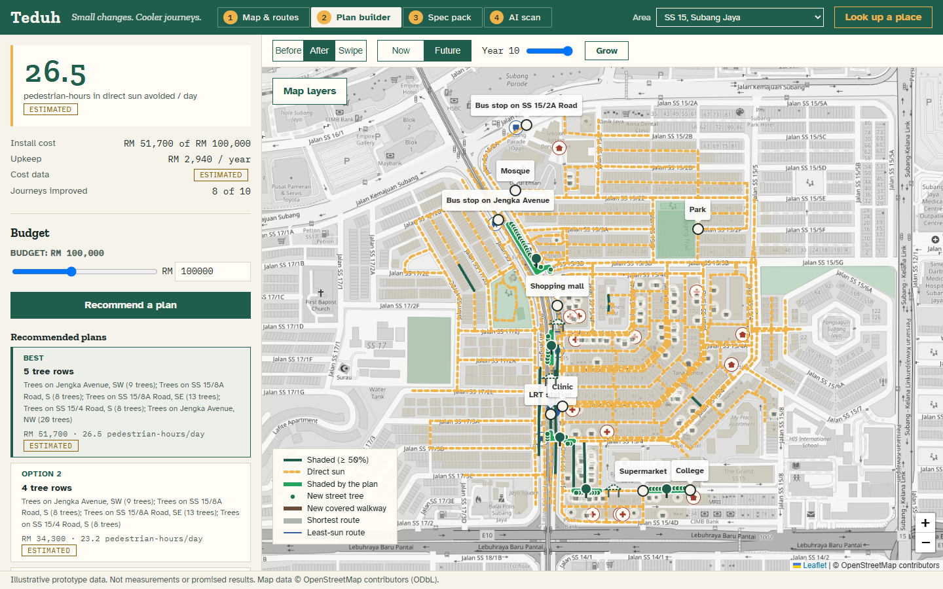
Trees take years. Walkways work today.
SCREEN · FUTURE CANOPY
At year 10 the best plan flips to five tree rows: twice the benefit for about half the cost, if the trees mature as modelled.
Notes:
Backup for the Future and Grow step (2:30) if the live demo fails.

Slide 17
Where the numbers come from
SOURCES
Map data: © OpenStreetMap contributors (ODbL): streets, buildings, places.
Rail ridership: Prasarana ticket-gate exits by station, published on data.gov.my (CC BY 4.0).
Unit costs: bottom-up estimates in MYR, editable in the app; to be replaced with contractor quotes.
Prior work: Open Government Products, Undercover, Hack for Public Good (2026), hack.gov.sg/2026/undercover
Schrodi et al., Climate-sensitive Urban Planning through Optimization of Tree Placements (2023), arxiv.org/abs/2310.05691
CoolWalks for active mobility in urban street networks, Scientific Reports (2025), nature.com/articles/s41598-025-97200-2
SDP strategy: Sime Darby Property Sustainability Strategy 2025–2030, from the hackathon briefing deck (9 Oct 2026).
Code: github.com/evan-2005/Teduh
Notes:
Reference slide. No need to present.

