Slide 1
TITLE PENDING A 2D Platforming Game by Evan Carey

Slide 2
Overview
What it might be one day
What it is right now
Data Structures & Algorithms
Level-Building!
Demo

Slide 3
Initial Vision
Make a 2D platformer that somehow uses a data structure.
Idea - linked list
The player is able to collect objects
These objects follow behind the player, stored in a linked list
The player can throw the objects at enemies

Slide 4
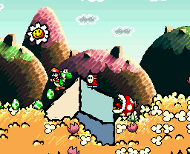
Maybe something similar to…

Slide 5

…or a 2D Pikmin, perhaps?

Slide 6
Not quite there yet
Currently, it’s just the shell of a platformer.
Basic start screen
One level
One tile set
One poorly animated sprite

Slide 7
Data Structures
GUI components are stored in an ArrayList.
Player’s items are stored in a LinkedList.
Though they’re not actually following behind the player yet ☹
A level’s entities (e.g. the player, items, enemies) are in an ArrayList.

Slide 8
Algorithms
Uninteresting
Render the game as frequently as possible, but limit logic updates to sixty times a second.
Slightly more interesting
Write in-game text using my own font sheet.
Correct tile for each character is determined by its ASCII value.

Slide 9

Font Sheet
0 1 2 . . . 15
0
16
32
48
64
…
for (int i = 0; i < text.length(); i++) {
int nextChar = text.charAt(i);
tileX = nextChar % 16;
tileY = nextChar / 16;
drawChar(xTop, yTop, tileX, tileY, color);
xTop += 6; // character width
if (text.charAt(i) == '\n') {
xTop = x;
yTop += 6; // character height
}
}

Slide 10
An Actually Interesting One
The problem – Level generation
When we’re building a level, how can we use multiple tiles?
How can we determine which tile should go where?
Phrased differently, how can we give objects sides?

Slide 11
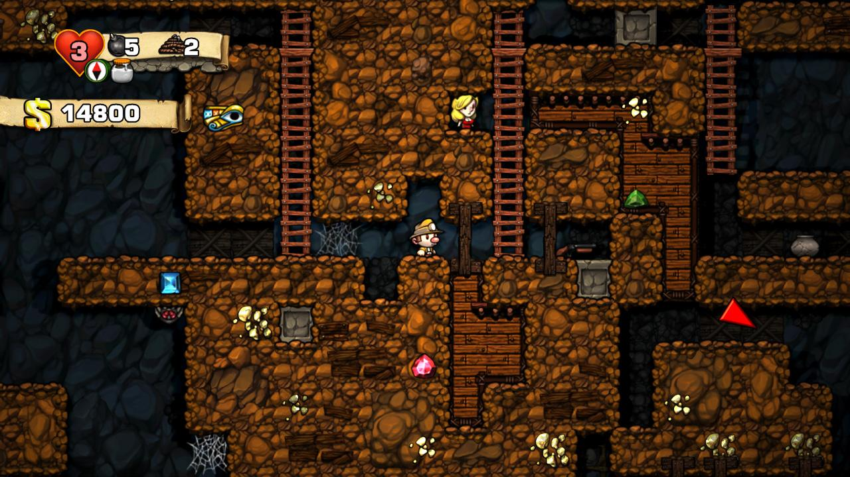
For Example

Slide 12
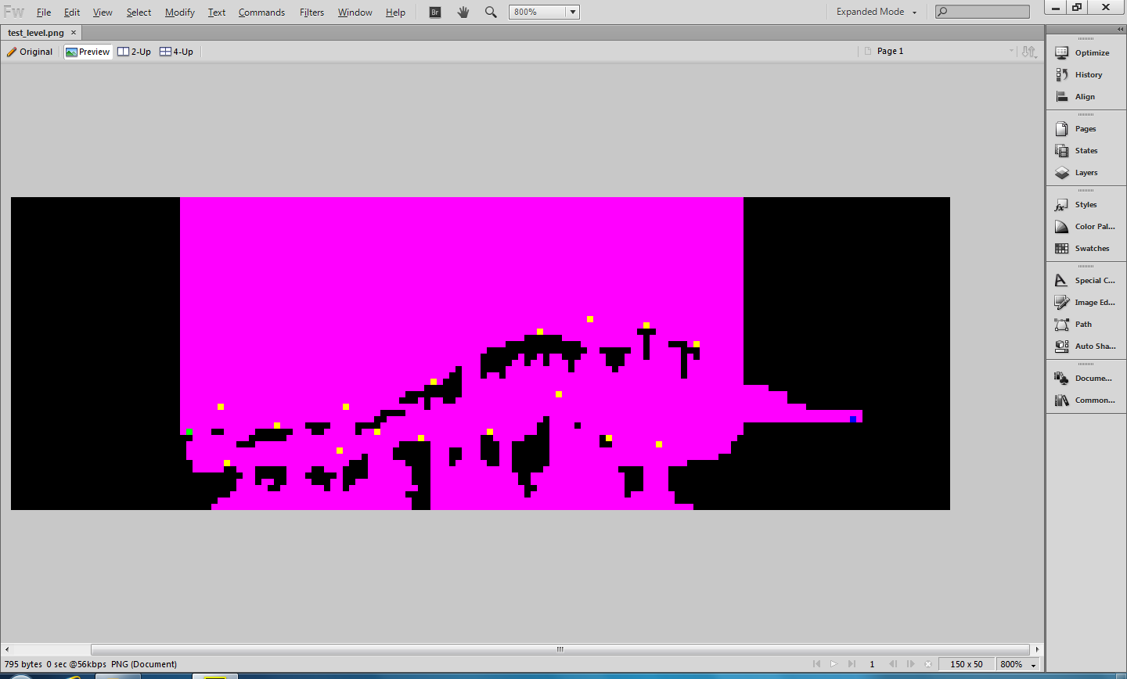

Slide 13
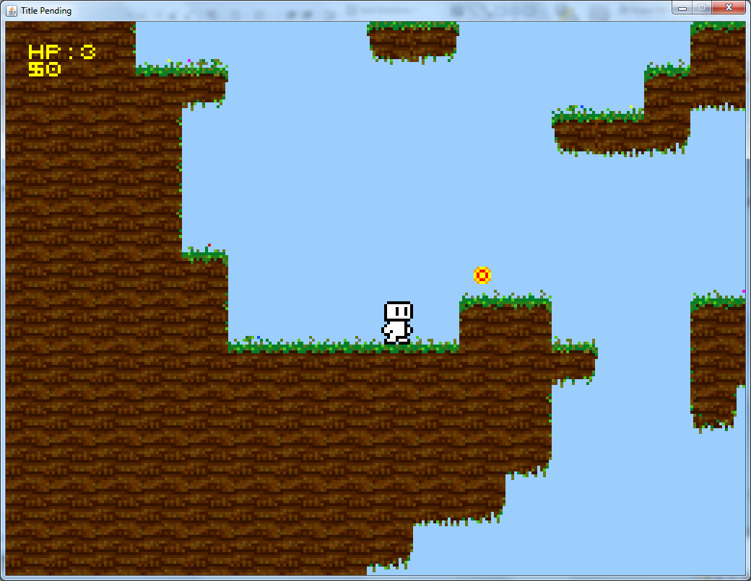

Slide 14
Solution?
You can determine the proper tile by examining its surrounding tiles.
How many different tiles are possible?
Each tile has four sides: { right, top, left, bottom }
Each side has two values: { 0, 1 }
0 indicating there is no tile there
1 indicating there is

Slide 15
Tile Algorithm
2⁴ = 16 different possible tiles.
So, to determine which tile we want, we need to look at its sides and get a value 0-15.
How can we get such a value?
(__ × 2³) + (__ × 2²) + (__ × 2¹) + (__ × 2⁰)
This value can then be used as an index to retrieve the proper tile sprite from the sheet.
Furthermore, if we arrange our the tiles on the sheet in a 4x4 pattern, we can determine the right tile using the % and / operators.

Slide 16
The code
// Dirt tile set
if (id == 1) {
// check sides to determine correct tile sprite
int right = level.getTileID(x + 1, y) == id ? 1 : 0;
int top = level.getTileID(x, y - 1) == id ? 2 : 0;
int left = level.getTileID(x - 1, y) == id ? 4 : 0;
int bottom = level.getTileID(x, y + 1) == id ? 8 : 0;
int sum = right + top + left + bottom;
tileX = sum % 4;
tileY = sum / 4;
if (top == 0) { // top tile, so it can have grass on it
grassTile = (new Random()).nextInt(7);
}
}

Slide 17


