Slide 1
Fraud Transaction Overview
Analysis of Credit Card Fraud in the Last 14 Days
Generated by Fraud Reasoning Engine

Slide 2
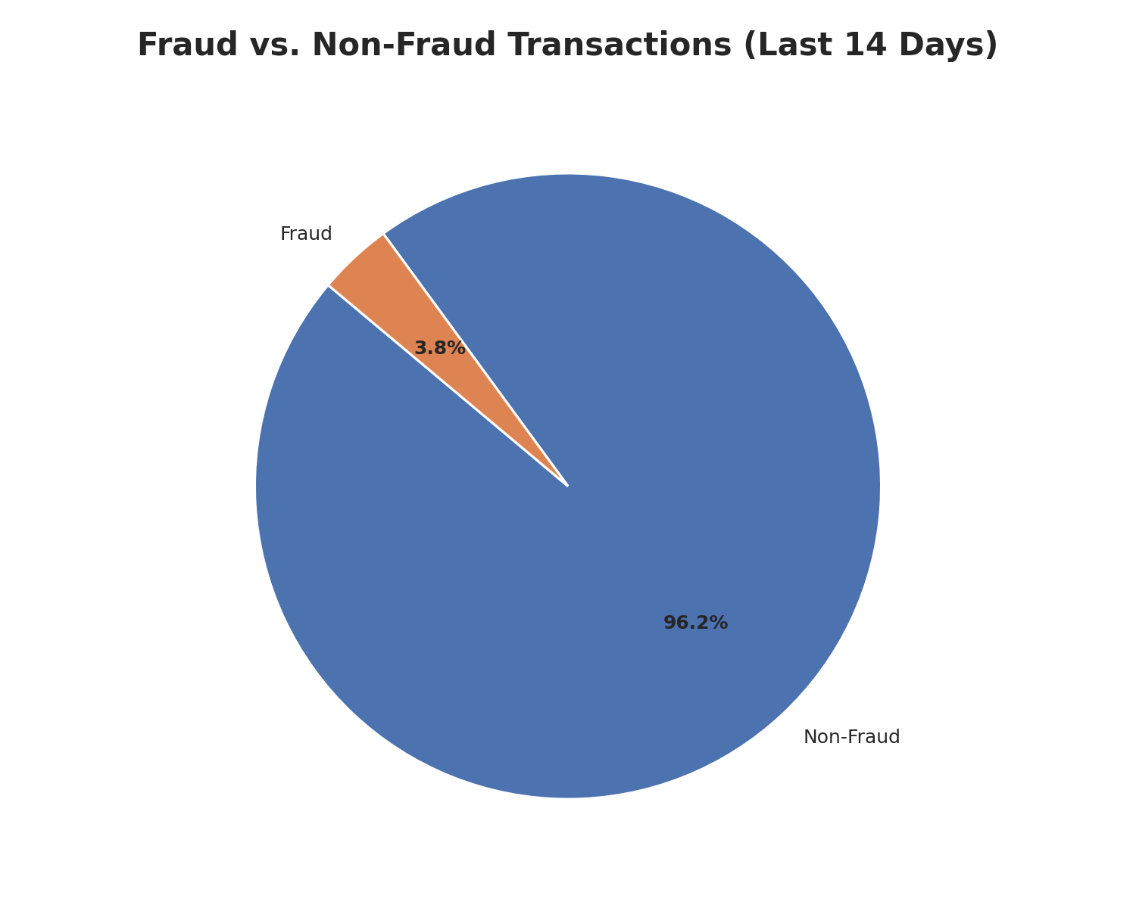
Summary of Fraud and Non-Fraud Transactions
Out of 1040 transactions in the last 14 days, 1000 were legitimate.
A total of 40 transactions were identified as fraudulent.

Slide 3
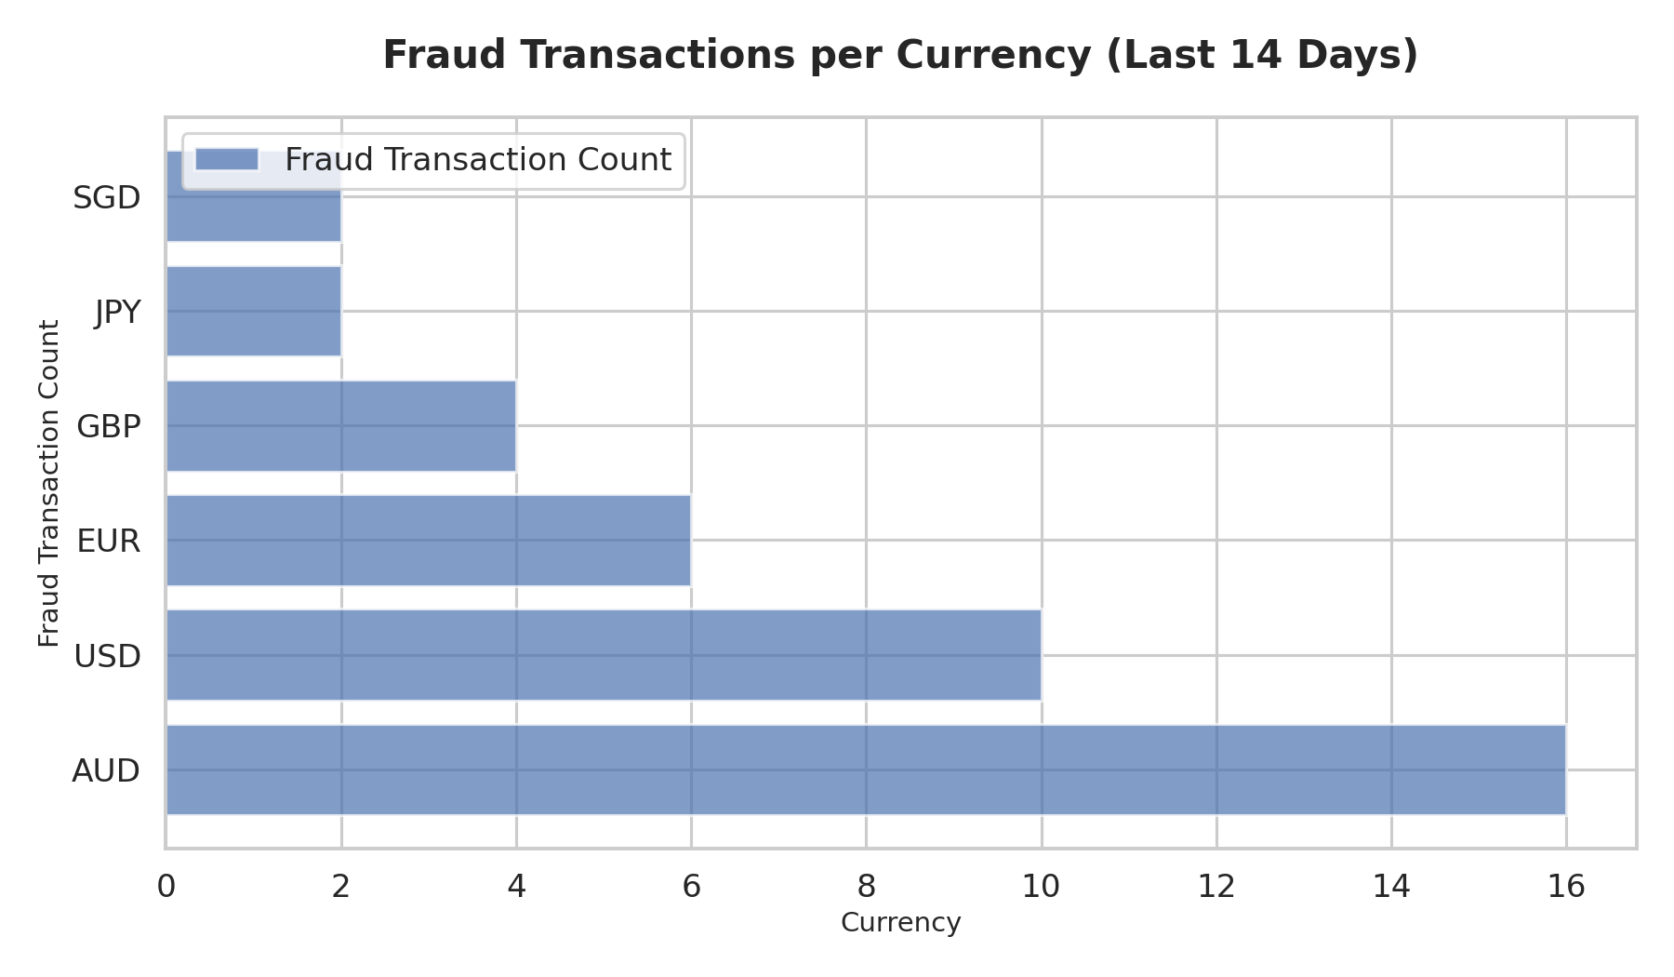
Fraud Transactions Per Currency
The Australian Dollar (AUD) recorded the highest number of fraud transactions with 16 instances.
The US Dollar (USD) followed with 10 fraud transactions.
Other currencies like EUR, GBP, JPY, and SGD showed fewer fraud cases.

Slide 4
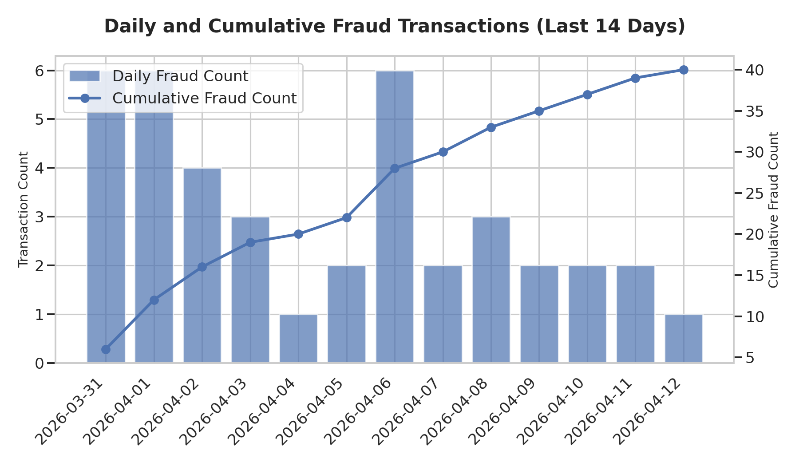
Daily and Cumulative Fraud Transactions
Daily fraud transactions fluctuated, with peaks of 6 cases on 2026-03-31, 2026-04-01, and 2026-04-06.
The cumulative number of fraud transactions reached 40 by 2026-04-12.

Slide 5
Descriptive Statistics: Daily Fraud Transactions
**Average (Mean):** 3.08 fraud transactions per day.
**Median:** 3.0 fraud transactions per day.
**Standard Deviation:** 1.85, indicating moderate spread in daily fraud counts.
**Variance:** 3.41.
**1st Quartile (Q1):** 2.0, meaning 25% of days had 2 or fewer fraud transactions.
**3rd Quartile (Q3):** 6.0, meaning 75% of days had 6 or fewer fraud transactions.
**Minimum:** 1 fraud transaction on a single day.
**Maximum:** 6 fraud transactions on a single day.

