Slide 1

Marriage & Divorce Statistics
Presented by: Charlotte Cabrera, Evan Stroh and Cesar Martinez

Slide 2



Hypothesis
Race, town size, and household income affect marriage and divorce rates.

Slide 3
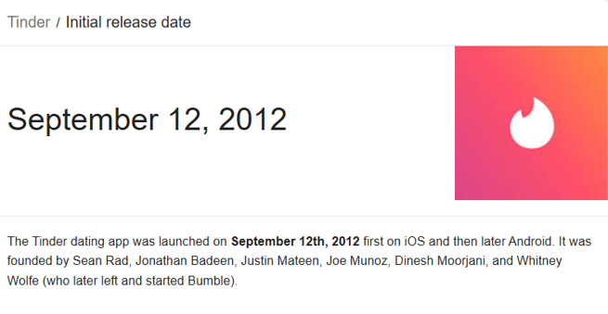
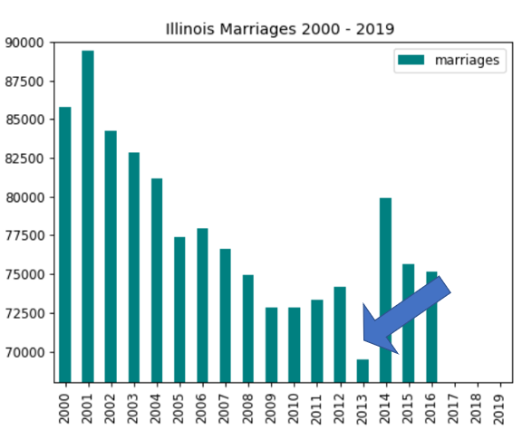
Popping the questions
Why did number of marriages in Illinois take such a hit in 2013?
Do smaller counties have more marriages and less divorces than larger ones?
Do wealthier counties have a higher number of marriages?
Are people more or less likely to be married depending on their race?
Does a spike in number of marriages precede a spike in number of divorces?
Notes:
Do smaller, less populous counties have a higher marriage/lower divorce rate since there are less options for citizens to choose from?
Does money buy happiness?
Explore trends in marriage and divorce rates broken down by race.
i.e. more marriages now = more divorces later

Slide 4
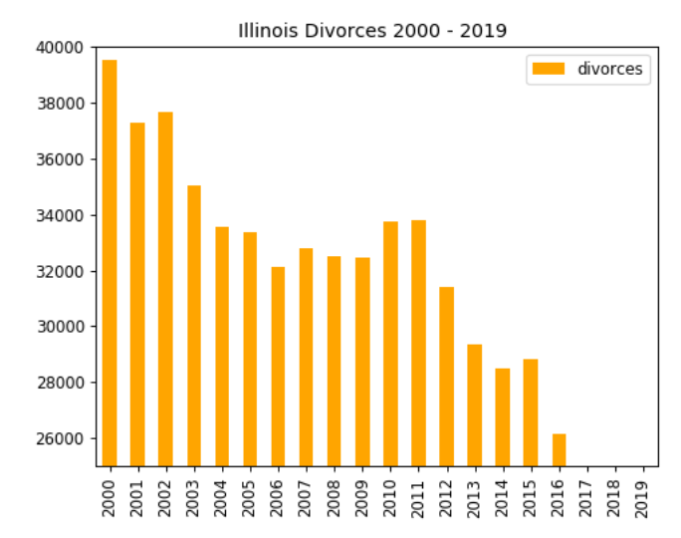
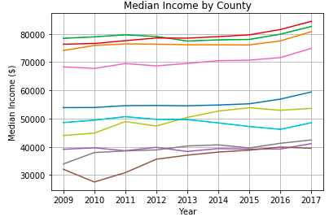
Trends our group found interesting
Although the total number of marriages in IL are not increasing, total number of divorces are decreasing.
The ratio of married to divorced people isn’t clearly related. Both trend with overall changes in population.
Percent of people married in low vs high income counties is not significantly different.
Notes:
The number married and divorced doesn’t move with each other but moves with population changes.

Slide 5


Where and how we found the data
IL.gov – Census
Factfinder.census.gov
Illinois Department of Public Health
IRS Tax Stats

Slide 6

Data exploration and clean up process
Exported data to .csv files and read into a pandas DataFrame
Clean up NaN values
Convert data to floats to be able to plot
Loop through data based on race and county to get married and divorced values

Slide 7


Summary of Conclusion
After gathering the data, we ran an ANOVA test on two specific groups:
Five largest counties by population
Five smallest counties by population
Based on our testing, the data is statistically significant. We conclude there is a correlation between the number of marriages and divorces, in both small and large counties, with race.

Slide 8

Discuss the implication of your findings. This is where you get to have an open-ended discussion about what your findings “mean”

