Slide 1

Hotel Review Analysis
Presented by: Hotelholics

Slide 2
Research Objectives
Our research analyzed hotel reviews and ratings based on regions of the United States
Questions Include:
What is the average rating and average sentiment for each region?
What is the average rating and average sentiment for each region during each season?
Which Hotels are the best and worst for each region?

Slide 3
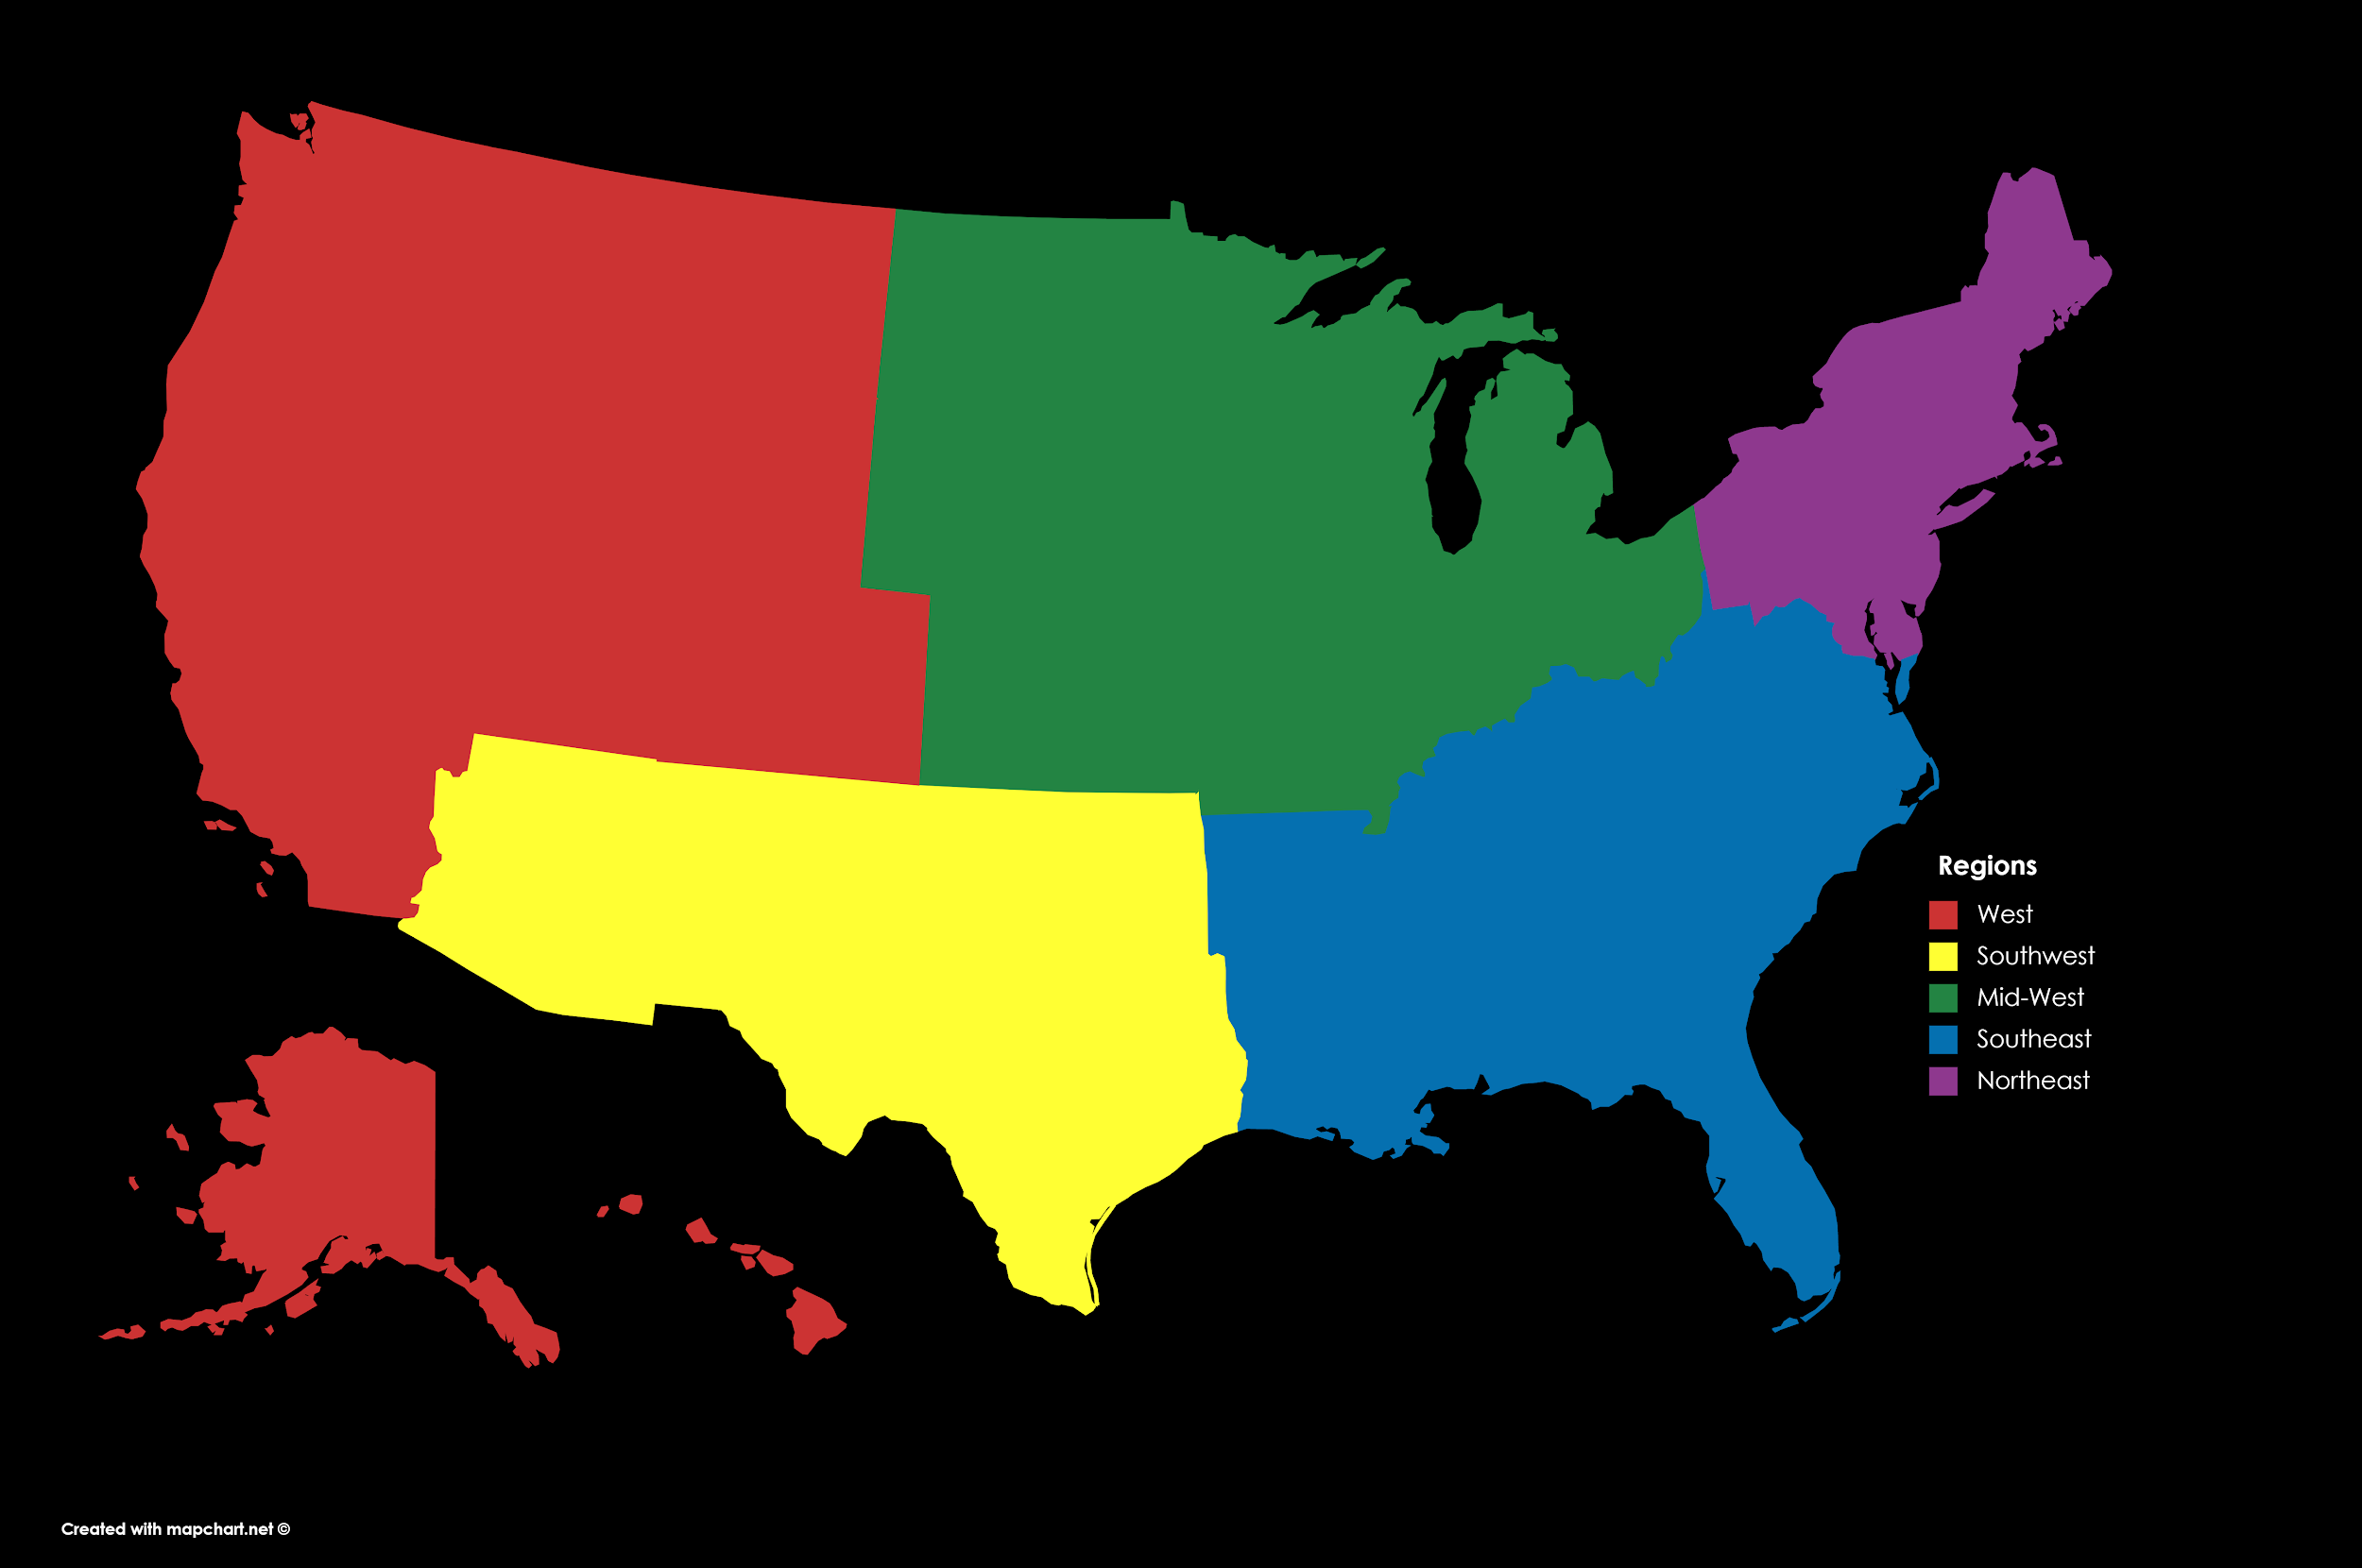
Regions Considered
WEST
NORTHEAST
MIDWEST
SOUTHWEST
SOUTHEAST

Slide 4
Average Rating and Sentiment for Each Region

Slide 5
Values Based on Region
Northeast
Total Reviews 6100
Average Rating 3.59
Average Sentiment .25
West
Total Reviews 8946
Average Rating 3.74
Average Sentiment .26
Mid-West
Total Reviews 6204
Average Rating 3.71
Average Sentiment .25
Southwest
Total Reviews 3325
Average Rating 3.57
Average Sentiment .22
Southeast
Total Reviews 11281
Average Rating 3.81
Average Sentiment .26

Slide 6
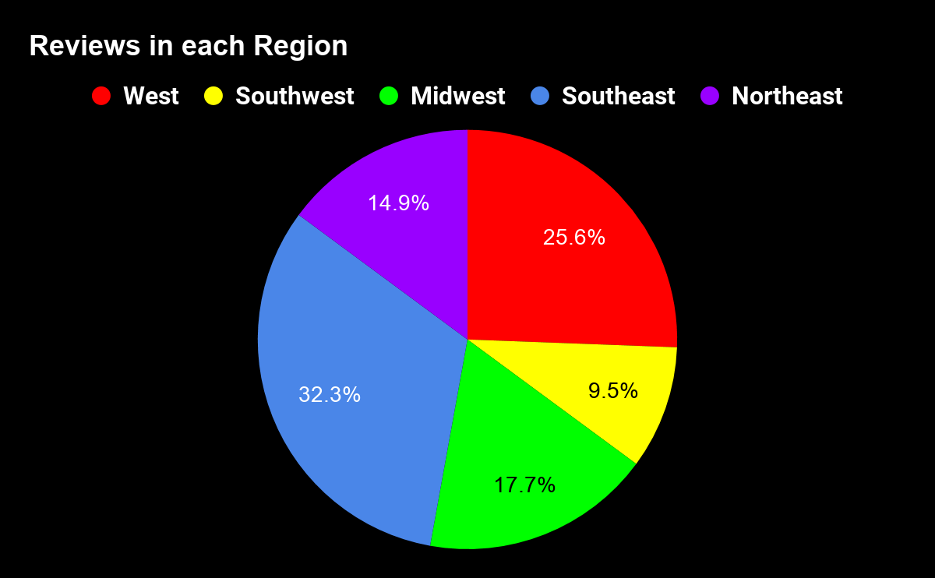

Slide 7
Average Rating and Sentiment for Each Region During Each Season

Slide 8
Spring
Northeast
Total Hotels 1629
Average Rating 3.62
Average Sentiment .25
West
Total Hotels 2676
Average Rating 3.70
Average Sentiment .26
Mid-West
Total Hotels 1702
Average Rating 3.71
Average Sentiment .24
Southwest
Total Hotels 1006
Average Rating 3.57
Average Sentiment .23
Southeast
Total Hotels 3403
Average Rating 3.80
Average Sentiment .26

Slide 9
Summer
Northeast
Total Hotels 2291
Average Rating 3.61
Average Sentiment .24
West
Total Hotels 3655
Average Rating 3.68
Average Sentiment .25
Mid-West
Total Hotels 2331
Average Rating 3.67
Average Sentiment .24
Southwest
Total Hotels 1076
Average Rating 3.39
Average Sentiment .20
Southeast
Total Hotels 3716
Average Rating 3.78
Average Sentiment .26

Slide 10
Fall
Northeast
Total Hotels 1289
Average Rating 3.59
Average Sentiment .25
West
Total Hotels 1652
Average Rating 3.86
Average Sentiment .28
Mid-West
Total Hotels 1323
Average Rating 3.80
Average Sentiment .26
Southwest
Total Hotels 639
Average Rating 3.73
Average Sentiment .23
Southeast
Total Hotels 2187
Average Rating 3.84
Average Sentiment .27

Slide 11
Winter
Northeast
Total Hotels 1015
Average Rating 3.70
Average Sentiment .25
West
Total Hotels 1348
Average Rating 3.91
Average Sentiment .29
Mid-West
Total Hotels 976
Average Rating 3.78
Average Sentiment .26
Southwest
Total Hotels 660
Average Rating 3.66
Average Sentiment .23
Southeast
Total Hotels 2197
Average Rating 3.91
Average Sentiment .27

Slide 12
Best and Worst Hotels for Each Region

Slide 13
How we determined Best and Worst Hotels
Only hotels that had ≥ 100 reviews were considers
Best and Worst hotel were based on average of:
The Probability a hotel will receive a 5 Star Rating
The Probability a hotel will receive a Sentiment Rating between 0.50 and 1.00
Norm.cdf function was used to achieve probability ratings

Slide 14
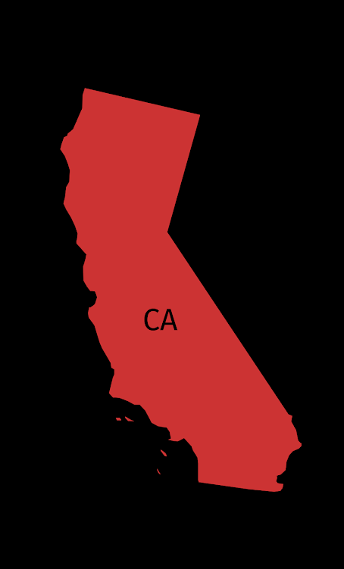
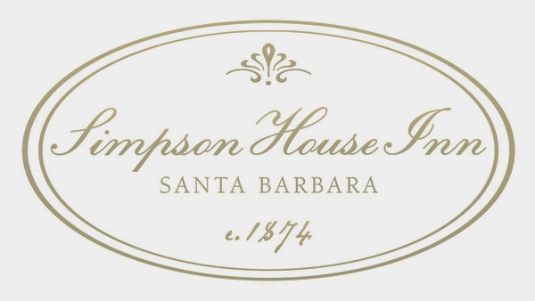
Best in the
West Region:
Simpson House Inn
Santa Barbara, CA
Total Review | 126
Average Rating | 4.75
Average Sentiment | .39
Probability of 5 star rating | 36.52%
Probability of good review | 31.54%

Slide 15
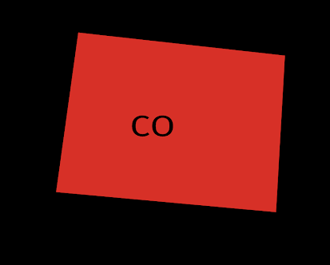
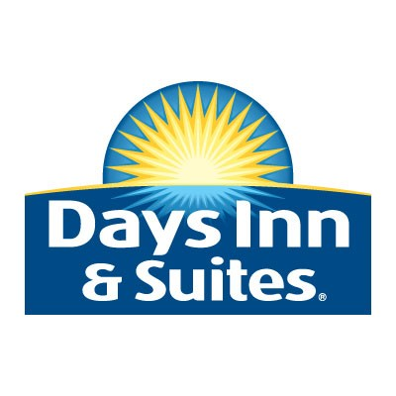
Worst in the
West Region:
Day’s Inn & Suite Castle Rock,CO
Total Review | 102
Average Rating | 3.66
Average Sentiment | .28
Probability of 5 star rating | 12.20%
Probability of good review | 16.85%

Slide 16
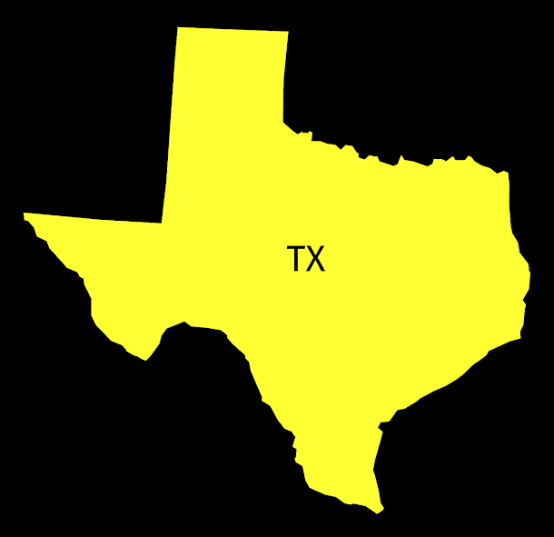

Best in the
Southwest Region:
Lakeway Resort
Austin, TX
Total Review | 122
Average Rating | 4.41
Average Sentiment | .39
Probability of 5 star rating | 33.40%
Probability of good review | 29.88%

Slide 17

Worst in the
Southwest Region:
Fiesta Inn & Suites
San Antonio, TX
Total Review | 546
Average Rating | 1.45
Average Sentiment | -.11
Probability of 5 star rating | 0.01%
Probability of good review | 3.31%

Slide 18
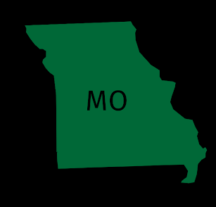

Best in the
Mid-West Region:
Four Seasons Hotel
St. Louis, MO
Total Review | 107
Average Rating | 4.70
Average Sentiment | .38
Probability of 5 star rating | 34.85%
Probability of good review | 27.22%

Slide 19
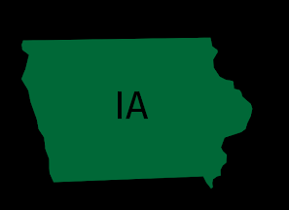

Worst in the
Mid-West Region:
Red Roof Inn
Cedar Rapids, IA
Total Review | 107
Average Rating | 2.18
Average Sentiment | .11
Probability of 5 star rating | 1.07%
Probability of good review | 12.03%

Slide 20
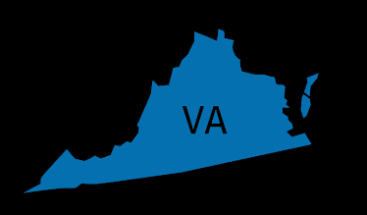

Best in the
Southeast Region:
The Alexandrian Alexandria, VA
Total Review | 1185
Average Rating | 4.48
Average Sentiment | .35
Probability of 5 star rating | 26.12%
Probability of good review | 27.18%

Slide 21
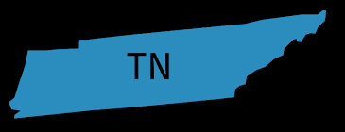

Worst in the
Southeast Region:
Microtel Inn
Knoxville, TN
Total Review | 101
Average Rating | 2.84
Average Sentiment | .15
Probability of 5 star rating | 4.17%
Probability of good review | 9.98%

Slide 22
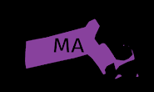

Best in the
Northeast Region:
Bayside Resort Hotel
West Yarmouth, MA
Total Review | 152
Average Rating | 4.16
Average Sentiment | .33
Probability of 5 star rating | 26.10%
Probability of good review | 22.16%

Slide 23
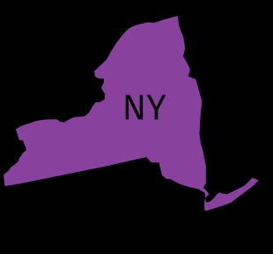
Worst in the
Northeast Region:
Days Inn & Suite
Albany, NY
Total Review | 111
Average Rating | 2.03
Average Sentiment | .01
Probability of 5 star rating | 0.85%
Probability of good review | 7.00%

Slide 24
Conclusion

