Slide 1
GameBoi
Game Boy Emulator

Slide 2
Review
Creating a Game Boy emulator
Running assembly code intended for the Game Boy hardware
All hardware needs to be emulated in software
Currently have a working debugger

Slide 3
Original Schedule
Week 1: Set up memory map/registers/other hardware structures
Week 2: Set up opcode interpreter (just reading)
Week 3-5: Implement opcodes
Week 6: Tilesets
Week 7: Maps
Week 8: Sprites
Week 9: Audio
Week 10-11: Add support for more advanced features
Extra: Port to Raspberry Pi 3

Slide 4
Updated Original Schedule
Week 1: Set up memory map/registers/other hardware structures
Week 2: Set up opcode interpreter/disassembler
Week 3-4: Implement opcodes
Week 5-6: Create debugger
Week 7-8: GPU/graphical rendering
Week 9: Audio
Week 10-11: Advanced features

Slide 5
Current Schedule
Week 1 - Set up memory map, registers, and basic CPU hardware structures
Week 2 - Set up opcode interpreter/disassembler
Week 3 - Implement opcodes
Week 4 - Create debugger first pass
Week 5 - Interrupts and GPU first pass
Week 6 - Flesh out debugger with memory window and contextual disassembly
Weeks 7-8 - Final pass on graphics and GPU and input handling
Week 9 - Implement audio
Weeks 10-11 - Advanced features

Slide 6
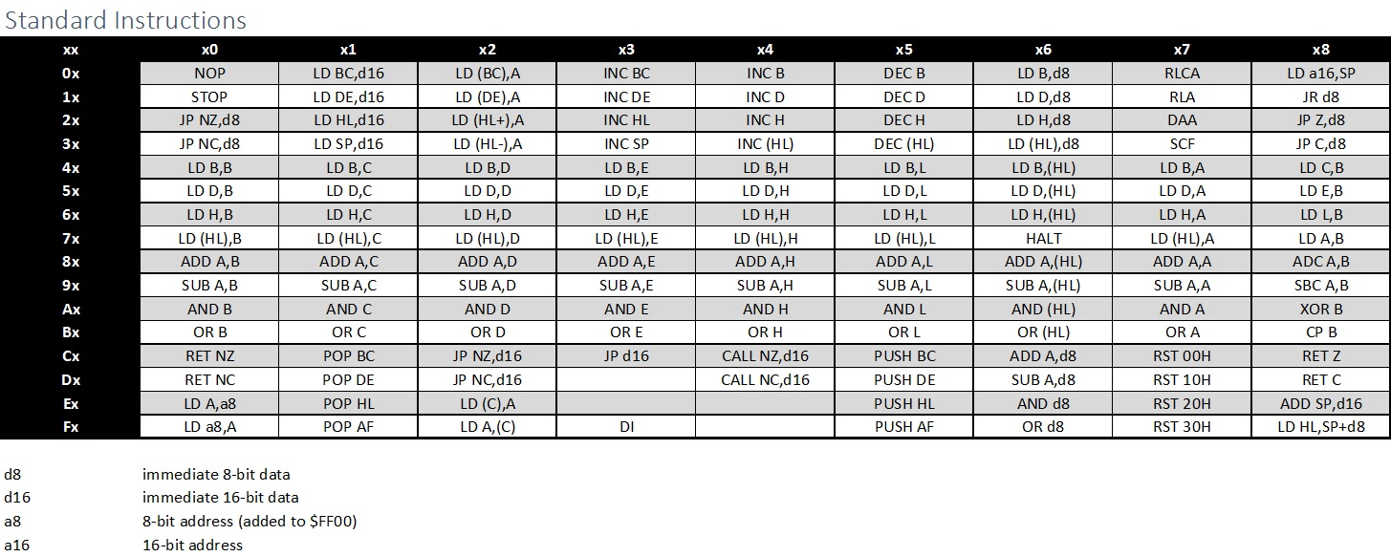
Disassembly

Slide 7
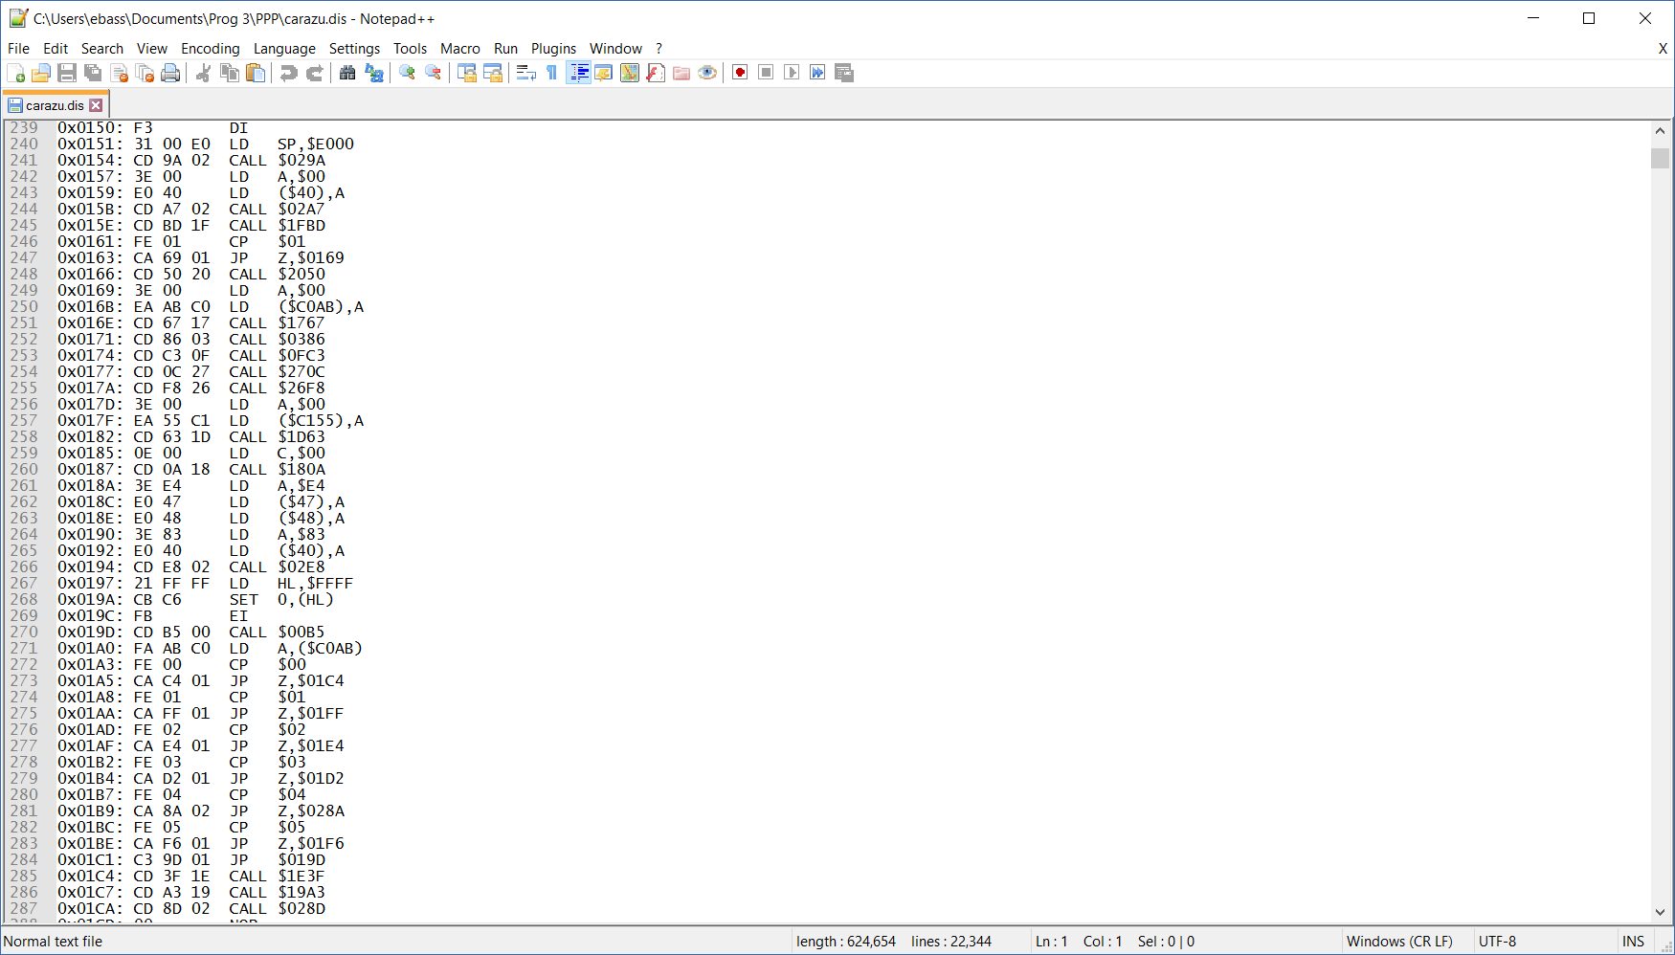
Disassembly
Carazu (Martin’s game)
Program Address
0x3E E4 = Load 0xE4 into register A
Opcode
Operand

Slide 8
Debugger
Code so far was in native C++ static library
Wanted to make a Windows Forms application
Had to wrap the static library in a C++/CLI dynamic library
Able to use that .dll in a C# Windows Forms app

Slide 9
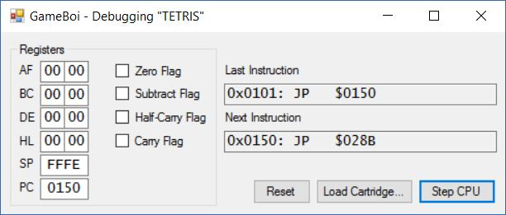
Debugger Result
Registers (modifying the text changes the registers)
Stack Pointer
Program Counter (address of next instruction to be executed)
Flags (set appropriately after each instruction)

Slide 10
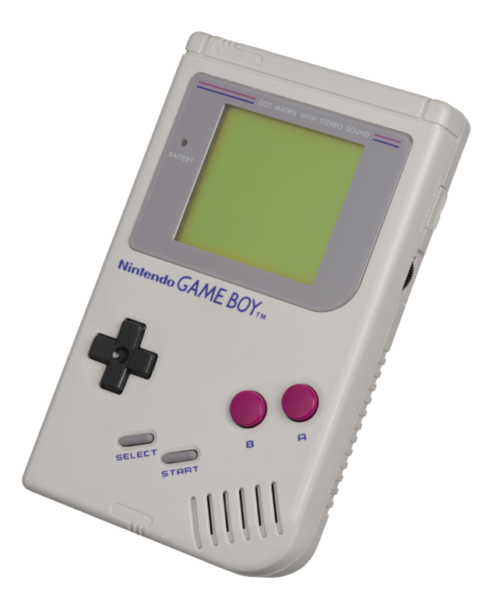
Demo
I

Slide 11

Questions?

