Slide 1
GameBoi
Game Boy Emulator

Slide 2
Review
Creating a Game Boy emulator
Running assembly code intended for the Game Boy hardware
All hardware needs to be emulated in software
Currently have a working debugger

Slide 3
Current Schedule
Week 1 - Set up memory map, registers, and basic CPU hardware structures
Week 2 - Set up opcode interpreter/disassembler
Week 3 - Implement opcodes
Week 4 - Create debugger first pass
Weeks 5-6 - Interrupts, Timers, Input, and first-pass GPU
Week 7 - Final pass on graphics and GPU
Week 8 - Hunt down and kill various breaking bugs
Week 9 - Add full support for MBC cartridges, bug fix, and polish

Slide 4
GameBoi Features
All CPU instructions implemented, all graphics-related hardware emulated
Full support for MBC1 cartridges (~80% of all games) and non-MBC cartridges
Partial support for MBC2 and MBC3 (Pokémon games are MBC3)
Support for game saving

Slide 5
Shortcomings
No audio
No color
Some graphical anomalies
V-sync issues
Occasional game-breaking bugs
Not all cartridge types supported

Slide 6
Future Goals
Audio
Color
Real-Time Clock for MBC3
Fix Bugs!!!

Slide 7
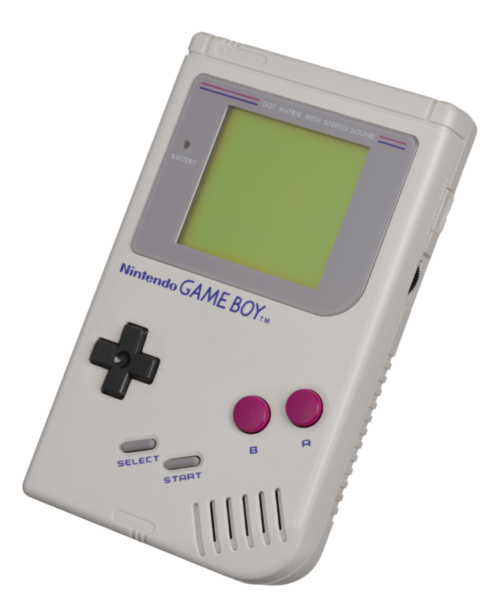
Demo
I

Slide 8

Questions?

