Slide 1
ECE:5995 Applied ML Air Sensor Project (Part 2 – Unsupervised)
Evan Bradley – Group 7
April 28, 2022

Slide 2
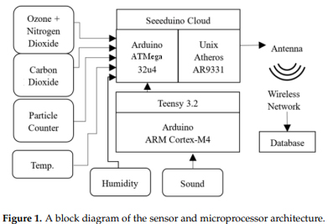
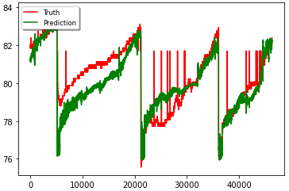
Recap of Part 1
Using measurements from a network of environmental hazard sensors predict the values of certain features
Measurements available – Temperature, CO2, Sounds, VOC, PM, Humidity, and Time
Accurate results for Temperature, Sound and PM

Slide 3
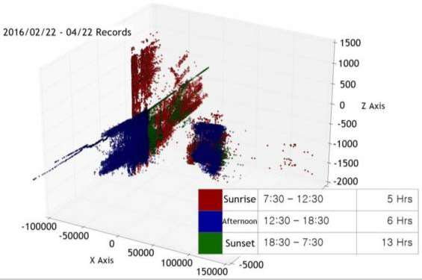
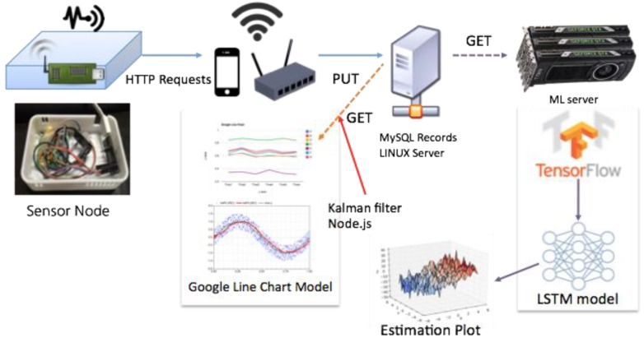
Existing Work
“Low-Cost, Distributed Environmental Monitors for Factory Worker Health” - 2018
“Indoor Air Quality Analysis Using Deep Learning with Sensor Data” - 2017

Slide 4
Proposal for Part 2 – Unsupervised
The current implementation of the air sensor network utilizes a threshold approach for each individual feature to detect unsafe conditions
Taking the input data, can each sample be classified as either a safe, risky, or unsafe working condition?
Goal - Use an Autoencoder, train a model to classify device measurements into three categories

Slide 5
Training Process
Remove outliers from all datasets
Replace Time feature with Sin transforms of Minute, Hour, and Day of Week
Create Data loader objects from measurements
Train using a Variational Auto-encoder
Encoder contains 3 linear layers, with non-linear activation functions
Decoder contains 3 linear layers, with non-linear activation functions
A resample layer
A forward method calling the encoder, resample layer, and decoder in that order and returning samples, mu and logvar
Loss function of Binary Cross Entropy
Using the mu value, the samples are separated into three categories

Slide 6
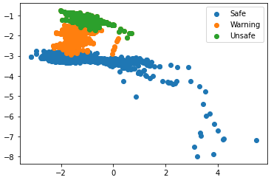
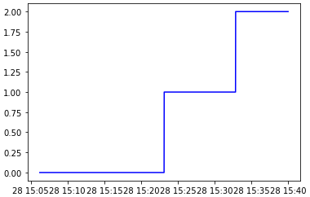
Results
Three distinct clusters of samples
Outliers were accurately recognized and labeled as unsafe
Hard to measure accuracy

Slide 7
Conclusion
This method of classifying the safety of working condition is promising
More data over a longer time period is necessary
Without information on what exposures to hazards would be considered dangerous it is hard to measure accuracy of classifications

Slide 8
Thank You!

